Slide 1

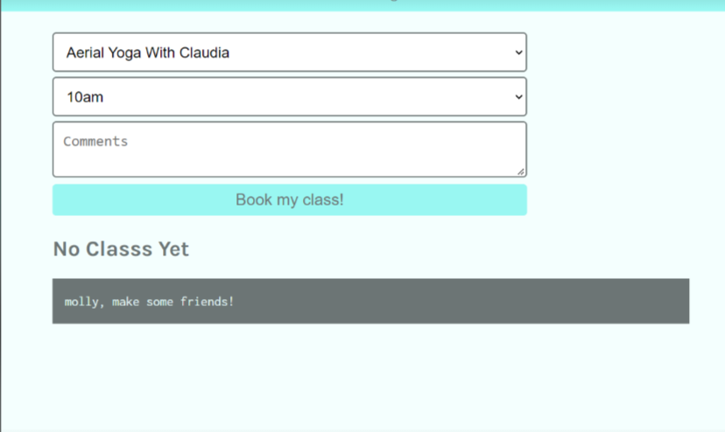
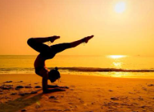

Yoga For Everyone Wireframe – Group 3
Logo
Logo
Logo
Schedule
Logo
Types of Yoga
schedule
Types of Yoga
Online classes
About
Content here
Log Out
Content here
username
Main text body
Content here
password
submit
Content here
Logo
Online Classes
Logo
About
Youtube Video Images and Links in each square.
Description of team members and date of launch.
Footer With Disclaimer Link, Copyright 2022 Team 3. Authors

