Slide 1
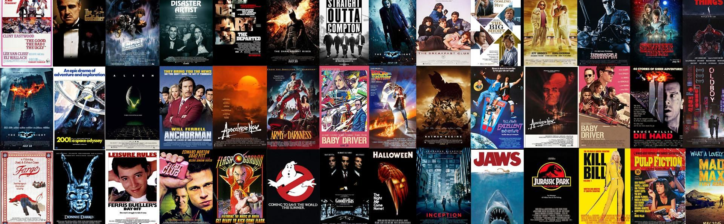
Technology Review Box Office Revenue Predictor

Slide 2
Background and Use-Case
Our project aims to develop a web-based tool designed to predict the potential box office revenues of hypothetical movies. This tool will leverage historical data to analyze how different compositions of cast and crew can influence a movie's financial success.
By inputting hypothetical cast and crew configurations, users can receive data-driven predictions on possible box office outcomes, aiding in decision-making for movie productions.
Our application seeks to train a machine learning model on over 5000 movies' data, including detailed cast and crew information, paired with their respective box office earnings. This could provide stakeholders with a tool for better forecasting and strategic planning based on predictive insights into the financial viability of future film projects.
In our project, we'll employ TensorFlow for its deep learning capabilities to unravel complex data patterns and XGBoost for its high efficiency in tabular data analysis through gradient boosting. The final choice between TensorFlow and XGBoost will hinge on their performance in accurately predicting box office revenues.

Slide 3
Python Package Choices
1. TensorFlow
Author(s): The TensorFlow project is developed and maintained by the Google Brain team.
Summary: TensorFlow is an open-source library for numerical computation and machine learning. TensorFlow provides a comprehensive ecosystem of tools, libraries, and community resources that allows researchers to push the state-of-the-art in ML, and developers to easily build and deploy ML-powered applications. It excels in handling deep learning models and offers extensive flexibility for building complex neural network architectures, making it ideal for projects that require analysis of intricate data patterns.
2. XGBoost
Author(s): XGBoost is developed by Tianqi Chen, as part of the Distributed (Deep) Machine Learning Community (DMLC).
Summary: XGBoost stands for eXtreme Gradient Boosting. It is a highly efficient and scalable implementation of gradient boosted trees designed for speed and performance. XGBoost is particularly known for its effectiveness in classification, regression, and ranking problems, with an emphasis on handling tabular data. Its versatility and performance make it a popular choice for machine learning competitions and real-world applications.

Slide 4
3. Beautiful Soup (BS4)
Author(s): The package was originally created by Leonard Richardson, who started the project in 2004. Since then, the library has been maintained and improved by a community of contributors.
Summary:
Beautiful Soup (often abbreviated as BS4) is a Python library used for web scraping purposes. It provides tools for extracting data from HTML and XML documents in a simple and intuitive manner.
It creates a parse tree from the raw HTML or XML content of a webpage, which can then be traversed and searched to extract the desired information.

Slide 5
Package Comparison: Pros and Cons
TensorFlow
Pros:
Ideal for complex modeling, potentially capturing nuanced interactions between cast/crew and revenue.
Extensive support for neural network architectures that can learn from diverse and high-dimensional data.
Cons:
Steeper learning curve, requiring more expertise in deep learning.
Higher computational resources needed, especially for large models and datasets.
XGBoost
Pros:
Highly efficient with tabular data, offering fast training times and predictive accuracy.
Easier to tune for specific tabular datasets, with a simpler setup process.
Cons:
Less capable of modeling the complex, non-linear relationships that deep learning can capture.
Primarily focused on gradient boosting, offering less flexibility for non-ensemble methods.

Slide 6
Package Comparison: Project Specific Consideration
Data Compatibility: XGBoost is directly compatible with our tabular dataset, offering a straightforward approach. TensorFlow excels in deep learning tasks that may not be necessary for our current dataset's structure.
Ease of Use: XGBoost might offer a quicker setup and easier parameter tuning for our team, given the tabular nature of our data.
Computational Efficiency: Considering our dataset's scale, XGBoost is likely more computationally efficient, essential for iterative modeling and tuning.
Predictive Power: TensorFlow could potentially uncover deeper patterns within the data, but at the cost of complexity and compute resources.

Slide 7
Our Package Choice: XGBoost
Why XGBoost?
Ideal for Our Data: XGBoost is renowned for its handling of tabular data, making it a perfect fit for our dataset of movies' cast, crew, and box office earnings. It's designed to tackle exactly the type of analysis we're conducting.
Efficiency & Speed: With the need to process extensive data and refine models, XGBoost's computational efficiency becomes crucial. It offers rapid training times, enabling more iterations and faster optimization of our predictive models.
Ease of Use: Compared to the complexities and resource demands of TensorFlow for deep learning, XGBoost is straightforward to implement and tune. This simplicity will allow our team to focus more on analysis and less on technical hurdles.
Proven Success: The algorithm's track record in machine learning competitions and practical applications underscores its capability to deliver robust, accurate predictions. This reassures us of its applicability to our project's goal.
Practicality: Considering our resources, project timeline, and the specific nature of our dataset, XGBoost strikes the best balance between complexity and effectiveness. It meets our requirements without the overhead of deploying more complex deep learning models.

Slide 8
Drawbacks & Considerations with XGBoost
Non-Linearity in Data:
Our datasets may contain complex, non-linear relationships that XGBoost, while powerful for tabular data, might struggle to fully capture compared to deep learning models. This could limit the model's ability to predict box office revenues with the highest accuracy.
Mitigation Strategies:
Feature Engineering: We plan to invest significant effort in feature engineering to better capture the non-linear interactions within our data, making it more amenable to XGBoost's strengths.
Model Ensemble: Consider combining XGBoost with models capable of capturing non-linearity, such as neural networks, in an ensemble method to improve overall prediction accuracy.
Potential Shift to TensorFlow:
Should XGBoost's performance be significantly hindered by the data's complexity, we remain open to integrating TensorFlow into our workflow. TensorFlow's deep learning capabilities might offer a better fit for modeling the intricate patterns in our data.

Slide 9

Fin.

