Slide 1
CAREER GRID

Slide 2
ABSTRACT
The project is a Career and Placement Cell Website designed for Nilgiri College of Arts and Science.
It aims to provide a centralized platform connecting students, placement officers, and recruiters.
The system includes: Secure Login/Signup restricted to college students.
Student Portfolio to showcase academic records, skills, and resumes.
Job & Internship postings with eligibility criteria and deadlines.
A Career Guidance Chatbot to answer placement-related queries.
Email and SMS notifications for job application deadlines and updates.

Slide 3
SYSTEM SPECIFICATIONS
1. Hardware Requirements
Processor: Intel Core i3 or higher (or equivalent AMD)
RAM: Minimum 4 GB
Storage: 250 GB HDD / SSD
Display: 1024 × 768 resolution or higher
Network: Stable internet connection for cloud APIs, email, and SMS notifications

Slide 4
SYSTEM SPECIFICATIONS
2. Software Requirements
Operating System: Windows 10 / Linux / macOS
Frontend: HTML5, CSS3, JavaScript, React.js / Angular
Backend: Django / Firebase
Database: MySQL / MongoDB
Browser: Chrome / Firefox

Slide 5
SYSTEM STUDY
1. Existing System
Currently, most placement activities are managed manually or via informal methods (WhatsApp groups, notice boards, emails). This causes:
Lack of centralized access to job postings.
Missed deadlines due to absence of timely reminders.
Difficulty in tracking student applications.
No structured portfolio system for students.

Slide 6
SYSTEM STUDY
2. Proposed System
The proposed web application automates and digitizes the placement process. It provides:
Student authentication using college email IDs.
Centralized job posting system with eligibility filters.
Email and SMS deadline notifications for applied jobs.
Basic chatbot for career guidance and placement FAQs.
Admin controls for placement officers to track applications and shortlist students

Slide 7
MODULES
The frontend modules of Career Grid create a user-friendly environment that helps students manage their placement journey efficiently.
There are mainly 5-6 modules visible on the frontend that the user can directly interact with:
Login / Signup
Student Portfolio
Job & Internship
Chatbot
Contact
About

Slide 8
1. Login / Signup
This is the entry point of the system.
Only students of Nilgiri College can sign up using their official email ID.
2. Student Portfolio
Students can create their online portfolio with personal and academic details.
They can add skills, upload resumes, and certificates.
3. Job & Internship
Displays all available job and internship opportunities.
4. Chatbot
A simple chatbot helps students with FAQs, resume tips, and interview guidance.
5. Contact
Allows students to easily communicate with the Placement Cell team.

Slide 9
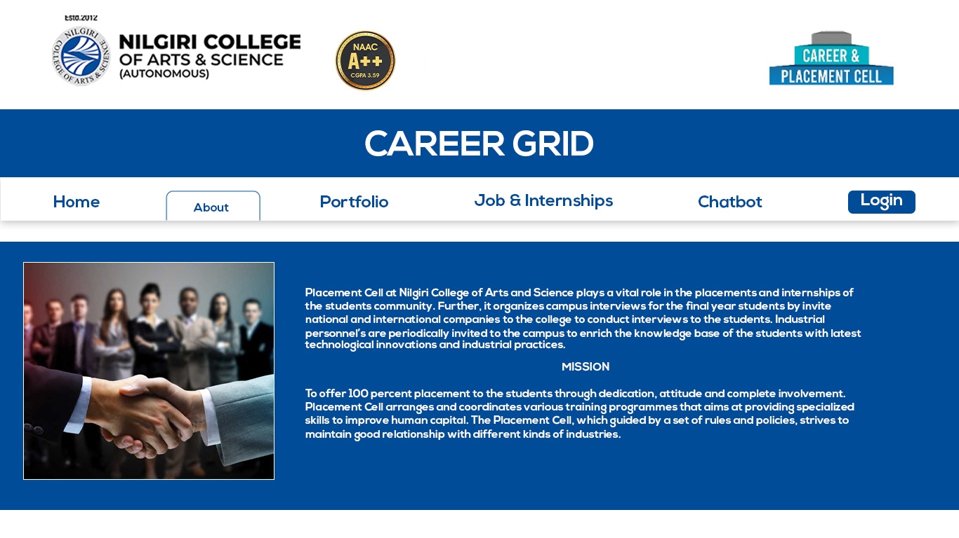
DESIGN

