Slide 1
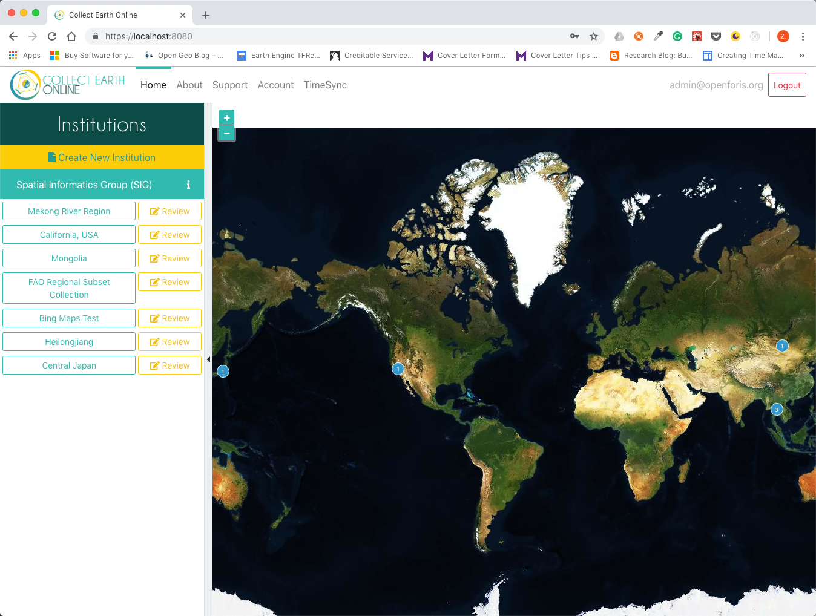
Must using https
Standalone TimeSync

Slide 2
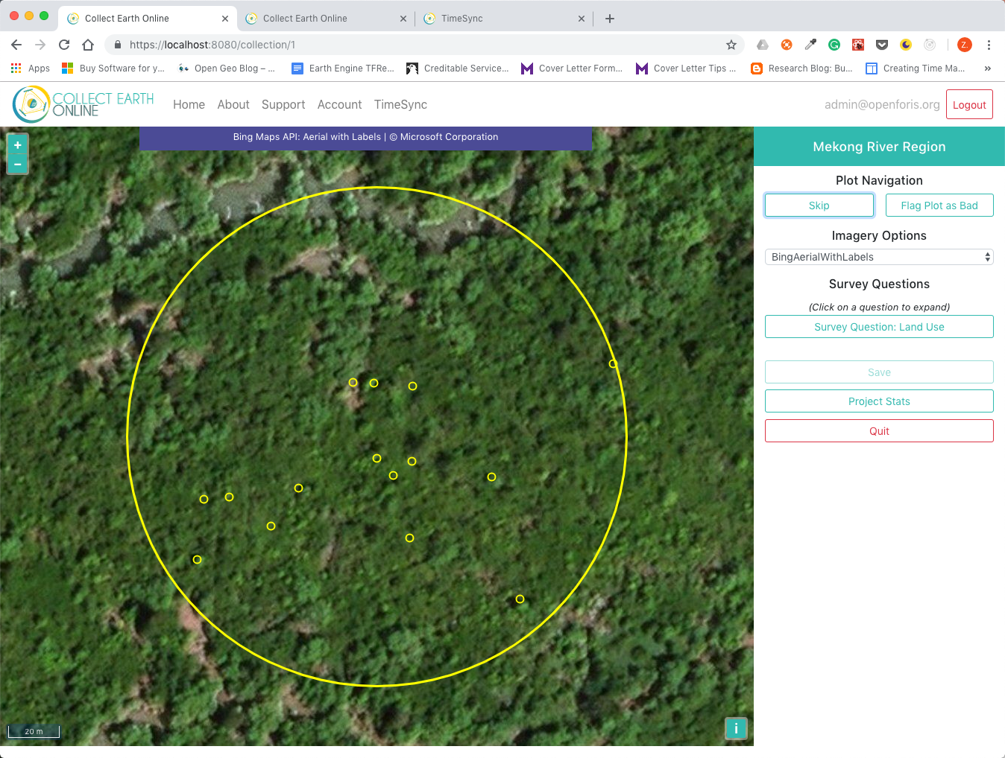
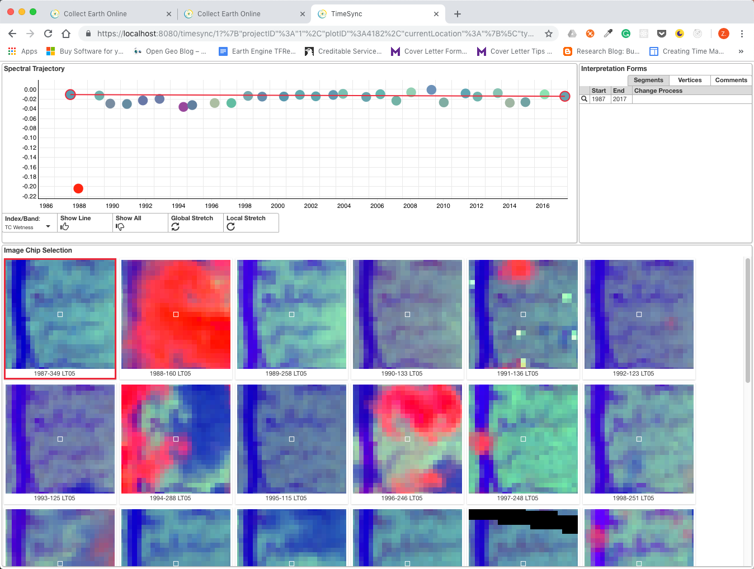
The same as geo-dash, TimeSync dash mode is opened automatically and synced with the plot on CEO window
Dash mode only has one plot showing. Plot selection is handled by CEO.

Slide 3

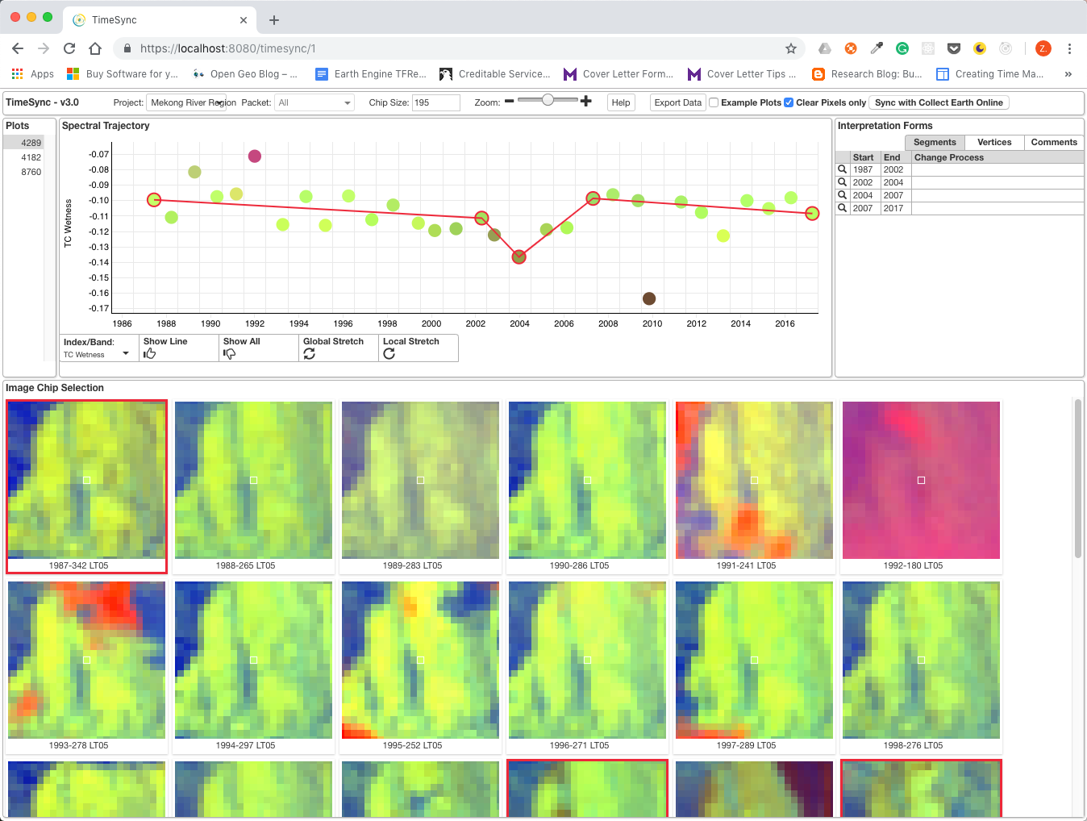
Click on TimeSync link will open TimeSync in standalone mode.
Standalone TimeSync share the same database with CEO.
User can pick project and plot to work on in standalone mode.

