Slide 1
Soapui Introduction https://www.linkedin.com/in/gayatri-mishra-freelancecoach/

Slide 2
Agenda
What is web service
Web Service architecture
How web service works
About soapui
Key features of soapui
Sample exercise to test an api [Rest api]

Slide 3
What is webservice
A web service is a software system that allows different applications to communicate with each other over a network, typically the Internet. Web services use standard protocols and formats such as WSDL, WADL, and REST to enable seamless communication between applications that are written in different programming languages and running on different platforms.
Notes:
Wsdl – web service description language XML
Wadl – Web application description language HTTP + XML
Rest – Representaional state transfer [JSON] // http+json

Slide 4
What is webservice
The main purpose of a web service is to expose the functionality of an application or a service to other applications over the network. For example, a travel booking website might offer a web service that allows other travel-related applications to query its database of flight schedules, prices, and availability.

Slide 5
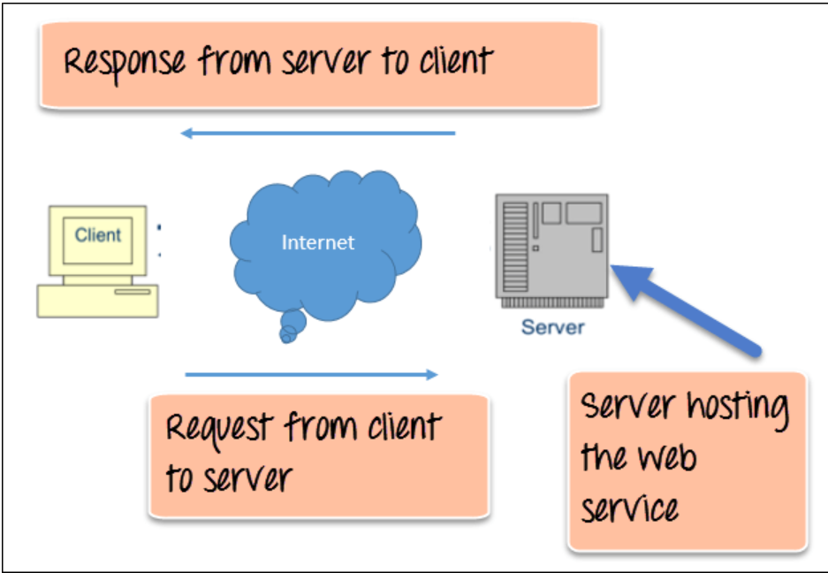
How webservice works

Slide 6
About the software
Developed by Smart Bear Software , released at 2005
Current stable version 5.7.0 for windows
Official site : https://www.soapui.org/
Compatible to Linux , Windows and Mac-OS
Both open-source and pro versions are available for soapui

Slide 7
What is soapui
SoapUI is an open-source web service testing tool used to test SOAP (Simple Object Access Protocol) and REST (Representational State Transfer) web services.
It provides a user-friendly graphical interface for creating, executing, and analyzing web service requests and responses.

Slide 8
What is soapui
SoapUI supports a wide range of protocols and formats, including HTTP, HTTPS, JDBC, JSON, and XML.
With SoapUI, you can test web services for functional features.
SoapUI is widely used by software testers, developers, and quality assurance professionals to ensure the quality and reliability of web services.

Slide 9
Few important features
Test suite
Test case
Assertion

Slide 10
Key features of soapui
Web Services Testing: SoapUI is primarily designed for testing web services, including REST and SOAP services. It provides a user-friendly interface to create, execute and validate web service requests and responses.
Functional Testing: SoapUI offers a powerful functional testing framework that helps users to create test cases and suites for verifying the functional behavior of web services.

Slide 11
Key features of soapui
Load and Performance Testing: SoapUI enables users to test the performance and scalability of web services by simulating a high volume of requests. It can generate load tests to measure the response time, throughput, and resource utilization of the web services under varying load conditions.

Slide 12
Key features of soapui
Security Testing: SoapUI provides several security testing features, such as scanning for vulnerabilities like SQL injection, cross-site scripting (XSS), and other common security threats. It also supports encryption and decryption of messages, digital signatures, and certificates.
Automation: SoapUI allows users to automate functional, performance, and security testing by integrating with other testing

Slide 13
Basic Features I used
Test suite
Test case
Assertion
Execution of testsuite
Log report analysis

Slide 14
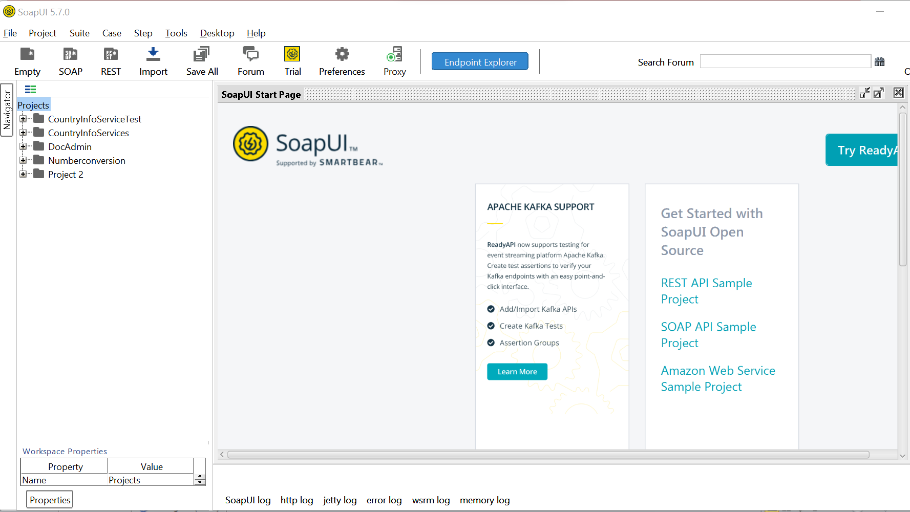
Sample Exercise
Soapui

Slide 15
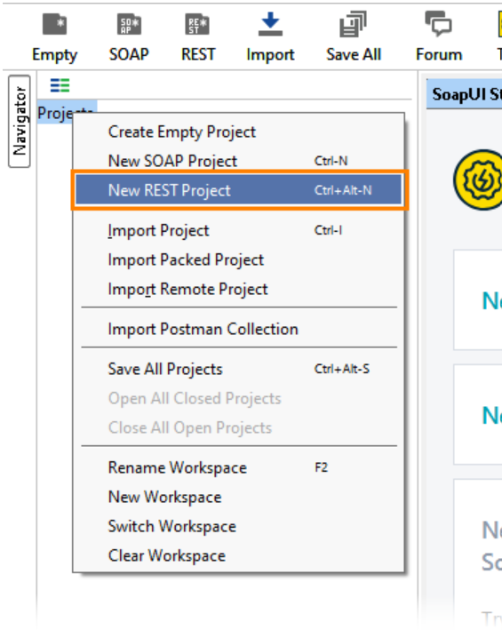
Create REST Project From Endpoint:

Slide 16
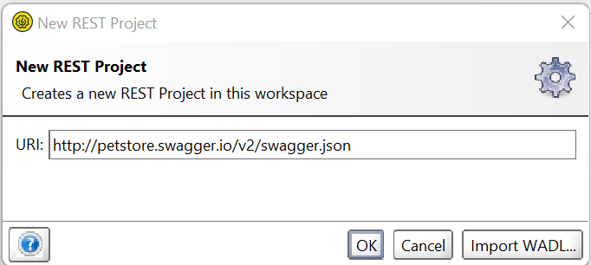
Exercise
Step-3

Slide 17
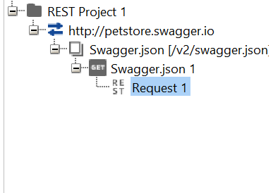
Step-4
Click on ok.

Slide 18
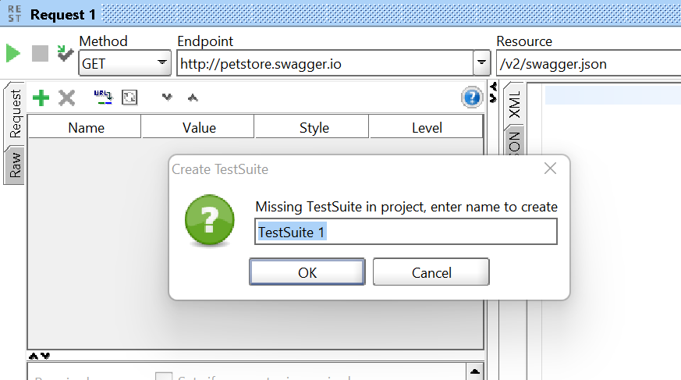
Step-5
Add a test suite:

Slide 19
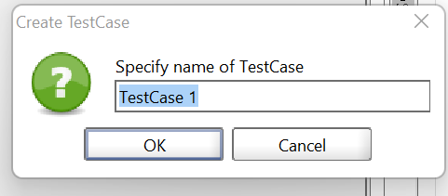
Step-6

Slide 20
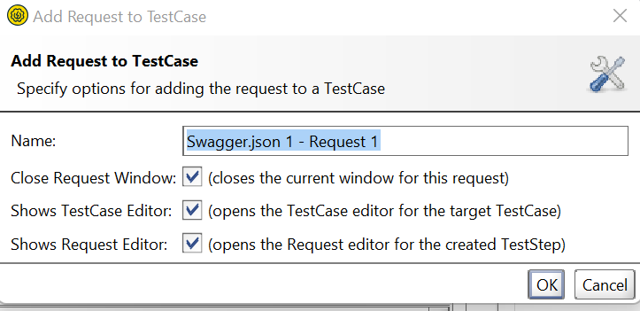
Add request to test case:

Slide 21
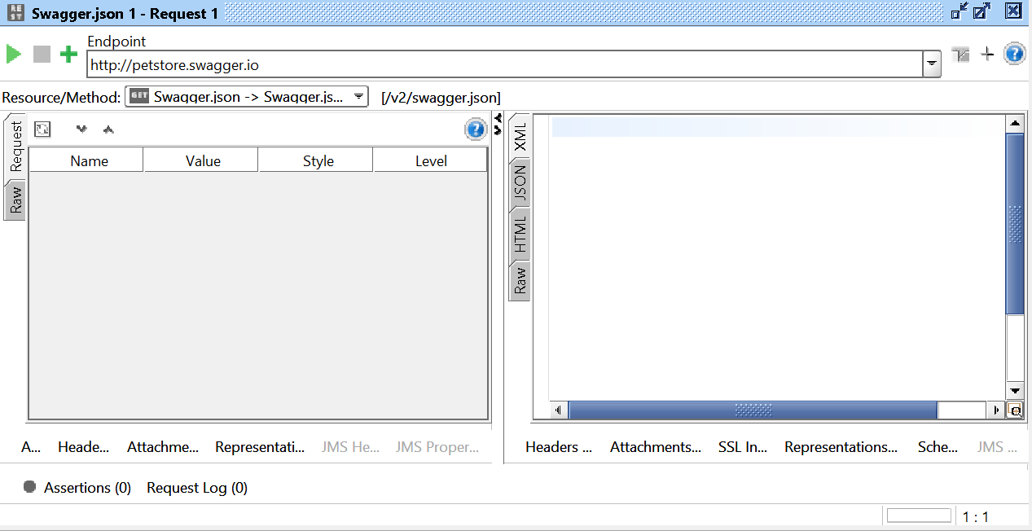

Slide 22
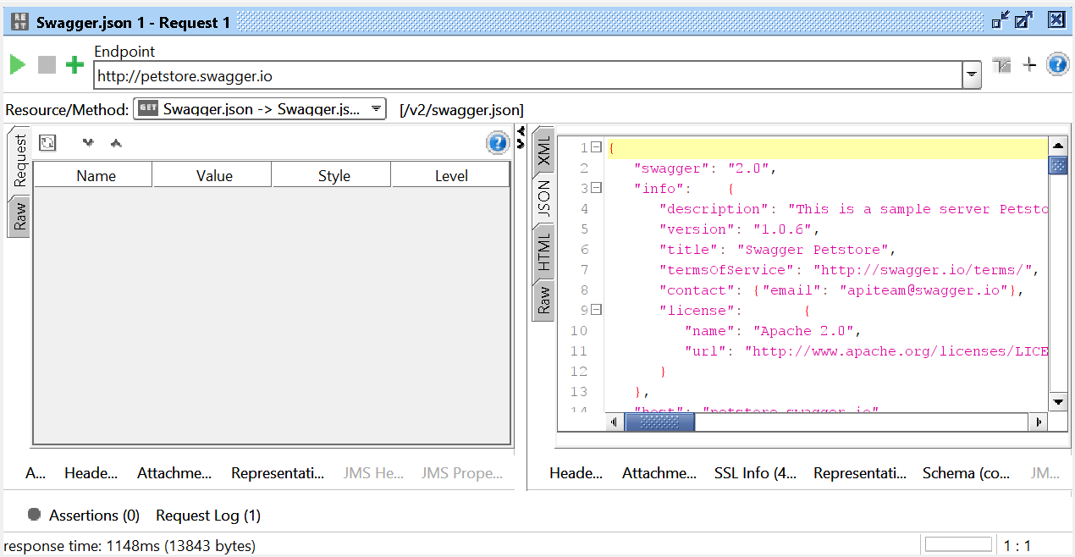

Slide 23
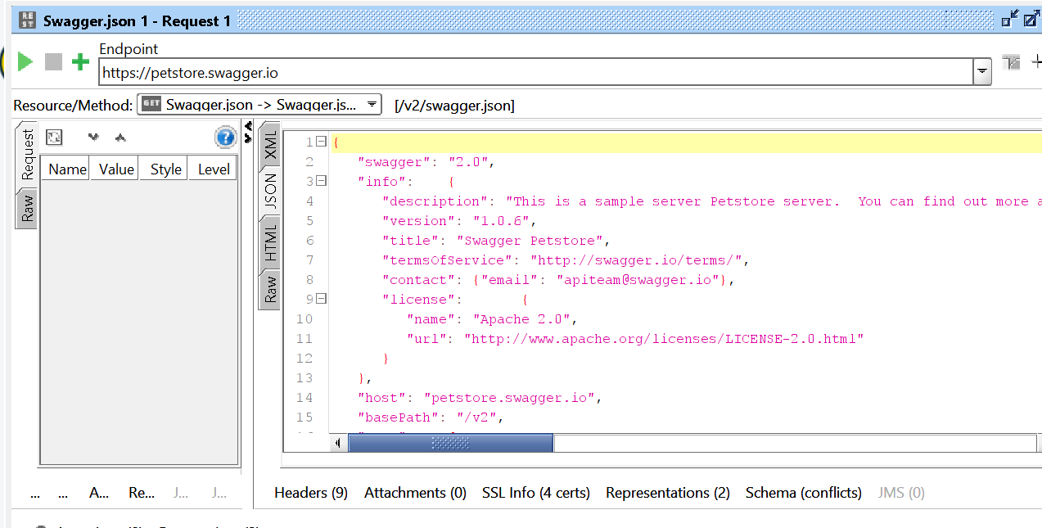
Add assertion :

Slide 24
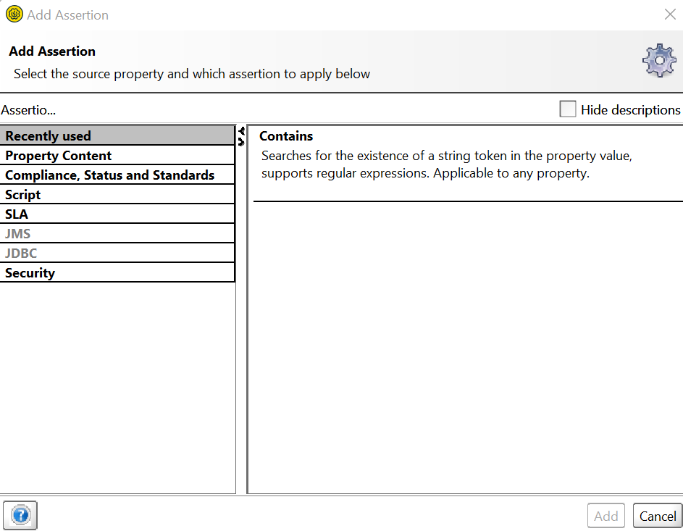
Add assertion:

Slide 25
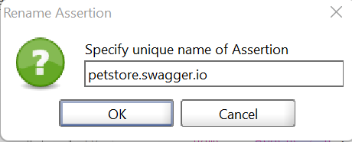
property content -> Contains

Slide 26
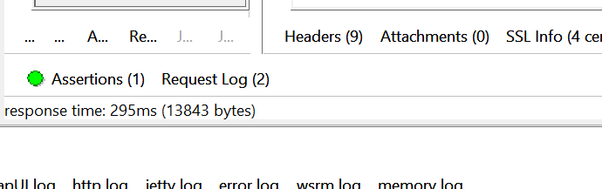
Assertion is passed:

Slide 27
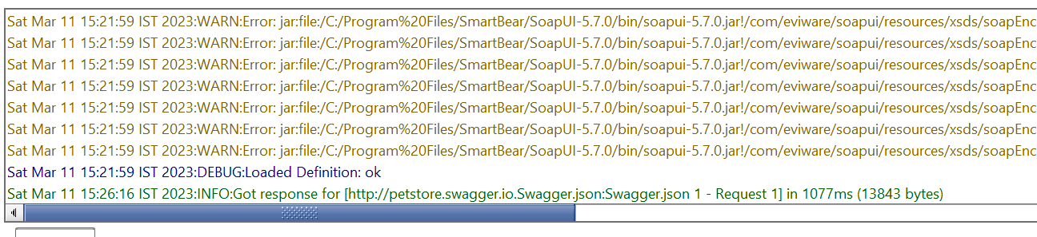
Execute :

Slide 28
Sample wsdl to test:
http://www.dataaccess.com/webservicesserver/numberconversion.wso?WSDL
File -> New soap project
Notes:
Wsdl : web service description language
Example:
http://www.dataaccess.com/webservicesserver/numberconversion.wso?WSDL
XML based services
The Web Application Description Language (WADL) is a machine-readable XML description of HTTP-based web services.
http://www.dataaccess.com/webservicesserver/numberconversion.wso?WSDL
http + xml
Representational State Transfer (REST) is a software architecture that imposes conditions on how an API should work.

Slide 29
Thank You

