Slide 1
What is a git branch
G

Slide 2
Git branch testdata1

Slide 3

Git branch

Slide 4
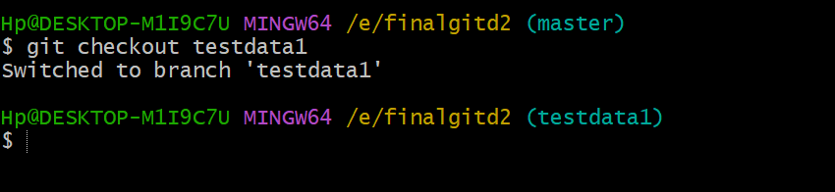
Git checkout:
Git checkout branchname

Slide 5
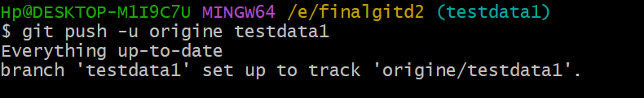
Git add file1.txt
Git commit –m “added file1”
Git push –u origine testdat1

Slide 6
Git push –u origine testdat1

Slide 7
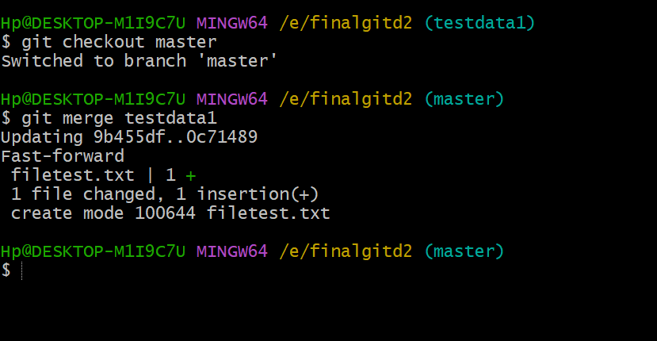
Merge process
Git checkout master
Git merge testdata1

Slide 8
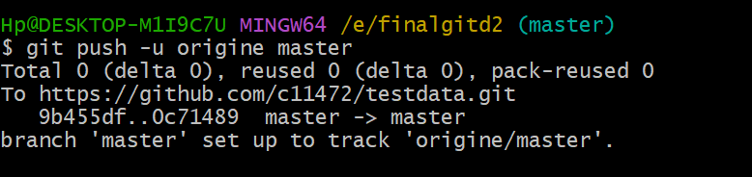
Git push –u origine master
Notes:
Git push master

Slide 9
To delete the branch
Git branch - - d testdat1
Git push origine - - d testdata1

