Slide 1
git commands – Day 2

Slide 2
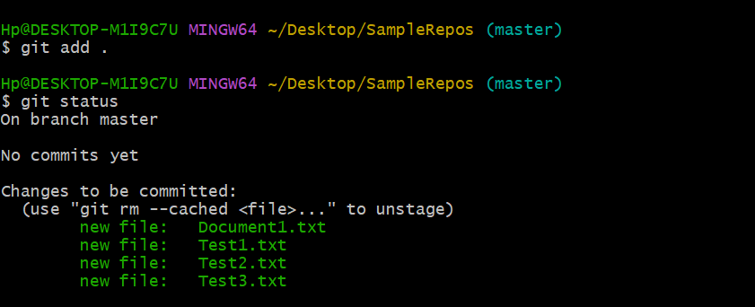
Adding multiple files in git repository
git add .

Slide 3
Removing files from git
git remote add origine “https://github.com/c11472/day1samplegit.git”
git push –u “https://github.com/c11472/day1samplegit.git”

Slide 4
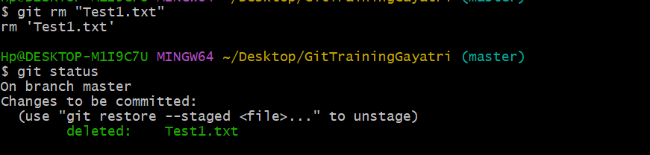
git rm “Test1.txt”

Slide 5
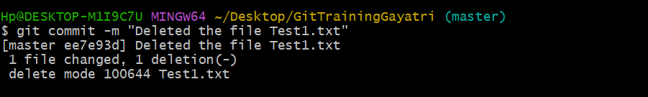
git status
git commit –m

Slide 6
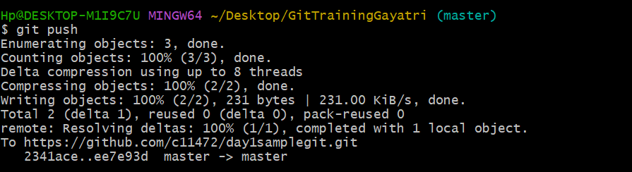
git push
Notes:
The git push command is used to upload local repository content to a remote repository..
After commit we need to push

Slide 7
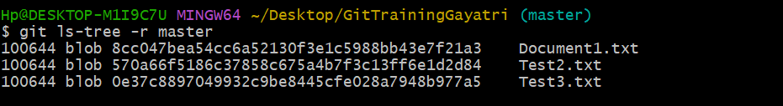
ls-tree
git ls-tree –r master
Notes:
To delete the folder
git rm –r <foldername>

