Slide 1
C12 HACKATHON / REFERENCE SOLUTION
AUTOMATE
CSD CALIBRATION
01
DETECT
short dark sticks
02
QUANTIFY
local contrast
Detect the sticks. Measure their contrast.
Recenter as the barriers move the scene.
03
RECENTER
plunger plane
A physics-guided detector + a drift-aware global optimizer
10 MIN · ENGLISH · REPRODUCIBLE SEEDS

Slide 2
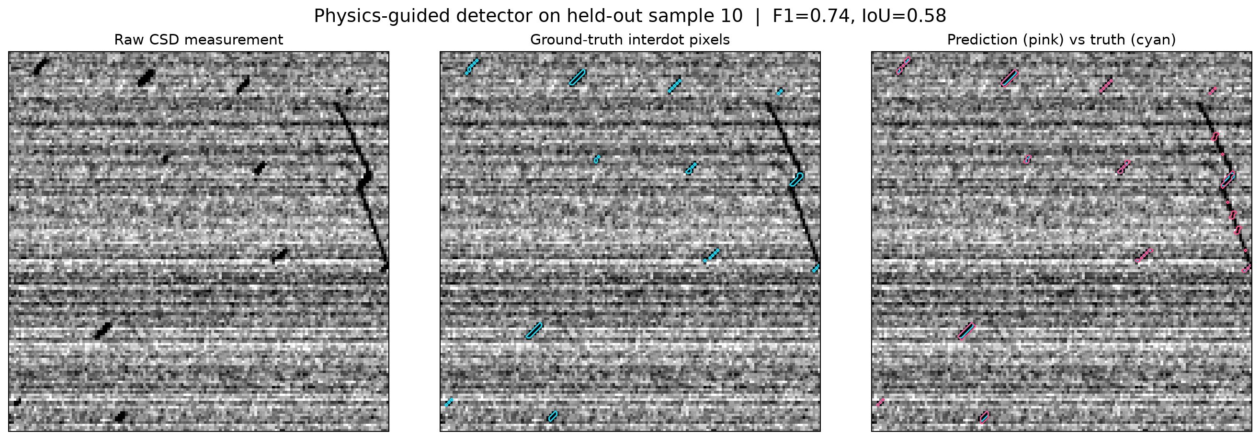
01 / DETECTION
A sparse target inside a noisy map
WHAT COUNTS AS A STICK?
•
Short and dark
•
Near 45° orientation
•
Only a few pixels wide
Row stripes and long charging-line connectors are nuisance structure, not labels.
Raw CSD → ground truth → detector overlay
C12 / 02
MEASURE · INFER · TUNE

Slide 3
01 / DETECTION
Matched filters grounded in device geometry
1
ROW BASELINE
2
TEMPLATE BANK
3
MASK
Subtract each row's median to suppress shared horizontal noise.
→
Blurred, zero-sum dark rectangles across physical length, width, and angle.
→
Noise-normalized response → non-maximum suppression → winning footprint.
WHY THIS MODEL?
Known geometry is a transferable prior; no training-set leakage, metadata input, or image normalization.
Segmentation threshold fixed at 4.0 on validation seed 999.
C12 / 03
MEASURE · INFER · TUNE

Slide 4
01 / VALIDATION
Held-out detection: high recall, transparent trade-off
120
PIXEL MASK
OBJECT-LEVEL
held-out images
seed 2026
0.746
0.931
macro F1
stick recall
0.608
macro IoU
0.718
object precision
Validation: 100 images / seed 999 · Test threshold untouched · 8-connected overlap defines an object hit
C12 / 04
MEASURE · INFER · TUNE

Slide 5
02 / OBJECTIVE
Optimize the strongest interdot, not image standard deviation
THE FIVE GATES
MEASUREMENT OBJECTIVE
g1 · g3 · g5
strongest local dip
barriers: contrast + drift
matched response ÷ template gain
g2 · g4
Removes most pixel-area bias while avoiding scene-wide dilution.
plungers: recenter the scan
Objective uses measured images only.
C12 / 05
MEASURE · INFER · TUNE

Slide 6
02 / TRACKING
Drift correction is part of the experiment
BARRIER
STEP
IMAGE
SHIFT
REGISTER
EDGES
PAN
WINDOW
→
→
→
gates change
sticks move
estimate Δx, Δy
keep sticks visible
CALIBRATE
FIT
GUARD
6 orthogonal probes
robust linear → quadratic drift
ambiguous match → repeat + average
Relative registration only: no known drift matrix, reveal(), or simulator attributes.
C12 / 06
MEASURE · INFER · TUNE

Slide 7
02 / SEARCH
Global exploration → local pattern search
01 GLOBAL
02 LOCAL
48 scrambled Sobol points
Two separated starts
3-D barrier cube: [−0.5, 0.5]³
0.08 V
→
0.04 V
→
0.02 V
→
0.01 V
Trackable route
explore
refine
refine
confirm
Nearest-neighbour order; each barrier move ≤ 0.08 V. Intermediate measurements still contribute scores.
Coordinate pattern search · 2 frames for local comparisons · 3-frame final score
C12 / 07
MEASURE · INFER · TUNE

Slide 8
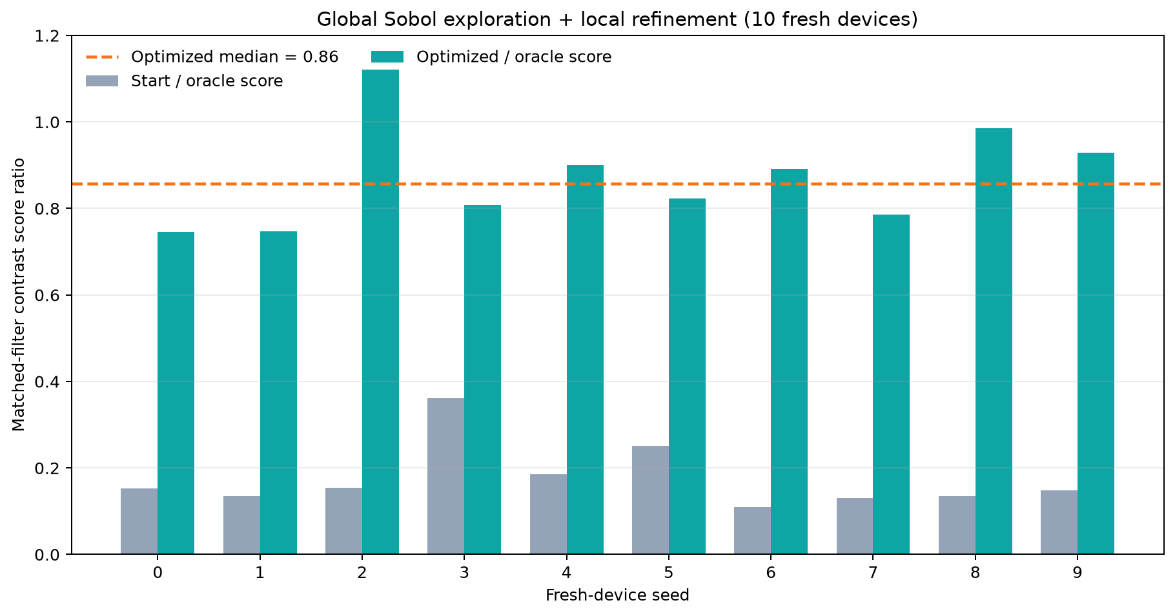
02 / RESULTS
Ten fresh devices: strong measured-score recovery
0.874
mean score ratio
0.857
median ratio
334.5 scans
7.53M pixels
median budget
Oracle measurements are post-run self-checks and excluded from the optimizer budget. Ratios are noisy image-derived proxies.
C12 / 08
MEASURE · INFER · TUNE

Slide 9
03 / OUTLOOK
What transfers — and what we would improve next
TRANSFER
LIMITS
NEXT
Physical template prior
Row-noise suppression
Fixed-seed evaluation
Known stick geometry
Ambiguous low-SNR drift
Noisy strongest-stick estimate
Uncertainty-aware CNR
Multi-resolution scans
Bayesian / trust-region search
TAKE-AWAY
Build the objective from physics. Track the scene. Keep the oracle outside the algorithm.
C12 / 09
MEASURE · INFER · TUNE

