Slide 1
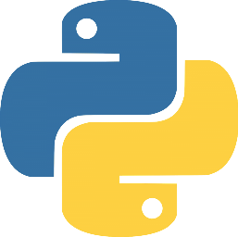
An Introduction to Python
Part 1 - The Big Picture

Slide 2
Overview
What is Python?
Why Should Developers/Analysts Care?
What Makes Python Different?
When and Where is it Being Used?
First steps with Python
Basics
Learning & Documentation
Next steps
Python 2 vs. Python 3
Executing Python Code

Slide 3
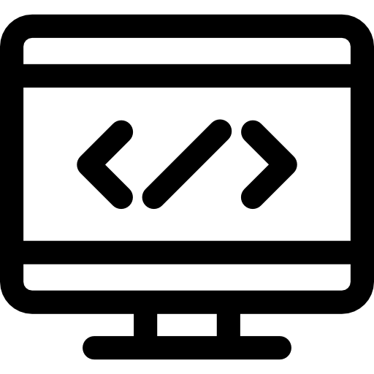



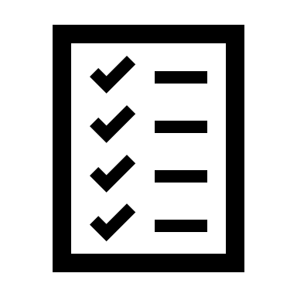
What is Python?
High Level Programming Language
Dynamic
Readable
Interpreted
Multi-paradigm

Slide 4
A Quick History
First release
(Guido Van Rossum)
Python 2.0 released
Used for special FX in Star Wars the Phantom Menace
Python 3.0 released
1991
2000
1999
2008

Slide 5
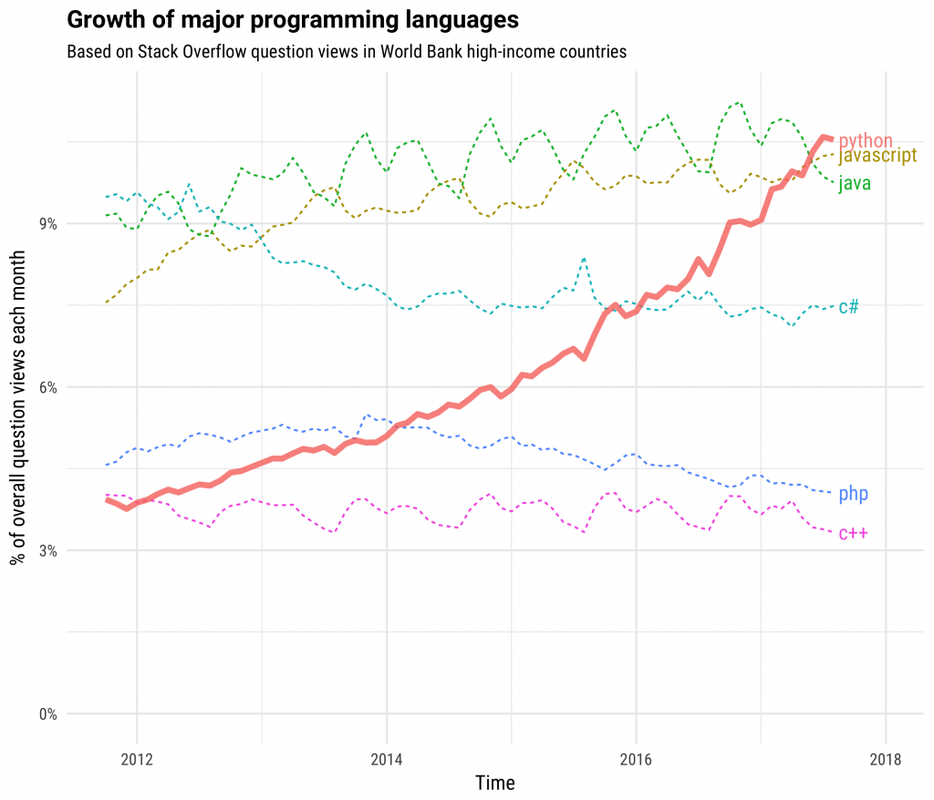
Why Should Analysts/Developers Care?
Rapid increase in popularity
Large community, enhanced support
Huge amount of open source libraries, frameworks etc.

Slide 6
The Python Philosophy

Slide 7
Where is it Being Used?

Slide 8
First Steps with Python
Basics
Python.org
About
Download & install
Documentation
Community
Installing
Working with Others Code
PyPi – Python Packages index
Using PIP

