Slide 1
Advanced Security Lab 4
Steven Aherne
C18742005

Slide 2
Part A
GPG4Win was used to create a public and private key pair
Clicked generate key pair
Entered details required
Key was created successfully

Slide 3
Part B
Downloaded Mozilla Thunderbird & Enigmail Extension
Set up email client and installed Enigmail
Emailed public key to Aneel
Created a new email and encrypted it using key pair created previously
Sent the message to aneelrahim263@gmail.com

Slide 4
Part C – NTP Installed on My Machine
Demo NTP up and running

Slide 5
Part C – Types of Attacks on Systems with Clocks
On-path – Attacks require the attacker to have an elevated position on the system/network
Off-path – Attacks that do not require the attacker to have an elevated position
(Rick Ratzel and Rodney Greenstreet)
Stopped Clock Attack – E.g. Attack on real time data
Clock Set Back Attack – E.g. Attack on HR System
Clock Set Forward Attack – E.g. Denial of Service attack on banks

Slide 6
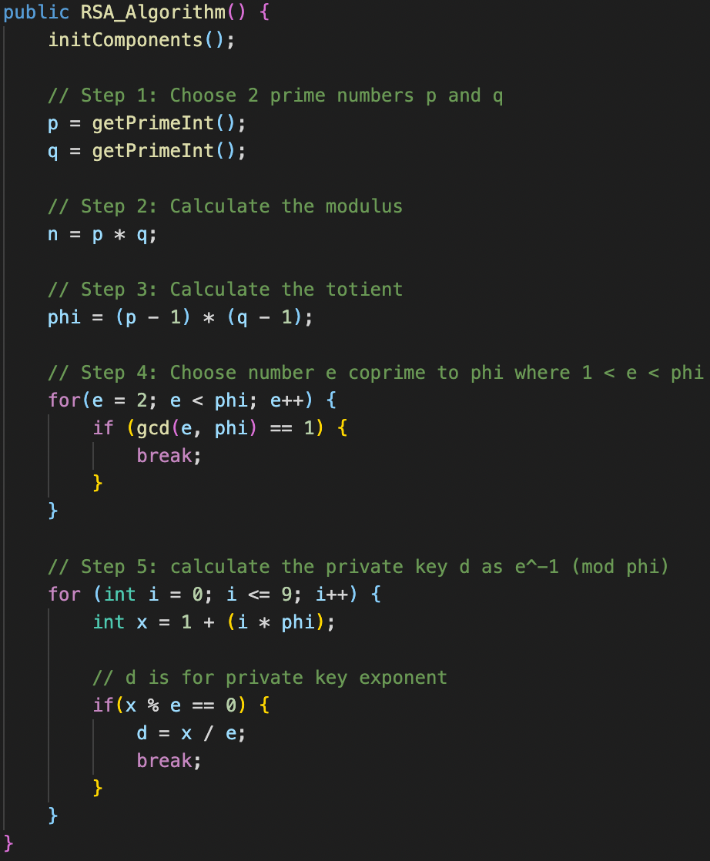
Part D – RSA Java Program

Slide 7
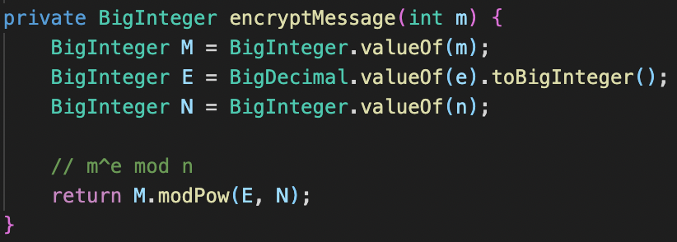
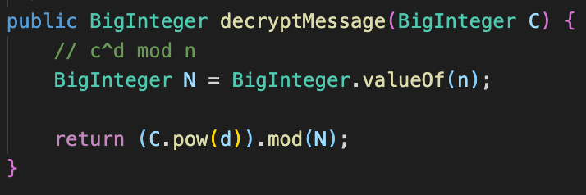
Part D – RSA Java Program

Slide 8
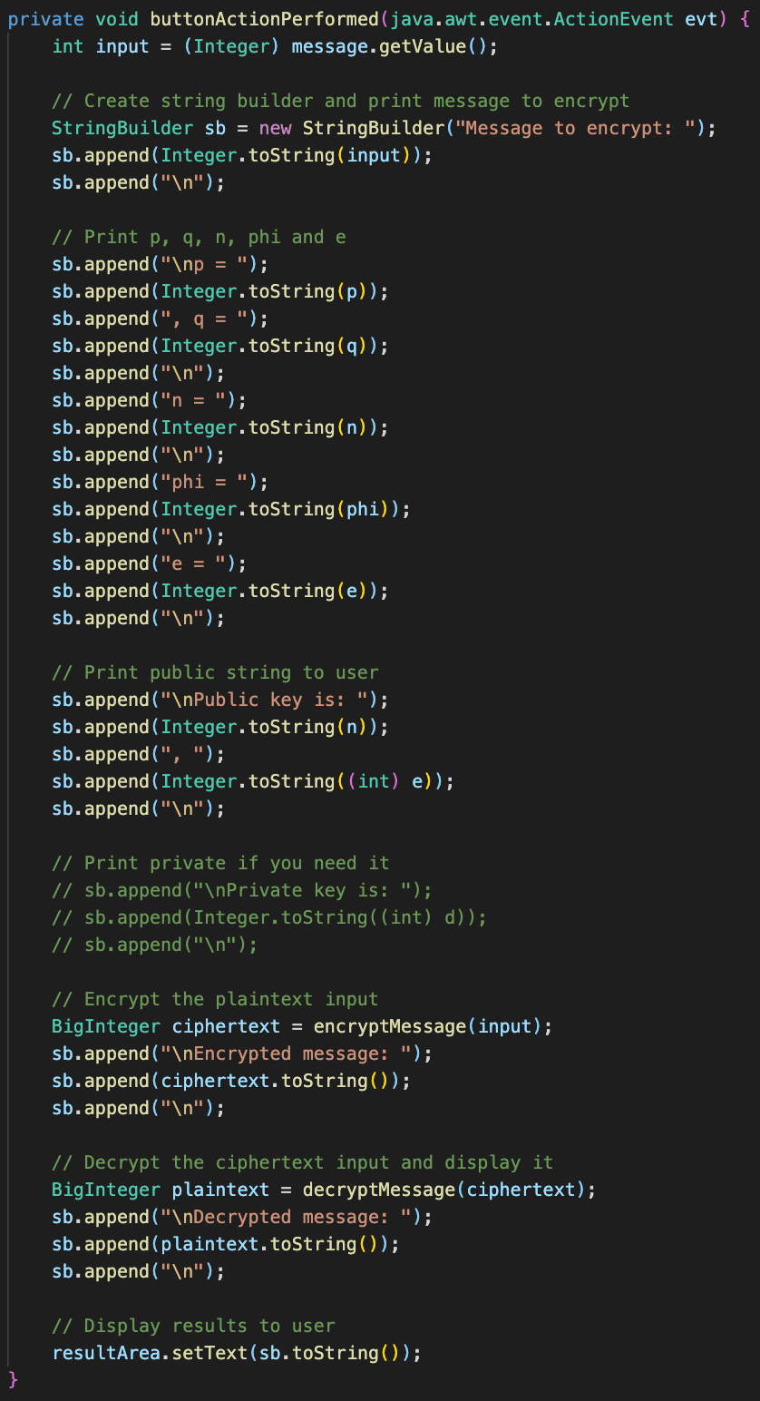
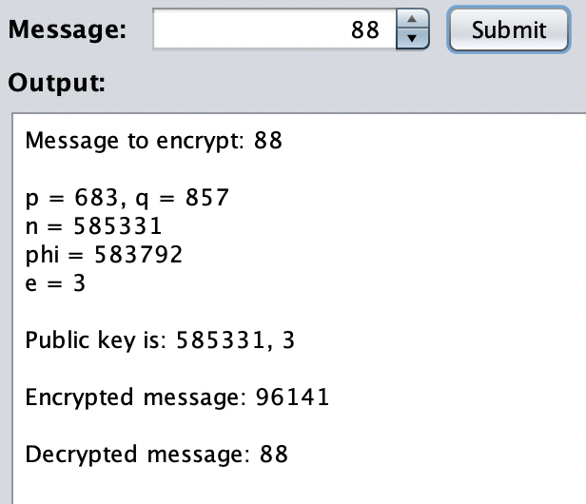
Part D – RSA Java Program

