Slide 1
Donors and Metadata
Sep 9, 2021
MarchionniLab

Slide 2
Sources
https://docs.google.com/spreadsheets/d/1l75CWPYbcFAYWvY3Xlu0oSoRIMQt2kFoiax-LwO58F4/edit#gid=0
https://docs.google.com/spreadsheets/d/1yXaydFIzDlXDQmZbRRaUAAlSyf3doY29ocEi0QRslMA/edit#gid=1461427396

Slide 3
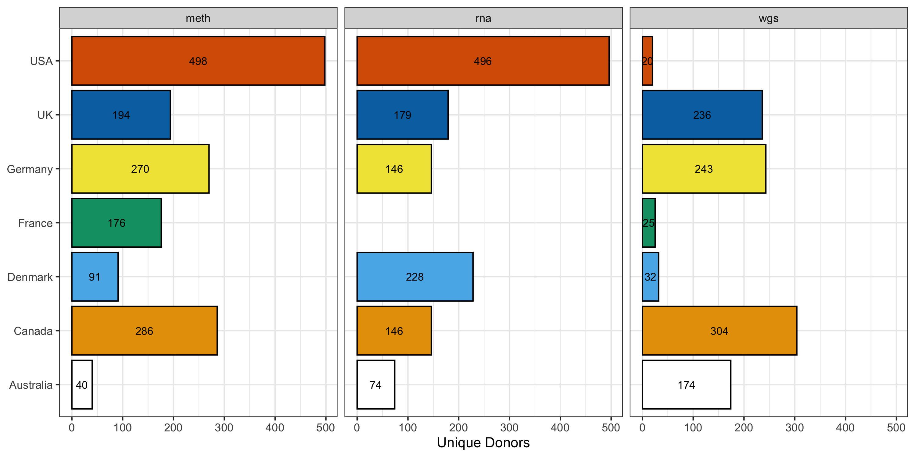

Slide 4
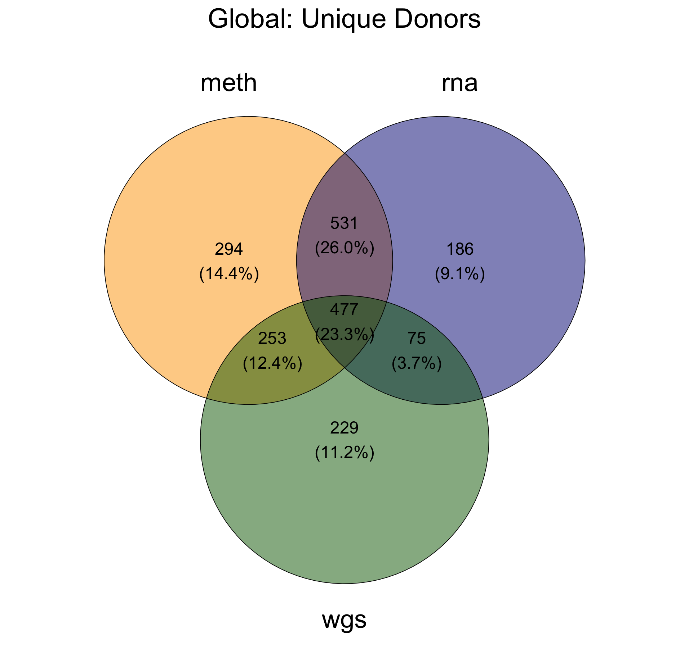

Slide 5
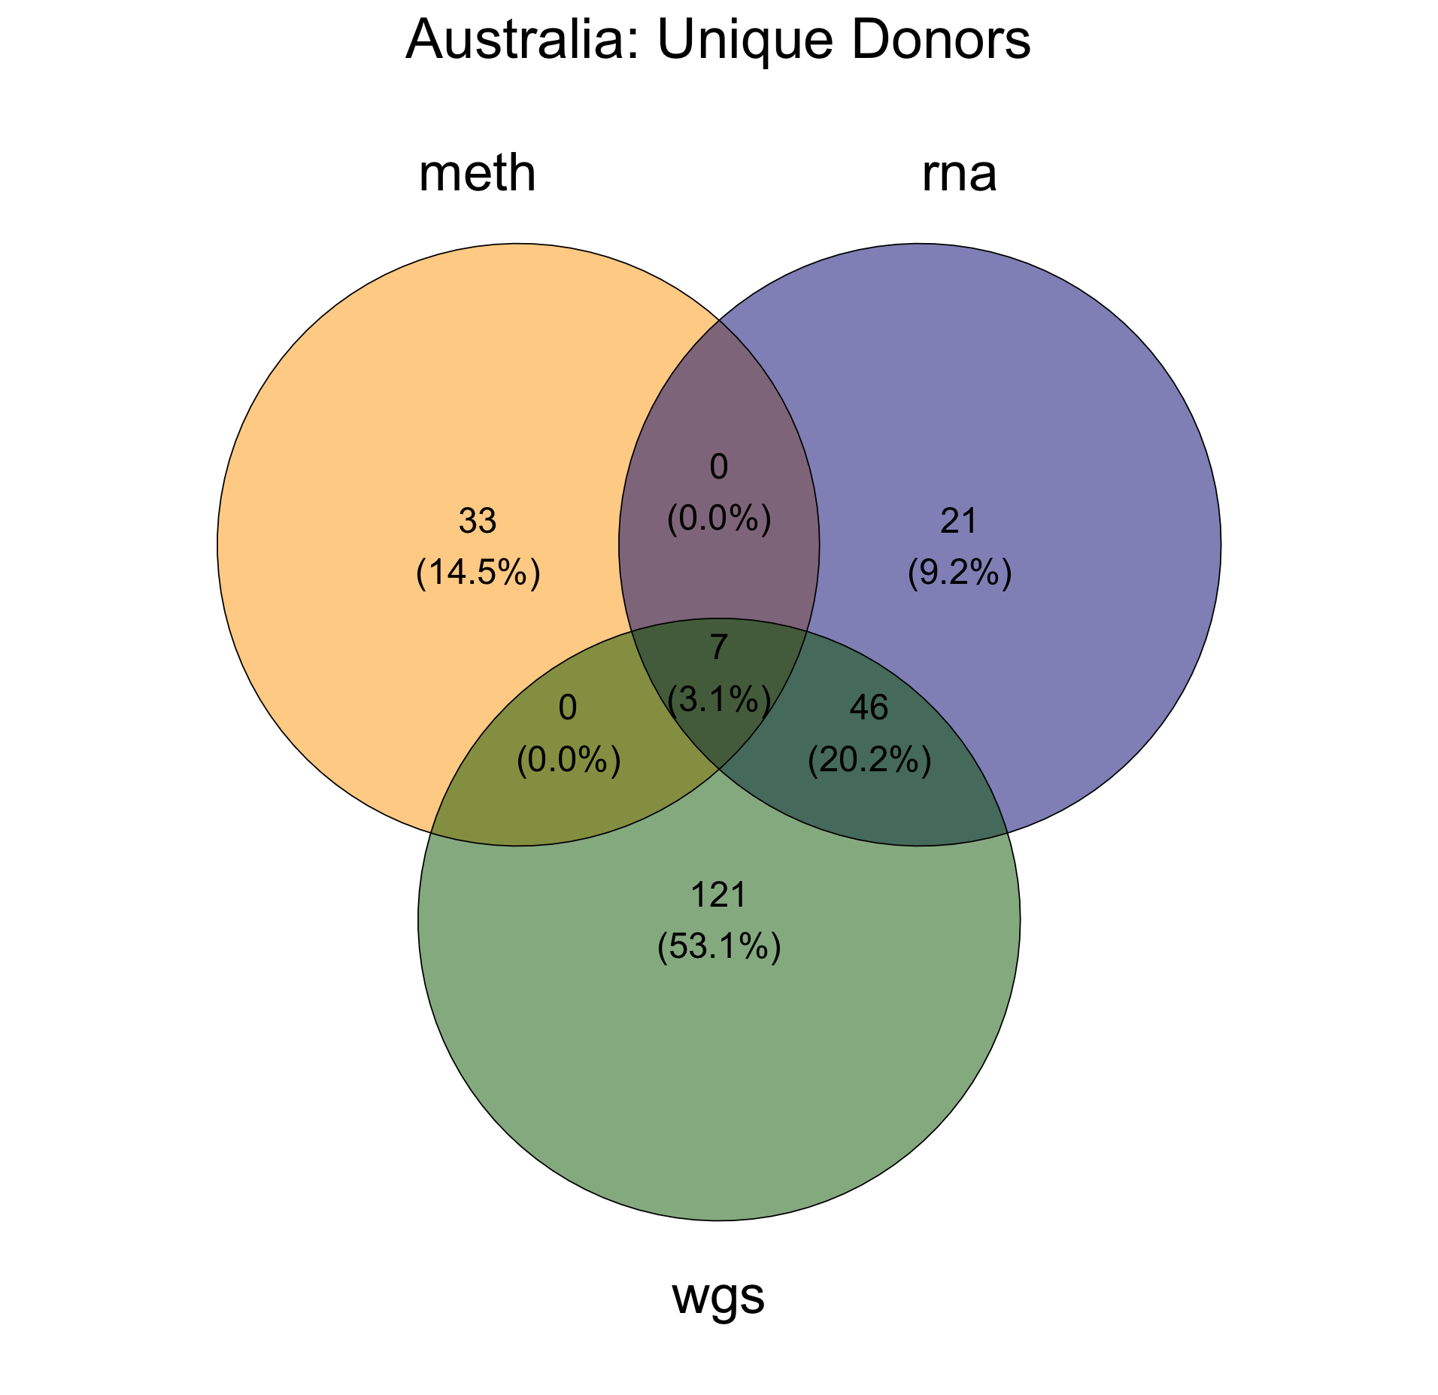
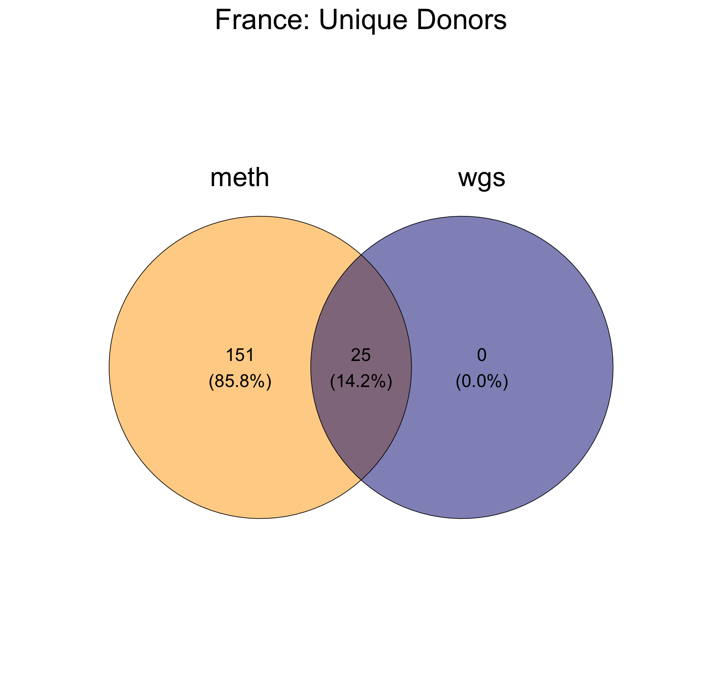

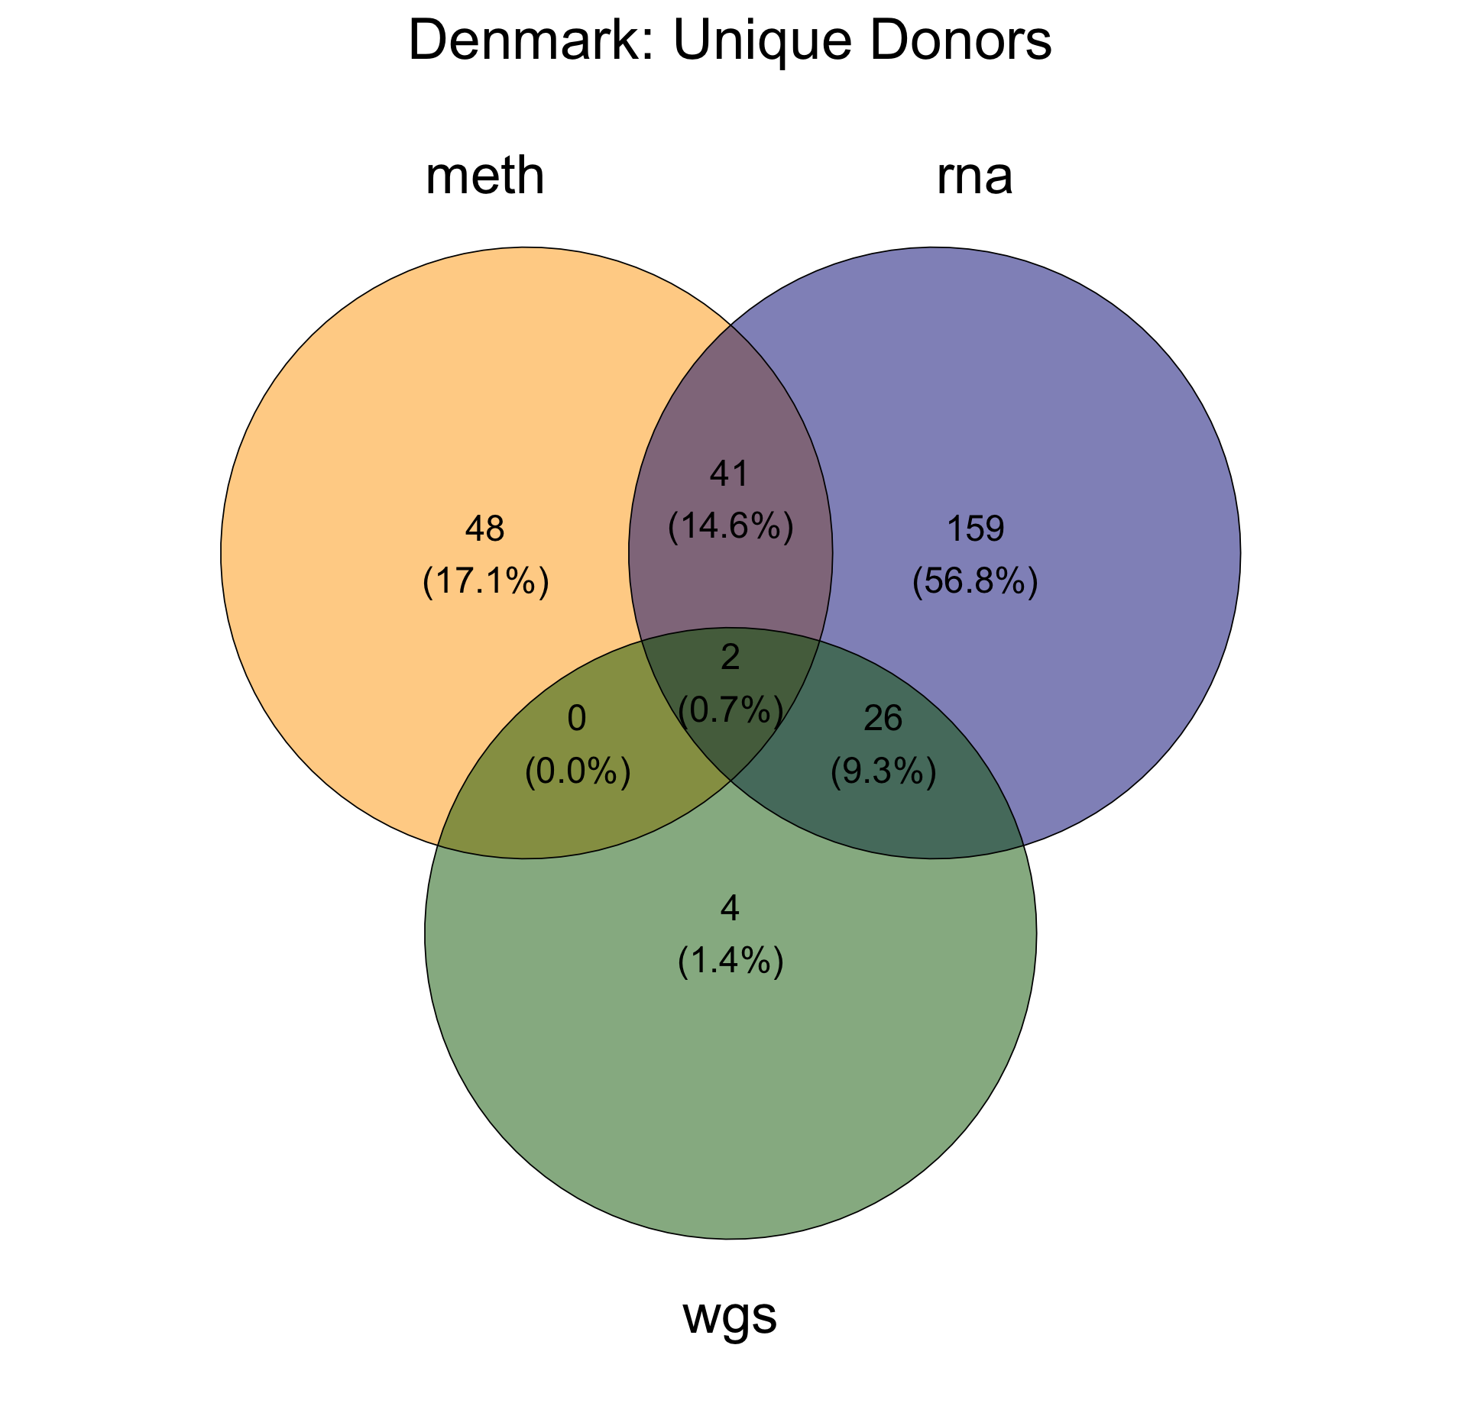

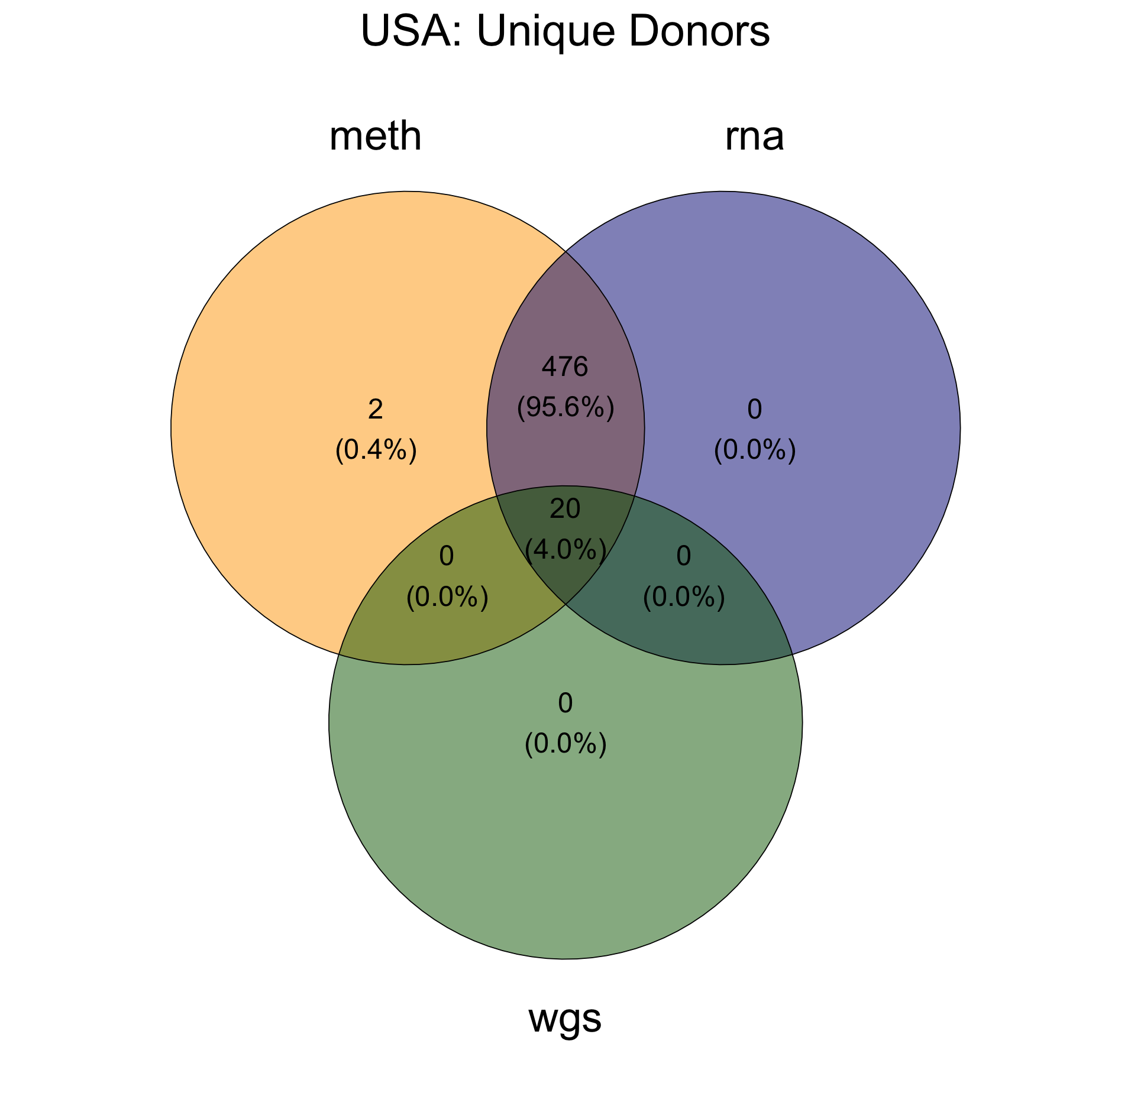

*
* 17 paired samples

