Slide 1
计算机取证
NTFS 文件系统

Slide 2
MBR and GPT Disks
MBR 磁盘，兼容 32b 86x
  从 MBR 开始以保持兼容性
  MBR 具有单个分区，分区表条目为 0xEE
适用于 64b 安腾处理器的 GPT 磁盘
Notes:
Master Boot Record (MBR) Itanium安腾处理器。MBR（主引导记录）就是我们常用的分区方式，最大支持2.19TB（2的32次方*512byte），可以划分4个主分区或3个主分区+1个扩展分区。大于2.19T的硬盘就会无法识别全部容量。
一般使用BIOS的x86架构PC，3T硬盘做系统盘（主盘）就必须使用MBR分区方式。从Vista、win7时代开始，为了解决硬盘容量限制问题，增加了GPT（GUID分区表）。GPT最大支持9.4ZB（1ZB=1024PB，1PB=1024EB，1EB=1024TB，即9.4ZEB=94亿TB）容量，支持128个主分区（window限制，有资料介绍实际无限），但使用GPT分区方式的硬盘只能作为数据盘（从盘）使用，并且注意xp 32位是无法识别GPT分区形式的数据盘的。

Slide 3
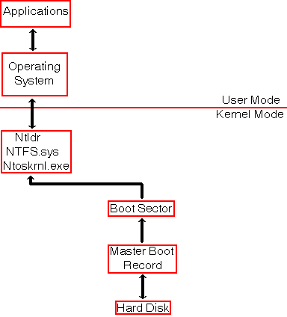
NTFS
Architecture

Slide 4

NTFS Architecture
$MFT占卷中分配空间12%

Slide 5
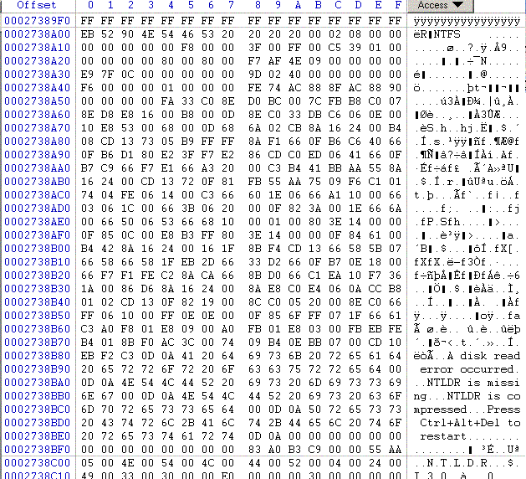
NTFS Boot Sector
Notice that the end of sector marker is 55 AA.
You can look for this to find boot sectors for NTFS and DOS.

Slide 6
NTFS Boot Sector
0x00 3B Jump Instruction
0x03 8B OEM ID
0x0B 25B BPB
0x24 48B Extended BPB
0x54 426B Bootstrap Code.
0x1FE 2B End of Sector Marker

Slide 7
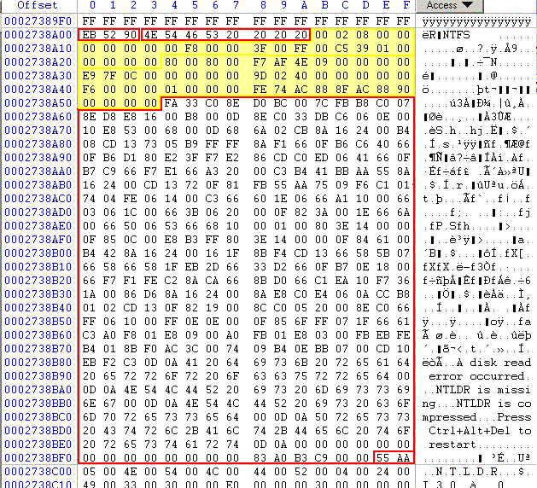
NTSF Boot Sector
BPB
Extended BPB

Slide 8
NTSF Boot Sector
Many fields are not important, but:
  0x0B, Bytes per sector.
  0x0D Sectors per Cluster
  0x15 Media descriptor. F8: HD; F0: HD Floppy
  0x28 Total sectors.
  0x30 Logical cluster number for the MFT
  0x38 Logical cluster number copy of the MFT
  0x40 Clusters per MFT Record.
  0x48 Volume serial
Notes:
F8: HD硬盘; F0: HD Floppy高密度high density软盘
字节偏移 长度 常用值 意义
0x0B 字 0x0002 每扇区字节数
0x0D 字节 0x08 每簇扇区数
0x0E 字 0x0000 保留扇区
0x10 3字节 0x000000 总为0
0x13 字 0x0000 NTFS未使用，为0
0x15 字节 0xF8 介质描述。值0xF8 表示硬盘,0xF0 表示 高密度的3.5寸软盘。
0x16 字 0x0000 总为0
0x18 字 0x3F00 每磁道扇区数
0x1A 字 0xFF00 磁头数
0x1C 双字 0x3F000000 隐含扇区
0x20 双字 0x00000000 NTFS未使用，为0
0x28 8字节 0x4AF57F0000000000 扇区总数
0x30 8字节 0x0400000000000000 $MFT的逻辑簇号
0x38 8字节 0x54FF070000000000 $MFTMirr的逻辑簇号
0x40 双字 0xF6000000 每MFT记录簇数
0x44 双字 0x01000000 每索引簇数
0x48 8字节 0x14A51B74C91B741C 卷标
0x50 双字 0x00000000 检验和

Slide 9
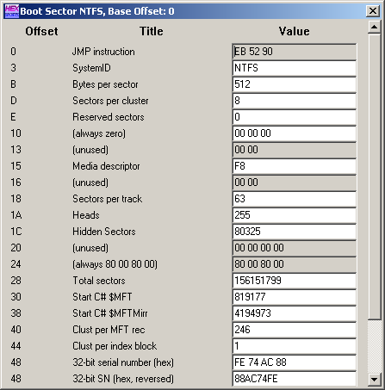
NTFS Boot Sector
WinHex allows access to an interpreted NTFS Boot Sector.
  Use the Access Tab.
Notes:
打开磁盘:访问-分区1-启动扇区(模板)，MFT记录簇数246=15*16+6即存储的是F6，根据公式计算得出是1024字节，占2扇区

Slide 10
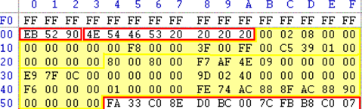
NTFS BPB
0x0B Bytes per sector: 00 02 → 0200 = 512 decimal
0x0D Sectors per cluster: 0x 08
0x0E Reserved sectors 0x 00 00
每扇区字节数
每簇扇区数
每磁道扇区数
磁头数

Slide 11
NTFS BPB
0x15: Media Descriptor: F8 hard drive, F0 floppy.
0x28 Total number of sectors: F7AF4E0900000000 → 000000094EAFF7 → 156,151,799 sectors, i.e. ~80GB

Slide 12
NTFS BPB
0x30: Logical cluster number for MFT copy 1: cluster 0C7FE9 (File $MFT)
0x38: Logical cluster number for MFT copy 2: cluster 40029D

Slide 13
NTFS BPB
0x40: Clusters per MFT record: F6，1024Bytes
0x48: Volume Serial Number
Notes:
F6 = 1k字节，MFT记录占2个扇区
每MFT记录簇数不能直接拿来计算每条记录的大小，要看它是否小于0x80,计算公式如下：
if (每MFT记录簇数 < 0x80) then
每MFT记录字节数 := 每MFT记录簇数*每簇字节数;
else
每MFT记录字节数 := 2^(0x100 -每MFT记录簇数) 即2^(0x100 - 0xF6)= 2^(16-6)=2^10=1024

Slide 14
NTFS Master File Table
First 16 records are reserved for metadata files, their name begins with a dollar sign ($)

Slide 15
NTFS Master File Table
Master file table $MFT.
Master file table mirror $MftMirr.
Log file $LogFile.
Volume $Volume;
Attribute definitions $AttrDef.
The root folder “.”
Cluster bitmap $Bitmap
Boot sector $Boot (located at the beginning of partition)
Bad cluster file $BadClus
Security file $Secure
Upcase table $Upcase
NTFS extension file $Extend, that is used for future use.
Notes:
主文件表（$MFT）：文件记录数组，每个记录为1KB；每个文件对应一个或多个文件记录；
主文件表副本（$MFTMirr）：是主文件表中前几项的副本，用于在主文件表不能读取时的元文件定位；
卷结构日志（$LogFile）：记录所有影响NTFS卷结构的操作，用于系统失败后的卷恢复；
空间分配位图（$Bitmap）：标识卷中每个簇的分配状态，即：空闲和已被分配；
引导文件（$Boot）：引导程序代码；
坏簇文件（$BadClus）：记录卷中据有损坏位置；
卷文件（$Volume）：卷名、文件系统版本、卷状态（卷是否被损坏）；
属性定义表（$AttrDef）：卷中支持的属性类型列表；

Slide 16
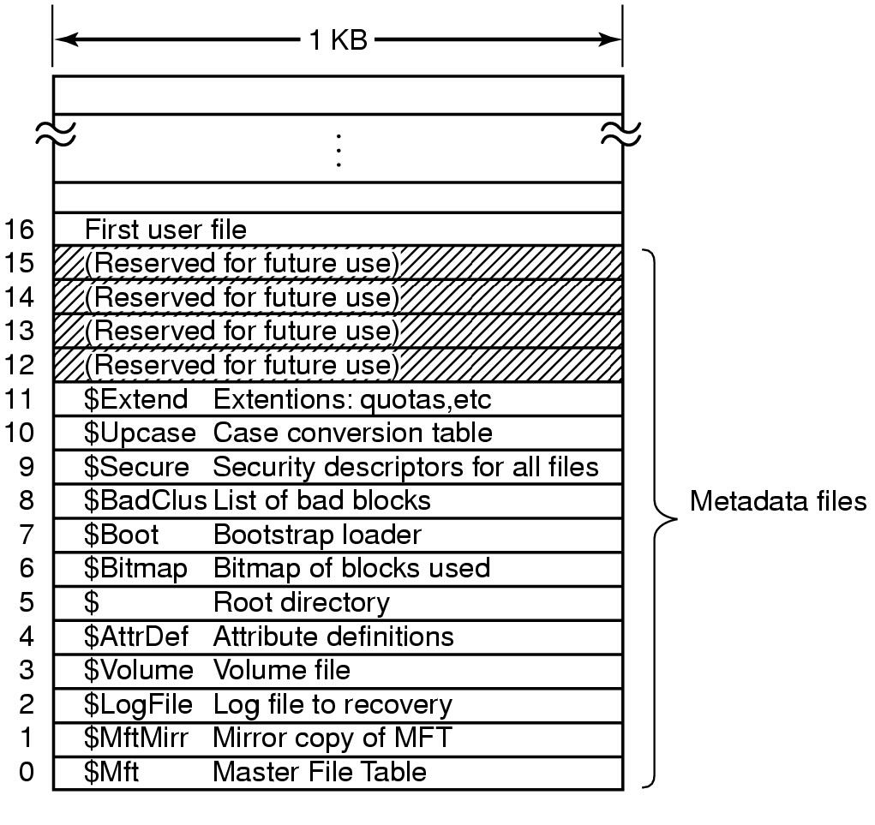
MFT for NTFS Organization
Boot-block has information
about the first block of MFT

Slide 17
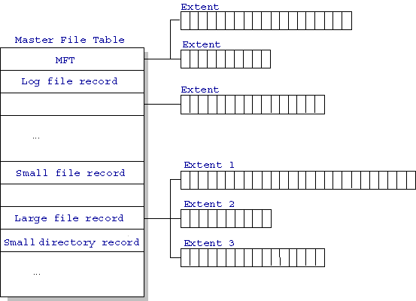
NTFS Master File Table

Slide 18
MFT Record Structure
Entries are 1KB each
Entries contain
  File Attributes
  Location Data

Slide 19
The header of MFT File Record
0x00 - 0x03: Magic Number: "FILE"
0x04-0x05: Offset to the update sequence.
0x06-0x07: Number of entries in fixup array
0x08-0x0f: $LogFile Sequence Number (LSN)
0x10-0x11: Sequence number
0x12 - 0x13: Hard link count
0x14-0x15: Offset to first attribute
Notes:
每次记录被修改都将导致日志文件序列号$LogFile Sequence Number（LSN）发生变化。
序列号Sequence Number（SN）用于记录主文件表记录被重复使用的次数。
硬连接数Hard Link Count记录硬连接的数目，只出现在基本文件记录中。硬链接(hard link, 也称链接)就是一个文件的一个或多个文件名。再说白点，所谓链接无非是把文件名和计算机文件系统使用的节点号链接起来。因此我们可以用多个文件名与同一个文件进行链接，这些文件名可以在同一目录或不同目录。一个文件有几个文件名(用ln命令实现多个文件名)，我们就说该文件的链接数为几

Slide 20
The header of MFT File Record
0x16 - 0x17: Flags.
0x18-0x1b: Used size of MFT entry
0x1c-0x1f: Allocated size of MFT entry.
0x20-0x27: File reference to the base FILE record
0x28-0x29: Next attribute ID
0x2a-0x2b: (XP) Align to 4B boundary
0x2c-ox2f: (XP) Number of this MFT record
0x30-0x100: Attributes and fixup value
Notes:
文件记录的实际长度是文件记录在磁盘上实际占用的字节空间。
基本文件记录中的文件索引号，对于基本文件记录，其值为0，如果不为0，则是一个主文件表的文件索引号，指向所属的基本文件记录中的文件记录号，在基本文件记录中包含有扩展文件记录的信息，存储在“属性列表ATTRIBUTE_LIST”属性中。

Slide 21
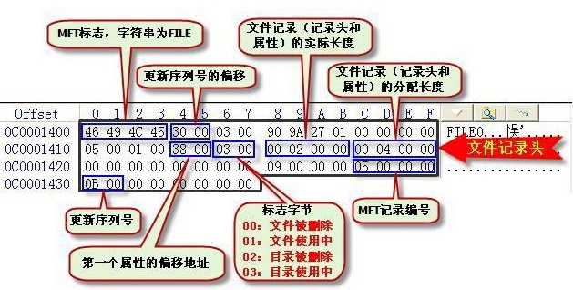
The header of MFT File Record
Notes:
注意删除标记00，02

Slide 22
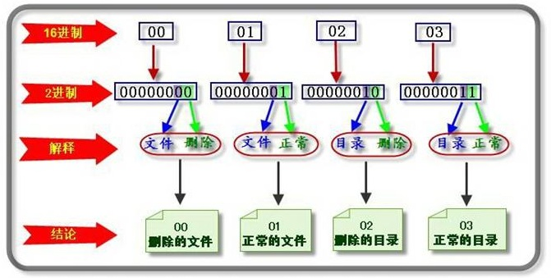
The header of MFT File Record
0x16 - 0x17: Flags

Slide 23
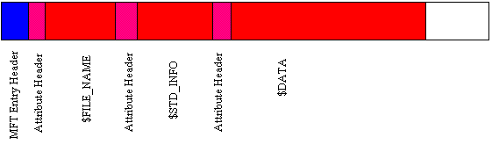
The attributes of MFT record
The attribute header gives basic information about the attribute.
A resident attribute is stored in the MFT entry.
A non-resident entry is stored in a cluster outside the MFT.
Notes:
常驻 非常驻

Slide 24
The attributes of MFT record
Resident attributes are stored in MFT record.
Non-resident attributes are stored in cluster runs.
  Cluster run consists of consecutive clusters and are identified by starting cluster and run length.
  NTFS distinguishes between Virtual Cluster Numbers and Logical Cluster Numbers.
    LCN * (#sectors in cluster) = sector number
    LCN 0 is first cluster in the volume (boot sector).
    VCN 0 refers to the first cluster in a cluster run.
Notes:
NTFS使用逻辑簇号（Logical Cluster Number，LCN）和虚拟簇号（Virtual Cluster Number，VCN）来进行簇的定位。LCN是对整个卷中所有的簇从头到尾所进行的简单编号。卷因子乘以LCN，NTFS就能够得到卷上的物理字节偏移量，从而得到物理磁盘地址。VCN (Virtual Cluster Number) = a relative cluster offset within the attribute's data

Slide 25
The attributes of MFT record
NTFS文件是属性的集合，通常所说的文件内容是指未命名数据属性流；
例：我们定义两个数据属性：ntfile(数据)和ntfile:data(自定义数据)。 在向FAT复制时，自定义属性会丢失。
Notes:
NTFS文档：文档属性定义.每个文档属性都由以下部分组成：一个由该属性的实际值组成的被称为“流”的重要的字节序列，元数据可访问该流。
文件中的每个文件属性都可能会有一个名字：在这种情况下，在命令行方式下可以通过语法“文件名：属性名”来访问该流（这也是文件名中不能使用“：”的原因）。Windows NT® 使用以下在元数据文件$AttrDef中预定义的文件属性列表（一般会有一个未命名流，为缺省流，未命名流只能有一个，而命名流可以有多个，NTFS支持多流文件）：

Slide 26
The attributes of MFT record
每个文件都由一组文件属性表示
  Standard Information，例如时间戳和链接数
  Attribute List，用来链接不在MFT中的属性记录
  File Name
  Security Descriptor，描述属主信息以及访问控制信息
  Data，文件数据
  Object ID
  Logged Tool Stream
  Reparse Point，用于卷的mount点
  Index Root
  Index Allocation
  Bitmap
  Volume Information，仅$Volume，卷版本
  Volume Name ，仅$Volume，卷标
用于目录和其他索引

Slide 27
MFT List of possible attributes
Defined in $AttrDef entry of MFT, but default is:
        0x10 STANDARD_INFORMATION
        0x20$ATTRIBUTE_LIST
        0x30$FILE_NAME0
        X40 (NT) $VOLUME_VERSION (2K) $OBJECT_ID
        0x50 $SECURITY_DESCRIPTOR
        0x60$VOLUME_NAME
        0x70 $VOLUME_INFORMATION
        0x80$DATA
        0x90$INDEX_ROOT
        0xA0$INDEX_ALLOCATION
        0xB0$BITMAP
        0xC0 (NT) $SYMBOLIC_LINK, (2K) $REPARSE_POINT
        0xD0$EA_INFORMATION
        0xE0$EA0xF0NT$PROPERTY_SET
        0x100 (2K) $LOGGED_UTILITY_STREAM

Slide 28
Standard Attribute Header
Resident, No Name
Offset | Size | Value | Description
0x00 | 4 |  | Attribute Type (e.g. 0x10, 0x60)
0x04 | 4 |  | Length (including this header)
0x08 | 1 | 0x00 | Non-resident flag
0x09 | 1 | 0x00 | Name length
0x0A | 2 | 0x00 | Offset to the Name
0x0C | 2 | 0x00 | Flags
0x0E | 2 |  | Attribute Id (a)
0x10 | 4 | L | Length of the Attribute
0x14 | 2 | 0x18 | Offset to the Attribute
0x16 | 1 |  | Indexed flag
0x17 | 1 | 0x00 | Padding
0x18 | L |  | The Attribute
Flags
Flag | Description
0x0001 | Compressed
0x4000 | Encrypted
0x8000 | Sparse
(a) Each attribute has a unique identifier
Notes:
Every attribute in every MFT record has a standard header. The header stores information about the attribute's type, size, name (optional) and whether it is resident, or not.
The size of the attribute depends on two things. Does it have a name? Is it resident?每个MFT记录中的每个属性都有一个标准标题。头存储关于属性的类型、大小、名称(可选)以及它是否是常驻的信息。
属性的大小取决于两件事。它有名字吗？是常驻的吗？

Slide 29
Resident, Named
Offset | Size | Value | Description
0x00 | 4 |  | Attribute Type (e.g. 0x90, 0xB0)
0x04 | 4 |  | Length (including this header)
0x08 | 1 | 0x00 | Non-resident flag
0x09 | 1 | N | Name length
0x0A | 2 | 0x18 | Offset to the Name
0x0C | 2 | 0x00 | Flags
0x0E | 2 |  | Attribute Id (a)
0x10 | 4 | L | Length of the Attribute
0x14 | 2 | 2N+0x18 | Offset to the Attribute (b)
0x16 | 1 |  | Indexed flag
0x17 | 1 | 0x00 | Padding
0x18 | 2N | Unicode | The Attribute's Name
2N+0x18 | L |  | The Attribute (c)
(a) Resident attributes cannot be compressed
(b) Each attribute has a unique identifier
(c) Rounded up to a multiple of 4 bytes

Slide 30
Non-Resident, No Name
Offset | Size | Value | Description
0x00 | 4 |  | Attribute Type (e.g. 0x20, 0x80)
0x04 | 4 |  | Length (including this header)
0x08 | 1 | 0x01 | Non-resident flag
0x09 | 1 | 0x00 | Name length
0x0A | 2 | 0x00 | Offset to the Name
0x0C | 2 |  | Flags
0x0E | 2 |  | Attribute Id (a)
0x10 | 8 |  | Starting VCN
0x18 | 8 |  | Last VCN
0x20 | 2 | 0x40 | Offset to the Data Runs
0x22 | 2 |  | Compression Unit Size (b)
0x24 | 4 | 0x00 | Padding
0x28 | 8 |  | Allocated size of the attribute (c)
0x30 | 8 |  | Real size of the attribute
0x38 | 8 |  | Initialized data size of the stream (d)
0x40 | ... |  | Data Runs
Notes:
(a) Each attribute has a unique identifier
(b) Compression unit size = 2x clusters. 0 implies uncompressed
(c) This is the attribute size rounded up to the cluster size
(d) When is this not equal to the allocated size?

Slide 31
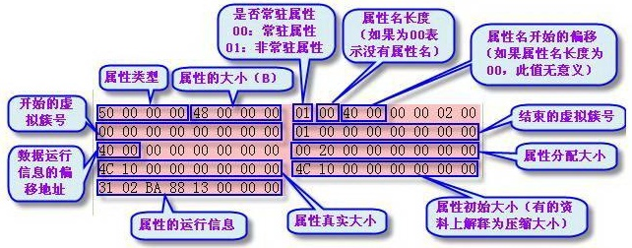
MFT Attribute Example

Slide 32
Non-Resident, Named
Offset | Size | Value | Description
0x00 | 4 |  | Attribute Type (e.g. 0x80, 0xA0)
0x04 | 4 |  | Length (including this header)
0x08 | 1 | 0x01 | Non-resident flag
0x09 | 1 | N | Name length
0x0A | 2 | 0x40 | Offset to the Name
0x0C | 2 |  | Flags
0x0E | 2 |  | Attribute Id (a)
0x10 | 8 |  | Starting VCN
0x18 | 8 |  | Last VCN
0x20 | 2 | 2N+0x40 | Offset to the Data Runs (b)
0x22 | 2 |  | Compression Unit Size (c)
0x24 | 4 | 0x00 | Padding
0x28 | 8 |  | Allocated size of the attribute (d)
0x30 | 8 |  | Real size of the attribute
0x38 | 8 |  | Initialized data size of the stream (e)
0x40 | 2N | Unicode | The Attribute's Name
2N+0x40 | ... |  | Data Runs (b)
Notes:
(a) Each attribute has a unique identifier
(b) Rounded up to a multiple of 4 bytes
(c) Compression unit size = 2x clusters. 0 implies uncompressed
(d) This is the attribute size rounded up to the cluster size
(e) When is this not equal to the allocated size?

Slide 33
MFT Attribute Example
Standard Info Attribute Layout
0x00 | 8 |  | File Creation Time
0x08 | 8 |  | File Alteration Time
0x10 | 8 |  | MFT Change
0x18 | 8 |  | File Read Time
0x20 | 4 |  | DOS File Permissions
0x24 | 4 |  | Maximum number of versions
0x28 | 4 |  | Version number
0x2C | 4 |  | Class ID
0x30 | 4 | 2K | Owner ID

Slide 34
MFT Attribute Example
Always resident.
Follows the MFT record hdr.
Contents:
  MACW times & dates
  MS-DOS file permissions
  Pointer to the secure file (which contains file's security descriptor) (NTFS v5)

Slide 35
MFT Attribute Example
The content layout for the $FILE_NAME attribute is:
Offset | length | Content | Comments
0 | 8 | File reference to parent directory
0 | 8 | Creation time
8 | 8 | Last modification time
10 | 8 | Last modification time for MFT record
18 | 8 | Last access time
28 | 8 | Allocated size | Is not always valid
30 | 8 | Real size | Is not always valid
38 | 8 | Flags | Directory Compressed Archive System Hidden Read-only
40 | 1 | Length of file name = L
41 | 1 | File name type | 0 POSIX 1 Unicode 2 DOS 3 Both Unicode and DOS
42 | 2*L | File name in Unicode

Slide 36
MFT Attribute Example
Always follows the standard info attr.
Sometimes 2 File Name attrs are found in a MFT record:
  Long file name
  DOS-truncated name
Contents:
  File Name
  File's Parent
  Same 4 dates as the SI Attr.
  Logical Files size (not including file attrs)
  File perms flags (DOS-like): read-only, hidden, system, archive, compressed, directory
  File Name (usually Unicode)
  File Type
  File Size

Slide 37
MFT Attribute Example
Data Attribute
  Attribute Type (4 bytes) (e.g. 0x80)
  Length including header (4 bytes)
  Non-resident flag (1 byte)
  Name length (1 byte)
  Offset to the Name (2 bytes)
  Flags (2 bytes)
  Attribute Id (2 bytes)
  Starting VCN (8 bytes)
Data Attribute
  Last VCN (8 bytes)
  Offset to the Data Runs (2 bytes)
  Compression Unit Size (2 bytes)
  Padding (4 bytes)
  Allocated size of the attribute (8 bytes)
  Real size of the attribute (8 bytes)
  Initialized data size of the stream (8 bytes)
  Data Runs ...

Slide 38
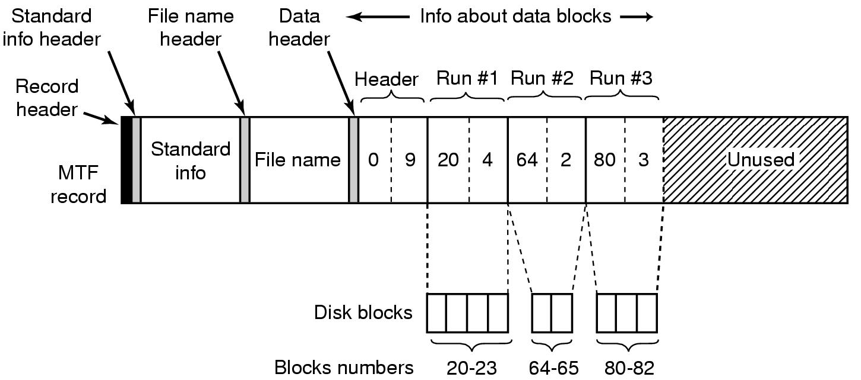
MFT Record for A File
File fits one MFT record
Header (0,9): Offset of the first block of the stream (0) and offset of the first block not covered by the record (9)
Notes:
0-8, VCN of the first block within the file(0);VCN of the first uncovered block(9)

Slide 39
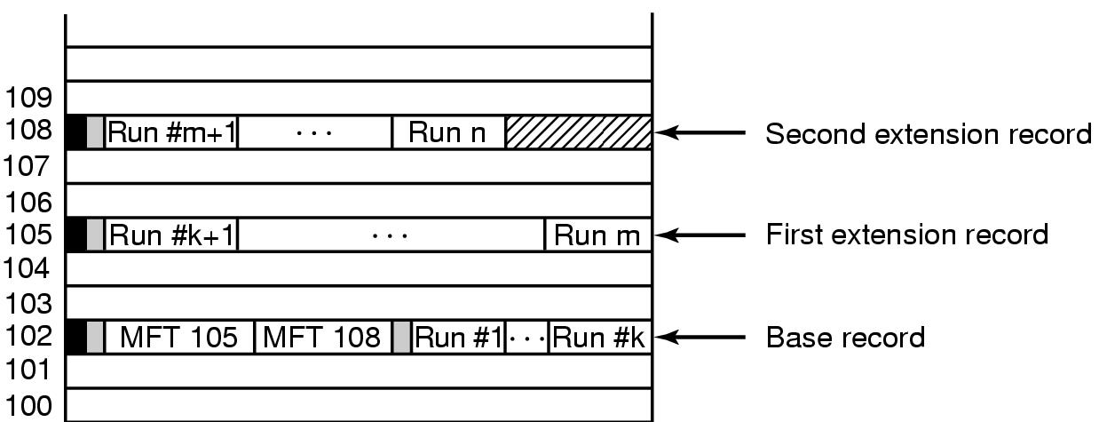
MFT Records for A File
A file that requires three MFT records to store all its runs
Notes:
文件大时，文件扩展记录，在基记录中增加mft105，mft108

Slide 40
MFT Record
Each MFT record is addressed by a 48 bit MFT entry value.
  First entry has address 0.
Each MFT entry has a 16 bit sequence number that is incremented when the entry is allocated.
MFT entry value and sequence number combined yield 64b file reference address.
Notes:
NTFS卷上的每个文件都有一个64位（bit）称为文件引用号（File Reference Number，也称文件索引号）的唯一标识。文件引用号由两部分组成：一是文件号，二是文件顺序号。文件号为48位，对应于该文件在MFT中的位置。文件顺序号随着每次文件记录的重用而增加，这是为NTFS进行内部一致性检查而设计的。

Slide 41
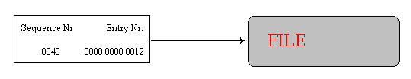
MFT Record
NTFS uses the file reference address to refer to MTF entries.
  When the system crashes during allocation, then the sequence number describes whether the MTF entry belonged to the previous file or to the current one.

Slide 42
MFT Record
MFT entry attributes are loosely defined.
Each attribute is preceded by the attribute header.
The attribute header identifies
  Type of attribute.
  Size.
  Name.

Slide 43
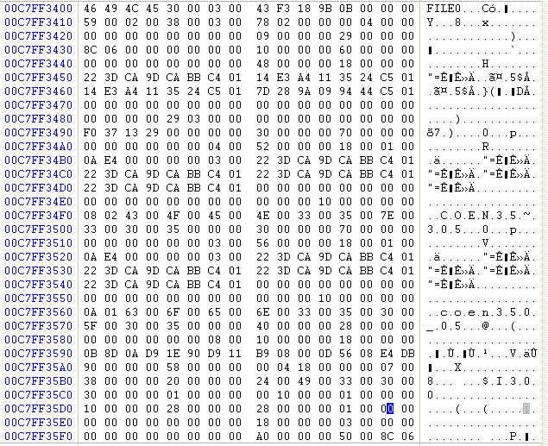
MFT Record Structure
EXAMPLE 1:
  A directory entry

Slide 44
MFT Record
MFT records start with “FILE”. A bad cluster would start with “BAAD”

Slide 45
MFT Record
Bytes 4-5: Offset to update sequence.
Bytes 6-7: Number of entries in fixup array
Bytes 8-f: Log file sequence number
Bytes 0x10-0x11: Sequence number: 59 00

Slide 46
MFT Record
Bytes 0x12-0x13: 2 – hard link count
Bytes 0x14-0x15: Offset to first attribute: 0x 38
Bytes 0x16-0x17: Flags: In use and contains a directory 0x 0001 | 0x 0002

Slide 47
MFT Record
Bytes 0x14 – 0x15: First attribute starts at 0x 38 00 → 0x 00 38

Slide 48
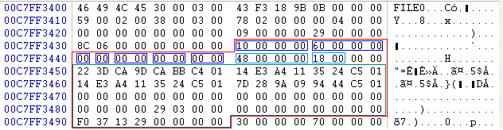
MFT Attribute Example
Attribute is of type 00 00 00 10.
  Standard Information
Attribute is 0x 00 00 00 60 bytes long.
Attribute is resident (0x00)
Contents are 0x 00 00 00 48 bytes long and start at offset 0x 00 18.

Slide 49
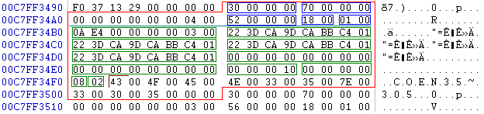
MFT Attribute Example
Second entry has attribute number 00 00 00 03 → 300000.
  $FILE_NAME attribute
Total attribute length is 70 B.
Contents start at offset 18B

Slide 50
MFT Attribute Example
Obviously, this is a short file name.

Slide 51
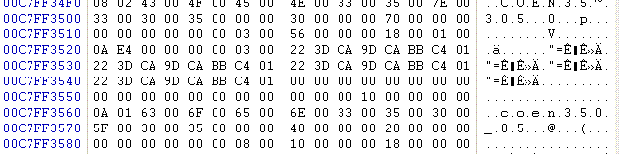
MFT Attribute Example
Third attribute is also a file name, but this time the complete entry

Slide 52
NTFS Versions
File system improves.
Disk Layout changes.

