Slide 1
NTFS MFT Example

Slide 2
The header of MFT File Record
0x00 - 0x03: Magic Number: "FILE"
0x04-0x05: Offset to the update sequence.
0x06-0x07: Number of entries in fixup array
0x08-0x0f: $LogFile Sequence Number (LSN)
0x10-0x11: Sequence number
0x12 - 0x13: Hard link count
0x14-0x15: Offset to first attribute

Slide 3
The header of MFT File Record
0x16 - 0x17: Flags: 0文件被删除: 1普通文件, 2目录被删除. 3:普通目录
0x18-0x1b: Used size of MFT entry
0x1c-0x1f: Allocated size of MFT entry.
0x20-0x27: File reference to the base FILE record
0x28-0x29: Next attribute ID
0x2a-0x2b: (XP) Align to 4B boundary
0x2c-ox2f: (XP) Number of this MFT record
0x30-0x100: Attributes and fixup value

Slide 4
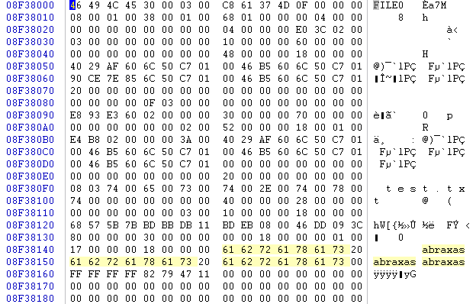
MFT Table Entry
Notes:
物理扇区(柱面/磁头/扇区);逻辑扇区;相对扇区;逻辑扇区号=相对扇区号+隐藏扇区

Slide 5
MFT Table Entry
Magic marker: FILE

Slide 6
MFT Table Entry
Update Sequence Offset: 0x 00 30
Three entries in update sequence

Slide 7
MFT Table Entry
Sequence number is 0x 00 08

Slide 8
MFT Table Entry
Link count is 00 01
(one)

Slide 9
MFT Table Entry
First attribute is located at offset
0x 00 38

Slide 10
MFT Table Entry
Flags are 0x 01 00
Record in use
Notes:
01正常文件

Slide 11
MFT Table Entry
Used size of MFT entry:
0x 00 00 01 68 =
360
Notes:
0x0168 16*16+6*16+8=22*16+8=360

Slide 12
MFT Table Entry
Allocated size of MFT entry:
0x 00 00 04 00 =
1024₁₀
Notes:
4*16*16=1024,共2个扇区1024字节,1kB

Slide 13
MFT Table Entry
File Reference 0

Slide 14
MFT Table Entry
Next attribute ID 0004

Slide 15
MFT Table Entry
MFT Record Number
00 02 3C E0

Slide 16
Standard Attribute Header
Resident, No Name
Offset | Size | Value | Description
0x00 | 4 |  | Attribute Type (e.g. 0x10, 0x60)
0x04 | 4 |  | Length (including this header)
0x08 | 1 | 0x00 | Non-resident flag
0x09 | 1 | 0x00 | Name length
0x0A | 2 | 0x00 | Offset to the Name
0x0C | 2 | 0x00 | Flags
0x0E | 2 |  | Attribute Id (a)
0x10 | 4 | L | Length of the Attribute
0x14 | 2 | 0x18 | Offset to the Attribute
0x16 | 1 |  | Indexed flag
0x17 | 1 | 0x00 | Padding
0x18 | L |  | The Attribute
Flags
Flag | Description
0x0001 | Compressed
0x4000 | Encrypted
0x8000 | Sparse
(a) Each attribute has a unique identifier
Notes:
Every attribute in every MFT record has a standard header. The header stores information about the attribute's type, size, name (optional) and whether it is resident, or not.
The size of the attribute depends on two things. Does it have a name? Is it resident?

Slide 17
MFT Table Entry
Attribute Type:
00 00 00 10
Standard

Slide 18
MFT Table Entry
Attribute Length:
00 00 00 60

Slide 19
MFT Table Entry
Non-resident flag:
resident

Slide 20
MFT Table Entry
Length of name: 0

Slide 21
MFT Table Entry
Offset to name: 0

Slide 22
MFT Table Entry
Flags: 0

Slide 23
MFT Table Entry
Attribute Identifier: 0

Slide 24
MFT Table Entry
Size of Content: 0x 48 = 72

Slide 25
MFT Table Entry
Offset to Content:
0x 18 = 24

Slide 26
MFT Attribute Example
Standard Info Attribute Layout
0x00 | 8 |  | File Creation Time
0x08 | 8 |  | File Alteration Time
0x10 | 8 |  | MFT Change
0x18 | 8 |  | File Read Time
0x20 | 4 |  | DOS File Permissions
0x24 | 4 |  | Maximum number of versions
0x28 | 4 |  | Version number
0x2C | 4 |  | Class ID
0x30 | 4 | 2K | Owner ID

Slide 27
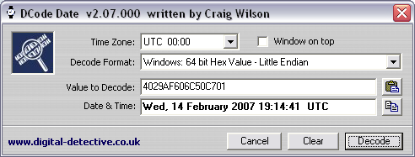
MFT Table Entry
Standard Information Content:
File Creation Time
4029AF606C50C701

Slide 28
MFT Table Entry
Standard Information Content:
File Alternation Time
0046B5606C50C701
2/14/2007, 19:14:41 UTC

Slide 29
MFT Table Entry
Standard Information Content:
MFT Change Time
90CE7E856C50C701
2/14/2007, 19:15:42 UTC

Slide 30
MFT Table Entry
Standard Information Content:
File Read Time
0046B5606C50C701
2/14/2007, 19:14:41 UTC

Slide 31
MFT Table Entry
DOS Permissions
00 00 00 20

Slide 32
MFT Table Entry
Maximum Number of Versions
00 00 00 00

Slide 33
MFT Table Entry
Version Number
00 00 00 00

Slide 34
MFT Table Entry
Class ID
00 00 00 00

Slide 35
MFT Table Entry
Owner ID
00 00 00 00

Slide 36
MFT Table Entry
Security ID
00 00 03 0F

Slide 37
MFT Table Entry
Quota Charged
00 00 03 0F

Slide 38
MFT Table Entry
Update Sequence Number
00 00 00 02 60 E3 93 E8

Slide 39
MFT Table Entry
Attribute Type Identifier
30: $FILENAME

Slide 40
MFT Table Entry
Length of Attribute: 0x 70

Slide 41
MFT Table Entry
Resident:

Slide 42
MFT Table Entry
No Name

Slide 43
MFT Table Entry
No Name

Slide 44
MFT Table Entry
No Flages

Slide 45
MFT Table Entry
Attribute identifier 2

Slide 46
MFT Table Entry
Size of Content: 0x 52

Slide 47
MFT Table Entry
Offset to Content: 0x 18
This gives us the structure of the attribute

Slide 48
MFT Attribute Example
The content layout for the $FILE_NAME attribute is:
Offset | length | Content | Comments
0 | 8 | File reference to parent directory
0 | 8 | Creation time
8 | 8 | Last modification time
10 | 8 | Last modification time for MFT record
18 | 8 | Last access time
28 | 8 | Allocated size | Is not always valid
30 | 8 | Real size | Is not always valid
38 | 8 | Flags | Directory Compressed Archive System Hidden Read-only
40 | 1 | Length of file name = L
41 | 1 | File name type | 0 POSIX 1 Unicode 2 DOS 3 Both Unicode and DOS
42 | 2*L | File name in Unicode

Slide 49
MFT Table Entry
File Reference to parent directory:
00 3A 00 00 00 02 B8 E4

Slide 50
MFT Table Entry
File creation time:
4029AF606c50C701
2/14/2007 19:14:41 UTC

Slide 51
MFT Table Entry
File modification time:
0046B5606c50C701
2/14/2007 19:14:41 UTC

Slide 52
MFT Table Entry
File access time:
0046B5606c50C701
2/14/2007 19:14:41 UTC

Slide 53
MFT Table Entry
MFT modification time:
0046B5606c50C701
2/14/2007 19:14:41 UTC

Slide 54
MFT Table Entry
Allocated Size of File

Slide 55
MFT Table Entry
Real Size of File

Slide 56
MFT Table Entry
Flags

Slide 57
MFT Table Entry
Filename length in Unicode Characters: 8
Notes:
文件名长度8，test.txt，

Slide 58
MFT Table Entry
Filename namespace
Notes:
文件名字类型03，unicode和dos

Slide 59
MFT Table Entry
File name / extension in unicode: test.txt

Slide 60
MFT Table Entry
Attribute Type: Object_ID

Slide 61
MFT Table Entry
Length of Attribute: 0x28

Slide 62
MFT Table Entry
B0: Resident
B1-4: No Name
B 5-6: Attribute ID: 3

Slide 63
MFT Table Entry
Size of content: 0x10
Offset to content 0x18

Slide 64
MFT Table Entry
Object ID:

Slide 65
MFT Table Entry
Object ID:

Slide 66
MFT Table Entry
Attribute Type: $DATA

Slide 67
MFT Table Entry
Attribute Length: 0x30

Slide 68
MFT Table Entry
Resident

Slide 69
MFT Table Entry
No name

Slide 70
MFT Table Entry
Size of contents: 0x17

Slide 71
MFT Table Entry
Offset to contents: 0x18

Slide 72
MFT Table Entry
Contents

Slide 73
MFT Table Entry
End of Entry

Slide 74
Formatted NTFS Volume
Partition
Boot Sector
Master File Table
System
Files
File Area
Boot Sector: gives the starting location of the MFT, cluster size (1 to 128 sectors, but commonly 8), size of each MFT entry
Master File Table: is basically a relational database table in which information (attributes) for each file or directory is represented by a record in the MFT
System Files: used by file system to store metadata and implement the file system

Slide 75
Filename Lookup
The operating system starts a search for a filename at the root directory
Directory
\Devices
MFT for Volume 1
C:
D:
Disk Volume 1
filename
Root Dir
Step 1: Look up C:
Step 2: Follow link to get disk portion
Step 3: Look up pathname
Step 4: Do work with filename

Slide 76
Folder/Directory Implementation
Index Root – index entries for folder contents
Index Allocation – too many index entries in a folder for the MFT, store remainder in index buffers in clusters and record cluster locations here
Support for links (a file can be referenced by entries in multiple folders)
Stored as binary trees, not lists for performance
Notes:
90H索引根目录属性 Index Root
A0H索引分配表属性 Index Allocation

Slide 77
MFT Records
Boot Sector
\Index
MFT Entry Bitmap
...1...
0
$LogFile Journal
$MFT
mirror
dir1 200
$logFile
...
...
Cluster Bitmap
5
RootDir
...11...
6
$Bitmap
dir1 Index
...
200
File1.dat 304
dir1
...
File1.dat $DATA attr.
304
File1.dat
Cluster 692
Cluster 693

Slide 78
Allocating a File
Bitmap modified to mark clusters as allocated
Create an allocated MFT record
Create index entry in parent folder’s MFT record or index buffer
For non-resident file: create cluster extent entries in file’s MFT record
  Extents are contiguous chunks of disk blocks
  修改位图以将簇标记为已分配
  创建分配的MFT记录
  在父文件夹的MFT记录或索引缓冲区中创建索引条目
  对于非常驻文件:在文件的MFT记录中创建簇范围条目
  扩展区是磁盘块的连续区块

Slide 79
File Allocation Example
Create the file \dir1\file1.dat where filesize = 4,000 bytes and clustersize = 2, 048 bytes
  Read the 1st sector and process boot sector to determine cluster size, starting @ of MFT and size of each MFT entry
  Read 1st entry of MFT which is $MFT file and determine layout of MFT
  Allocate an MFT entry for the new file by using $BITMAP to find an unused entry, say 304, and set corresponding bit to 1
  Create $STANDARD_INFORMATION and $FILE_NAME and set times to current time
  Allocate 2 clusters for the file by using $DATA attribute of $BITMAP file, MFT entry 6...clusters 692 and 693 are found using best-fit algorithm and write file content
  Add a file name entry reading $INDEX_ROOT and $INDEX_ALLOCATION and traverse sorted tree to find 200
  Seek to MFT entry 200 and find location for file1.dat, resort tree and find MFT entry 304
  Entries made for journal and new file size modified if quotas
Notes:
MFT entry 6:Cluster bitmap $Bitmap 参考前面图，创建文件file1.dat
0号$MFT 包含一个$BITMAP 属性， 用来描述MFT 项的分配使用情况。$BITMAP 的每个bit 对应于一个MFT 项， bit 为0说明该MFT 项未被分配使用；bit 为1 说明该MFT 项已被分配使用。6号$BITMAP 文件即 位图文件， 使用6号MFT 项， 它的数据属性用于描述 “文件系统中簇”的分配情况。 其中每一个bit 对应卷中的一个簇， 并说明 该簇是否已被分配使用。

Slide 80
Adding to the MFT
As more files are added to the file system, more records are added to the MFT
Storing the entries contiguously on disk improves performance, so the operating system reserves ~12.5% of the disk space that immediately follows the MFT, called the MFT Zone
This space will only be used when necessary
If it continues to grow larger, the MFT may be fragmented (and cannot generally be defrag’d)
Notes:
系统在读写磁盘时会频繁地访问MFT，因此MFT对NTFS系统的性能有着至关重要的影响。NTFS文件系统在默认情况下已经在MFT的附近预留着一个特定的区域，用来减少MFT中的碎片。默认状态下，这一区域占整个卷大小的12.5%

Slide 81
Deleting a File
Cluster references in $BITMAP file zeroed
MFT allocation flag zeroed – marked for deletion
Index entry deleted, all entries below it are moved up (except if it is the last entry)
NTFS overwrites MFT entries marked for deletion before creating new ones
Non-resident attributes of a file may still be found, even if MFT entry is deleted
$BITMAP文件中的簇引用被清零
MFT分配标志归零-标记为删除
删除索引条目，它下面的所有条目都上移(除非它是最后一个条目)
NTFS会在创建新条目之前覆盖标记为删除的MFT条目
即使MFT条目被删除，文件的非常驻属性仍然可以被找到

Slide 82
File Deletion Example
Step 1: Process boot sector, get @ of MFT and cluster size
Step 2: Read 1st entry from MFT
Step 3: Starting with MFT entry 5, find dir1 entry at 200 (update last accessed time)
Step 4: Search entry 200 and find file1.dat at entry 304
Step 5: Remove the entry from the index
Step 6: Unallocate MFT entry 304, and set MFT entry bitmap to 0
Step 7: Set assigned clusters to unallocated in bitmap
Notes:
5 根目录. 删除\dir1\file1.dat

Slide 83
MFT Records
Boot Sector
\Index
MFT Entry Bitmap
...0...
0
$LogFile Journal
$MFT
mirror
dir1 200
$logFile
...
...
Cluster Bitmap
5
RootDir
...00...
6
$Bitmap
dir1 Index
...
200
dir1
...
File1.dat $DATA attr.
304
File1.dat
Cluster 692
Cluster 693

Slide 84
File Deletion Example
在NTFS中，如果由shift+del直接删除文件时，文件记录项的文件名不变
如果先将文件移到回收站时（即del），文件将改名，改名的规则是由D（回收站的第一个字母）加盘符再加数字序号组成，如由G盘删除的文本文件，名字改为DG1.TXT,MFT中的文件记录号不变。如果删除的是文件夹，文件夹按照以上规则改名，但文件夹下的文件保持原文件名。
区别桌面回收站与分区回收站文件夹
Notes:
每个分区都有回收站文件夹，用winhex打开可看到该文件夹可以看到该分区删除的文件。在OS中打开Windows桌面上的回收站文件夹，可看到所有分区删除的的全部文件.用“回收站”实现批量重命名:删除要改名的文件，在D盘建立一文件夹如：ren，在DOS模式下进入Recycled目录，键入COPY *.* D:\ren，所有的文件已全改为DD1、DD2 注意：删除之前要先清空“回收站

Slide 85
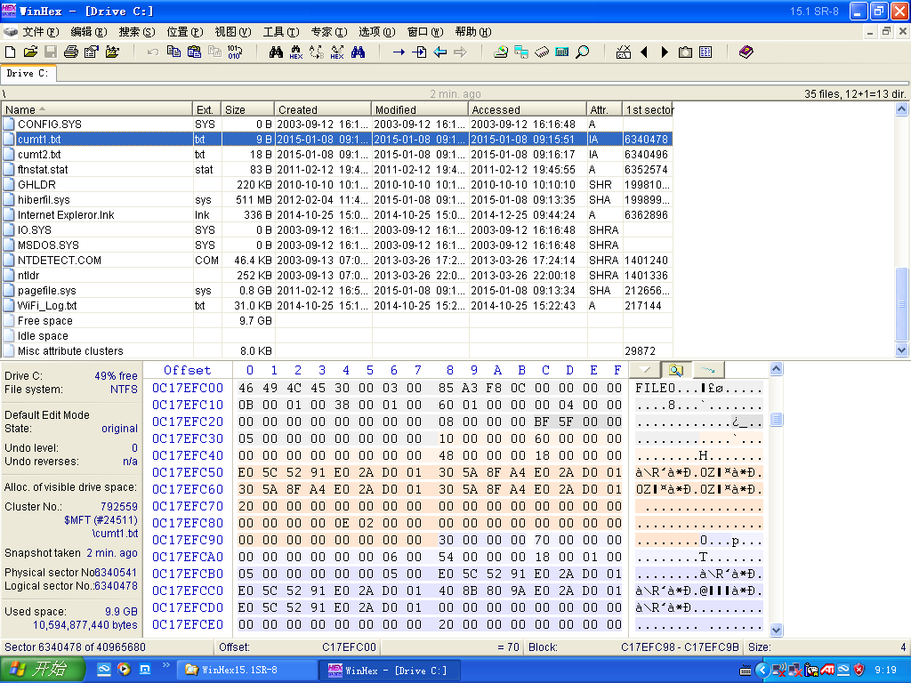
Notes:
2个文本文件cumt1，cumt2

Slide 86
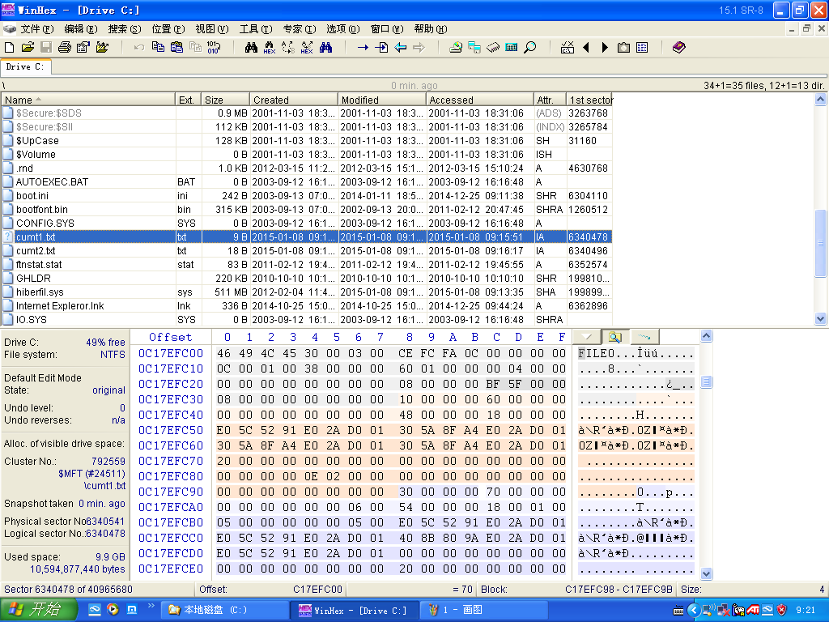
Shift-del后
Notes:
Shift-del后

Slide 87
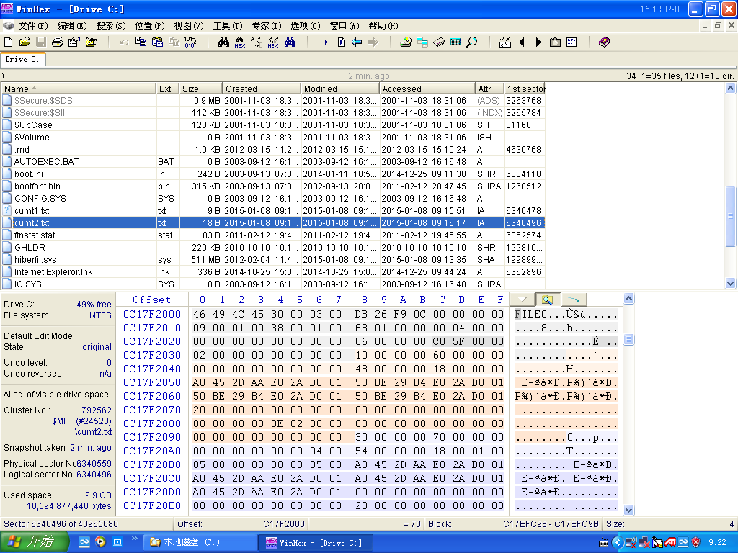
Notes:
cumt2

Slide 88
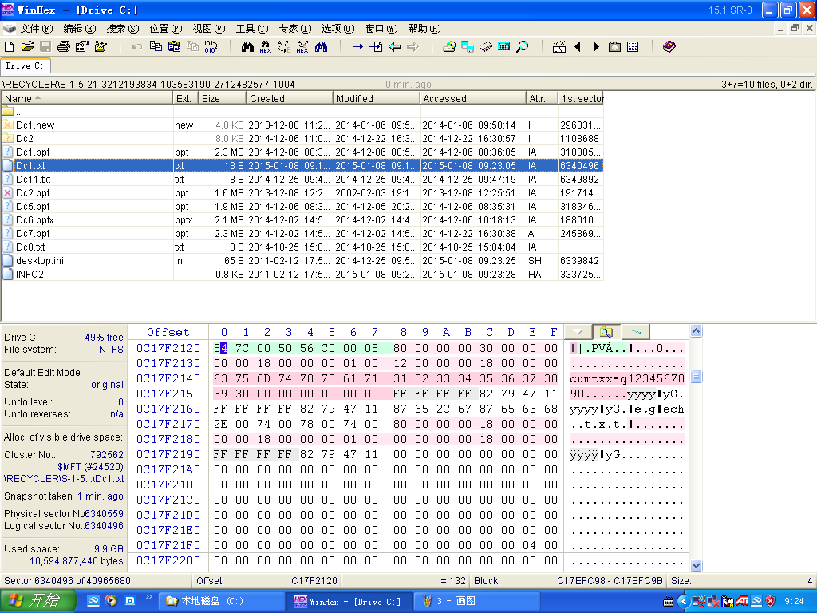
Del后进入回收站，文件改名
Notes:
Del后进入回收站，文件改名

Slide 89
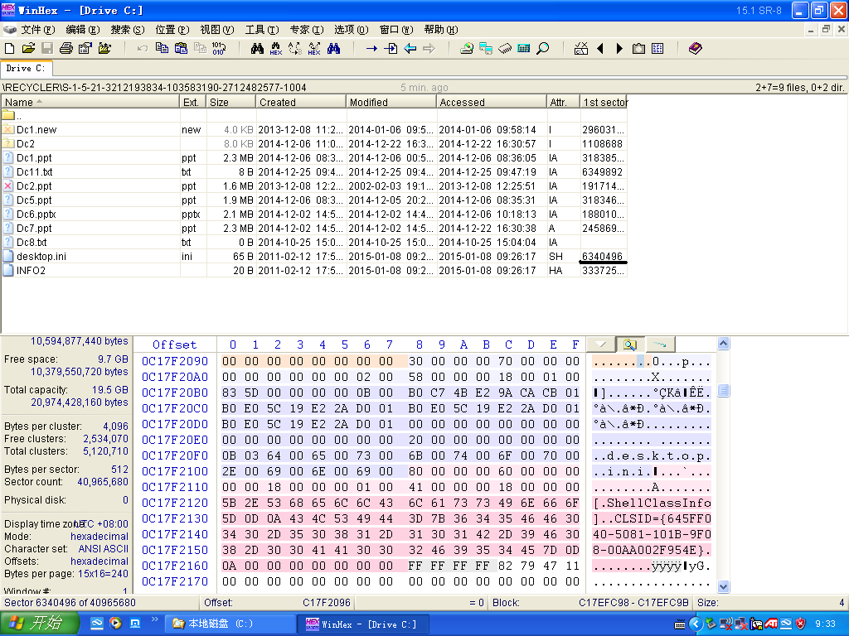
清空回收站后。文件被覆盖，不可恢复
Notes:
清空回收站后。文件被覆盖，不可恢复

Slide 90
File Recovery
When a file is deleted:
  The name is removed from the parent directory index
  The MFT entry is unallocated
  Clusters are unallocated
Problem: when filename is removed from parent directory, the index is resorted and name information could be lost
  However, MFT entries are found in one table, so all unallocated entries can be found
  And each entry has the $FILE_NAME attribute with the file reference address of the parent directory, so when an unallocated entry is found, its entire path can be determined
To recover all deleted files in NTFS, examine MFT for unallocated entries and determine name using $FILE_NAME attribute and parent directory file reference
Notes:
在winhex中，打开ntfs分区，执行“搜索文件记录（向下）”，在菜单“搜索-查找文本-填写被删除的文件名”找到待恢复的文件。

Slide 91
$LOGFILE
Keep track of filesystem transactions to enable recovery
Transactions: operations that change file system data or the volume’s directory structure
Keeps track of completion of steps in file deletion or creation – pick up where you left off, etc

Slide 92
Information in $LOGFILE
Index entries from folders (name, MAC times)
Copy of MFT record (all begin with word ‘File’ followed by hex character “2A”
Link file headers
Index buffers (begin with “INDX”)
A good way to find file names that no longer exist elsewhere

Slide 93
Recovery Deleted NTFS Files http://www.ntfs.com/disk-scan.htm
The www.ntfs.com example uses these parameters:
  Total Sectors 610406
  Cluster size 512 bytes
  One Sector per Cluster
  MFT starts from offset 0x4000, non-fragmented
  MFT record size 1024 bytes
  MFT Size 1968 records

Slide 94
Example
Scan all 1968 MFT for flag indicating file marked for deletion
MFT record number 57 contains our recently deleted file "My Presentation.ppt“
MFT entries have predefined structure
Begins with standard “FILE” record header
8 fields into record, in byte 23 is Flag field
  00 = marked deleted
  01 = in use

Slide 95
Non-Resident, No Name
Offset | Size | Value | Description
0x00 | 4 |  | Attribute Type (e.g. 0x20, 0x80)
0x04 | 4 |  | Length (including this header)
0x08 | 1 | 0x01 | Non-resident flag
0x09 | 1 | 0x00 | Name length
0x0A | 2 | 0x00 | Offset to the Name
0x0C | 2 |  | Flags
0x0E | 2 |  | Attribute Id (a)
0x10 | 8 |  | Starting VCN
0x18 | 8 |  | Last VCN
0x20 | 2 | 0x40 | Offset to the Data Runs
0x22 | 2 |  | Compression Unit Size (b)
0x24 | 4 | 0x00 | Padding
0x28 | 8 |  | Allocated size of the attribute (c)
0x30 | 8 |  | Real size of the attribute
0x38 | 8 |  | Initialized data size of the stream (d)
0x40 | ... |  | Data Runs
Notes:
(a) Each attribute has a unique identifier
(b) Compression unit size = 2x clusters. 0 implies uncompressed
(c) This is the attribute size rounded up to the cluster size
(d) When is this not equal to the allocated size?

Slide 96
Offset 0 1 2 3 4 5 6 7 8 9 A B C D E F
00012400 46 49 4C 45 2A 00 03 00 9C 74 21 03 00 00 00 00 FILE*...?t!..... 00012410 47 00 02 00 30 00 00 00 D8 01 00 00 00 04 00 00 G...0...O....... 00012420 00 00 00 00 00 00 00 00 05 00 03 00 00 00 00 00 ................ 00012430 10 00 00 00 60 00 00 00 00 00 00 00 00 00 00 00 ....`........... 00012440 48 00 00 00 18 00 00 00 20 53 DD A3 18 F1 C1 01 H....... SY?.nA. 00012450 00 30 2B D8 48 E9 C0 01 C0 BF 20 A0 18 F1 C1 01 .0+OHeA.A? .nA. 00012460 20 53 DD A3 18 F1 C1 01 20 00 00 00 00 00 00 00 SY?.nA. ....... 00012470 00 00 00 00 00 00 00 00 00 00 00 00 02 01 00 00 ................ 00012480 00 00 00 00 00 00 00 00 00 00 00 00 00 00 00 00 ................ 00012490 30 00 00 00 78 00 00 00 00 00 00 00 00 00 03 00 0...x........... 000124A0 5A 00 00 00 18 00 01 00 05 00 00 00 00 00 05 00 Z............... 000124B0 20 53 DD A3 18 F1 C1 01 20 53 DD A3 18 F1 C1 01 SY?.nA. SY?.nA. 000124C0 20 53 DD A3 18 F1 C1 01 20 53 DD A3 18 F1 C1 01 SY?.nA. SY?.nA. 000124D0 00 00 00 00 00 00 00 00 00 00 00 00 00 00 00 00 ................ 000124E0 20 00 00 00 00 00 00 00 0C 02 4D 00 59 00 50 00 .........M.Y.P. 000124F0 52 00 45 00 53 00 7E 00 31 00 2E 00 50 00 50 00 R.E.S.~.1...P.P. 00012500 54 00 69 00 6F 00 6E 00 30 00 00 00 80 00 00 00 T.i.o.n.0...€... 00012510 00 00 00 00 00 00 02 00 68 00 00 00 18 00 01 00 ........h....... 00012520 05 00 00 00 00 00 05 00 20 53 DD A3 18 F1 C1 01 ........ SY?.nA. 00012530 20 53 DD A3 18 F1 C1 01 20 53 DD A3 18 F1 C1 01 SY?.nA. SY?.nA. 00012540 20 53 DD A3 18 F1 C1 01 00 00 00 00 00 00 00 00 SY?.nA......... 00012550 00 00 00 00 00 00 00 00 20 00 00 00 00 00 00 00 ........ ....... 00012560 13 01 4D 00 79 00 20 00 50 00 72 00 65 00 73 00 ..M.y. .P.r.e.s. 00012570 65 00 6E 00 74 00 61 00 74 00 69 00 6F 00 6E 00 e.n.t.a.t.i.o.n. 00012580 2E 00 70 00 70 00 74 00 80 00 00 00 48 00 00 00 ..p.p.t.€...H... 00012590 01 00 00 00 00 00 04 00 00 00 00 00 00 00 00 00 ................ 000125A0 6D 00 00 00 00 00 00 00 40 00 00 00 00 00 00 00 m.......@....... 000125B0 00 DC 00 00 00 00 00 00 00 DC 00 00 00 00 00 00 .U.......U...... 000125C0 00 DC 00 00 00 00 00 00 31 6E EB C4 04 00 00 00 .U......1neA.... 000125D0 FF FF FF FF 82 79 47 11 00 00 00 00 00 00 00 00 yyyy‚yG......... 000125E0 00 00 00 00 00 00 00 00 00 00 00 00 00 00 00 00 ................ 000125F0 00 00 00 00 00 00 00 00 00 00 00 00 00 00 03 00 ................ ...............
00012600 00 00 00 00 00 00 00 00 00 00 00 00 00 00 00 00 ................
Standard
Info Attribute
FILE_NAME
attribute
FILE_NAME
attribute
Non-resident
flag:01
Length:48
Starting VCN
Last VCN
Offset to the Data Runs
开始VCN为0,最后VCN为6d,共110簇(6EH)
Notes:
开始VCN为0,最后VCN为6d,共110簇(6EH)

Slide 97
Example (2)
Can see Flag set to deleted (in red)
See short and long filenames
Offset 0x188, non-resident DATA attribute (green), interested in:
  Compression unit size (0 = non-compressed)
  Allocated size of attribute: (0xDC00 = 56320 bytes)
  Real size of attribute: (0xDC00 = 56320 bytes)
  Data Runs
Notes:
0x188+0x400=0x588开始数据属性

Slide 98
Example – The Data Runs
We find the values: 31 6E EB C4 04 00
  0x31
    0x3 = 3 bytes allocated to hold the value of the start cluster offset
    0x1 = 1 byte allocated to hold the value of the length of the data run = 0x6E
    0x6E = 110 clusters
    0xEBC404 = start cluster offset = 312555
    0x00 = end of data runs (not fragmented)

Slide 99
Example – Getting the Data
Cluster size = 512 bytes
110 clusters * 512 bytes = 56320 bytes
= Real/Allocated size attributes
Since we have 512 byte clusters, offset
=512 * 312555 = 160028160
= 0x0989D600
Or use dd
  # dd if=./ntfs.img bs=51200 count=110 skip=312555 | nc \
  > –w 3 forensic.net 31337

Slide 100
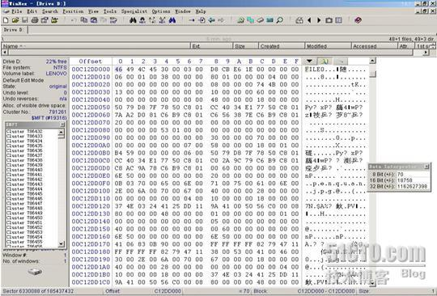
Attribute Type: $DATA
Starting VCN
Last VCN
偏移0x16.17为0表示该文件已经被删除了
Notes:
开始VCN为0,最后VCN为5,共6簇(06H)，分配大小0x6000字节=48扇区，故1簇为8扇区

Slide 101
关键是要分析80H属性，即数据属性，在该属性所有的描述中，对恢复数据最有用的信息有两个，一个是偏移00C12DD160H开始的8个字节的属性是该文件的实际大小506E，单位是字节。还有一个地方是偏移00C12DD170H开始的数据运行位置描述，这里为十六进制数41H 06H 83H 0BH 90H 00H。其中41H定义了其后面有1个字节表示该文件的数据运行所占的簇的个数，4个字节表示该数据运行的起始逻辑簇号，这里定义了其运行占用了06个簇，其起始逻辑簇号为900B83H。知道了起始簇号和数据运行的真实大小，甚至知道运行所占的簇的个数，要恢复文件数据就很容易了。
在WinHex中选择“位置”|“转换到扇区”命令，打开对话框，在“簇”文本框中输入9440131（900B83H转换后的十进制数），然后单击确定，即可找到数据的起始位置，其中FFH DBH是.jpg照片的文件头标志。在找到的数据起始位置右击，选择“选块开始”命令。
继续在WinHex中选择“位置”|“转换偏移量”命令，打开“转到偏移量”对话框输入20590（506EH转换成十进制数） .单击确定后会跳到文件的结尾位置，单击右键选择“选块结尾”命令

