Slide 1
Computer Forensics
网络取证概述

Slide 2
Network Protocols: Layering
网络的复杂性导致分层架构.
  TCP/IP stack has four levels.
  OSI has seven.

Slide 3
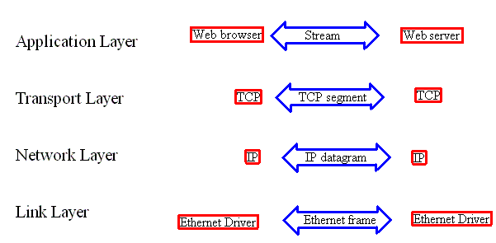
Network Protocols: Layering
Notes:
物理层：Physical layer 数据链路层：Data link layer，数据帧zhen 网络层：Network layer IP数据报 传输层：Transport layer TCP段 会话层：Session layer 表示层：Presentation layer 应用层：Application layer

Slide 4

Network Protocols: Layering
Each layer adds a header.
  Application
  TCP
  IP
  Link

Slide 5
Repetition:
捕获网络上的数据
Develop a threat model before deploying Network Security Monitoring
  Internal / External Attacker
  Wireless / Wired / …
Develop Monitoring zoning
  Demilitarized zone
  Wireless zone
  Intranet zones
Notes:
repetition [,repi'tiʃәn]复制品, 副本 Demilitarized zone 非军事区

Slide 6
Repetition:
Capturing Data on a Network
Wired monitoring
  Hubs
  Switched Port Analyzer(SPAN) ports
  Taps (Test Access Port)
  Inline devices
Notes:
Switched Port Analyzer(SPAN) ports 镜像端口; Test Access Port (TAP)测试访问端口

Slide 7
Repetition:
Capturing Data on a Network
Hubs
  Broadcasts incoming data on all interfaces.
  Be careful about NIC capacity (10/100/1000 Mb/sec)
  Be careful about hub quality
Are inexpensive, but can introduce collisions on the links where the hub sits.
Notes:
Network Interface Cards (NIC).Hub集线器工作于物理层，信号放大/广播.手机使用Wi-Fi上网，数据包很容易被截获，使用免费Wi-Fi是危险的。

Slide 8
Repetition:
Capturing Data on a Network
Switched Port Analyzer (SPAN)
  A.k.a. Port mirroring, Port monitoring.
  SPAN port located on enterprise class switches.
  Copy traffic between certain ports to SPAN port.
  Configurable
Easy access to traffic.
Can make mistakes with configuration.
Under heavy load, SPAN port might not get all traffic.
SPAN only allows monitoring of a single switch.
Notes:
A.k.a. Also known as 。SPAN端口镜像 Switch 工作于数据链路层，保存端口-mac地址表，根据mac地址转发。路由器根据IP地址转发，局域网内通过mac地址寻址。

Slide 9
Repetition:
Capturing Data on a Network
Test Access Port (TAP)
  Networking device specifically designed for monitoring applications.
  Typically four ports:
    Router
    Firewall
    Monitor traffic on remaining ports.
      One port sees incoming, the other outgoing traffic.
Moderately high costs.
Notes:
moderately 适当地, 适度地。Tap的概念类似于“三通”的意思，即原来的流量正常通行，同时分一股出来供监测设备分析使用。 其实这只是最简单的Tap的概念，目前的技术发展已经产生出很多种的Tap：有可以把多条链路汇聚起来的Tap、有把一条链路流量分成几份的regeneration Tap、有bypass Tap、有matrix Tap switch等等，已经不能再用“三通”这个词去简单概括了。 从功能来讲，Tap的出现是整个监控/监测领域的巨大革命，它从根本上改变了监测分析系统的接入方式，使得整个监测系统有了完整灵活的解决方案。

Slide 10
Repetition:
Capturing Data on a Network
Specialized inline devices:
  Server or hardware device
    Filtering bridges
      Server with OpenBSD and two NICs

Slide 11
Link Layer
Network Interface Cards (NIC)
  Unique Medium Access Control (MAC) number
Format 48b written as twelve hex bytes.
  First 6 identify vendor.
  Last 6 serial number.
NICs either select based on MAC address or are in promiscuous mode (capture every packet).

Slide 12
Link Layer
地址解析协议 （ARP）
将 IP 地址解析为 MAC 地址
RFC 826

Slide 13
ARP数据包格式
目的端 MAC 地址
源 M A C 地址
0 8 0 6
硬件类型
协议类型
硬件地址长度
协议地址长度
A R P 包类型
发送端 M
A
C 地址
发送端 I P 地址
目的端 M A
C 地址
目的端 I P 地址
6
6
2
2
2
1
1
2
6
4
6
4
<------以太网首部-------->
<------28字节ARP请求/应答-------->

Slide 14
Link Layer:
ARP Resolution Protocol
假设 IP 地址为 10.10.10.100 且 MAC 为 00：01：02：03：04：05 的节点 A 想要与 IP 地址 10.10.10.101 通信。
发出广播谁有请求：
00:01:02:03:04:05;ff：ff：ff：ff：ff：ff;ARP 42 谁有 10.10.10.101
链路上的所有设备捕获数据包并将其传递到 IP 层。
10.10.10.101 是唯一回答：
a0：a0：a0：a0：a0：a0;00:01:02:03:04:05;ARP 64;ARP 回复 10.10.10.101 是 A0：A0：A0：A0：A0：A0
A 将值缓存在其 arp 缓存中。

Slide 15
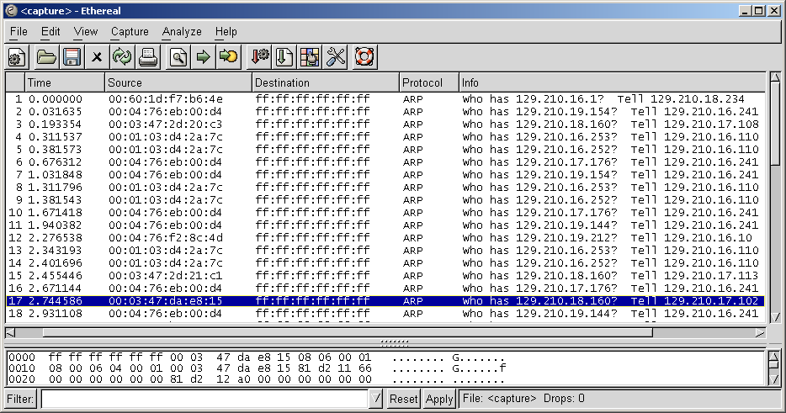
Link Layer:
ARP Resolution Protocol
ARP requests:

Slide 16
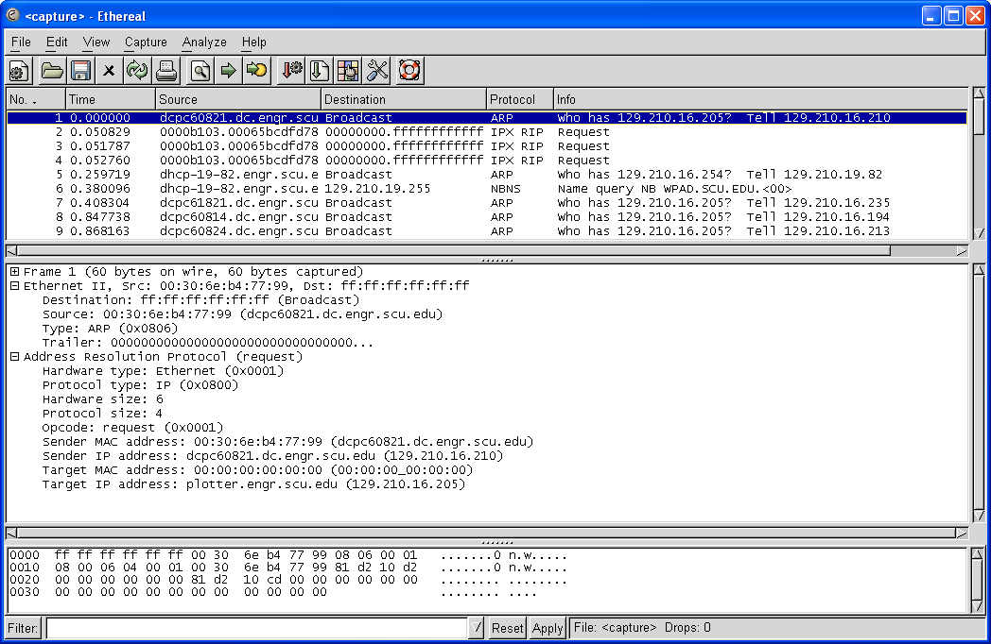
Link Layer:
ARP Resolution Protocol

Slide 17
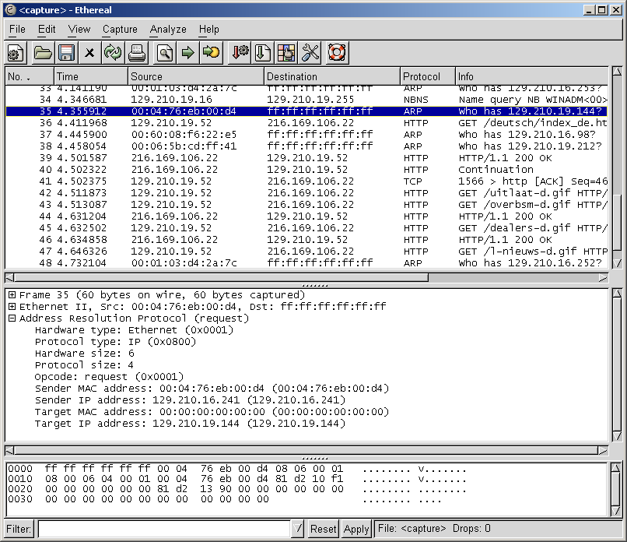
Link Layer Forensics
Network monitoring tools such as Argus or Ethereal log MAC addresses.
Notes:
记录物理地址

Slide 18
Link Layer Forensics
例：
网络流量峰值来自具有特定 IP 地址的计算机。
然而, Argus日志显示流量来自具有不同 MAC 的计算机，然后来自分配了该 IP 的计算机。（欺骗）
最后，入侵响应会找到装有该 MAC 的计算机，这是一台已被入侵并用于拒绝服务攻击的 Linux 笔记本电脑。
Notes:
ARP欺骗.虚假的IP地址。Spike 尖峰信号; 一个遭侵害的Linux笔记本（MAC1）假冒一个IP发起DoS攻击，IP对应的MAC地址（发起攻击的MAC1）不是事先绑定的MAC2

Slide 19
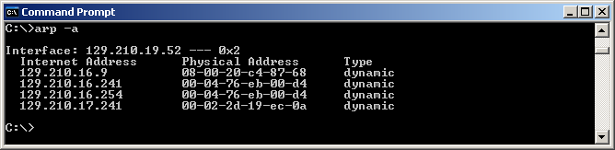
Link Layer Forensics
ARP cache can be viewed on Windows NT/2000/XP with arp –a command.

Slide 20
Link Layer Evidence
Sniffers in promiscuous mode.
Intruders also use sniffers.
  Typically monitor traffic to / from compromised system.
  Sometimes they monitor themselves coming back to look at the sniffer logs.
Intruders sometimes encrypt their traffic.
  But the sniffers still see the packets, they just cannot read them.
Installing sniffers can violate the wire-tapping and other laws and is resource-intensive.
  FreeBSD / OpenBSD seem to be the best platforms.

Slide 21
Link Layer Evidence
Sniffer location:
  On compromised machine.
    Evidence not trustworthy.
  Nearby host.
  Switched Port Analyzer (SPAN)
    Copies network traffic from one switch port to another
    Only copy valid ethernet packets.
    Do not duplicate all error information.
    Copying process has lower priority and some packets might not be mirrored.
    Misses out on traffic on the local link.

Slide 22
Link Layer Evidence
Sniffer configuration
  Can capture entire frames.
  Or only first part.
    Tcpdump default setting.

Slide 23
Link Layer Evidence
Some organizations log ARP information.
Routers keep ARP tables.
  show ip arp
All hosts keep ARP tables.
DHCP often assigns addresses only to computers with known MAC.
Notes:
DHCP（Dynamic Host Configuration Protocol，动态主机配置协议）是一个局域网的网络协议，使用UDP协议工作， 主要有两个用途：给内部网络或网络服务供应商自动分配IP地址，给用户或者内部网络管理员作为对所有计算机作中央管理的手段

Slide 24
Link Layer Evidence
一名员工收到来自雇主网络上的主机的骚扰电子邮件，IP 地址为 192.168.1.65。
DHCP 服务器数据库显示此 IP 已分配给 MAC 地址为 00：00：48：5c：3a：6c 的计算机。
此 MAC 属于网络打印机。
路由器的ARP表显示IP地址为192.168.1.65。由具有 MAC 00：30：65：4b：2a：5c 的计算机使用。（IP 欺骗）
虽然这个MAC不在组织的名单上，但网络上只有几台苹果电脑，罪魁祸首很快就找到了。
Notes:
culprit 犯人, 罪犯.打印机192.168.1.65-- 00:00:48:5c:3a:6c，路由器ARP表192.168.1.65--00:30:65:4b:2a:5c，该MAC地址为攻击者，假冒了打印机的IP

Slide 25
Link Layer Evidence
Analyze and filter log files:
  Keyword searches
    E.g. for USER, PASS, login
    Nicknames, channel names
  Filters
  Reconstruction
    E.g. contents of web-mail inbox.

Slide 26
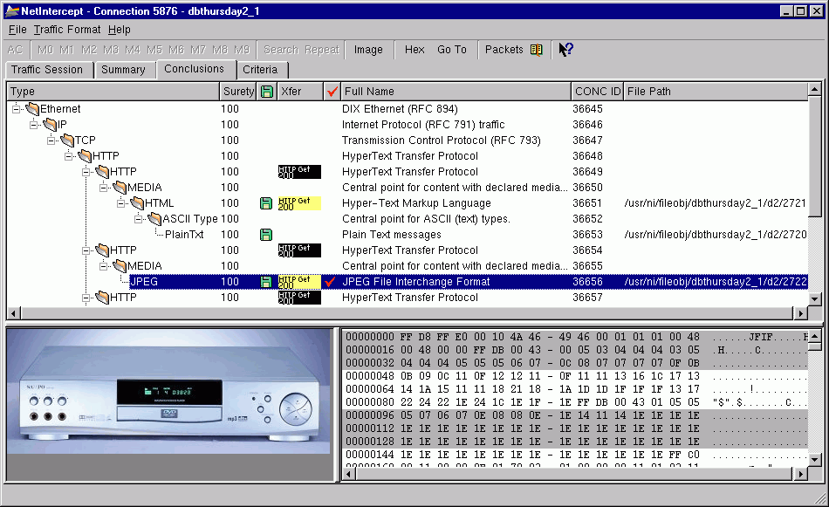
Link Layer
Evidence
NetIntercept Screenshot
An example for a Network Forensics / Network Intrusion Detection commercial tool that reveals link layer evidence

Slide 27
IP
使用源和目标的 IP 地址。
IP 数据报在跳之间移动。
“尽力而为”服务。
检测到并丢弃损坏的数据报。
Notes:
尽力服务

Slide 28
IP
IPv4 地址的长度为 32 位
IPv6 地址长度为 8*16 位.

Slide 29
IPv4
0 4 8 16 19 31
版本号
报头长
服务类型
分组总长度
Version
IHL
ServiceType
Total Length
(4bit)
(4bit)
(8bit)
(16bit)
标识
标志
片偏移
Identification
Flags
Fragment Offset
(16bit)
(3bit)
(13bit)
20 bytes
生存时间
传输层协议
头部校验和
Time to Live
Protocol
Header Checksum
(8bit)
(8bit)
(16bit)
源
IP
地址
Source Address(32bit)
宿
IP
地址
Destination Address(32bit)
可选项
填充域
Option
padding
有效负载
Payload（0或多个字节）

Slide 30
IP: ICMP
Internet Control Message Protocol
Created to deal with non-transient problems. For example
  Fragmentation is necessary, but the No Frag flag is set.
  UPD datagram sent to a non-listening port.
  Ping.
    Used to detect network connectivity before it became too useful for attack reconnaissance.
Does not use ports.
Allows broadcasting.
More on ICMP later
Notes:
检测错误，与IP层同级，为主机-路由器、主机-主机之间提供简单的错误报告方式

Slide 31
ICMP报文
封装
ICMP header ICMP data
IP header I P data
ICMP报文的一般格式
0 8 16 31
类型
代码
检验和
Type
Code
Checksum
(8bit)
(8bit)
(16bit)
不同类型和代码有不同的内容Data
差错信息
出错IP数据报的头+64个字节数据
Data

Slide 32
Transport Layer: TCP and UDP
Transmission Control Protocol (TCP)
  Reliable
  Connection-Oriented.
  Slow
User Datagram Protocol (UDP)
  Unreliable
  Connectionless.
  Fast.

Slide 33
TCP
仅支持单播。
全双工连接。
消息编号，以防止消息丢失。
Notes:
Unicasting单播 duplex [计] 双工的

Slide 34
TCP头部
源端口
Source Port
宿端口
Destination Port
(16bit)
(16bit)
序列号
Sequence Number
(32bit)
确认号
Acknowledgment Number
(32bit)
Data
Reserved
U
A
P
R
S
F
窗口大小
Window
size
Offset
R
C
S
S
Y
I
(4bit)
(6bit)
G
K
H
T
N
N
(16bit)
校验和
Checksum
(16bit)
紧急指针
Urgent Pointer
(16bit)
选项
Options (0
或多个
32
bit
字
)
数据
Data (
可选
)
Notes:
PSH：推标志

Slide 35
TCP:
Three Way Handshake
Initiator to responder: Syn_{s}
Responder to initator: Ack_{s}, Syn_{t}
Initiator to responder: Ack_{t}
Sets up two connections with initial message numbers s and t.

Slide 36
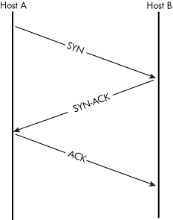
TCP:
Three Way Handshake

Slide 37
TCP:
Terminating Connections
Graceful shutdown
  Party 1 to Party 2: Fin
  Party 2 to Party 1: Ack
  Party 2 to Party 1: Fin
  Party 1 to Party 2: Ack
Abrupt shutdown
  Party 1 to Party 2: Res

Slide 38
TCP
Exchanging Data
Each packet has a sequence number.
  (One for each direction.)
Initial sequence numbers are created during initial three way handshake.
  NMap uses the creation of these sequence numbers to determine the OS.
  OS are now much better with truly random sequence numbers.

Slide 39
TCP
Exchanging Data
Party that receives packet sends an acknowledgement.
Acknowledgement consists in
  Ack flag.
  Sequence number of the next package to be expected.
  (TCPDump shows number of bytes acknowledged).

Slide 40
TCP
Exchanging Data
If a package is lost, then the ack sequence number will not change:
  “Duplicate acknowledgement”
Depending on settings, sender will resend, after at most three stationary ack numbers.
Also, senders resend after timeout.

Slide 41
TCP flags
Part of TCP header
  F : FIN - Finish; end of session
  S : SYN - Synchronize; indicates request to start session
  R : RST - Reset; drop a connection
  P : PUSH - Push; packet is sent immediately
  A : ACK - Acknowledgement
  U : URG - Urgent
  E : ECE - Explicit Congestion Notification Echo
  W : CWR - Congestion Window Reduced

Slide 42
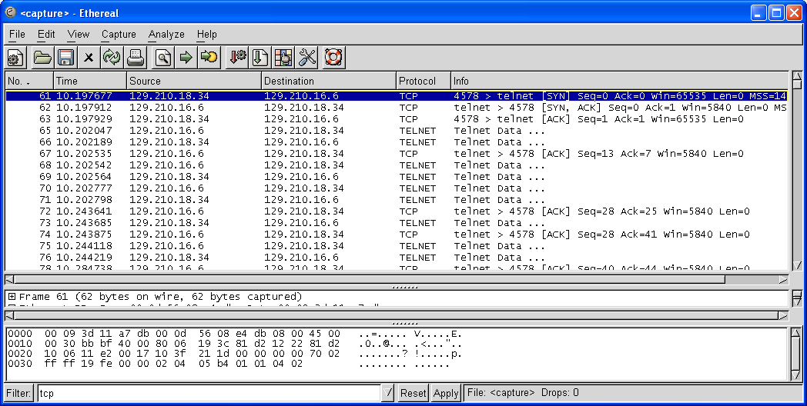
TCP Example with Ethereal

Slide 43
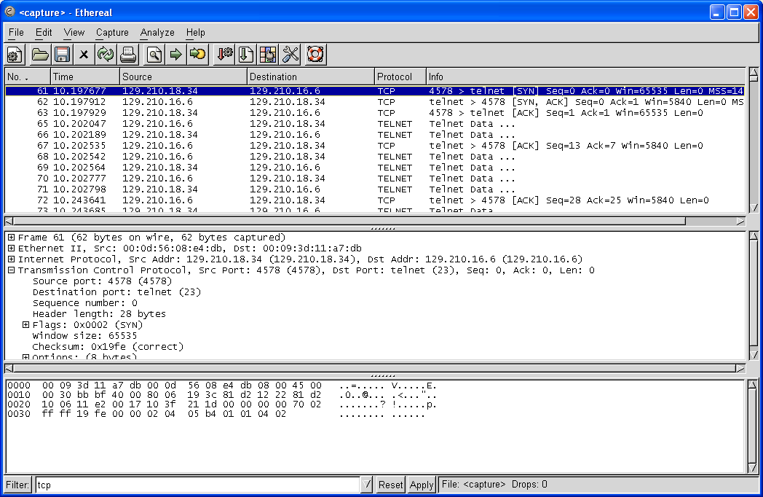
TCP Example with Ethereal
First Syn message
This is the Syn packet with sequence number 10 3f 21 1d and ack number 00 00 00 00
Notes:
序列号前为源端口11e2h=4096+256+14*16+2=4578,目的端口0017h=23。确认号为期望收到的下一个TCP段序列号

Slide 44
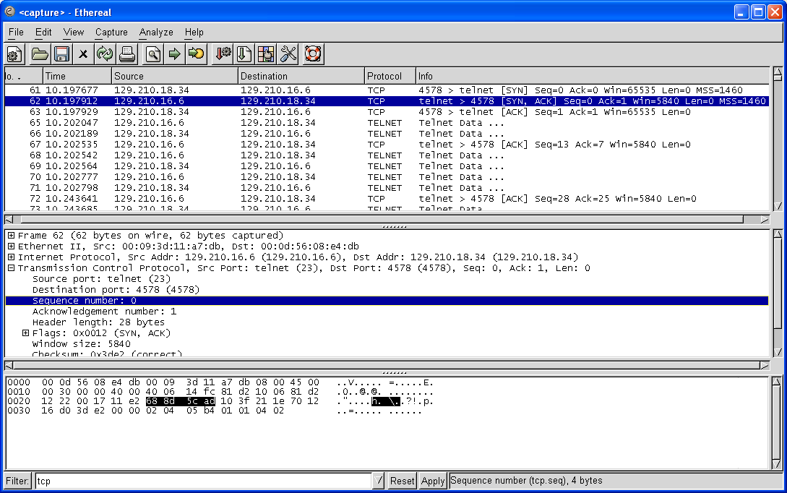
TCP Example with Ethereal
This is the Syn-ack packet with sequence number 68 8d 5c ad and ack number 10 3f 21 1e
Notes:
序列号前为源端口17h=23 目的端口11e2h=4096+256+14*16+2=4578

Slide 45
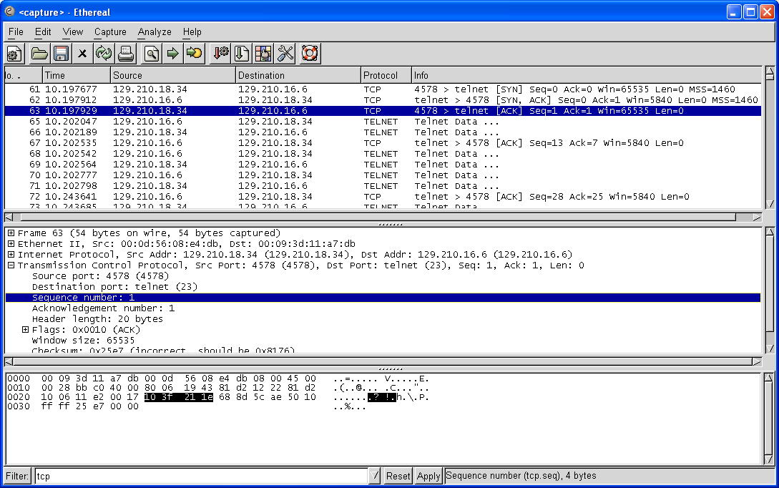
TCP Example with Ethereal
Syn number 10 3f 21 1e
Ack number 68 8d 5c ae

Slide 46
UDP
“发送并祈祷”
无连接。
没有像 TCP 这样的特殊标头。
IP 报头中的协议字段0x11
IP 标头中的另一个字段包含特定于 UDP 的标头信息

Slide 47
UDP头部
16bit
16bit
UDP源端口
UDP宿端口
UDP长度
UDP校验和
最小值为8
全“0”：不选；
全“1”：校验和为0。

Slide 48
ICMP
像TCP这样的协议可以自己发送错误消息。
Host uses ICMP for
  Simple replies and requests
  Inform other hosts of some kind of error condition.
    E.g.: To throttle delivery rate, receiving host can use the ICMP source quench message.
    E.g.: Router can send “admin prohibited” ICMP message.
UDP 等无状态协议需要另一种机制来发送错误消息.
Notes:
ICMP数据包是封装在IP数据包中的传送的，ICMP是在网络层。

Slide 49

ICMP
ICMP 没有端口号。
没有确认，没有消息传递保证
允许广播
包的第一个字节是类型
包的第二个字节是代码

Slide 50
ICMP
Attackers can use ICMP for scanning:
  映射网络。
  检测目标的可用性。
  通过主机的响应方式检测操作系统。

Slide 51
ICMP
Tireless Mapper
  Sends ICMP echo requests messages to all possible IP addresses
  Many IDS might not capture this scan if the number of packages per hour is small.
Therefore: Firewalls should filter incoming ping requests.
Notes:
Tireless孜孜不倦的。穷举

Slide 52
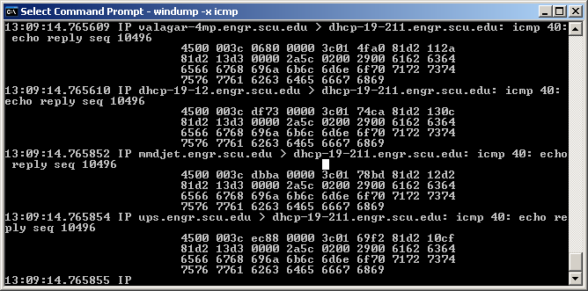
ICMP
Efficient Mapper
Use the ICMP echo request with a broadcast address.
Ping 129.210.19.255
Notes:
广播

Slide 53
ICMP
Clever Mapper
Use a different ICMP message such as ICMP address mask.
Determines the class of the network

Slide 54
Malicious ICMP: Smurf Attack
Smurf attack on victim 129.219.19.198
步骤 1：发送ICMP 回显请求到广播地址， 使用欺骗 IP 129.219.19.198
第 2 步：路由器允许 ICMP 回显请求广播地址
第 3 步：所有实时主机都使用 ICMP 回显回复到源 IP 为 129.219.19.198 的真机
Notes:
攻击者假冒受害者129.219.19.198发送广播包，攻击129.219.19.198

Slide 55
Malicious ICMP: Smurf Attack
ICMP Smurf Attack
  拒绝服务攻击。
  攻击者的努力<<受害者的努力。
  使用来自网络的 ICMP 回复作为放大器。
  如果受害者的连接速度较慢，则效果很好。

Slide 56
TCP/IP Related Evidence
Sniffer Logs
计算机入侵留下了一个名为路由器的程序。对二进制代码的调查显示，它是一个葡萄牙语嗅探器，将数据存储在给定文件中。
嗅探器文件包含从巴西登录到未经身份验证的帐户的日志条目以及进一步的活动。
Notes:
分析遗留的痕迹

Slide 57
TCP/IP Related Evidence
Authentication, Server Logs
莫里·特拉维斯案：
在圣路易斯的一系列凶杀案中，一名记者收到了一封信，上面写着另一名受害者的位置。
联邦调查局确定这张地图来自 Expedia.com。
Web服务器日志显示，在发送信件时，只有一个IP地址请求了该特定地图。
Notes:
Reporter记者。Server Logs记录IP地址，IP地址是认证过的地址，与电话号码绑定

Slide 58
TCP/IP Related Evidence
IP 地址属于 ISP。
ISP日志显示，该IP地址已注册给Maury Travis。连接中的电话号码也属于Maury Travis 。
对Maury Travis家的搜查发现了一个酷刑室和莫里折磨和杀害受害者的录像带。
Maury Travis在拘留期间自杀身亡。 受害者总数不详。
Notes:
torture chamber刑讯室torture拷问 custody监管

Slide 59
TCP/IP Related Evidence
Internet dial-up logs are created by RADIUS and TACACS authentication servers.
These servers are also used for VPN concentrators.
Kerberos logs authentication requests.
…

Slide 60
TCP/IP Related Evidence
Application Logs
  When someone defaces web servers, they usually view them shortly before and after defacement.
  The web logs might contain evidence of someone checking for vulnerabilities before defacement.
    With the IP address that they used.

Slide 61
TCP/IP Related Evidence
Application Logs
  Mail servers log details of message.
    Example: An email spoofer makes a typo.
      Logs contains entries with backspaces, …
  OS log connections.
  Network devices log.

