Slide 1


MYB(Manage Your Budget)

Slide 2
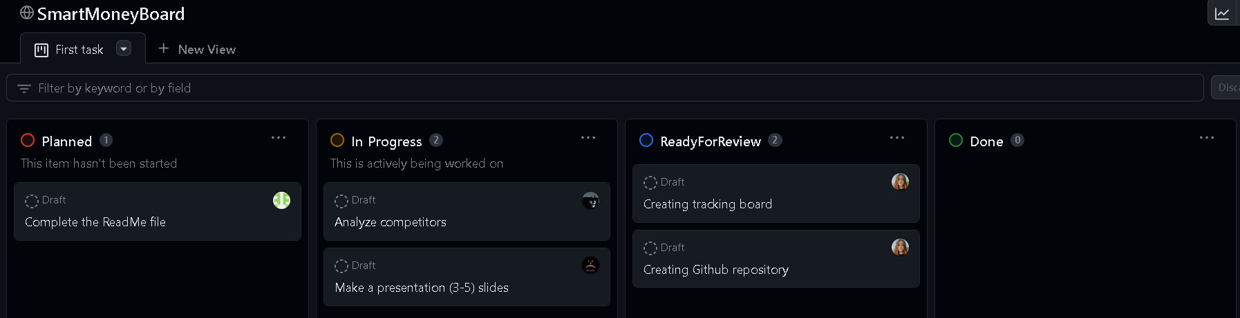
We have created a kanban board on GitHub

Slide 3

Theme of project
We decided to make an application that will help people to manage their budget

Slide 4
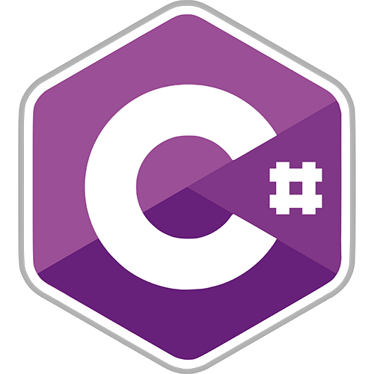

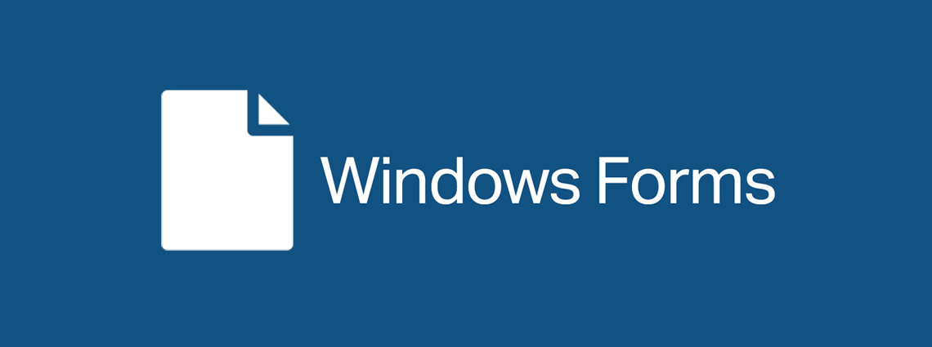

Technology stack

Slide 5

Our goal
Problems that we are solving
Requirements
Budgeting and Expense Tracking
Financial Awareness
Categorizing your expenses
Bill Reminders
Expense Analysis
Friendly-user interface
Data confidence
No ads(yet)
Free
Our goal is to create an application with zero-based budgeting strategy that everyone can use

Slide 6



Our competitors

Slide 7
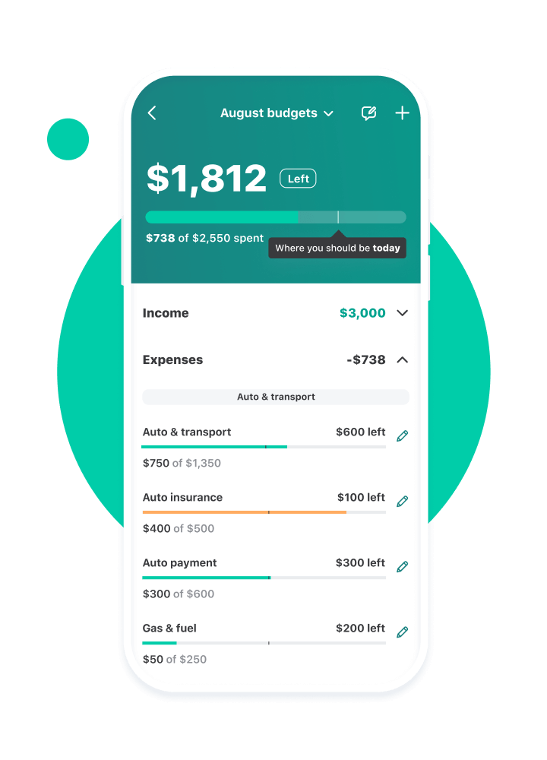
Mint
Pros:
Free
Able to link your cards
Categorizing transactions
Various reports
Cons:
A lot of ads
Interface is confusing
Hard for unexperienced users
Can't delete default categories
Notification are strange
Auto-categorizing transactions

Slide 8
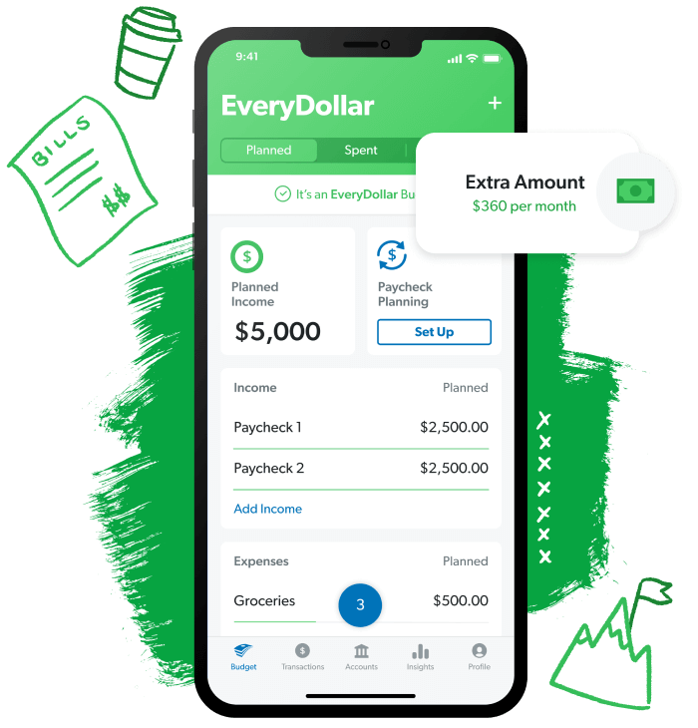
EveryDollar
Pros:
Free
Simple to use
Various reports
Have guides
Cons:
Subscription for additional features quite expensive
Interface is confusing
Data can't be exported
Doesn't check overspending or underspending

Slide 9
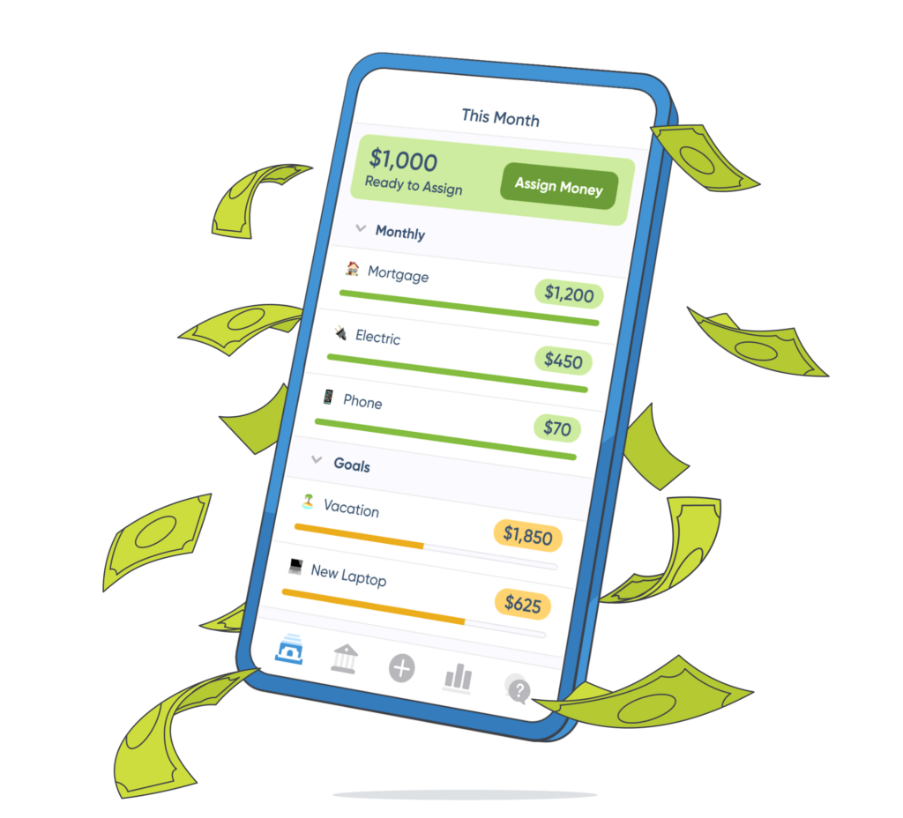
YNAB
Pros:
Beautiful interface
Easy to use
Notification are fantastic
Holds you accountable for overspending
Reports, that can be exported in Excel file
Linking your cards
Cons:
Only paid subscription
Hard for unexperienced users
Export only all transaction

Slide 10


