Slide 1
Synthesis — Architecture Recommendation
Portfolio keystone — c1v self-application

Slide 2
Recommendation
c1v is an AI-native PRD + system-design tool. The synthesizer recommends a Vercel-deployed Next.js front-end orchestrated by LangGraph, using Anthropic Claude Sonnet 4.5 as the spec-generation LLM and pgvector (Supabase Postgres) for retrieval. This pairing was selected from the M4 Pareto frontier (AV.01 dominates AV.02..AV.05 across cost/latency/availability) because it satisfies the 3-second p95 user-facing budget (interface_specs chain AUTHORING_SPEC_EMIT sums 2600 ms) while keeping the 100% citation-floor (NFR.01) achievable through grounded-retrieval gating. The recommendation carries 14 high-RPN residual risks from M8.b that ride alongside the architecture; each is mapped to a landed control surfaced via M5 form_function_map.

Slide 3
Decisions (winning alternatives)
ID | Question | Winner
D-01
D-02
D-03
D-04

Slide 4
Pareto Frontier
ID | Architecture | Cost | Latency p95 | Availability
★ AV.01 | Claude Sonnet 4.5 + pgvector + LangGraph + Vercel | 320 USD/month at 100 DAU | 2600 ms p95 end-to-end | 99.9 % uptime
AV.02 | GPT-4 Turbo + Pinecone + LangChain Chains + Cloud Run | 378 USD/month at 100 DAU | 2810 ms p95 end-to-end | 99.9 % uptime
AV.03 | OpenRouter federated + Weaviate self-hosted + Custom orch + Fly.io | 240 USD/month at 100 DAU | 3100 ms p95 end-to-end | 99.5 % uptime

Slide 5
Top-Level Risks
ID | Description | Severity / RPN
F01 |  | high
F02 |  | medium
F03 |  | medium
F04 |  | medium

Slide 6
Tail Latency — chain AUTHORING_SPEC_EMIT

Slide 7
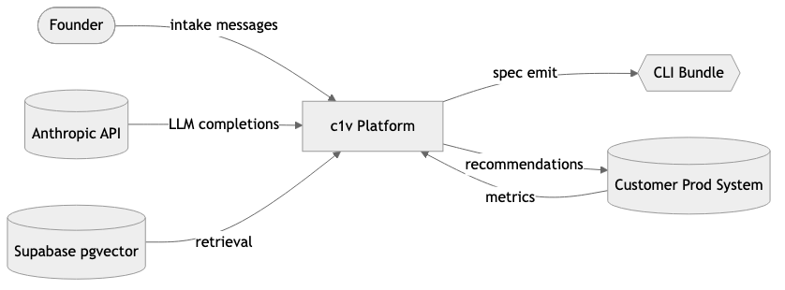
Context Diagram

Slide 8
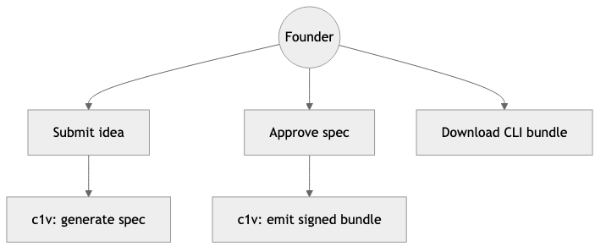
Use Cases

Slide 9
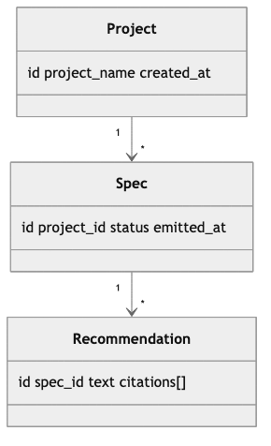
Class Model

Slide 10
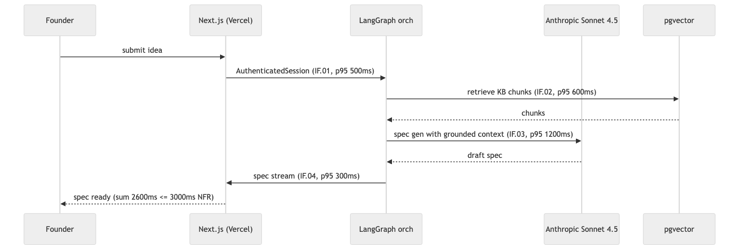
Sequence — Authoring Spec Emit

Slide 11
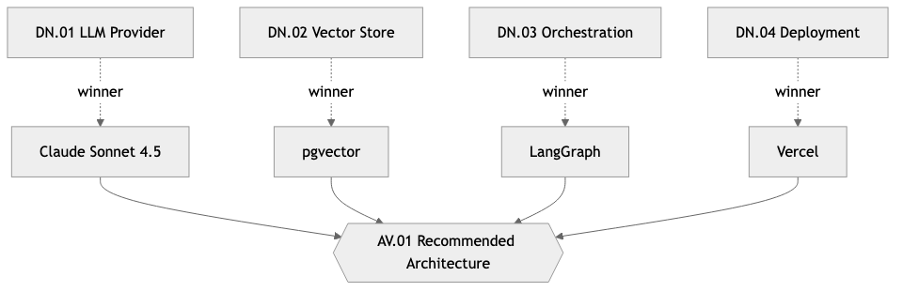
Decision Network — Winners

Slide 12
Residual Risk Flags (RPN ≥ 100, n=13)
Failure Mode | Description | RPN
FM.01 |  | 8
FM.02 |  | 4
FM.04 |  | 8
FM.05 |  | 9
FM.06 |  | 6
FM.07 |  | 6
FM.09 |  | 4
FM.11 |  | 6
FM.12 |  | 4
FM.13 |  | 6
FM.14 |  | 6
FM.15 |  | 9
FM.16 |  | 6

Slide 13
House of Quality — Summary
PCs: 6
ECs: 18
Matrix nonzero: 27 / 108
Sparsity: 75%

Slide 14
Next Steps
# | Action | Owner
 | Wire telemetry probe stack to capture per-IF p95 latencies in production for prior-refresh.
 | Promote 4 mitigation controls (FR.02, FR.07, FR.10, IF.04 stream) into the test plan.
 | Backfill kb_chunk_ids[] with real pgvector UUIDs once corpus is ingested at full scale.
 | Re-run synthesis quarterly; recompute inputs_hash to detect drift in upstream artifacts.

