Slide 1
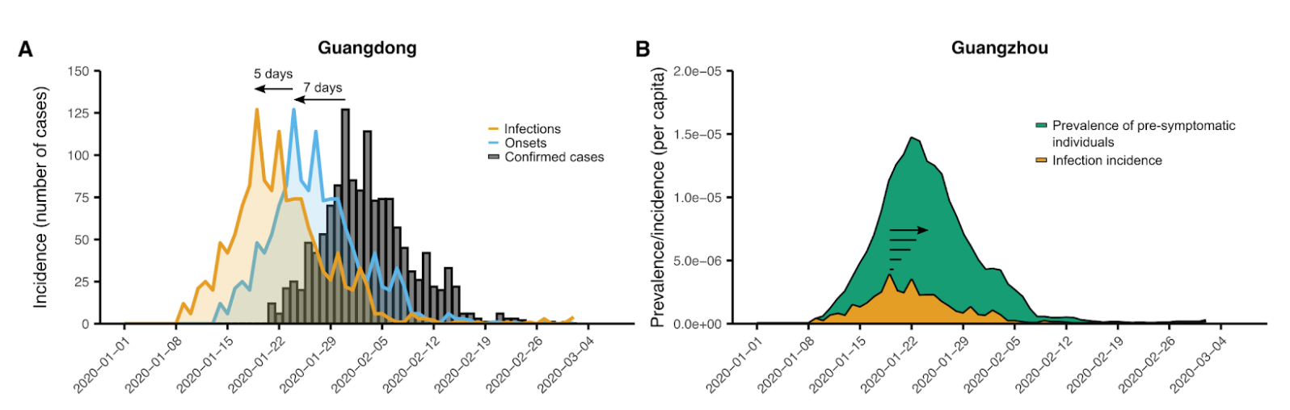
Summary of Changes - Methods
Updated the method to estimate prevalence in China
key idea: define a prevalence indicator (linearly proportional to actual prevalence by the same factor across China)
Start with: daily confirmed cases (per province),
Shifting in time (infection to symptom onset, onset to confirmation)
Adjusting for ratio in ascertainment
Account for duration of pre-symptomatic infection
Attribute to cities

Slide 2
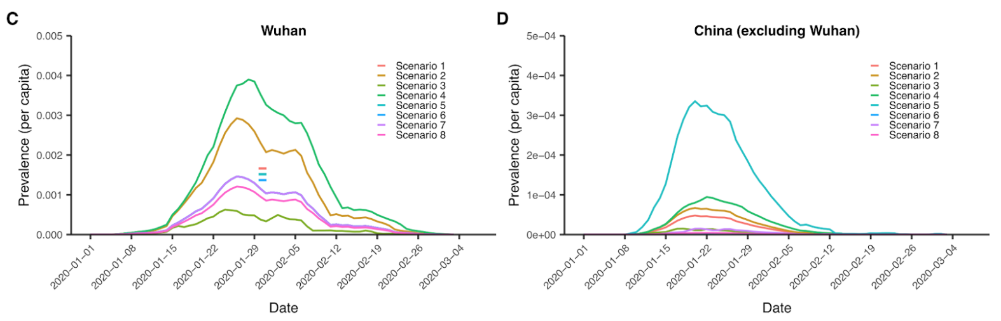
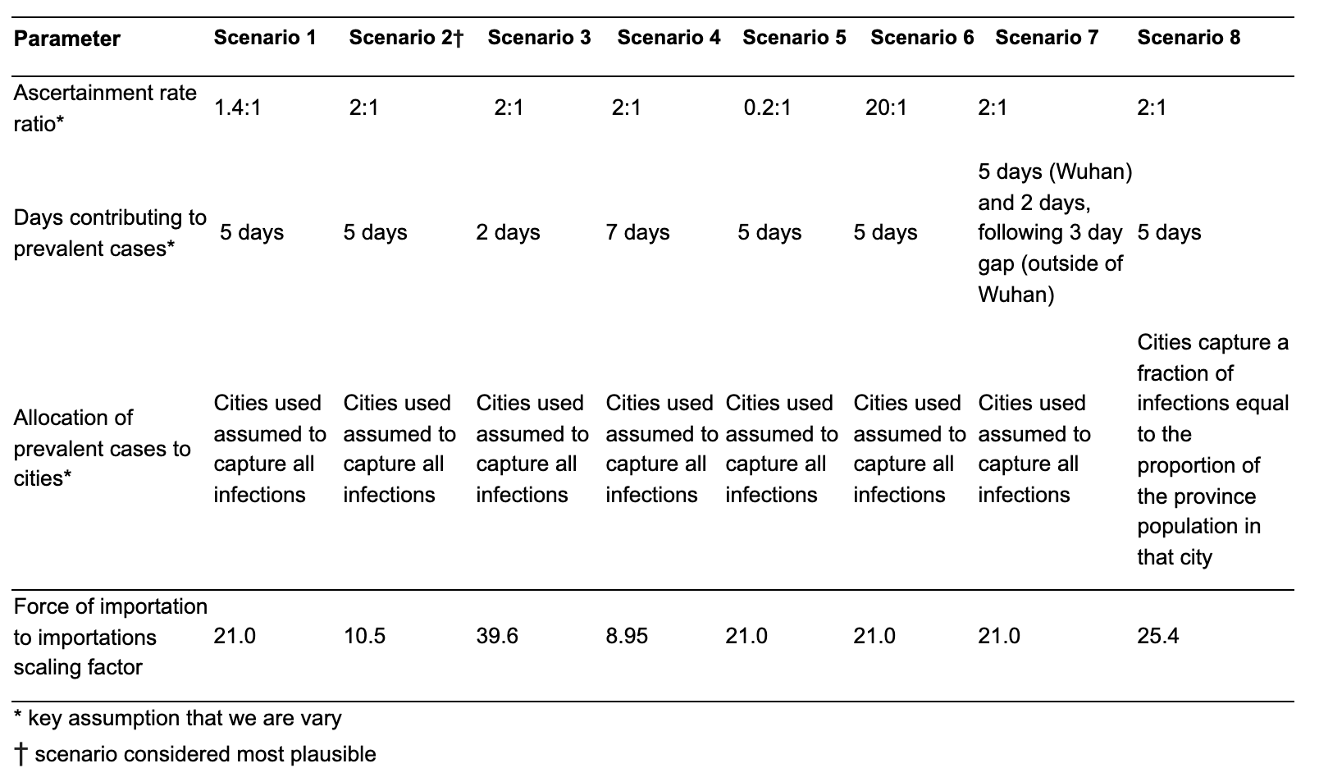
Summary of Changes - Methods
We include 8 scenarios to represent uncertainty in key assumptions:
Ascertainment rate ratio
Duration of being presymptomatic
How this duratoinmay be different for within China travellers
Attribution to cities
Uncertainty from different scenarios prevails over uncertainty from model fit. We report ranges from scenario means plus selected best-estimate scenario 2

Slide 3
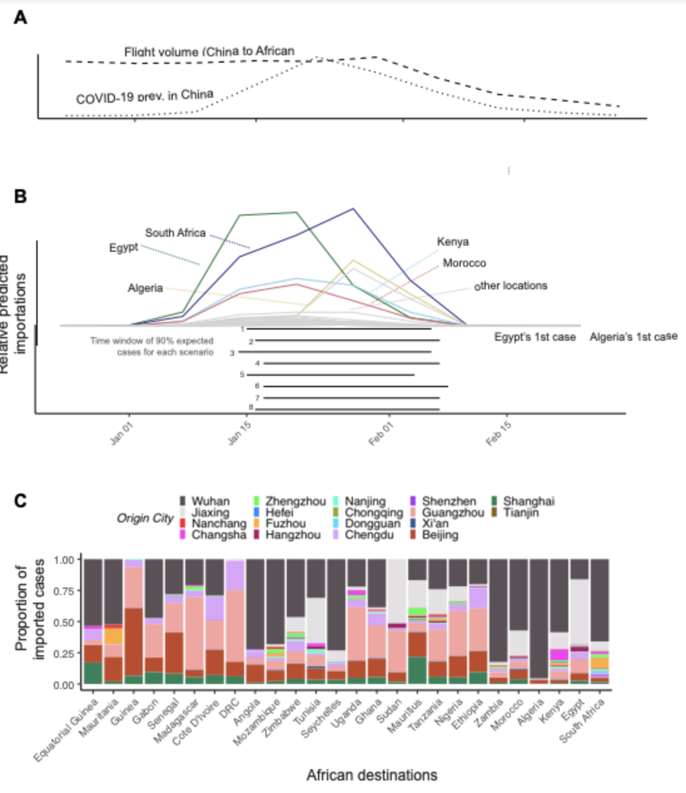
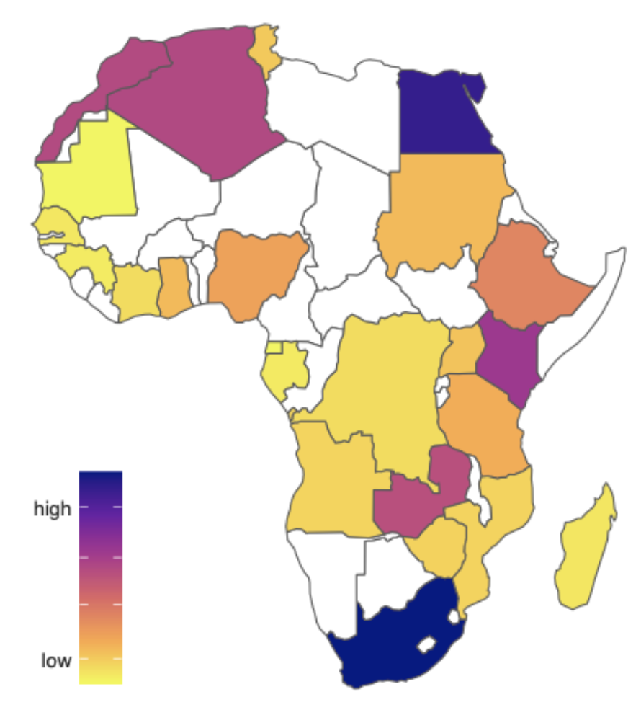
Summary of Changes - Results
Range of predicted imports is wider
Still heterogeneity between different locations (which we now link to epidemic sizes 1 month after)
Time range for expected imports is narrower, with same center
Still drastic change in contribution to imports: first Wuhan and later other cities

