Slide 1



Statistical learning VS Machine learning ?
GEFFLOT – BENKIRAN – PENICHON

Slide 2
01
02
Introduction
Methods and results
03
Real-life application: diabetes database
04
Discussion

Slide 3

01
Introduction

Slide 4


Statistical Learning
Machine Learning
refers to a set of tools for modeling and understanding complex datasets.
is defined as ”the study of computer algorithms that allow computer
programs to automatically improve through experience”.
Machine Learning is becoming a huge economic concern for companies.

Slide 5

02
Methods and results

Slide 6
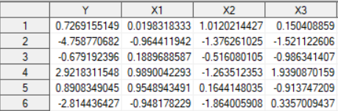
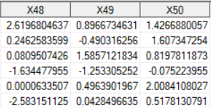
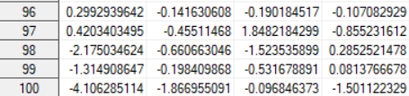
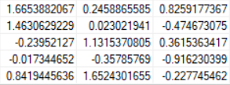
How did we test the performance ?
Exemple of 1 dataset’s structure:

Slide 7
Data Generating Processes (DGP)
In each DGP, Y is based on the following equation :
Y = 1.5 · X1 + 0.9 · X2 + 1 · X3 + 0.1 · X4 − 0.5 · X5
and all datasets (which is the X matrix) of 50 variables using the multivariate normal distribution.
DGP1
DGP2
DGP3
DGP4
Perfect model
Only variables X1 to X5 are positively correlated with each other, whereas the variables X6 to X50 are not.
Variables X1 to X50 are positively correlated with each other.
Presence of extreme values.

Slide 8

Conclusion of results
Machine Learning > Statistical Learning in DGP1, DGP2, and DGP4.
Statistical Learning techniques find the variables of interest more easily than Machine Learning methods only in the scenario of DGP3, but Statistical Learning is not necessarily better.

Slide 9
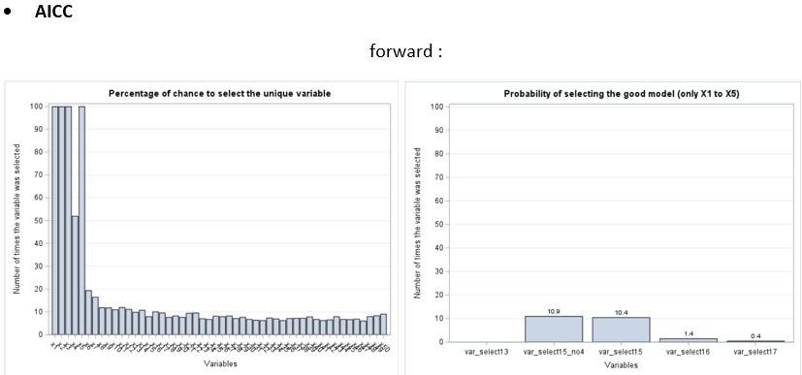
Nuance in the DGP3 scenario: Statistical Learning method (Forward with AICc) VS Machin learning method (ElasticNet with AICc)
Forward (AICc)

Slide 10
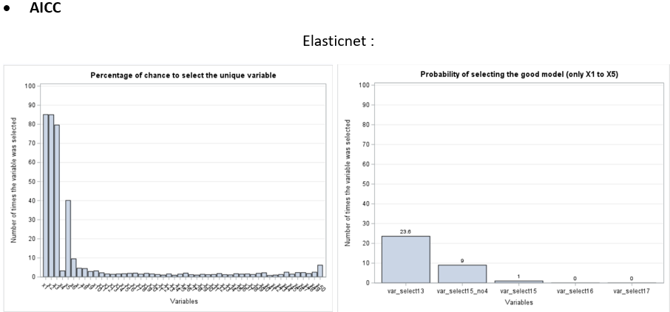
ElasticNet (AICc)

Slide 11

03
Real-life application: diabetes database

Slide 12

Diabetes database analysis
442
1
10
Observations
Explained variable
Explanatory variables
Analyse extreme values with the skewness coefficient.
Analyse the correlation between the variables with the correlation matrix.

Slide 13
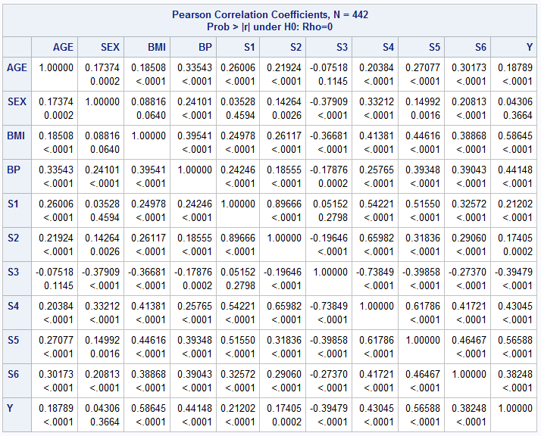
Correlation matrix

Slide 14

Assess the significance of the model’s explanatory variable.
With a 1% significance level, the variables that better explain Y are SEX, BMI, BP, and S5 (lamotrigine measure).

Slide 15
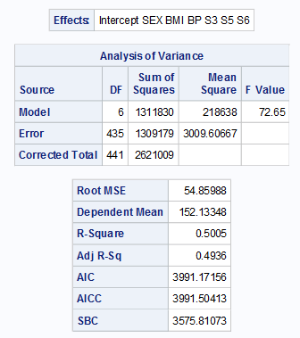
Selected model
ElasticNet algorithm with AICc criteria has chosen 6 variables

Slide 16

04
Discussion

Slide 17


The limitations of our paper
Other criteria and other options may have been used.
It would be more interesting to design a DGP6.
An improvement goal rather than a comparison goal might be more interesting

Slide 18
Thank you for your attention !
Do you have any question?

Slide 19

SAS

