Slide 1
Lab work: data basics
Calculate the Q score, GC content of fastq file (/2_disk/Bioinf2018/HomoTestRead.fq)
Quality score across all bases
Quality score distribution over all sequences
GC distribution over all sequences
Output
Mean/median of quality score across all bases (two arrays)
Distribution of quality score (average of all bases on each read) of all reads
generates a hash/dictionary; the score range be treated as keys (interval is 5, from 0 to 40)
Two columns: the first column is the key, second column is the value
GC distribution of over all reads (hash/dictionary)
generates a hash/dictionary; the GC content ranges be treated as keys (interval is 10%, from 0 to 100%)
Two columns: the first column is the key, second column is the value
You could leave after you complete the work.

Slide 2
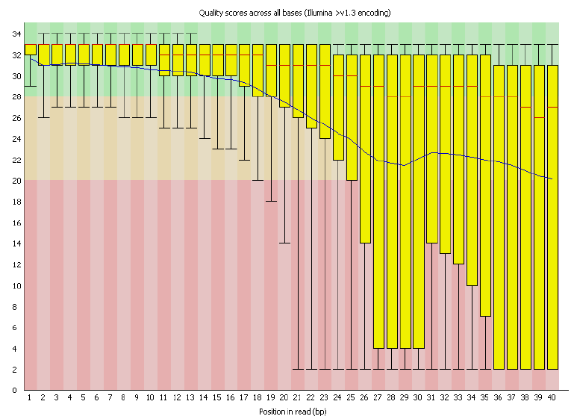
Quality score across all bases

Slide 3
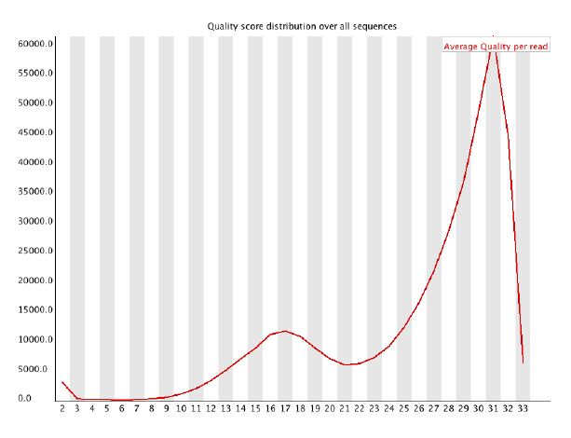
Quality score distribution over all sequences

Slide 4
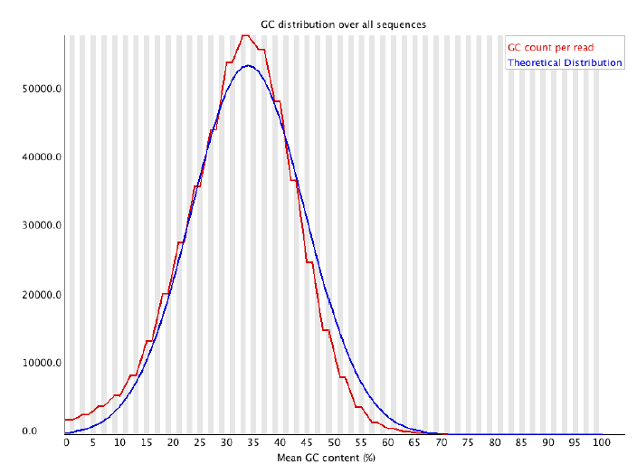
GC distribution over all sequences

