Slide 1
Short reads alignment
Jiankui He

Slide 2
Alignment of reads to a reference
Reference
..ACTGGGTCATCGTACGATCGATCGATCGATCGATCGGCTAGCTAGCTA..
Sample
..ACTGGGTCATCGTACGATCGATAGATCGATCGATCGCTAGCTAGCTA..

Slide 3
Short Read Applications
Goal: identify variations
Genotyping
RNA-seq, ChIP-seq, Methyl-seq
GGTATAC…
…CCATAG
TATGCGCCC
CGGAAATTT
CGGTATAC
…CCAT
CTATATGCG
TCGGAAATT
CGGTATAC
…CCAT
GGCTATATG
CTATCGGAAA
GCGGTATA
…CCA
AGGCTATAT
CCTATCGGA
TTGCGGTA
C…
…CCA
AGGCTATAT
GCCCTATCG
TTTGCGGT
C…
…CC
AGGCTATAT
GCCCTATCG
AAATTTGC
ATAC…
…CC
TAGGCTATA
GCGCCCTA
AAATTTGC
GTATAC…
…CCATAGGCTATATGCGCCCTATCGGCAATTTGCGGTATAC…
Goal: classify, measure significant peaks
GAAATTTGC
GGAAATTTG
CGGAAATTT
CGGAAATTT
TCGGAAATT
CTATCGGAAA
CCTATCGGA
TTTGCGGT
GCCCTATCG
AAATTTGC
…CC
GCCCTATCG
AAATTTGC
ATAC…
…CCATAGGCTATATGCGCCCTATCGGCAATTTGCGGTATAC…

Slide 4
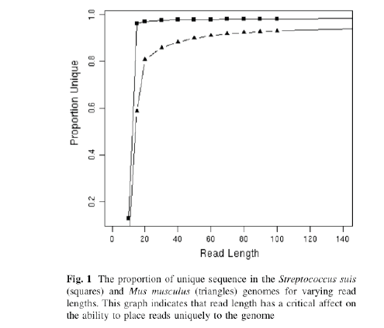
Why is short read alignment hard?
The shorter a read, the less likely it is to have a unique match to a reference sequence

Slide 5
Why do we generate short reads?
Sanger reads lengths ~ 800-2000bp
Generally we define short reads as anything below 200bp
Illumina (100bp – 250bp)
SoLID (75bp max)
Ion Torrent (200-300bp max – currently...)
Roche 454 – 400-800bp
Even with these platforms it is cheaper to produce short reads (e.g. 50bp) rather than 100 or 200bp reads
Diminishing returns:
For some applications 50bp is more than sufficient
Resequencing of smaller organisms
Bacterial de-novo assembly
ChIP-Seq
Digital Gene Expression profiling
Bacterial RNA-seq

Slide 6
Contents
Alignment algorithms for short-reads
Adapting hashed seed-extend algorithms to work with shorter reads
Indel detection
Suffix/Prefix Tries
Other alignment considerations
Typical alignment pipeline
Assembly algorithms for short reads
Effect of repeats
Overlap-Consensus
de Bruijn graphs
Assembly evaluation metrics
Typical assembly pipeline

Slide 7
Adapting hashed seed-extend algorithms to work with shorter reads
Improve seed matching sensitivity
Allow mismatches within seed
BLAST
Allow mismatches + Adopt spaced-seed approach
ELAND, SOAP, MAQ, RMAP, ZOOM
Allow mismatches + Spaced-seeds + Multi-seeds
SSAHA2, BLAT, ELAND2
Above and/or Improve speed of local alignment for seed extension
Single Instruction Multiple Data
Shrimp2, CLCBio
Reduce search space to region around seed

Slide 8
Hashed seed-extend algorithms
2 step process
Identify a match to the seed sequence in the reference
Extend match using sensitive (but slow) Smith-Waterman algorithm (dynamic programming)

Slide 9
Seed-extend algorithm
Reference sequence:
...ACTGGGTCATCGTACGATCGATCGATCGATCGATCGGCTAGCTAGCTA...
Short read:
GTCATCGTACGATCGATAGATCGATCGATCGGCTA
Note that the short read has 1 difference wrt to reference
Notes:
N.B This is only a toy example, the real BLAST selects kmers rather than breaking a read up like this

Slide 10
Seed-extend algorithm
Reference sequence:
...ACTGGGTCATCGTACGATCGATCGATCGATCGATCGGCTAGCTAGCTA...
Short read:
GTCATCGTACG ATCGATAGATCG ATCGATCGGCTA
11bp word
11bp word
11bp word
The algorithm will try to match each word to the reference. If there is a match at with any single word it will perform a local alignment to extend the match

Slide 11
Seed-extend algorithm
Reference sequence:
...ACTGGGTCATCGTACGATCGATCGATCGATCGATCGGCTAGCTAGCTA...
Seed
Extend with Smith Waterman
GTCATCGTACG
ATCGAACGATCGATCGATCGGCTA
Short read:
GTCATCGTACG ATCGATAGATCG ATCGATCGGCTA
Here the algorithm is able to match the short read with a word length of 11bp

Slide 12
Seed-extend algorithm
Reference sequence:
...ACTGGGTCATCGTACGATCGATCGATCGATCGATCGGCTAGCTAGCTA...
Short read:
GTCATCGTACGATCGATCGATCGATCGATCGGCAA
Note that the short read has 3 differences
Possibly sequencing errors, possibly SNPs

Slide 13
Seed-extend algorithm
Reference sequence:
...ACTGGGTCATCGTACGATCGATCGATCGATCGATCGGCTAGCTAGCTA...
Short read:
GTCATCGTACG ATCGATCGATCG ATCGATCGGCAA
11bp word
11bp word
11bp word
Note that the short read has 3 differences

Slide 14
Seed-extend algorithm
Reference sequence:
...ACTGGGTCATCGTACGATCGATCGATCGATCGATCGGCTAGCTAGCTA...
Short read:
GTCATCGTACG ATCGATCGATCG ATCGATCGGCAA
No seeds match
Therefore the algorithm would find no hits at all!

Slide 15
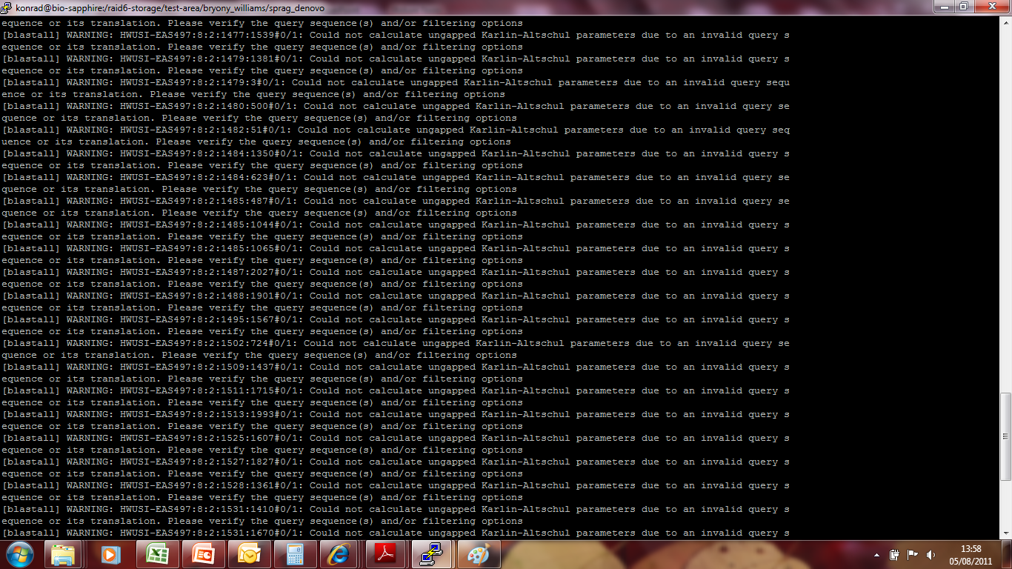

Slide 16
Adapting hashed seed-extend algorithms to work with shorter reads
Improve seed matching sensitivity
Allow mismatches within seed
BLAST
Allow mismatches + Adopt spaced-seed approach
ELAND, SOAP, MAQ, RMAP, ZOOM
Allow mismatches + Spaced-seeds + Multi-seeds
SSAHA2, BLAT, ELAND2
Above and/or Improve speed of local alignment for seed extension
Single Instruction Multiple Data
Shrimp2, CLCBio
Reduce search space to region around seed

Slide 17
Adapting hashed seed-extend algorithms to work with shorter reads
Improve seed matching sensitivity
Allow mismatches within seed
BLAST
Allow mismatches + Adopt spaced-seed approach
ELAND, SOAP, MAQ, RMAP, ZOOM
Allow mismatches + Spaced-seeds + Multi-seeds
SSAHA2, BLAT, ELAND2
Above and/or Improve speed of local alignment for seed extension
Single Instruction Multiple Data
Shrimp2, CLCBio
Reduce search space to region around seed

Slide 18
Contents
Alignment algorithms for short-reads
Background – Blast (why can’t we use it?)
Adapting hashed seed-extend algorthims to work with shorter reads
Suffix/Prefix Tries
Other alignment considerations
Typical alignment pipeline
Assembly algorithms for short reads
Effect of repeats
Overlap-Consensus
de Bruijn graphs
Assembly evaluation metrics
Typical assembly pipeline

Slide 19
Suffix-Prefix Trie
A family of methods which uses a Trie structure to search a reference sequence
Bowtie
BWA
SOAP version 2
Trie – data structure which stores the suffixes (i.e. ends of a sequence)
Key advantage over hashed algorithms:
Alignment of multiple copies of an identical sequence in the reference only needs to be done once
Use of an FM-Index to store Trie can drastically reduce memory requirements (e.g. Human genome can be stored in 2Gb of RAM)
Burrows Wheeler Transform to perform fast lookups

Slide 20
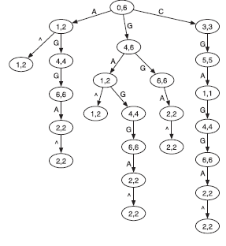
Suffix Trie
AGGAGC
Heng Li & Nils Homer. Sequence alignment algorithms for next-generation sequencing. Briefings in Bioinformatics. Vol 11. No 5. 473 483, 2010
Notes:
Data structures based on a prefix trie. (A) Prefix trie of string AGGAGC where symbol ^ marks the
start of the string. The two numbers in each node give the suffix array interval of the substring represented by
the node, which is the string concatenation of edge symbols from the node to the root.

Slide 21
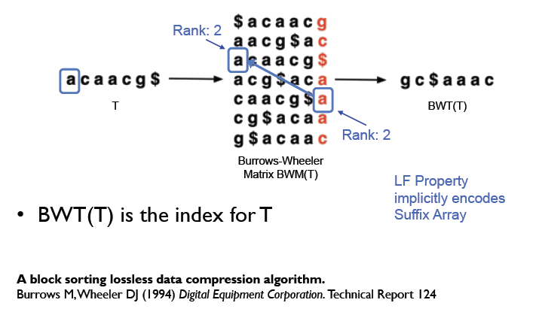
Suffix Trie

Slide 22
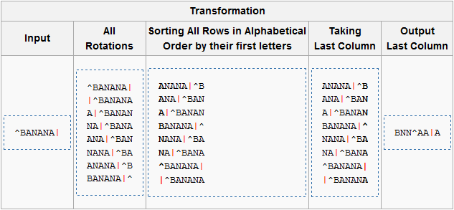
Burrows-Wheeler Algorithm
Encodes data so that it is easier to compress
Burrows-Wheeler transform of the word BANANA
Can later be reversed to recover the original word

Slide 23
More Burrows-Wheeler
Input | SIX.MIXED.PIXIES.SIFT.SIXTY.PIXIE.DUST.BOXES
Burrows-Wheeler Output | TEXYDST.E.IXIXIXXSSMPPS.B..E.S.EUSFXDIIOIIIT
Repeated characters mean that it is easier to compress

Slide 24
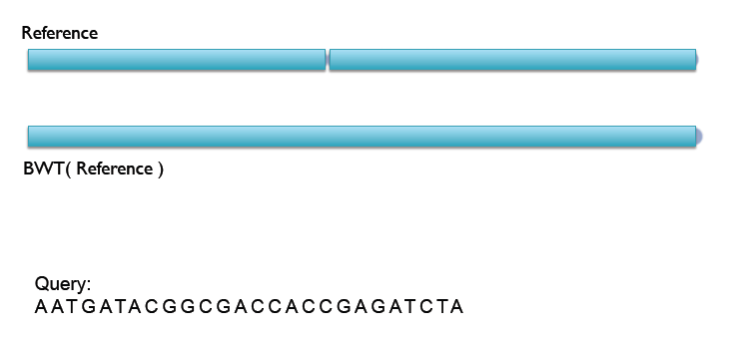
Bowtie/Soap2 example

Slide 25
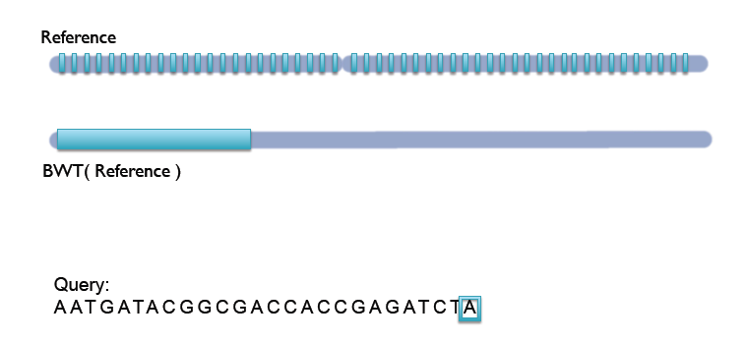
Bowtie/Soap2 example

Slide 26
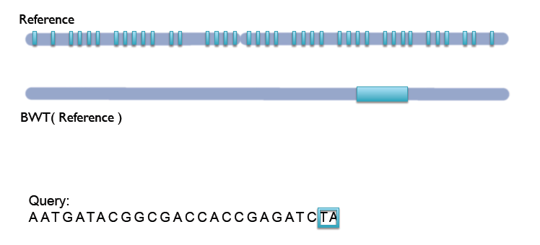
Bowtie/Soap2 example

Slide 27
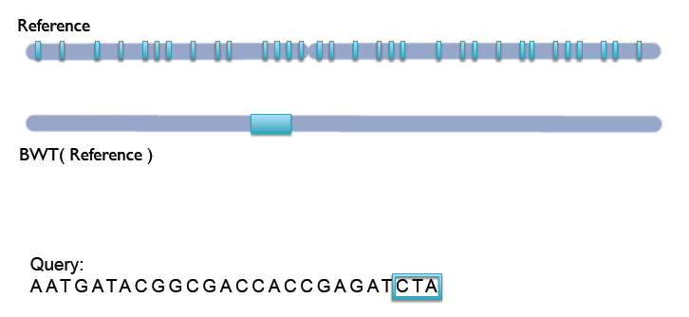
Bowtie/Soap2 example

Slide 28
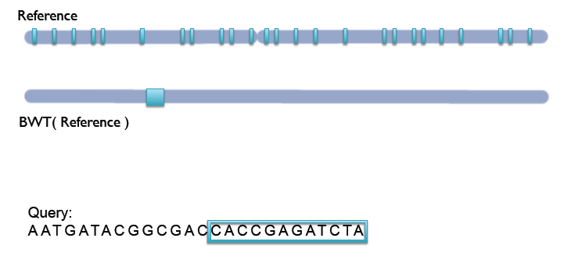
Bowtie/Soap2 example

Slide 29
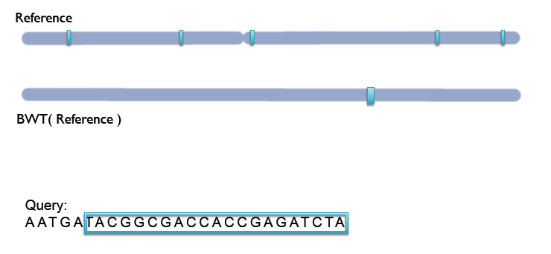
Bowtie/Soap2 example

Slide 30
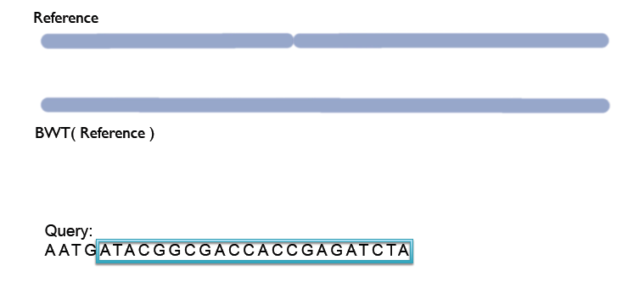
Bowtie/Soap2 example

Slide 31
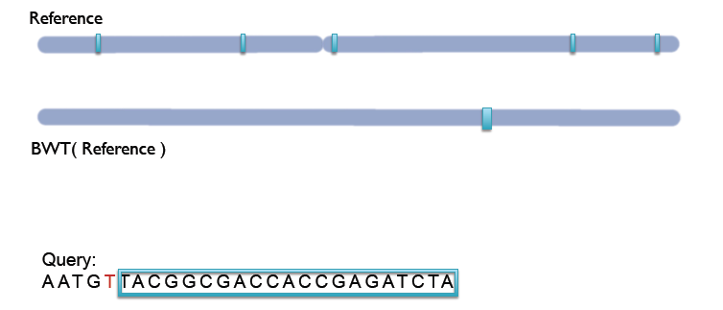
Bowtie/Soap2 example

Slide 32
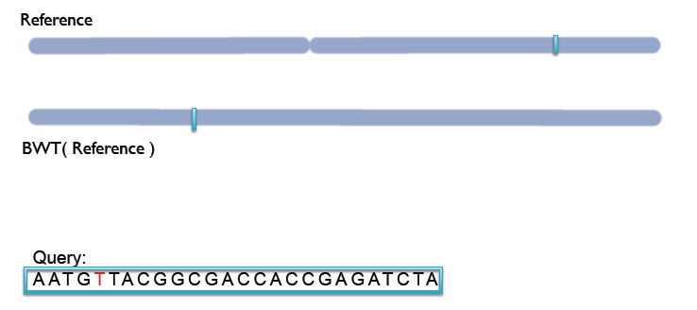
Bowtie/Soap2 example

Slide 33
Bowtie/Soap2 vs. BWA
Bowtie and Soap2 cannot handle gapped alignments
No indel detection => Many false SNP calls
Bowtie/Soap2:
ACTCCCATTGTCATCGTACTTGGGATCGTAACA Reference
CCATTGTCATCGTACTTGGGATCTA
TCATCGTACTTGGGATCTA
TTGGGATCTA
False SNPs
N.B. Bowtie2 can handle gapped alignments

Slide 34
Bowtie/Soap2 vs. BWA
Bowtie and Soap2 cannot handle gapped alignments
No indel detection => Many false SNP calls
BWA:
ACTCCCATTGTCATCGTACTTGGGATCGTAACA Reference
CCATTGTCATCGTACTTGGGATC-TA
TCATCGTACTTGGGATC-TA
TTGGGATC-TA
N.B. Bowtie2 can handle gapped alignments

Slide 35
Comparison
Hash referenced spaced seeds
Requires ~50Gb of memory
Runs 30-fold slower
Is much simpler to program
Most sensitive
Suffix/Prefix Trie
Requires <2Gb of memory
Runs 30-fold faster
Is much more complicated to program
Least sensitive

Slide 36
Comparison
Bowtie's reported 30-fold speed increase over hash-based MAQ with
small loss in sensitivity
Limitations to Trie-based approaches:
Only able to find alignments within a certain 'edit distance’
Bowtie does not do gapped alignments – no indels!
Important to quality clip reads (-q in BWA)
Non-A/C/G/T bases on reads are simply treated as mismatches
Make sure Ns are removed!
Hash based approaches are more suitable for divergent alignments
Rule of thumb:
<2% divergence -> Trie-based
E.g. human alignments
>2% divergence -> seed-extend based approach
E.g. wild mouse strains alignments

