Slide 1

Bowtie: A Highly Scalable Tool for Post-Genomic Datasets
Ben Langmead (langmead@cs.umd.edu)
Work with: Cole Trapnell, Mihai Pop, Steven Salzberg
NCBI Seminar
November 10, 2008

Slide 2
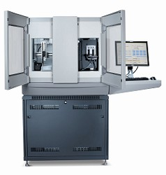
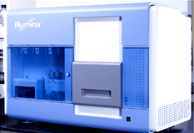
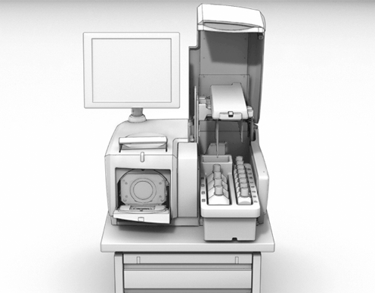
Supply
High-throughput sequencing produces short DNA sequences (“reads”) in huge volumes at low cost
Costs are down, adoption is up, next-next generation is coming soon
Illumina
ABI
454

Slide 3



Demand
Researchers have no problem putting this data to work
Future growth may be multiplicative
  Spatial resolution: tissues, individuals, geography
  Temporal resolution: circadian, seasonal, lifetimes
1000 Genomes
Global Ocean Survey
Human Microbiome

Slide 4
Short Read Applications
Goal: identify variations
Genotyping
RNA-seq, ChIP-seq, Methyl-seq
GGTATAC…
…CCATAG
TATGCGCCC
CGGAAATTT
CGGTATAC
…CCAT
CTATATGCG
TCGGAAATT
CGGTATAC
…CCAT
GGCTATATG
CTATCGGAAA
GCGGTATA
…CCA
AGGCTATAT
CCTATCGGA
TTGCGGTA
C…
…CCA
AGGCTATAT
GCCCTATCG
TTTGCGGT
C…
…CC
AGGCTATAT
GCCCTATCG
AAATTTGC
ATAC…
…CC
TAGGCTATA
GCGCCCTA
AAATTTGC
GTATAC…
…CCATAGGCTATATGCGCCCTATCGGCAATTTGCGGTATAC…
Goal: classify, measure significant peaks
GAAATTTGC
GGAAATTTG
CGGAAATTT
CGGAAATTT
TCGGAAATT
CTATCGGAAA
CCTATCGGA
TTTGCGGT
GCCCTATCG
AAATTTGC
…CC
GCCCTATCG
AAATTTGC
ATAC…
…CCATAGGCTATATGCGCCCTATCGGCAATTTGCGGTATAC…

Slide 5
Short Read Applications
GGTATAC…
…CCATAG
TATGCGCCC
CGGAAATTT
CGGTATAC
…CCAT
CTATATGCG
TCGGAAATT
CGGTATAC
…CCAT
GGCTATATG
CTATCGGAAA
GCGGTATA
…CCA
AGGCTATAT
CCTATCGGA
TTGCGGTA
C…
Finding the alignments is typically the performance bottleneck
…CCA
AGGCTATAT
GCCCTATCG
TTTGCGGT
C…
…CC
AGGCTATAT
GCCCTATCG
AAATTTGC
ATAC…
…CC
TAGGCTATA
GCGCCCTA
AAATTTGC
GTATAC…
…CCATAGGCTATATGCGCCCTATCGGCAATTTGCGGTATAC…
GAAATTTGC
GGAAATTTG
CGGAAATTT
CGGAAATTT
TCGGAAATT
CTATCGGAAA
CCTATCGGA
TTTGCGGT
GCCCTATCG
AAATTTGC
…CC
GCCCTATCG
AAATTTGC
ATAC…
…CCATAGGCTATATGCGCCCTATCGGCAATTTGCGGTATAC…

Slide 6
Short Read Alignment
Given a reference and a set of reads, report at least one “good” local alignment for each read if one exists
  Approximate answer to: where in genome did read originate?
What is “good”? For now, we concentrate on:
  Fewer mismatches is better
  Failing to align a low-quality base is better than failing to align a high-quality base
…TGATCATA…
GATCAA
better than
…TGATCATA…
GAGAAT
…TGATATTA…
GATcaT
better than
…TGATcaTA…
GTACAT

Slide 7
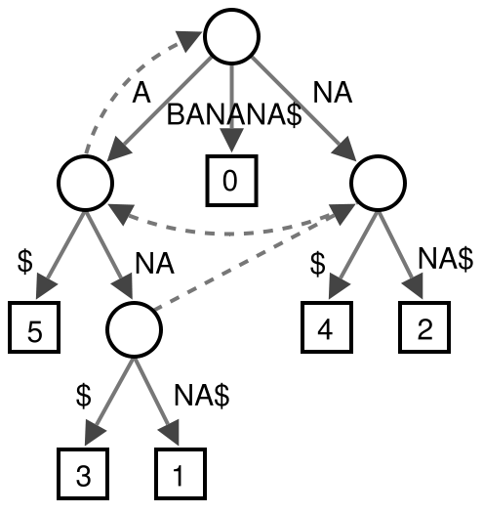
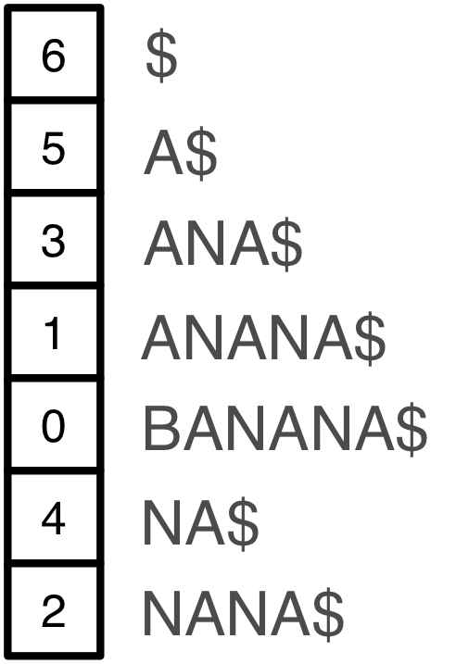
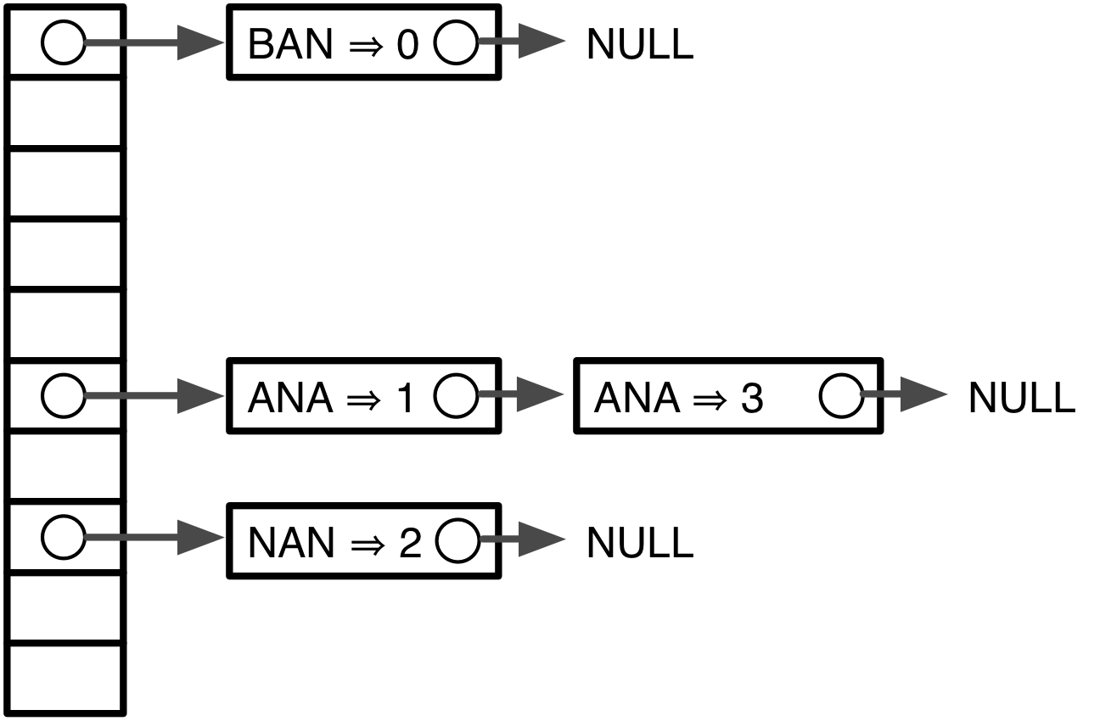
Indexing
Genomes and reads are too large for direct approaches like dynamic programming
Indexing is required
Choice of index is key to performance
Suffix tree
Suffix array
Seed hash tables
Many variants, incl. spaced seeds

Slide 8
Indexing
Genome indices can be big. For human:
Large indices necessitate painful compromises
  Require big-memory machine
  Use secondary storage
> 35 GBs
> 12 GBs
> 12 GBs
  Build new index each run
  Subindex and do multiple passes

Slide 9
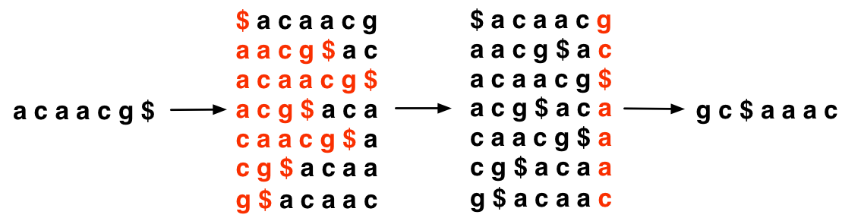
Burrows-Wheeler Transform
Reversible permutation used originally in compression
Once BWT(T) is built, all else shown here is discarded
  Matrix will be shown for illustration only
T
BWT(T)
Burrows
Wheeler
Matrix
Last column
Burrows M, Wheeler DJ: A block sorting lossless data compression algorithm. Digital Equipment Corporation, Palo Alto, CA 1994, Technical Report 124; 1994

Slide 10
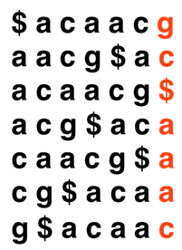

Burrows-Wheeler Transform
Property that makes BWT(T) reversible is “LF Mapping”
  i^{th} occurrence of a character in Last column is same text occurrence as the i^{th} occurrence in First column
Rank: 2
BWT(T)
T
Rank: 2
Burrows Wheeler
Matrix

Slide 11
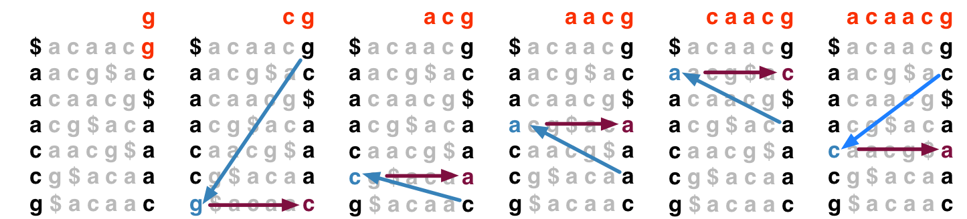
Burrows-Wheeler Transform
To recreate T from BWT(T), repeatedly apply rule:
  T = BWT[ LF(i) ] + T; i = LF(i)
  Where LF(i) maps row i to row whose first character corresponds to i’s last per LF Mapping
Could be called “unpermute” or “walk-left” algorithm
Final T

Slide 12
FM Index
Ferragina & Manzini propose “FM Index” based on BWT
Observed:
  LF Mapping also allows exact matching within T
  LF(i) can be made fast with checkpointing
  …and more (see FOCS paper)
Ferragina P, Manzini G: Opportunistic data structures with applications. FOCS. IEEE Computer Society; 2000.
Ferragina P, Manzini G: An experimental study of an opportunistic index. SIAM symposium on Discrete algorithms. Washington, D.C.; 2001.

Slide 13
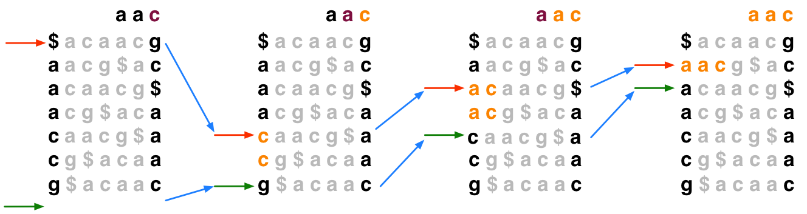
Exact Matching with FM Index
To match Q in T using BWT(T), repeatedly apply rule:
  top = LF(top, qc); bot = LF(bot, qc)
  Where qc is the next character in Q (right-to-left) and LF(i, qc) maps row i to the row whose first character corresponds to i’s last character as if it were qc

Slide 14
Exact Matching with FM Index
In progressive rounds, top & bot delimit the range of rows beginning with progressively longer suffixes of Q

Slide 15
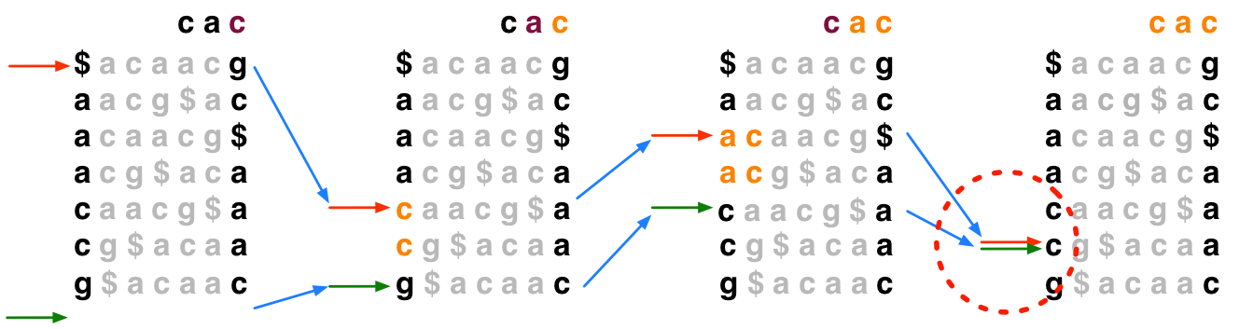
Exact Matching with FM Index
If range becomes empty (top = bot) the query suffix (and therefore the query) does not occur in the text

Slide 16
Rows to Reference Positions
Once we know a row contains a legal alignment, how do we determine its position in the reference?
Where am I?

Slide 17
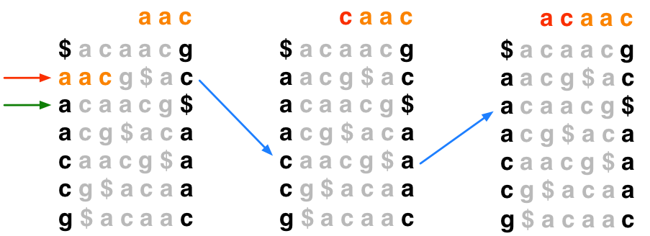
Rows to Reference Positions
Naïve solution 1: Use “walk-left” to walk back to the beginning of the text; number of steps = offset of hit
Linear in length of text in general – too slow
2 steps, so hit offset = 2

Slide 18
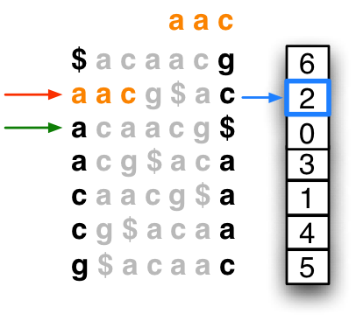
Rows to Reference Positions
Naïve solution 2: Keep whole suffix array in memory. Finding reference position is a lookup in the array.
Suffix array is ~12 gigabytes for human – too big
hit offset = 2

Slide 19
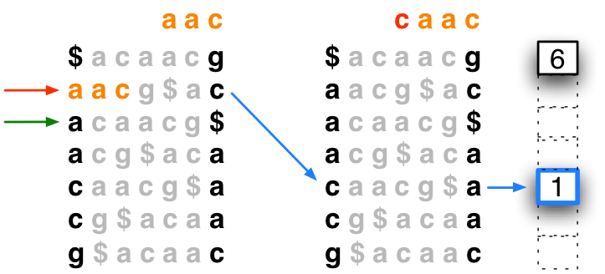
Rows to Reference Positions
Hybrid solution: Store sample of suffix array; “walk left” to next sampled (“marked”) row to the left
  Due to Ferragina and Manzini
Bowtie marks every 32nd row by default (configurable)
1 step
offset = 1
Hit offset = 1 + 1 = 2

Slide 20
Put It All Together
Algorithm concludes: “aac” occurs at offset 2 in “acaacg”

Slide 21

Checkpointing in FM Index
LF(i, qc) must determine the rank of qc in row i
Naïve way: count occurrences of qc in all previous rows
  This LF(i, qc) is linear in length of text – too slow
Scanned by naïve rank calculation

Slide 22
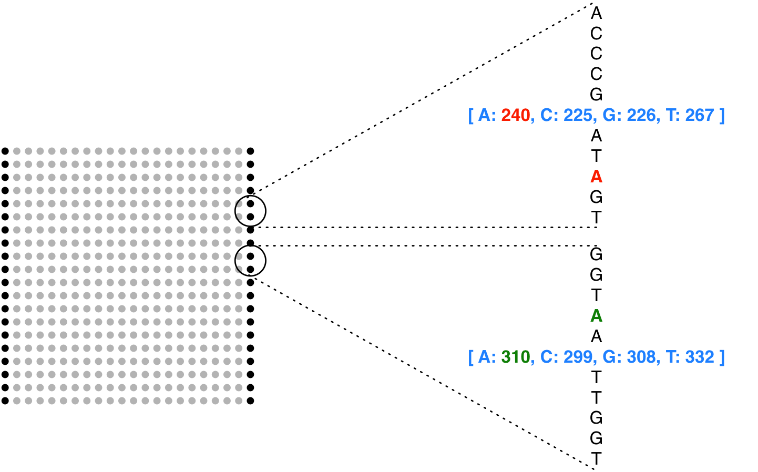
Checkpointing in FM Index
Solution: pre-calculate cumulative counts for A/C/G/T up to periodic checkpoints in BWT
LF(i, qc) is now constant-time
  (if space between checkpoints is considered constant)
Rank: 242
Rank: 309

Slide 23
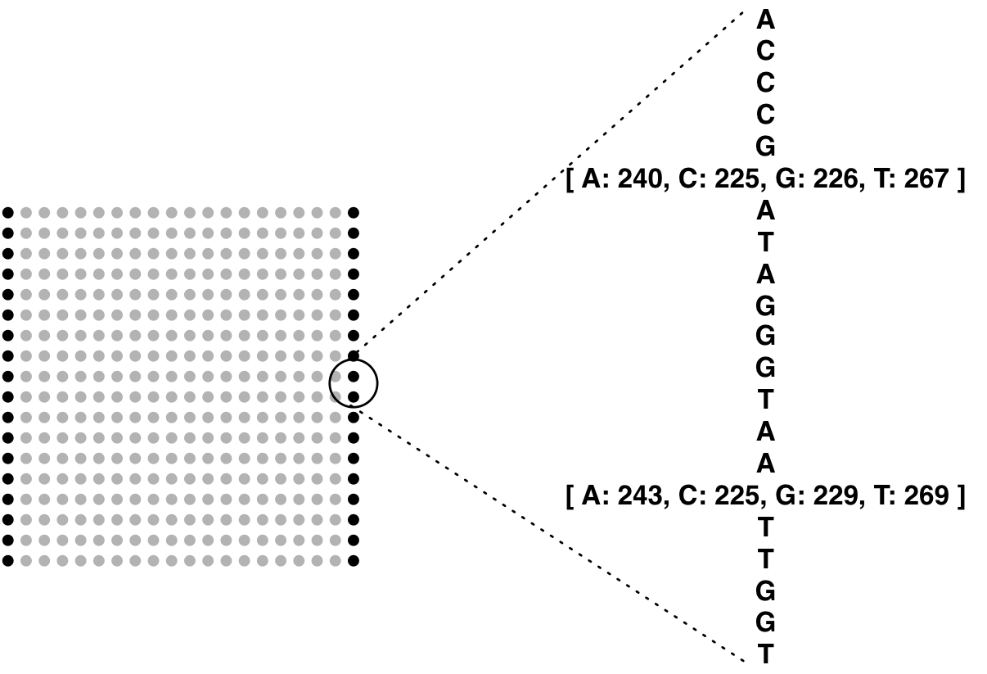
FM Index is Small
Entire FM Index on DNA reference consists of:
  BWT (same size as T)
  Checkpoints (~15% size of T)
  SA sample (~50% size of T)
Total: ~1.65x the size of T
Assuming 2-bit-per-base encoding and
no compression, as in Bowtie
Assuming a 16-byte checkpoint every 448 characters, as in Bowtie
Assuming Bowtie defaults for suffix-array sampling rate, etc
~1.65x
>45x
>15x
>15x

Slide 24
FM Index in Bioinformatics
Oligomer counting
  Healy J et al: Annotating large genomes with exact word matches. Genome Res 2003, 13(10):2306-2315.
Whole-genome alignment
  Lippert RA: Space-efficient whole genome comparisons with Burrows-Wheeler transforms. J Comp Bio 2005, 12(4):407-415.
Smith-Waterman alignment to large reference
  Lam TW et al: Compressed indexing and local alignment of DNA. Bioinformatics 2008, 24(6):791-797.

Slide 25
Short Read Alignment
FM Index finds exact sequence matches quickly in small memory, but short read alignment demands more:
  Allowances for mismatches
  Consideration of quality values
Lam et al try index-assisted Smith-Waterman
  Slower than BLAST
We tried index-assisted “seed-and-extend”
  Competitive with other aligners, but not much faster
Bowtie’s solution: backtracking quality-aware search

Slide 26
Backtracking
Consider an attempt to find Q = “agc” in T = “acaacg”:
Instead of giving up, try to “backtrack” to a previous position and try a different base
“g”
“c”
“gc” does not occur in the text

Slide 27
Backtracking
Backtracking attempt for Q = “agc”, T = “acaacg”:
“g”
“c”
“gc” does not occur in the text
Substitution
“a”
“a”
Found this alignment:
acaacg
agc
“c”

Slide 28
Backtracking
May not be so lucky
“g”
“t”
“c”
“a”
“a”
Found this alignment (eventually):
acaacg
agc

Slide 29
Backtracking
Relevant alignments may lie along multiple paths
  E.g., Q = “aaa”, T = “acaacg”
“a”
“a”
“a”
“a”
“a”
“c”
“a”
“a”
“c”
“a”
“a”
“c”
acaacg
acaacg
acaacg
aaa
aaa
aaa

Slide 30
Backtracking
Bowtie’s –v <int> option allows alignments with up to <int> mismatches
  Regardless of quality values
  Max mismatches allowed: 3
  Equivalent to SOAP’s* –v option
* Li R et al: SOAP: short oligonucleotide alignment program. Bioinformatics 2008, 24(5):713-714.

Slide 31
Qualities
When backtracking is necessary, Bowtie will backtrack to leftmost just-visited position with minimal quality
Greedy, depth-first, not optimal, but simple
Sequence:
G
C
C
A
T
A
C
G
G
A
T
T
A
G
C
C
Phred Quals:
40
40
35
40
40
40
40
30
30
20
15
15
40
40
40
40
(higher number = higher confidence)
G
C
C
A
T
A
C
G
G
A
C
T
A
G
C
C
40
40
35
40
40
40
40
30
30
20
15
15
40
40
40
40
G
C
C
A
T
A
C
G
G
G
C
T
A
G
C
C
40
40
35
40
40
40
40
30
30
20
15
15
40
40
40
40

Slide 32
Qualities
Bowtie supports a Maq*-like alignment policy
  ≤ N mismatches allowed in first L bases on left end
  Sum of mismatch qualities may not exceed E
  N, L and E configured with -n, -l, -e
  E.g.:
  Maq-like is Bowtie’s default mode (N=2, L=28, E=70)
G
C
C
A
T
A
C
G
G
G
C
T
A
G
C
C
If N < 2
40
40
35
40
40
40
40
30
30
20
15
15
40
25
5
5
If E < 45
If L < 9 and N < 2
L=12
E=50, N=2
* Li H, Ruan J, Durbin R: Mapping short DNA sequencing reads and calling variants using mapping quality scores. Genome Res 2008.

Slide 33
Implementation
Free, Open Source under Artistic License
C++
Uses SeqAn* library (http://www.seqan.de)
Uses POSIX threads to exploit parallelism
bowtie-build is the indexer
bowtie is the aligner
bowtie-convert converts Bowtie’s alignment output format to Maq’s .map format
  Users may leverage tools in the Maq suite, e.g., maq assemble, maq cns2snp
  Uses code from Maq
* Doring A, Weese D, Rausch T, Reinert K: SeqAn an efficient, generic C++ library for sequence analysis. BMC Bioinformatics 2008, 9:11.

Slide 34
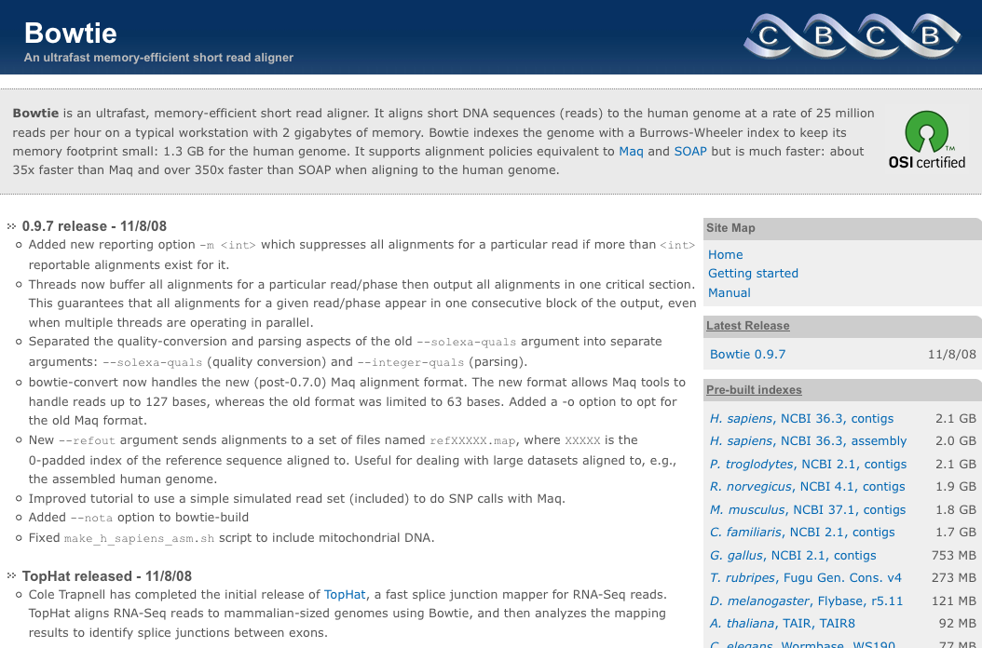
http://bowtie-bio.sf.net

Slide 35
Indexing Performance
Bowtie employs a indexing algorithm* that can trade flexibly between memory usage and running time
For human (NCBI 36.3) on 2.4 GHz AMD Opteron:
Physical memory Target | Actual peak memory footprint | Wall clock time
16 GB | 14.4 GB | 4h:36m
8 GB | 5.84 GB | 5h:05m
4 GB | 3.39 GB | 7h:40m
2 GB | 1.39 GB | 21h:30m
* Kärkkäinen J: Fast BWT in small space by blockwise suffix sorting. Theor Comput Sci 2007, 387(3):249-257.

Slide 36
Comparison to Maq & SOAP
 | CPU time | Wall clock time | Reads per hour | Peak virtual memory footprint | Bowtie speedup | Reads aligned (%)
Bowtie –v 2 (server) | 15m:07s | 15m:41s | 33.8 M | 1,149 MB | - | 67.4
SOAP (server) | 91h:57m:35s | 91h:47m:46s | 0.08 M | 13,619 MB | 351x | 67.3
Bowtie (PC) | 16m:41s | 17m:57s | 29.5 M | 1,353 MB | - | 71.9
Maq (PC) | 17h:46m:35s | 17h:53m:07s | 0.49 M | 804 MB | 59.8x | 74.7
Bowtie (server) | 17m:58s | 18m:26s | 28.8 M | 1,353 MB | - | 71.9
Maq (server) | 32h:56m:53s | 32h:58m:39s | 0.27 M | 804 MB | 107x | 74.7
PC: 2.4 GHz Intel Core 2, 2 GB RAM
Server: 2.4 GHz AMD Opteron, 32 GB RAM
Bowtie v0.9.6, Maq v0.6.6, SOAP v1.10
SOAP not run on PC due to memory constraints
Reads: FASTQ 8.84 M reads from 1000 Genomes (Acc: SRR001115)
Reference: Human (NCBI 36.3, contigs)

Slide 37
Comparison to Maq & SOAP
 | CPU time | Wall clock time | Reads per hour | Peak virtual memory footprint | Bowtie speedup | Reads aligned (%)
Bowtie –v 2 (server) | 15m:07s | 15m:41s | 33.8 M | 1,149 MB | - | 67.4
SOAP (server) | 91h:57m:35s | 91h:47m:46s | 0.08 M | 13,619 MB | 351x | 67.3
Bowtie (PC) | 16m:41s | 17m:57s | 29.5 M | 1,353 MB | - | 71.9
Maq (PC) | 17h:46m:35s | 17h:53m:07s | 0.49 M | 804 MB | 59.8x | 74.7
Bowtie (server) | 17m:58s | 18m:26s | 28.8 M | 1,353 MB | - | 71.9
Maq (server) | 32h:56m:53s | 32h:58m:39s | 0.27 M | 804 MB | 107x | 74.7
Bowtie delivers about 30 million alignments per CPU hour

Slide 38
Comparison to Maq & SOAP
 | CPU time | Wall clock time | Reads per hour | Peak virtual memory footprint | Bowtie speedup | Reads aligned (%)
Bowtie –v 2 (server) | 15m:07s | 15m:41s | 33.8 M | 1,149 MB | - | 67.4
SOAP (server) | 91h:57m:35s | 91h:47m:46s | 0.08 M | 13,619 MB | 351x | 67.3
Bowtie (PC) | 16m:41s | 17m:57s | 29.5 M | 1,353 MB | - | 71.9
Maq (PC) | 17h:46m:35s | 17h:53m:07s | 0.49 M | 804 MB | 59.8x | 74.7
Bowtie (server) | 17m:58s | 18m:26s | 28.8 M | 1,353 MB | - | 71.9
Maq (server) | 32h:56m:53s | 32h:58m:39s | 0.27 M | 804 MB | 107x | 74.7
Disparity in reads aligned between Bowtie (67.4%) and SOAP (67.3%) is slight

Slide 39
Comparison to Maq & SOAP
 | CPU time | Wall clock time | Reads per hour | Peak virtual memory footprint | Bowtie speedup | Reads aligned (%)
Bowtie –v 2 (server) | 15m:07s | 15m:41s | 33.8 M | 1,149 MB | - | 67.4
SOAP (server) | 91h:57m:35s | 91h:47m:46s | 0.08 M | 13,619 MB | 351x | 67.3
Bowtie (PC) | 16m:41s | 17m:57s | 29.5 M | 1,353 MB | - | 71.9
Maq (PC) | 17h:46m:35s | 17h:53m:07s | 0.49 M | 804 MB | 59.8x | 74.7
Bowtie (server) | 17m:58s | 18m:26s | 28.8 M | 1,353 MB | - | 71.9
Maq (server) | 32h:56m:53s | 32h:58m:39s | 0.27 M | 804 MB | 107x | 74.7
Disparity in reads aligned between Bowtie (71.9%) and Maq (74.7%) is more substantial (2.8%)
  Mostly because Maq –n 2 reports some, but not all, alignments with 3 mismatches in first 28 bases
  Fraction (<5%) of disparity is due to Bowtie’s backtracking limit (a heuristic not discussed here)

Slide 40
Comparison to Maq & SOAP
 | CPU time | Wall clock time | Reads per hour | Peak virtual memory footprint | Bowtie speedup | Reads aligned (%)
Bowtie –v 2 (server) | 15m:07s | 15m:41s | 33.8 M | 1,149 MB | - | 67.4
SOAP (server) | 91h:57m:35s | 91h:47m:46s | 0.08 M | 13,619 MB | 351x | 67.3
Bowtie (PC) | 16m:41s | 17m:57s | 29.5 M | 1,353 MB | - | 71.9
Maq (PC) | 17h:46m:35s | 17h:53m:07s | 0.49 M | 804 MB | 59.8x | 74.7
Bowtie (server) | 17m:58s | 18m:26s | 28.8 M | 1,353 MB | - | 71.9
Maq (server) | 32h:56m:53s | 32h:58m:39s | 0.27 M | 804 MB | 107x | 74.7
Bowtie and Maq have memory footprints compatible with a typical workstation with 2 GB of RAM
  Maq builds non-reusable spaced-seed index on reads; recommends segmenting reads into chunks of 2M (which we did)
SOAP requires a computer with >13 GB of RAM
  SOAP builds non-reusable spaced-seed index on genome

Slide 41
Comparison to Maq w/ Poly-A Filter
 | CPU time | Wall clock time | Reads per hour | Peak virtual memory footprint | Bowtie speedup | Reads aligned (%)
Bowtie (PC) | 16m:39s | 17m:47s | 29.8 M | 1,353 MB | - | 74.9
Maq (PC) | 11h:15m:58s | 11h:22m:02s | 0.78 M | 804 MB | 38.4x | 78.0
Bowtie (server) | 18m:20s | 18m:46s | 28.8 M | 1,352 MB | - | 74.9
Maq (server) | 18h:49m:07s | 18h:50m:16s | 0.47 M | 804 MB | 60.2x | 78.0
Maq documentation: reads with “poly-A artifacts” impair Maq’s performance
Re-ran previous experiment after running Maq’s “catfilter” to eliminate 438K poly-A reads
Maq makes up some ground, but Bowtie still >35x faster
Similar disparity in reads aligned, for same reasons

Slide 42
Multithreaded Scaling
 | CPU time | Wall clock time | Reads per hour | Peak virtual memory footprint | Speedup
Bowtie, 1 thread (server) | 18m:19s | 18m:46s | 28.3 M | 1,353 MB | -
Bowtie, 2 threads (server) | 20m:34s | 10m:35s | 50.1 M | 1,363 MB | 1.77x
Bowtie, 4 threads (server) | 23m:09s | 6m:01s | 88.1 M | 1,384 MB | 3.12x
Bowtie uses POSIX threads to exploit multi-processor computers
  Reads are distributed across parallel threads
  Threads synchronize when fetching reads, outputting results, etc.
  Index is shared by all threads, so footprint does not increase substantially as # threads increases
Table shows performance results for Bowtie v0.9.6 on 4-core Server with 1, 2, 4 threads

Slide 43
1000 Genomes Genotyping
…CCATAG
TATGCGCCC
CGGAAATTT
CGGTATAC
…CCAT
CTATATGCG
TCGGAAATT
CGGTATAC
…CCAT
GGCTATATG
CTATCGGAAA
GCGGTATA
…CCA
AGGCTATAT
CCTATCGGA
TTGCGGTA
C…
…CCA
AGGCTATAT
GCCCTATCG
TTTGCGGT
C…
…CC
AGGCTATAT
GCCCTATCG
AAATTTGC
ATAC…
…CC
TAGGCTATA
GCGCCCTA
AAATTTGC
GTATAC…
…CCATAGGCTATATGCGCCCTATCGGCAATTTGCGGTATAC…
Bowtie aligns all 1000-Genomes (Build 2) reads for human subject NA12892 on a 2.4 Ghz Core 2 workstation with 4 GB of RAM with 4 parallel threads:
  14.3x coverage, 935 M reads, 42.9 Gbases
  Running time: 14 hrs – 1 overnight

Slide 44
Future Work
Paired-end alignment
Finding alignments with insertions and deletions
ABI color-space support

Slide 45
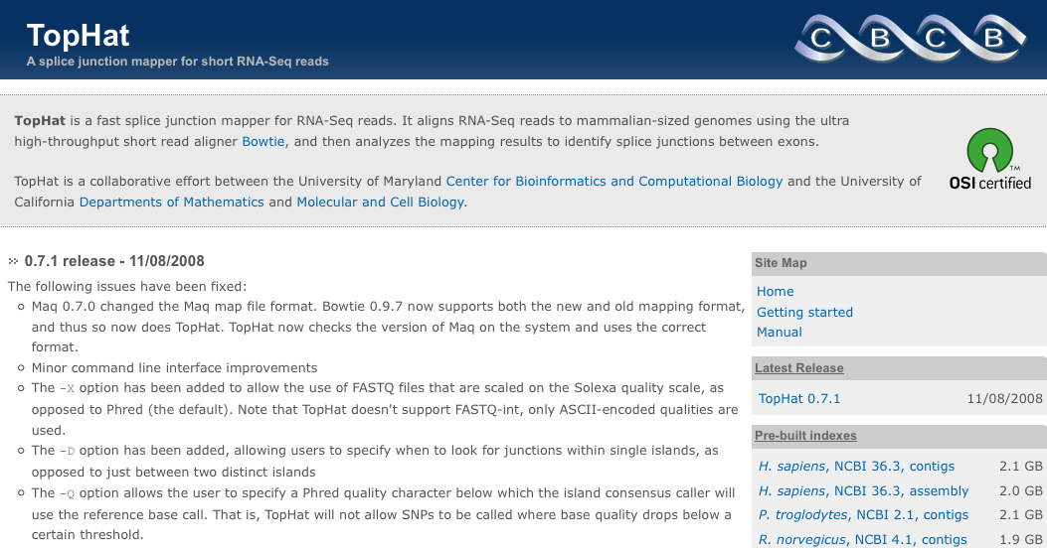
TopHat: Bowtie for RNA-seq
TopHat is a fast splice junction mapper for RNA-Seq reads. It aligns RNA-Seq reads using Bowtie, and then analyzes the mapping results to identify splice junctions between exons.
  Contact: Cole Trapnell (cole@cs.umd.edu)
  http://tophat.cbcb.umd.edu

Slide 46

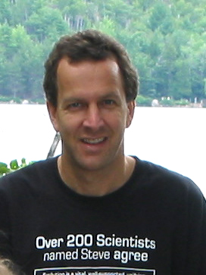
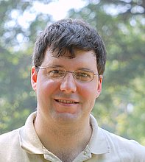
Work With
Cole Trapnell
Steven Salzberg
Mihai Pop

Slide 47
Extra Slides

Slide 48
Bowtie Usage
Usage: bowtie [options]* <ebwt_base> <query_in> [<hit_outfile>]
<ebwt_base> ebwt filename minus trailing .1.ebwt/.2.ebwt
<query_in> comma-separated list of files containing query reads
(or the sequences themselves, if -c is specified)
<hit_outfile> file to write hits to (default: stdout)
Options:
-q query input files are FASTQ .fq/.fastq (default)
-f query input files are (multi-)FASTA .fa/.mfa
-c query sequences given on command line (as <query_in>)
-e/--maqerr <int> max sum of mismatch quals (rounds like maq; default: 70)
-l/--seedlen <int> seed length (default: 28)
-n/--seedmms <int> max mismatches in seed (0, 1 or 2, default: 2)
-v <int> report end-to-end hits w/ <=v mismatches; ignore qualities
-5/--trim5 <int> trim <int> bases from 5' (left) end of reads
-3/--trim3 <int> trim <int> bases from 3' (right) end of reads
-u/--qupto <int> stop after the first <int> reads
-t/--time print wall-clock time taken by search phases
--solexa-quals convert FASTQ qualities from solexa-scaled to phred
--concise write hits in a concise format
--maxns <int> skip reads w/ >n no-confidence bases (default: no limit)
-o/--offrate <int> override offrate of Ebwt; must be >= value in index
--seed <int> seed for random number generator
--verbose verbose output (for debugging)
--version print version information and quit

Slide 49
Bowtie Indexer Usage
Usage: bowtie-build [options]* <reference_in> <ebwt_outfile_base>
reference_in comma-separated list of files with ref sequences
ebwt_outfile_base write Ebwt data to files with this dir/basename
Options:
-f reference files are Fasta (default)
-c reference sequences given on cmd line (as <seq_in>)
--bmax <int> max bucket sz for blockwise suffix-array builder
--bmaxmultsqrt <int> max bucket sz as multiple of sqrt(ref len)
--bmaxdivn <int> max bucket sz as divisor of ref len
--dcv <int> diff-cover period for blockwise (default: 1024)
--nodc disable difference cover (blockwise is quadratic)
-o/--offrate <int> SA index is kept every 2^offRate BWT chars
-t/--ftabchars <int> # of characters in initial lookup table key
--big --little endianness (default: little, this host: little)
--seed <int> seed for random number generator
--cutoff <int> truncate reference at prefix of <int> bases
-q/--quiet verbose output (for debugging)
-h/--help print detailed description of tool and its options
--version print version information and quit

Slide 50
Reporting
-k <int> | Report up to <int> valid alignments per read (default: 1). Validity of alignments is determined by the alignment policy (combined effects of -n, -v, -l, and -e). If many alignments are reported, they may be subject to stratification; see --best, --nostrata. Bowtie is designed to be very fast for small -k but BOWTIE CAN BECOME VERY SLOW AS -k INCREASES.
-a/--all | Report all valid alignments per read (default: off). Validity of alignments is determined by the alignment policy (combined effects of -n, -v, -l, and -e). Reported alignments may be subject to stratification; see --best, --nostrata. Bowtie is designed to be very fast for small -k; BOWTIE CAN CAN BECOME VERY SLOW IF -a/--all IS SPECIFIED.
--best | Reported alignments must belong to the best possible alignment "stratum" (default: off). A stratum is a category defined by the number of mismatches present in the alignment (for -n, the number of mismatches present in the seed region of the alignment). E.g., if --best is not specified, Bowtie may sometimes report an alignment with 2 mismatches in the seed even though there exists an unreported alignment with 1 mismatch in the seed. bowtie IS ABOUT 3-5 TIMES SLOWER WHEN --best IS SPECIFIED.
--nostrata | If many valid alignments exist and are reportable (according to the --best and -k options) and they fall into various alignment "strata", report all of them. By default, Bowtie only reports those alignments that fall into the best stratum, i.e., the one with fewest mismatches. BOWTIE CAN BECOME VERY SLOW WHEN --nostrata IS COMBINED WITH -k OR -a.

Slide 51
Excessive Backtracking
Bowtie only backtracks if it can make progress, i.e., if top ≠ bot after the backtrack
  Rightmost positions are likeliest targets because shorter suffixes are likeliest to occur “by chance”
When >1 mismatch is allowed, such backtracks can easily dominate running time and make search slow
G
C
C
A
T
A
C
G
G
A
T
T
A
G
C
C
Longer suffixes, less likely targets
Shorter suffixes, more likely targets

Slide 52
Excessive Backtracking
Solution: Double indexing
We’ve considered matching from right to left, but what if left-to-right were possible too?
G
C
C
A
T
A
C
G
G
A
T
T
A
G
C
C
Longer suffixes, less likely targets
Shorter suffixes, more likely targets
G
C
C
A
T
A
C
G
G
A
T
T
A
G
C
C
Shorter prefixes, more likely targets
Longer prefixes, less likely targets

Slide 53
Excessive Backtracking
Suggests a multi-stage scheme that minimizes excessive backtracking in reddest regions
  Workflow for up to 1-mismatch that matches in both directions & disallows backtracks in reddest regions:
G
C
C
A
T
A
C
G
G
A
T
T
A
G
C
C
No backtracks allowed
G
C
C
A
T
A
C
G
G
A
T
T
A
G
C
C
No backtracks allowed

Slide 54
Excessive Backtracking
G
C
C
A
T
A
C
G
G
A
T
T
A
G
C
C
No backtracks allowed
G
C
C
A
T
A
C
G
G
A
T
T
A
G
C
C
No backtracks allowed
Minimizes backtracks by disallowing backtracks in reddest regions
Maintains full sensitivity by matching in both directions

Slide 55
Excessive Backtracking
But how to match left-to-right?
Double indexing:
  Reverse read and use “mirror index”: index for reference with sequence reversed
G
C
C
A
T
A
C
G
G
A
T
T
A
G
C
C
Forward Index
No backtracks allowed
C
C
G
A
T
T
A
G
G
C
A
T
A
C
C
G
Mirror Index
No backtracks allowed

Slide 56

Demand
“True understanding of how genes function requires knowledge of their expression patterns, their impact on all other genes and their effects on DNA structure and modifications. These data will have to be obtained across large numbers of cell types, individuals, environments and time points.“
- Kahvejian, A., Quackenbush, J., Thompson, J.F., “What would you do if you could sequence everything?” Nat. Biotechnol. 26, 1099 (Oct 2008)

Slide 57
Wanted: Scalable Algorithms
“…the overwhelming amounts of data being produced are the equivalent of taking a drink from a fire hose…”
“…grant-awarding bodies should start focusing on the back-end bioinformatics as much as the sequencing technology itself. And as the bioinformatics bottleneck threatens to limit instrument sales, manufacturers as a group have a massive incentive to unblock it.”
- Editorial, Nature Biotechnology 26, 1099 (Oct 2008)

Slide 58
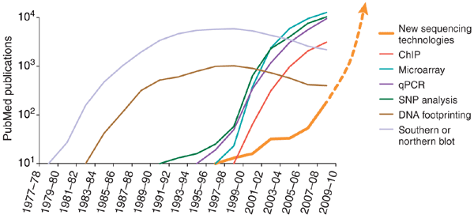
NGS Trend
PubMed was “searched in two-year increments for key words and the number of hits plotted over time.”
From the following article
What would you do if you could sequence everything?
Avak Kahvejian, John Quackenbush & John F Thompson
Nature Biotechnology 26, 1125 - 1133 (2008)
doi:10.1038/nbt1494

