Slide 1
Data Structure and Algorithm Analysis
LUO Zongwei
2018，9，3

Slide 2
Questions about this course
What are data structures and algorithms?
What good will it do me to know about them?
Why can't I just use arrays and for loops to handle my data?
When does it make sense to apply what I learn here?

Slide 3
Data Structures
Data Structures | Advantages | Disadvantages
Array | Quick insertion, very fast access if index known | Slow search, slow deletion, fixed size.
Ordered array | Quicker search than unsorted array. | Slow insertion and deletion, fixed size.
Stack | Provides last-in, first-out access. | Slow access to other items.
Queue | Provides first-in, first-out access. | Slow access to other items.
Linked list | Quick insertion, quick deletion. | Slow search.
Binary tree | Quick search, insertion, deletion (if tree remains balanced). | Deletion algorithm is complex.
Graph | Models real-world situations. | Some algorithms are slow and complex.

Slide 4
About data structure
Many of the algorithms we'll discuss apply directly to specific data structures. For most data structures, you need to know how to
  Insert a new data item.
  Search for a specified item.
  Delete a specified item.
You may also need to know how to iterate through all the items in a data structure, visiting each one in turn so as to display it or perform some other action on it.
One important algorithm category is sorting.

Slide 5
Question 1
How to draw a vertical line perpendicular to a line at a certain point?
A

Slide 6
Another question
How to divide a line equally in three parts?
A
B

Slide 7
About algorithm
Algorithm: a sequence of instructions with clear semantics for solving a particular information processing problems, realizable based on a set computing model.
Input/output
Finiteness
Correctness

Slide 8

Question 3
Hailstone(7)={7，22，11，34，17，52，26，13，40， 20，10，5，16，8，4，2 , 1)
试编写一个非递归程序，计算Flailstone(n)的长度hailstone(n)

Slide 9

Reference textbook

Slide 10
Evaluation
Homework 10%
Class participation/Quiz 10%
Course project 30%
Mid term exam 20%
Final exam 30%

Slide 11
Schedule
Week 1
Week 2-3
Week 4-5
Week 6-7
Week 8
Week 9-10
Week 11-12
Week 13-14
Week 15-16
Introduction
List
Stack and Queues
String
Mid term
Tree
Graph
Sorting
Presentation and review

Slide 12
QQ Group
南科大数据结构与算法
  488714541
加群方式：
  问： 第一次上课时间
  答： 20170913
进群后修改名字：
  学号+姓名

Slide 13
Homework
Search and identify a suitable MOOC course

Slide 14
What do we do next
Array review
Write a program to remove white space from an array.

Slide 15
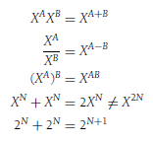



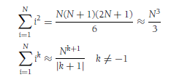


数学

Slide 16


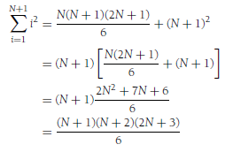

推理证明
Proof by Induction

Slide 17
推理证明
Proof by Counterexample

Slide 18


推理证明
Proof by Contradiction

Slide 19
www.scholat.com/ytang
http://www.scholat.com/course/sustechdsaa

