Slide 1
Data Structure and Algorithm Analysis
LUO Zongwei
2018，9，3

Slide 2
Social networks for this course
www.scholat.com/ytang
http://www.scholat.com/course/sustechdsaa

Slide 3
Questions about this course
What are data structures and algorithms?
What good will it do me to know about them?
Why can't I just use arrays and for loops to handle my data?
When does it make sense to apply what I learn here?

Slide 4
Data Structures
Data Structures | Advantages | Disadvantages
Array | Quick insertion, very fast access if index known | Slow search, slow deletion, fixed size.
Ordered array | Quicker search than unsorted array. | Slow insertion and deletion, fixed size.
Stack | Provides last-in, first-out access. | Slow access to other items.
Queue | Provides first-in, first-out access. | Slow access to other items.
Linked list | Quick insertion, quick deletion. | Slow search.
Binary tree | Quick search, insertion, deletion (if tree remains balanced). | Deletion algorithm is complex.
Graph | Models real-world situations. | Some algorithms are slow and complex.

Slide 5
About data structure
Many of the algorithms we'll discuss apply directly to specific data structures. For most data structures, you need to know how to
  Insert a new data item.
  Search for a specified item.
  Delete a specified item.
You may also need to know how to iterate through all the items in a data structure, visiting each one in turn so as to display it or perform some other action on it.
One important algorithm category is sorting.

Slide 6
Question 1
How to draw a vertical line perpendicular to a line at a certain point?
A

Slide 7
Another question
How to divide a line equally in three parts?
A
B

Slide 8
About algorithm
Algorithm: a sequence of instructions with clear semantics for solving a particular information processing problems, realizable based on a set computing model.
Input/output
Finiteness
Correctness

Slide 9

Question 3
Hailstone(7)={7，22，11，34，17，52，26，13，40， 20，10，5，16，8，4，2 , 1)
试编写一个非递归程序，计算Flailstone(n)的长度hailstone(n)

Slide 10
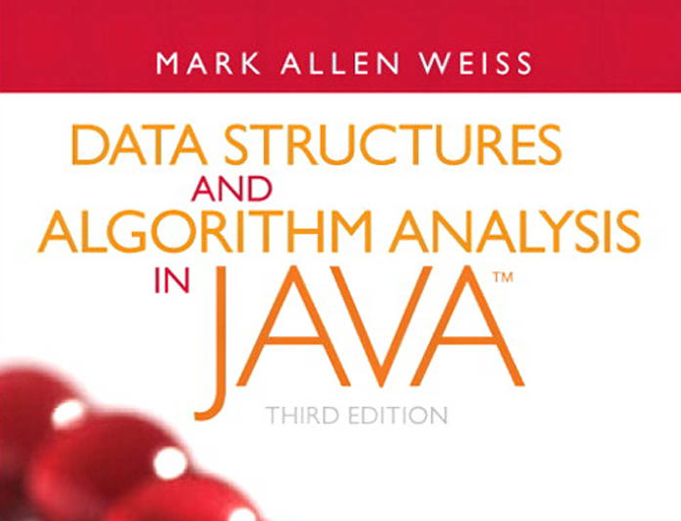
Reference textbook

Slide 11
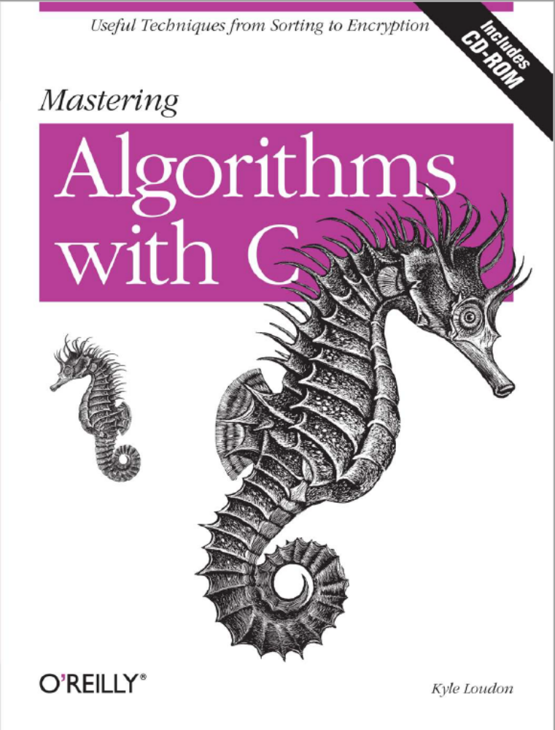
Reference textbook

Slide 12
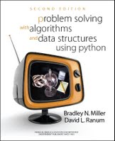
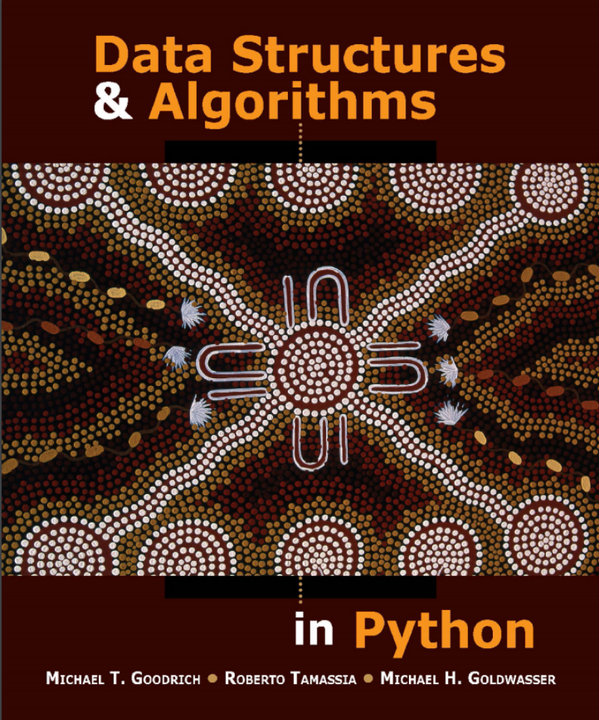
Reference textbook

Slide 13
Evaluation
Homework 10%
Class participation/Quiz 10%
Course project 30%
Mid term exam 20%
Final exam 30%

Slide 14
Schedule
Week 1
Week 2-3
Week 4-5
Week 6-7
Week 8
Week 9-10
Week 11-12
Week 13-14
Week 15-16
Introduction
List
Stack and Queues
String
Mid term
Tree
Graph
Sorting
Presentation and review

Slide 15

QQ Group
南科大数据结构2018
  870276954
加群方式：
  问： 学号+姓名
  答：
进群后修改名字：
  学号+姓名
  发电子邮件

Slide 16
Homework
http://www.scholat.com/course/sustechdsaa
Search and identify a suitable MOOC course

Slide 17
What do we do next
Array review
Write a program to remove white space from an array.

Slide 18
Some functions
The Constant function
The Logarithm Function
The Linear function
The N-Log-N Function
The Quadratic Function
The Cubic Function and Other Polynomials
The Exponential Function

Slide 19
Some functions
The Constant function
f(n) = c
That is, for any argument n, the constant function f(n) assigns the value c.

Slide 20

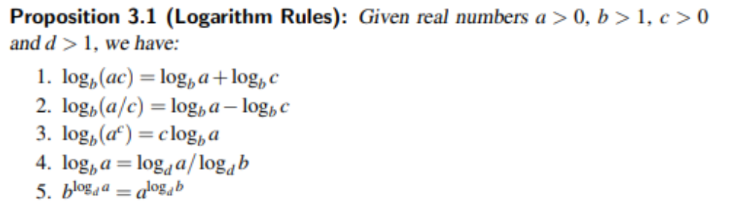
Some functions
The Logarithm Function

Slide 21
Some functions
The Linear function
f(n) = n

Slide 22
Some functions
The N-Log-N Function
f(n) = nlogn

Slide 23
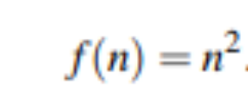
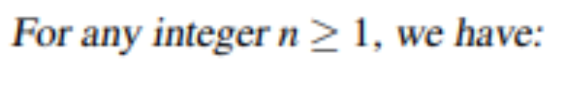
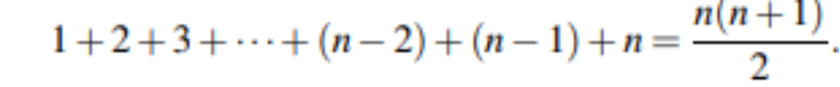
Some functions
The Quadratic Function

Slide 24
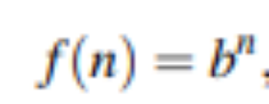
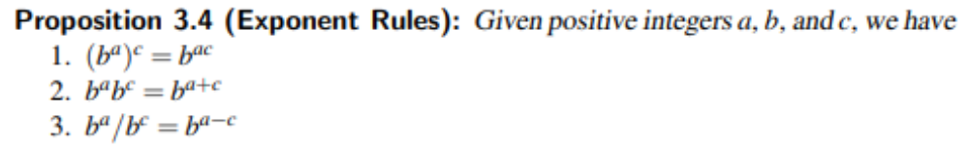
Some functions
The Exponential Function

Slide 25
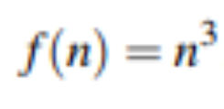
Some functions
The Cubic Function and Other Polynomials

Slide 26
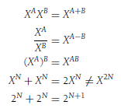



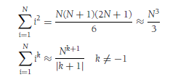


Mathematics

Slide 27


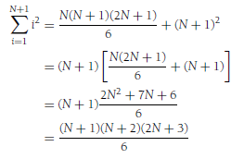

Proof
Proof by Induction

Slide 28

Proof
Proof by Counterexample

Slide 29


Proof
Proof by Contradiction

Slide 30
Lab 1
Pick one and complete it

Slide 31
Programming 1
Write a program to draw a vertical line perpendicular to a line at a certain point.
A

Slide 32
Programming 2
Write a program to divide a line equally in three parts.
A
B

Slide 33
Programming 3
Hailstone(7)={7，22，11，34，17，52，26，13，40， 20，10，5，16，8，4，2 , 1)
试编写一个非递归程序，计算Flailstone(n)的长度hailstone(n)

