Slide 1
Data Structures and Algorithm Analysis – Week 6
LUO Zongwei
2018，10，22

Slide 2
Key Content
Introduction
Logical structure
Storage structure
Operations
Pattern matching
Algorithm analysis

Slide 3
String
String：a series of 0 or more characters
Length of string：number of characters
Empty string：string with length 0，””.
A non empty string ：
S=“a₁ a₂…a_{n}”
S: name of string，“”: delimiter
value of string is within this “”，
a_{i}（1≤i≤n）can be any character.

Slide 4
Basic concept
Two strings are equal：strings with equal length and same character at corresponding index。
Sub string：a series of any consecutive characters within the string
Primary string：String contains sub strings。
Position of sub string is the index of first character of the sub string in the primary string

Slide 5
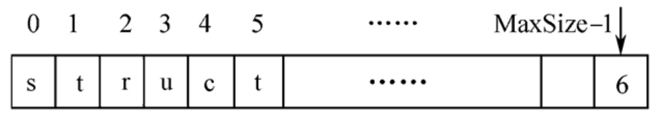
Array Implementation
How can you decide the length of the string?

Slide 6
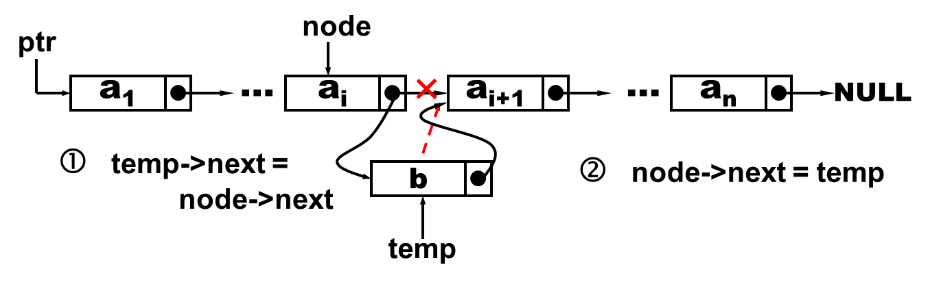
Linked List Implementation

Slide 7
Which implementation do you prefer?

Slide 8
Basic Operations
Linkage
Comparison
Duplicate

Slide 9
Pattern Matching
Given a primary string, S="s₁s₂…s_{n}” and pattern T="t₁t₂…t_{m}"，search for T in S.
If successful, return the location of T in S.

Slide 10
Matching Algorithms
Brute force
KMP

Slide 11
BF Algorithm
Example: S="ababcabcacbab"，T="abcac"
i
i
i
a b a b c a b c a c b a b
a b c a c
i=2，j=2 failed；
i goes back to 1，j goes back to 0
j
j
j

Slide 12
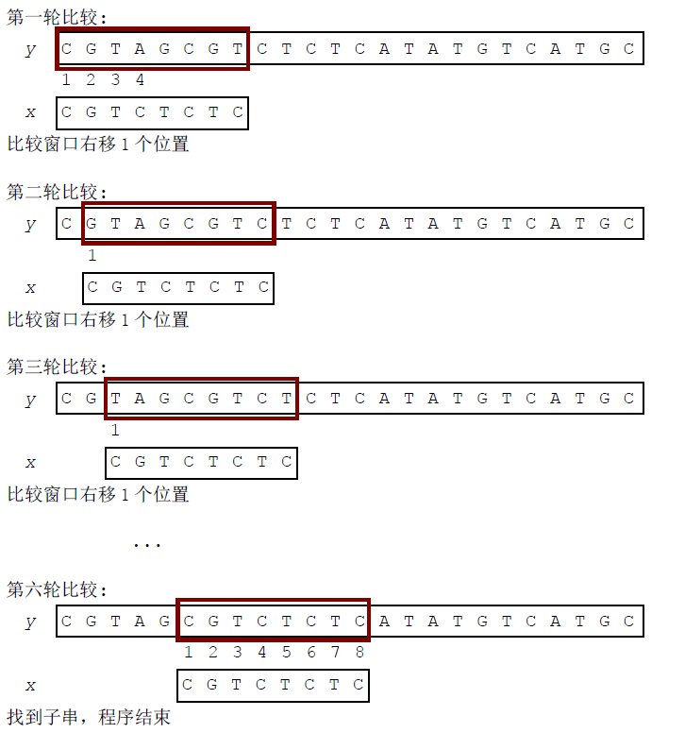
Brute Force

Slide 13
Time complexity?
Best case?
Worst case?

Slide 14
Brute Force Algorithm Analysis
Time complexity，assume T has m chars，S has n chars：
  Best case：S’s first m chars matches up with T，result will be available after m comparison, O(m)。
  Worse case：assume there is no optimization，and first char can always match up, but here is sub string can match up pattern.
    P=“abc”, T=“aaaaaaaa” (m=3,n=8)，
    O(mn)。
Slow

Slide 15
Brute Force Algorithm
No pre-processing；
Need only fix storage；
Shift of sliding window is 1；
String comparison can be conducted in any order (left to right, right to left, or in any order) ；
O(m×n)；
Maximum comparison: (n-m+1)×m。

Slide 16
Brute Force Algorithm
No pre-processing；
Need only fix storage；
Shift of sliding window is 1；
String comparison can be conducted in any order (left to right, right to left, or in any order) ；
O(m×n)；
Maximum comparison: (n-m+1)×m。
Can we do anything?

Slide 17
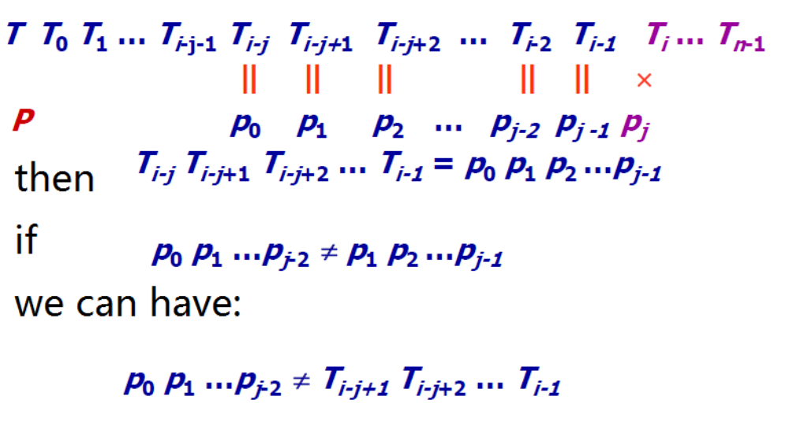
Any Ideas for that 1 improvement?

Slide 18
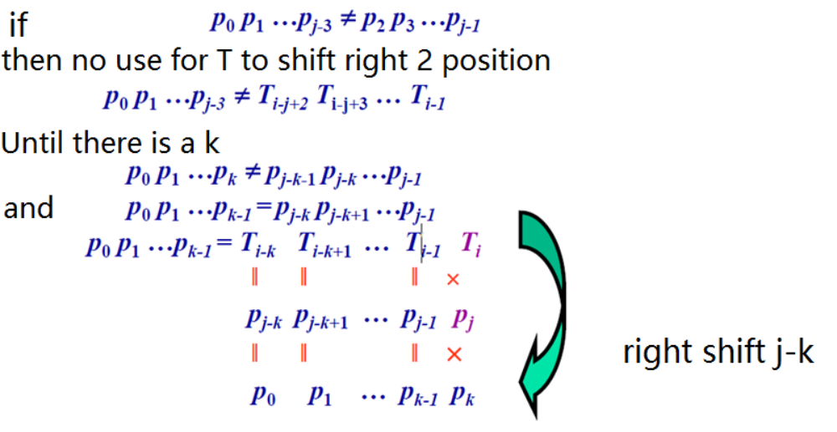
Looking for a k?

Slide 19
KMP
Knuth-Morris-Pratt (KMP) discover that k only depends on T，no relationship with S
  1970，S. A. Cook proves pattern matching can be accomplished within N+M
  D. E. Knuth and V. R. Pratt developed an algorithm of N+M，at the same time J. H. Morris developed this algorithm

Slide 20
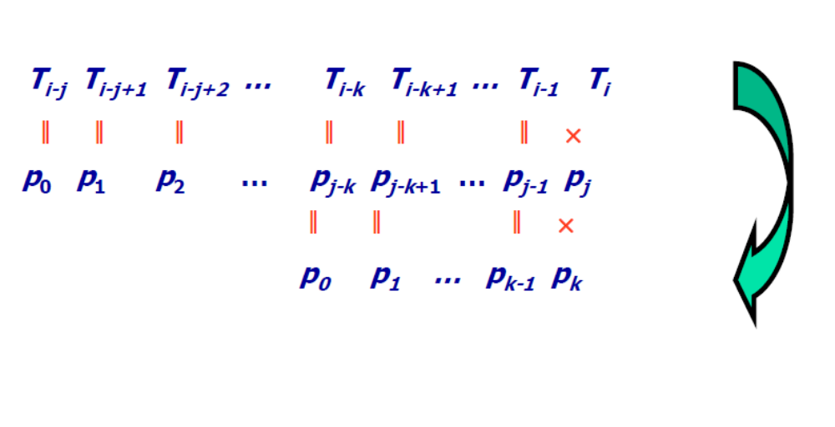
Idea of KMP
Leverage the content in the pattern T to guide the shifting distance k
The key is how K can be obtained from P?
Right shift j-k

Slide 21
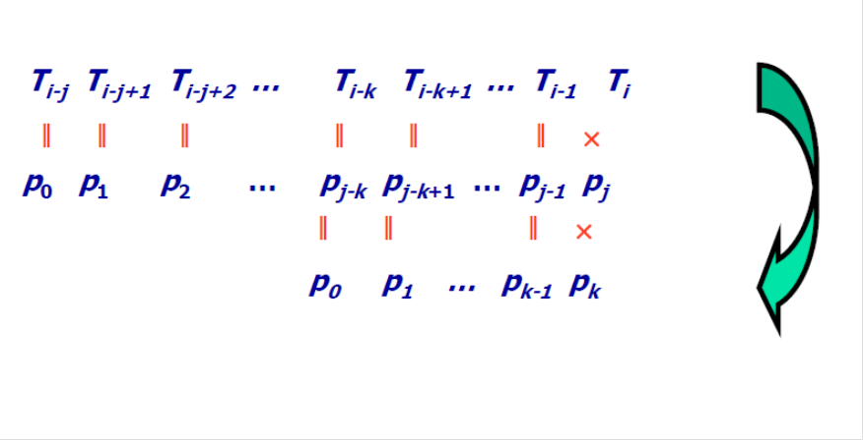
KMP Core
What is K for each p_{i}?

Slide 22
K?
T₀…T_{k-1}＝T_{j-k} …T_{j-1}
（1） k has some relationship with j ，with current matching failure position j ，we can calculate right shifting distance k to obtain a new comparison position
（2）k only depends on T

Slide 23
K?
T₀…T_{k-1} ＝ T_{j-k} …T_{j-1}
From 0 to k-1
Right shifting k positions
From j-1 to j-k
Left shifting
K positions
How far can T right-shift to achieve best efficiency?
k＝max { k |0<=k<j 且T₀…T_{k-1}＝T_{j-k} …T_{j-1} }

Slide 24
Next Function Calculation
Let k = next[ j ]：
-1 when j＝1 //no comparison
max { k | 0<=k<j and T₀…T_{k-1}=T_{j-k} …T_{j-1} }
0 other situations
next[ j ]＝

Slide 25
Next Function Example
j | 0 | 1 | 2 | 3 | 4 | 5 | 6 | 7
t | a | b | a | a | b | c | a | c
next[j] | -1 | 0 | 0 | 1 | 1 | 2 | 0 | 1
j=0, next[ j ]＝ -1；
j=1, next[ j ]＝ 0；
j=2, t₀≠t₁，k=0；
j=3, t₀＝t₂，k=1；
j=4, t₀＝t₃，k=1；
And so forth

Slide 26
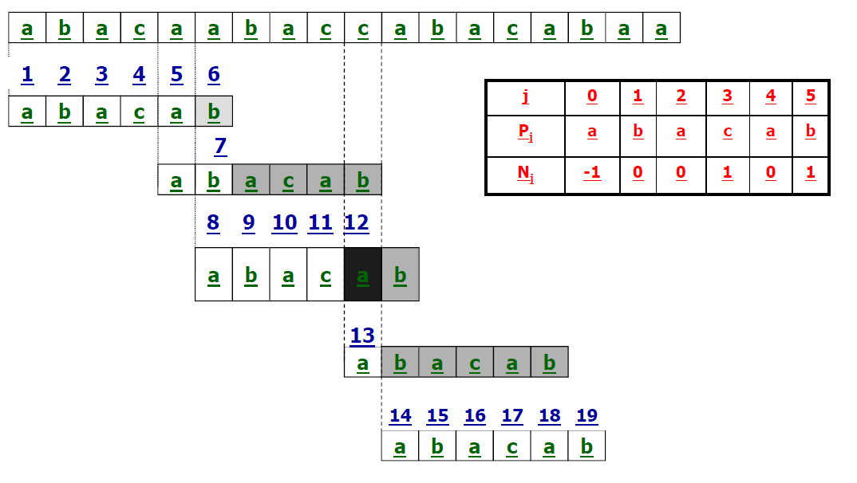
Matching Example

Slide 27
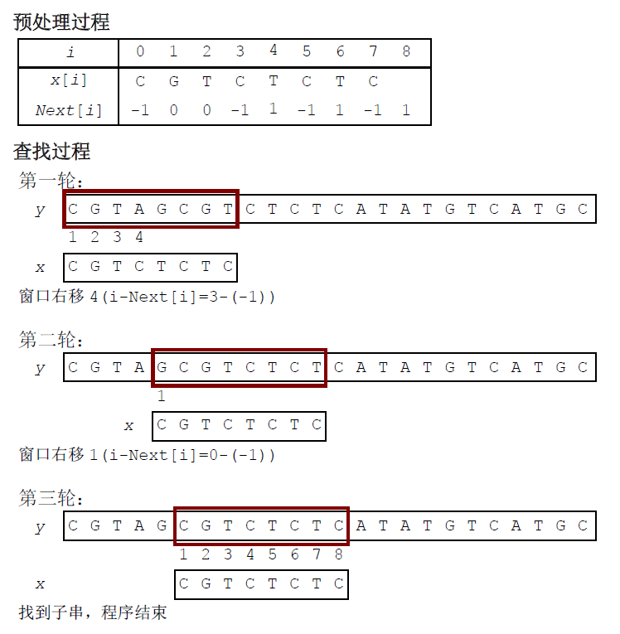
KMP Example

Slide 28
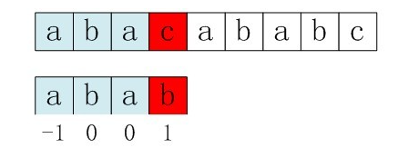
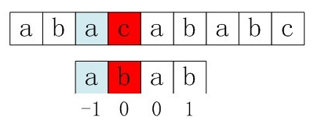
Next Function Optimization
The problem is p[j] = p[ next[j] ]
When p[j] != s[i] ，next comparison will be p[ next [j]] ?s[i]，if p[j] = p[ next[j] ]，it will result in false in the next comparison (because p[j] is tested not equal to s[i], if still use p[next[j]] which is equal to p[j] to compare against s[i], apparently there will be mismatch)
So we need to ensure no p[j] = p[ next[j ]] is allowed
If there is p[j] = p[ next[j] ], what could be the action? We need another iterative calculation, i.e. next[j] = next[ next[j] ].

Slide 29
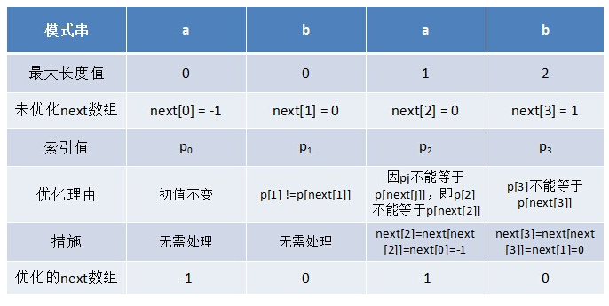
Next Function Optimization

