Slide 1
Data Structures and Algorithm Analysis – Week 9
LUO Zongwei
2018，11，5

Slide 2
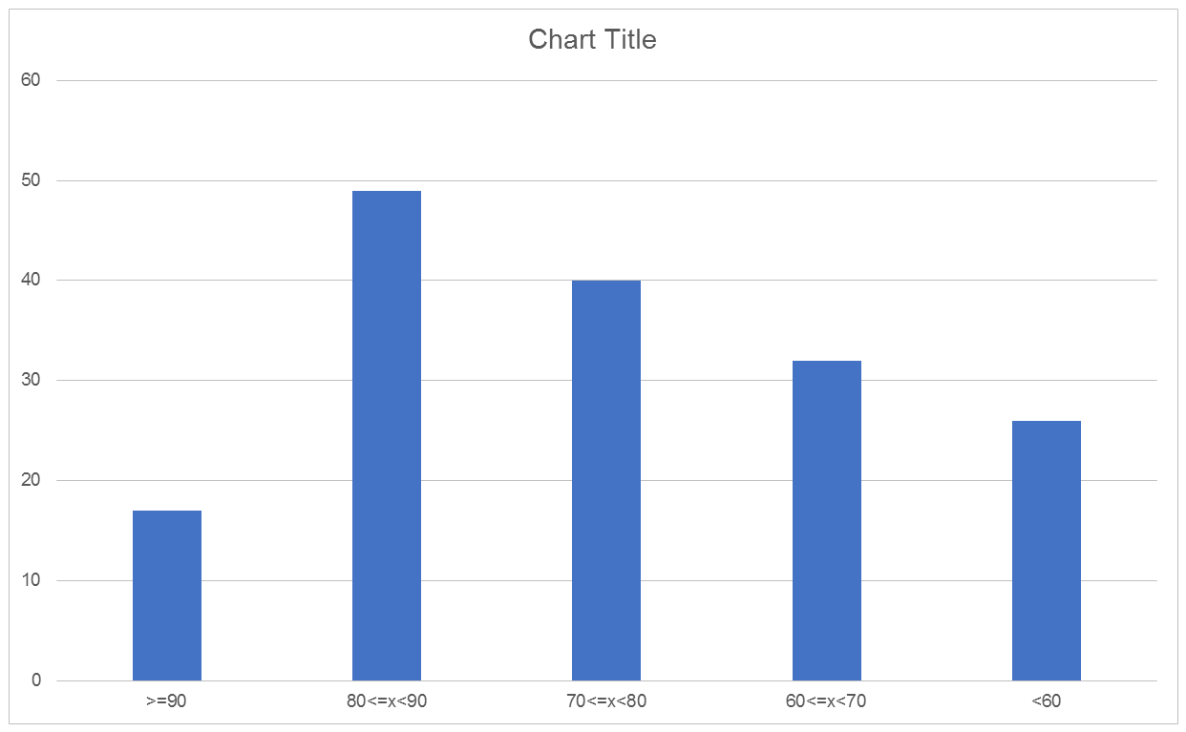
Mid term review

Slide 3



Slide 4
Topics left
Tree
Binary tree
Priority queue/binary heap
Graph/Shortest path
Sorting
Hashing/Disjoint set

Slide 5















Tree
Pedigree Tree
( binary tree )
Lineal Tree

Slide 6
【Definition】A tree is a collection of nodes. The collection can be empty; otherwise, a tree consists of
(1) a distinguished node r, called the root;
(2) and zero or more nonempty (sub)trees T₁, ⋅⋅⋅, T_{k}, each of whose roots are connected by a directed edge from r.

Slide 7

Note:
➢ Subtrees must not connect together. Therefore every node in the tree is the root of some subtree.
➢ There are edges in a tree with N nodes.
➢ Normally the root is drawn at the top.
N − 1

Slide 8

 degree of a node ::= number of subtrees of the node. For example, degree(A) = 3, degree(F) = 0.
A
B
C
D
 degree of a tree ::=
For example, degree of this tree = 3.
E
F
G
H
I
J
K
L
M
 parent ::= a node that has subtrees.
 children ::= the roots of the subtrees of a parent.
 siblings ::= children of the same parent.
 leaf ( terminal node ) ::= a node with degree 0 (no children).

Slide 9
 path from n₁ to n_{k} ::= a (unique) sequence of nodes n₁, n₂, …, n_{k} such that n_{i} is the parent of n_{i+1} for 1 ≤ i < k.
A
B
C
D
 length of path ::= number of edges on the path.
E
F
G
H
I
J
 depth of n_{i} ::= length of the unique path from the root to n_{i}. Depth(root) = 0.
K
L
M
 height of n_{i} ::= length of the longest path from n_{i} to a leaf. Height(leaf) = 0, and height(D) = 2.
 height (depth) of a tree ::= height(root) = depth(deepest leaf).
 ancestors of a node ::= all the nodes along the path from the node up to the root.
 descendants of a node ::= all the nodes in its subtrees.

Slide 10
Implementation?

Slide 11
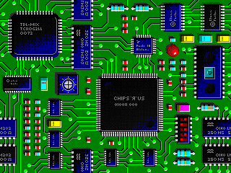
Wire Routing
Notes:
Represent as a grid in which components and already placed wires are denoted by
blocked grid positions.

Slide 12
Wire Router
start pin
end pin
Label all reachable squares 1 unit from start.
Notes:
Could use rat in a maze animation from Web site instead.
Blue squares are blocked squares. Orange squares are available to route a wire.
A queue of reachable squares is used. The queue is initially empty, and the start pin square/cell is the examine cell. This cell has a distance value of 0. Unreached unblocked squares adjacent to the examine cell are marked with their distance (this is 1 more than the distance value of the examine cell) and added to the queue. Then a cell is removed from the queue and made the new examine cell. This process is repeated until the end pin is reached or the queue becomes empty. Cells become examine cells in order of their distance from the start pin.

Slide 13
Wire Router
6
5
6
start pin
4
5
3
3
end pin
2
2
1
1
2
2
2
6
3
4
3
4
5
6
4
4
5
6
5
6
5
6
6
End pin reached. Traceback.

Slide 14

❖ List Representation
A
( A )
B
C
D
( A ( B, C, D ) )
E
F
G
H
I
J
( A ( B ( E, F ), C ( G ), D ( H, I, J ) ) )
K
L
M
( A ( B ( E ( K, L ), F ), C ( G ), D ( H ( M ), I, J ) ) )
So the size of each node
depends on the number of
branches.
Hmmm... That’s not good.
E
K
B
L
F
A
C
G
H
M
D
I
J

Slide 15
❖ FirstChild-NextSibling Representation
Element
A
FirstChild
NextSibling
N
B
C
D
A
N
B
C
D
E
F
G
H
I
J
E
F
G
H
I
J
N
N
N
N
N
N
N
K
L
M
K
L
M
N
N
N
N
N
Note: The representation is not unique since the children in a tree can be of any order.

Slide 16
Binary Trees
【Definition】A binary tree is a tree in which no node can have more than two children.
Element
Left
Right

Slide 17
Rotate the FirstChild-NextSibling tree clockwise by 45°.
A
45°
A
N
N
B
B
C
D
E
N
N
K
C
N
F
E
F
G
H
I
J
L
N
N
N
G
D
N
N
N
N
N
N
N
N
N
N
H
K
L
M
N
N
N
N
N
M
N
I
Left
N
N
N
J
N
Right

Slide 18
❖ Expression Trees (syntax trees)
〖Example〗 Given an infix expression:
A + B ∗ C / D
+
A
/
∗
D
B
C

Slide 19


Constructing an Expression Tree
〖Example〗 ( a + b ) * ( c * ( d + e ) ) =
a b + c d e + * *
a
+
+
b
*
c
c
d
*
+
e
T₂
T₂
a
b
a
+
b
c
T₁
d
*
+
e
T₁
T₁
a
b
c
d
+
e
T₁
T₂
T₂
d
e

Slide 20
Tree Traversals
visit each node exactly once
❖ Preorder Traversal
void preorder ( tree_ptr tree )
{ if ( tree ) {
visit ( tree );
for (each child C of tree )
preorder ( C );
}
}
1
2
3
4
5
6
7

Slide 21
❖ Postorder Traversal
void postorder ( tree_ptr tree )
{ if ( tree ) {
for (each child C of tree )
postorder ( C );
visit ( tree );
}
}
1
2
3
4
5
6
7

Slide 22
❖ Levelorder Traversal
void levelorder ( tree_ptr tree )
{ enqueue ( tree );
while (queue is not empty) {
visit ( T = dequeue ( ) );
for (each child C of T )
enqueue ( C );
}
}

Slide 23

1
1
2
3
4
2
3
5
6
7
4
5
6
7
1
2
3
4
5
6
7

Slide 24
❖ Preorder Traversal
❖ Postorder Traversal
void preorder ( tree_ptr tree )
{ if ( tree ) {
visit ( tree );
for (each child C of tree )
preorder ( C );
}
}
void postorder ( tree_ptr tree )
{ if ( tree ) {
for (each child C of tree )
postorder ( C );
visit ( tree );
}
}
❖ Levelorder Traversal
void levelorder ( tree_ptr tree )
{ enqueue ( tree );
while (queue is not empty) {
visit ( T = dequeue ( ) );
for (each child C of T )
enqueue ( C );
}
}

Slide 25
❖ Inorder Traversal
void inorder ( tree_ptr tree )
{ if ( tree ) {
inorder ( tree->Left );
visit ( tree->Element );
inorder ( tree->Right );
}
}
Iterative Program
void iter_inorder ( tree_ptr tree )
{ Stack S = CreateStack( MAX_SIZE );
for ( ; ; ) {
for ( ; tree; tree = tree->Left )
Push ( tree, S ) ;
tree = Top ( S ); Pop( S );
if ( ! tree ) break;
visit ( tree->Element );
tree = tree->Right; }
}
1
2
3
4
5
6
7

Slide 26
〖Example〗 Given an infix expression:
A + B ∗ C / D
+
Then inorder traversal ⇒
A + B ∗ C / D
postorder traversal ⇒
A B C ∗ D / +
preorder traversal ⇒
+ A / ∗ B C D
A
/
∗
D
B
C

Slide 27

Directory listing in a hierarchical file system
/usr
mark
alex
bill
book
course
hw.c
hw.c
work
course
ch1.c
ch2.c
ch3.c
cop3530
cop3212
fall96
spr97
sum97
fall96
fall97
syl.r
syl.r
syl.r
grades
p1.r
p2.r
p2.r
p1.r
grades
Unix directory
Listing format: files that are of depth d_{i} will have their names indented by d_{i} tabs.

Slide 28
/usr
mark
book
Ch1.c
Ch2.c
Ch3.c
course
cop3530
fall96
syl.r
spr97
syl.r
sum97
syl.r
hw.c
alex
hw.c
bill
work
course
cop3212
fall96
grades
p1.r
p2.r
fall97
p2.r
p1.r
grades
static void ListDir ( DirOrFile D, int Depth )
{
if ( D is a legitimate entry ) {
PrintName (D, Depth );
if ( D is a directory )
for (each child C of D )
ListDir ( C, Depth + 1 );
}
}
T ( N ) = O( N )

Slide 29
/usr
mark
book
Ch1.c
Ch2.c
Ch3.c
course
cop3530
fall96
syl.r
spr97
syl.r
sum97
syl.r
hw.c
alex
hw.c
bill
work
course
cop3212
fall96
grades
p1.r
p2.r
fall97
p2.r
p1.r
grades
Note: Depth is an internal variable and must not be seen by the user of this routine. One solution is to define another interface function as the following:
void ListDirectory ( DirOrFile D )
{ ListDir( D, 0 ); }

Slide 30
〖Example〗 Calculating the size of a directory.
/usr
1
mark
1
alex
bill
1
1
book
course
hw.c
hw.c
work
course
1
1
6
8
1
1
ch1.c
ch2.c
ch3.c
cop3530
cop3212
3
2
4
1
1
fall96
spr97
sum97
fall96
fall97
1
1
1
1
1
syl.r
syl.r
syl.r
grades
p1.r
p2.r
p2.r
p1.r
grades
1
5
2
3
4
1
2
7
9
Unix directory with file sizes

Slide 31
static int SizeDir ( DirOrFile D )
{
int TotalSize;
TotalSize = 0;
if ( D is a legitimate entry ) {
TotalSize = FileSize( D );
Unix directory with file sizes
if ( D is a directory )
for (each child C of D )
TotalSize += SizeDir(C);
} /* end if D is legal */
return TotalSize;
}
T ( N ) = O( N )

Slide 32

❖ Threaded Binary Trees
Because I enjoy giving
you headaches ... Just kidding.
Okay, think of a full
binary tree with n nodes.
How many links are there?
Here comes
the typical question of mine:
Why do we need
threaded binary trees?
Any clue on how to
improve the situation?
We can replace
the null links by “threads”
which will make traversals
easier.
Then who should
take the credit?
They are
A. J. Perlis and C. Thornton.
You are such a
genius !
n + 1.
Oh well,
I wish I’d have really done it
Of course not!
How many of them
are NULL?
You got it!
Can I stand that?

Slide 33
Rule 1: If Tree->Left is null, replace it with a pointer to the inorder predecessor of Tree.
Rule 2: If Tree->Right is null, replace it with a pointer to the inorder successor of Tree.
Rule 3: There must not be any loose threads. Therefore a threaded binary tree must have a head node of which the left child points to the first node.

Slide 34
typedef struct ThreadedTreeNode *PtrTo ThreadedNode;
typedef struct PtrToThreadedNode ThreadedTree;
typedef struct ThreadedTreeNode {
int LeftThread; /* if it is TRUE, then Left */
ThreadedTree Left; /* is a thread, not a child ptr. */
ElementType Element;
int RightThread; /* if it is TRUE, then Right */
ThreadedTree Right; /* is a thread, not a child ptr. */
}

Slide 35
〖Example〗 Given the syntax tree of an expression (infix)
A + B ∗ C / D
head node
F
F
+
A
/
F
+
F
∗
D
B
C
T
A
T
F
/
F
F
∗
F
T
D
T
T
B
T
T
C
T

