Slide 1
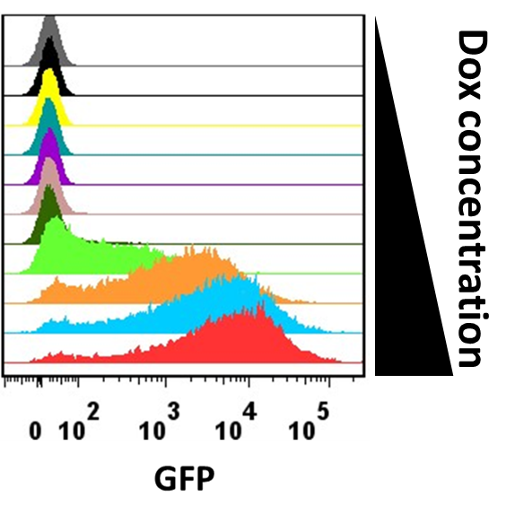
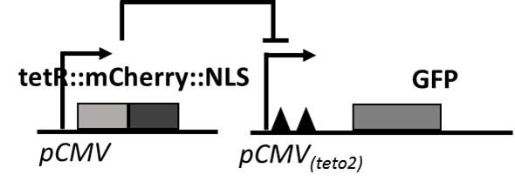
Part 1: Modeling doxycycline-induced GFP expression systems, without feedback
pCMV is a constitutive promoter
Black triangle is a tetR-dimer binding site (tetO), there are two of them near TATA box
NLS is nuclear localization sequence, facilitate the translocation of tetR to nucleus
In the absence of Doxcycline, tetR-dimer preferably binds to tetO, block the RNA polymerase
In the presence of Doxcycline, tetR-dimer preferably disassociate from tetO, remove the interference to RNA polymerase
Please
write step-by-step reactions;
write ODE equations from reactions;
simplified the model with quasi-steady state assumption, please justified the assumptions
play with the parameters to minic data from fig C
A B C
Dox
tetR GFP
Two days after adding Dox

Slide 2
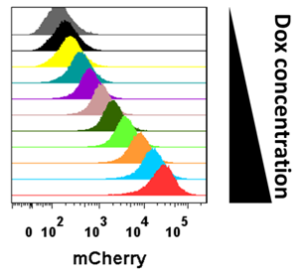
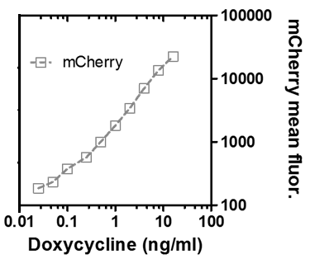
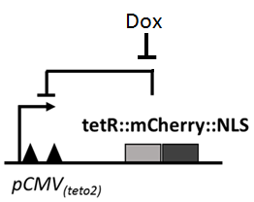
Part 2: Modeling doxycycline-induced mCherry expression systems, with feedback
Please
write step-by-step reactions;
write ODE equations from reactions;
simplified the model with quasi-steady state assumption, please justified the assumptions
play with the parameters to minic data from fig F
Discuss the differences between F and C, and explain them using the model
D E F
Negative feedback
tetR mCherry
Two days after adding Dox

Slide 3
Part 3: Modeling the heterogeneity of the Dox-induced GFP (or mCherry) expressions
Please
Please pay attention to Figures B and E
Simulate the gene expressions in single cells using the ODE model, because you cannot assume quasi-steady state anymore.
Introducing the sources of fluctuations/noises into the model
Simulate the flow cytometry data with simulations of 1000-10000 cells
Trying to adjust sources of fluctuations/noises and parameters to mimic the data in Figures B and E
Discuss your results, and discuss the similarity and discrepancy between the data and your simulations.

