Slide 1
Automated Deployment and Monitoring
of TodoApp with DevOps Practices
Subtitle:Implementing Continuous Integration, Deployment, and Monitoring for a Containerized Todo Application
Presented by: Komal vede
Institute: Sunbeam Institute of Information Technology, Pune

Slide 2

Introduction:
Modern organizations require secure and isolated network environments to protect sensitive data.
A DMZ (Demilitarized Zone) provides an extra layer of security between the internal network and the external internet.
This project implements a multi-server architecture within a DMZ.
Security tools, monitoring systems, and intrusion detection are integrated to protect servers and data.
Ensures safe operations and proactive threat detection against potential attacks.

Slide 3
Project Objective
Containerized TodoApp using Docker.
Deployed application on Kubernetes cluster.
Implemented Persistent Volumes (PV/PVC) for data persistence.
Build CI/CD pipeline: GitHub Actions (CI) → ArgoCD (CD).
Monitored application and cluster using Prometheus and Grafana.

Slide 4
Tools & Technologies Used
Docker – Containerization
Kubernetes – Orchestration
Helm – Packaging applications
GitHub Actions – Continuous Integration
ArgoCD – Continuous Deployment
Prometheus – Metrics collection
Grafana – Dashboards and alerts

Slide 5
Docker Setup
Steps:
Installed Docker on Debian.
Created Dockerfile for Todo App.
Built Docker image & ran two containers:
Database (MySQL)
Todo App
Observation:
Containers communicate via Docker network.
Application successfully containerized.

Slide 6
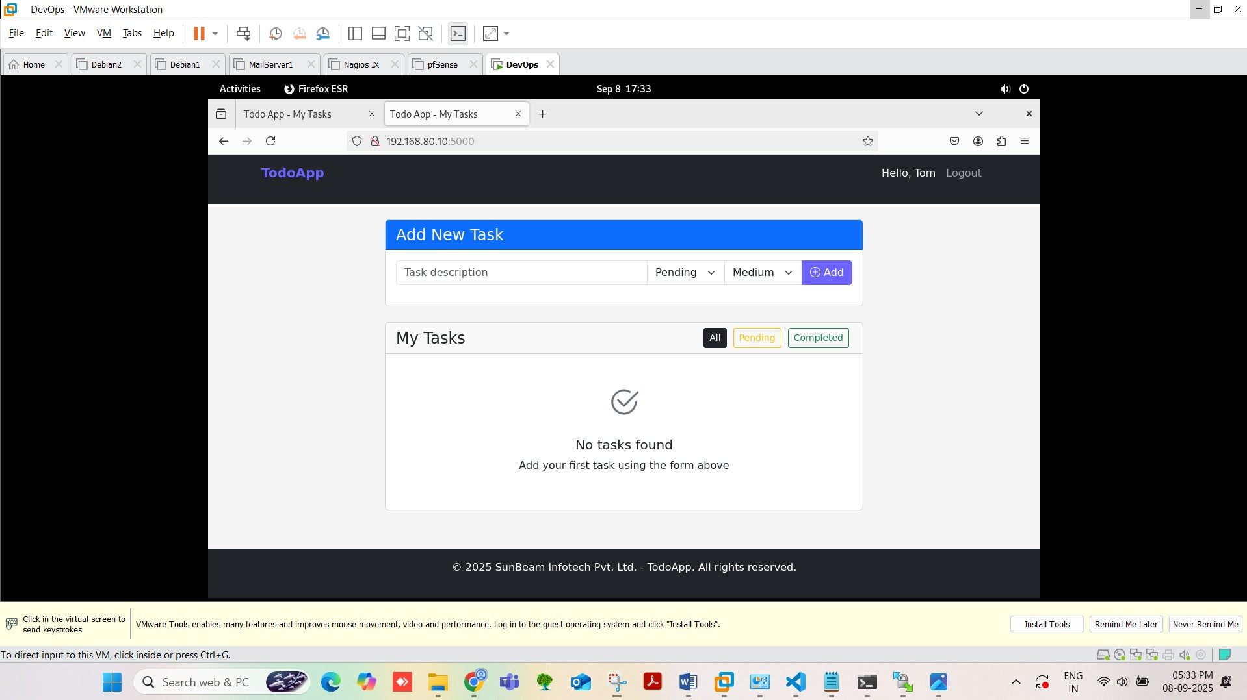

Slide 7
Kubernetes Cluster Setup
Steps:
Created 2 VMs: Master & Worker.
Installed K8s components: kubeadm, kubelet, kubectl.
Initialized Master Node & joined Worker Node.
Observation:
Multi-node Kubernetes cluster is ready.
Supports high availability and scaling.

Slide 8
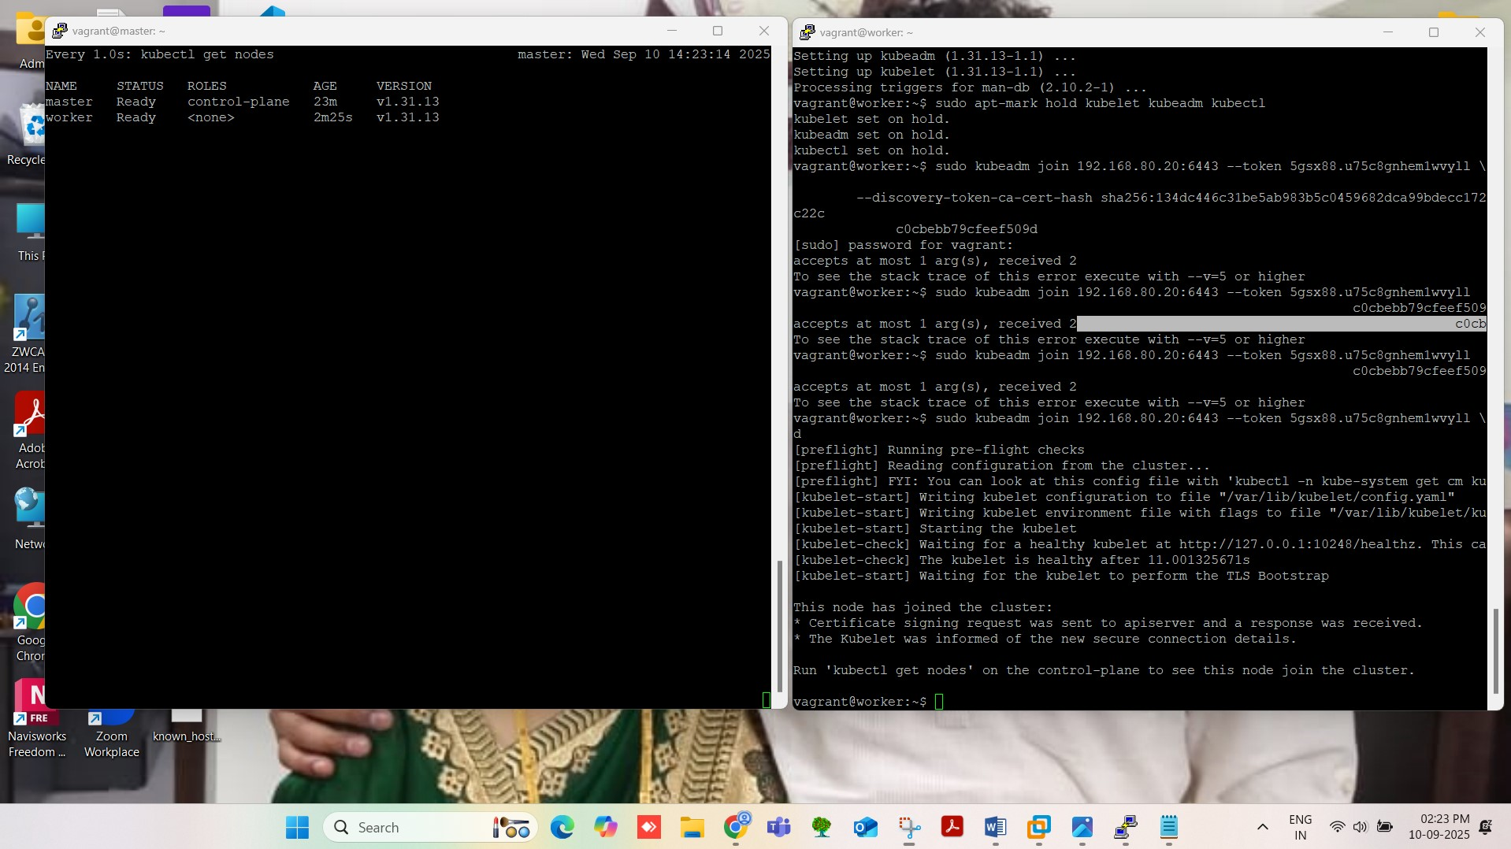

Slide 9
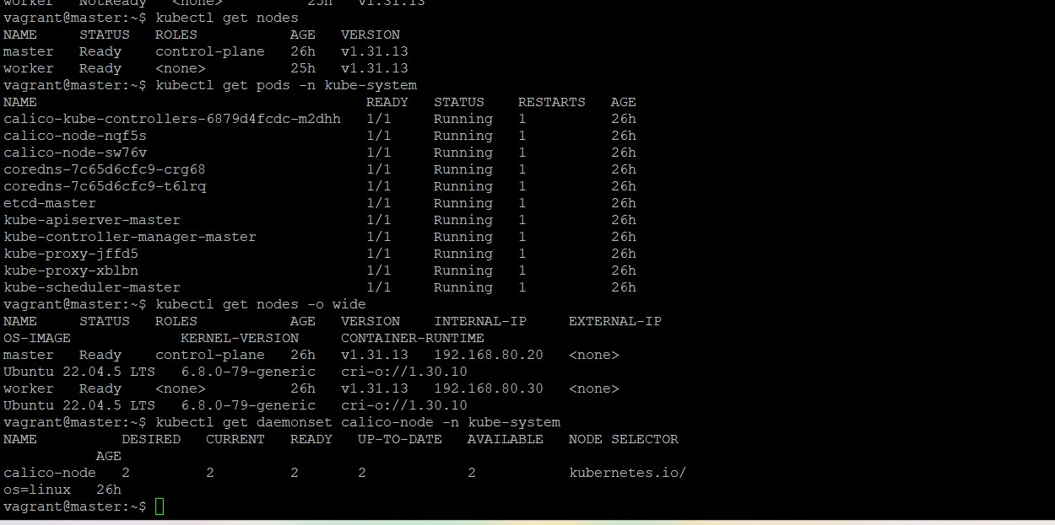

Slide 10
Application Orchestration
Steps:
Created Deployment YAML for Todo App.
Created Service YAML for exposing app.
Applied resources using kubectl.
Observation:
App runs with multiple replicas.
NodePort Service exposes app externally.

Slide 11
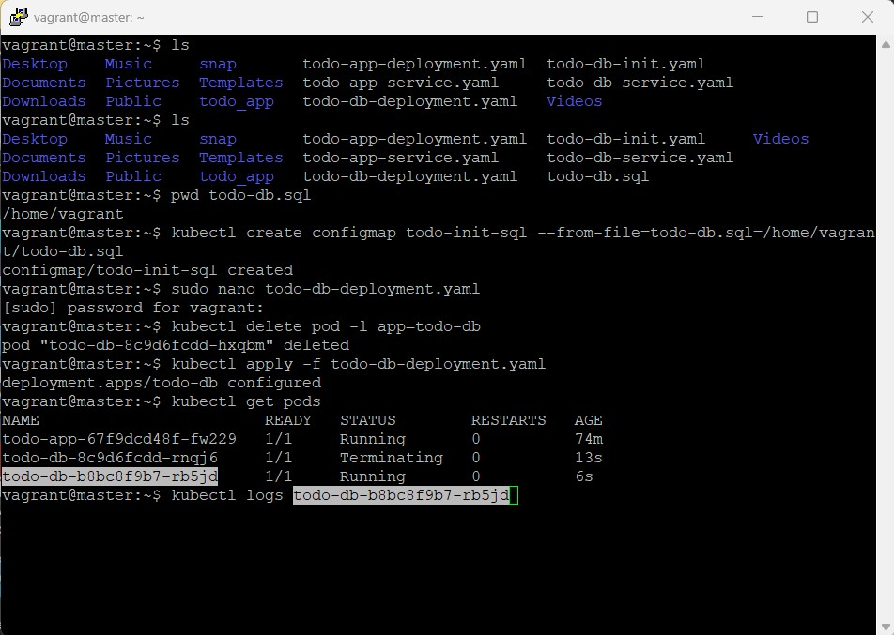

Slide 12
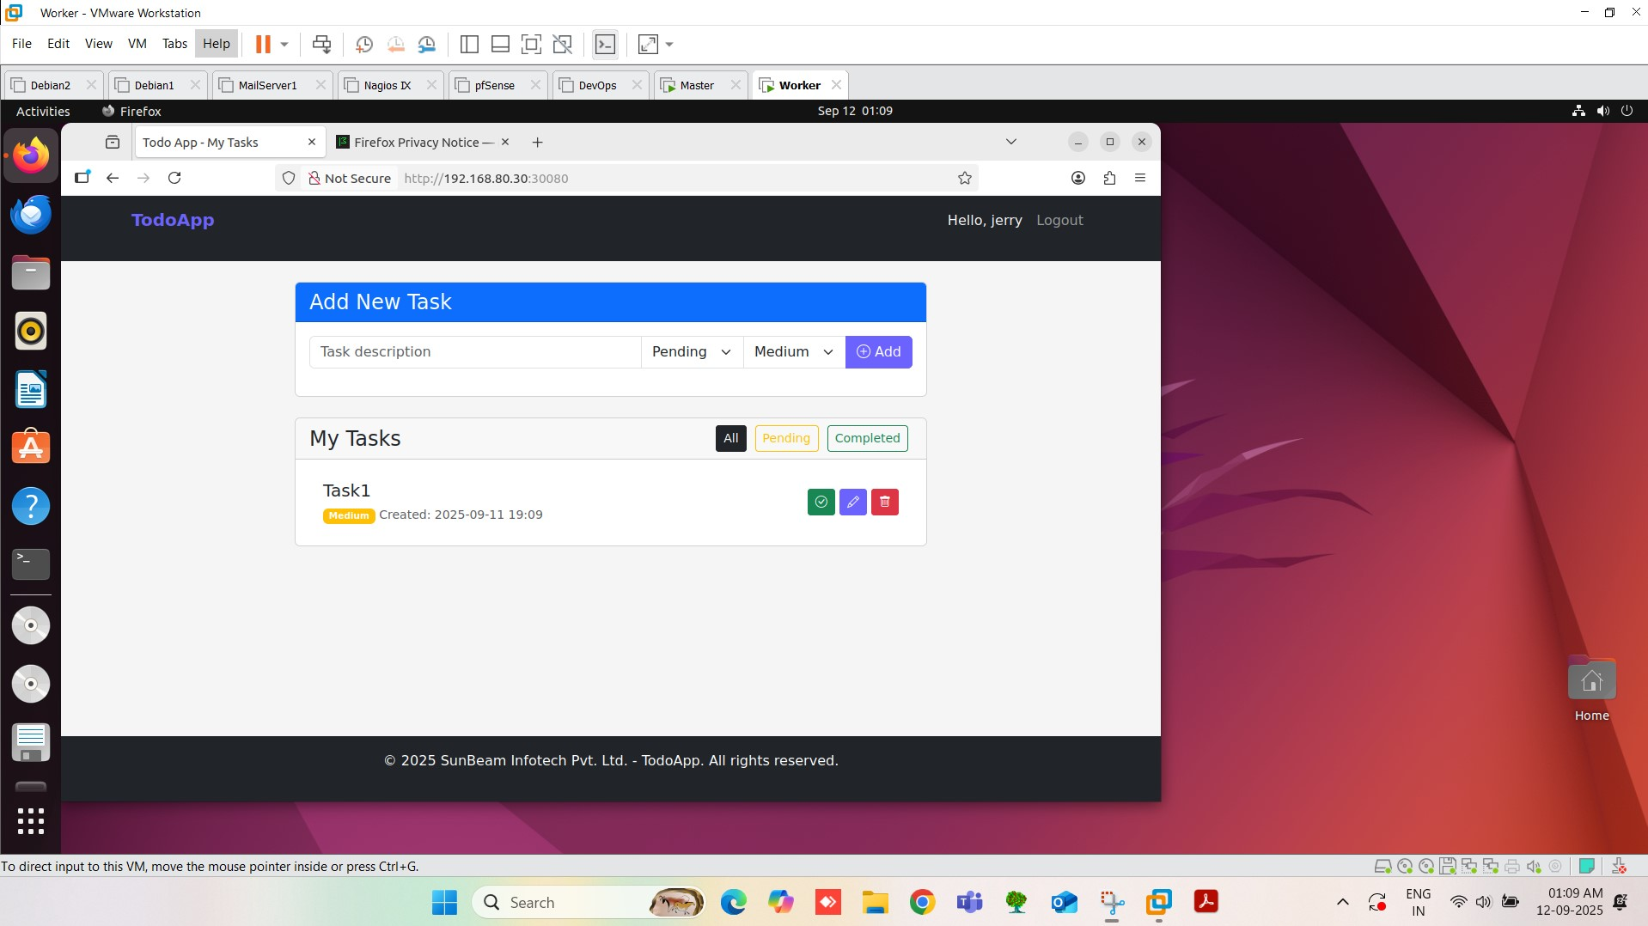

Slide 13
Persistent Storage & CI/CD
Persistent Storage:
Created PV & PVC for MySQL database.
Data persists even if pod restarts.
CI/CD Implementation:
CI: GitHub Actions → Build & push Docker image.
CD: ArgoCD → Deploy updates to Kubernetes.
Helm Charts: Manage app, DB, PV/PVC dynamically.

Slide 14
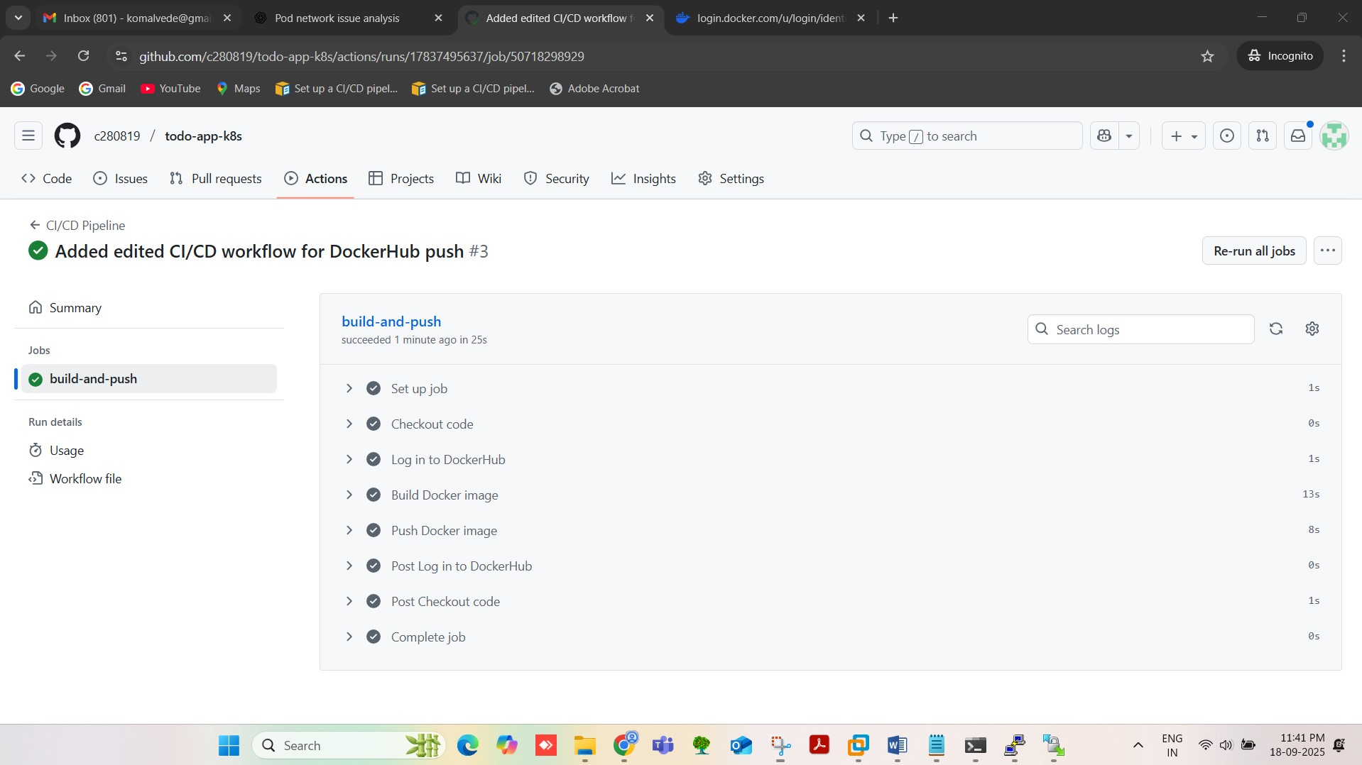

Slide 15
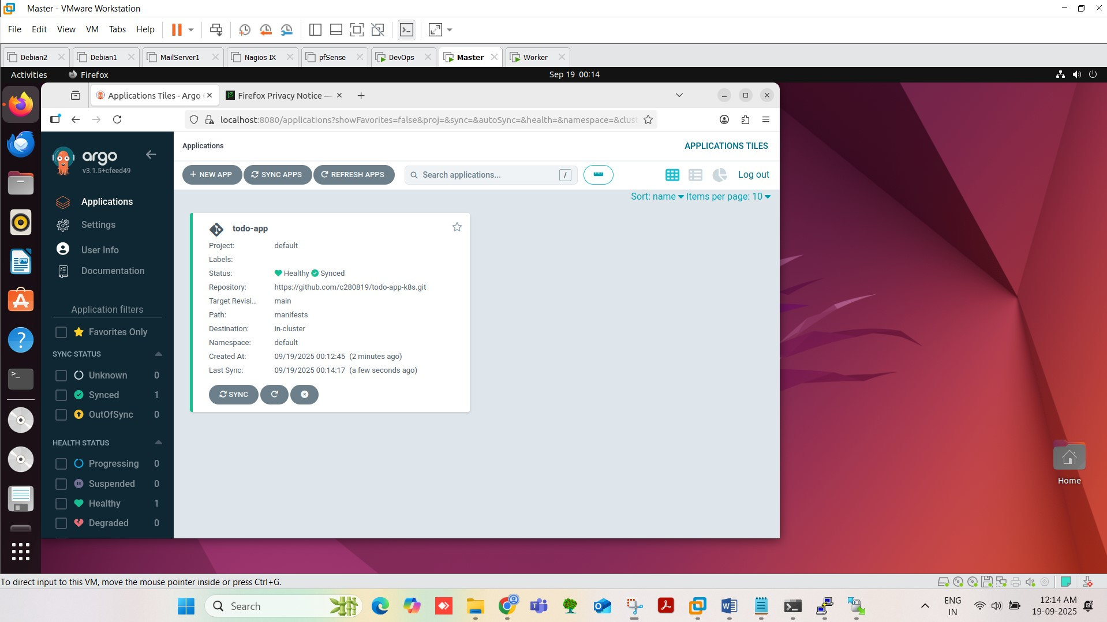

Slide 16
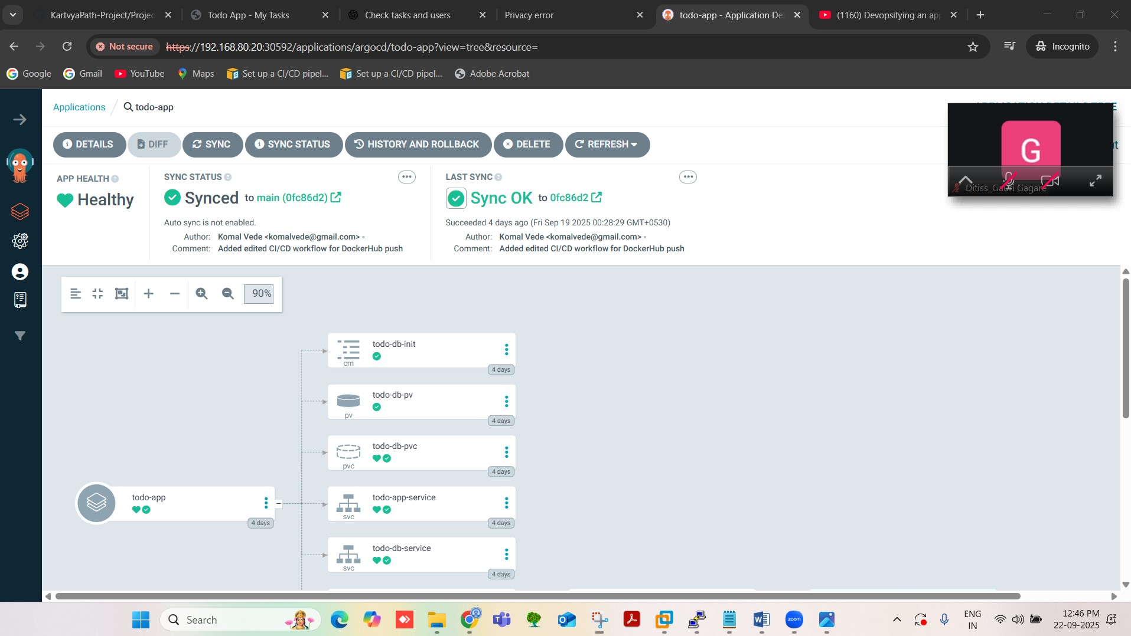

Slide 17
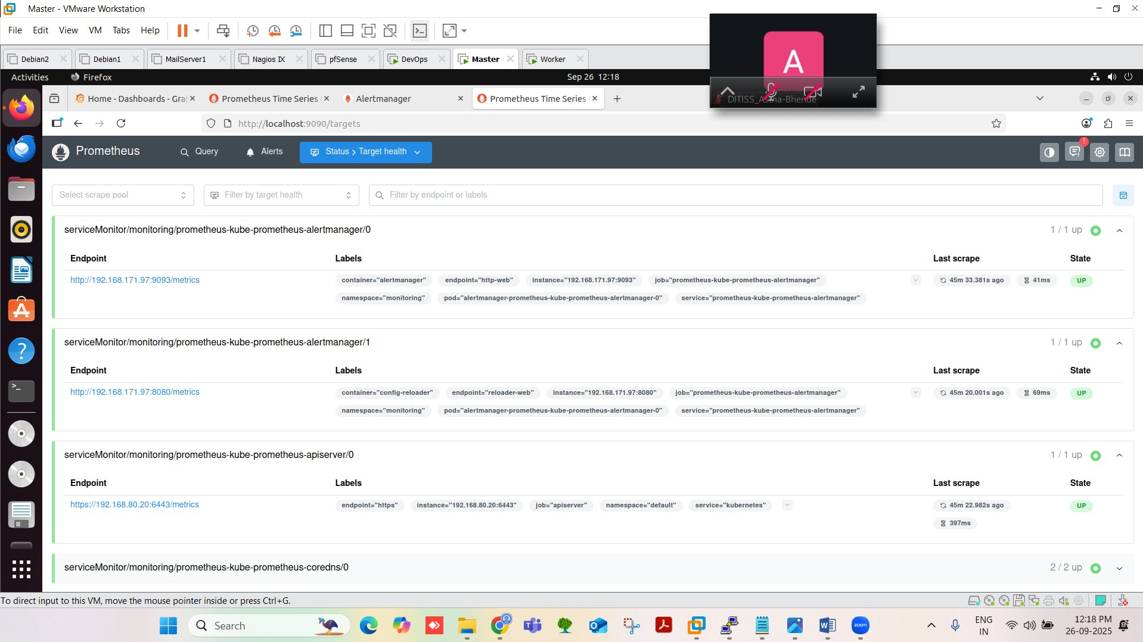

Slide 18
Conclusion
Demonstrated full DevOps lifecycle: containerization → orchestration → automation → monitoring.
Ensured automation, scalability, and observability.
Provides a practical example of modern DevOps practices.

Slide 19
THANK YOU

