Slide 1
Oyster Anatomy
Eastern Oyster: Crassostrea Virginica
anatomy -
  the branch of science concerned with the bodily structure of living organisms, especially as revealed by dissection and the separation of parts.
  the study of the structure of internal workings of something
Notes:
Unless otherwise noted, photos courtesy of http://ww2.mdsg.umd.edu/interactive_lessons/oysters/anatlab/index.htm

Slide 2
External Anatomy

Slide 3
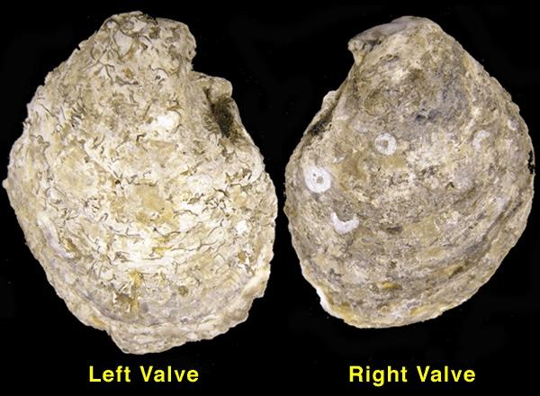

Slide 4
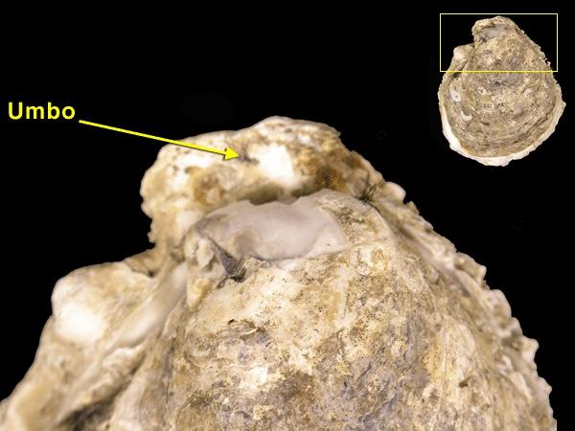
Notes:
The umbo is the oldest part of the oyster shell. This is where the oyster is hinged.

Slide 5
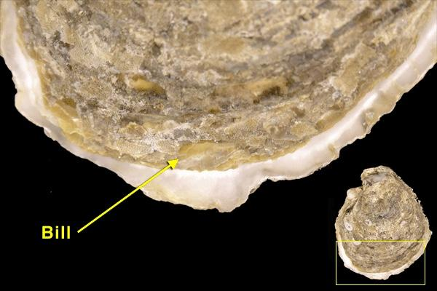
Notes:
As the oyster grows, shell is laid down where the shells are attached to one another. This end is called the bill and is free to open so the oyster can filter feed.

Slide 6
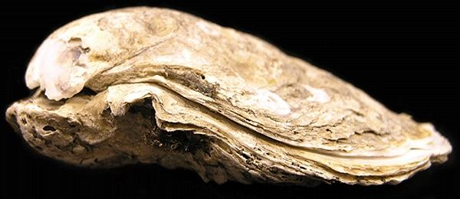

Slide 7
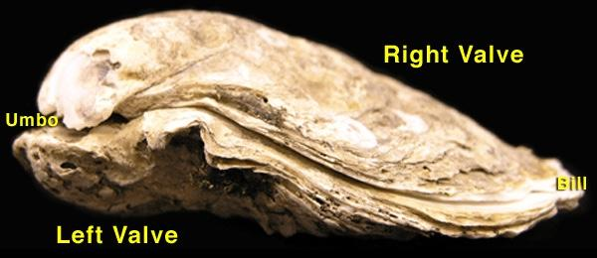

Slide 8
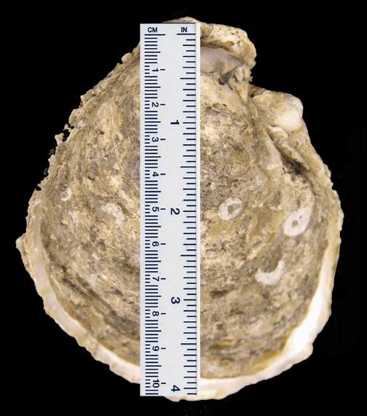

Slide 9
Oyster Artifacts
Evidence of organisms that lived on the oyster.

Slide 10
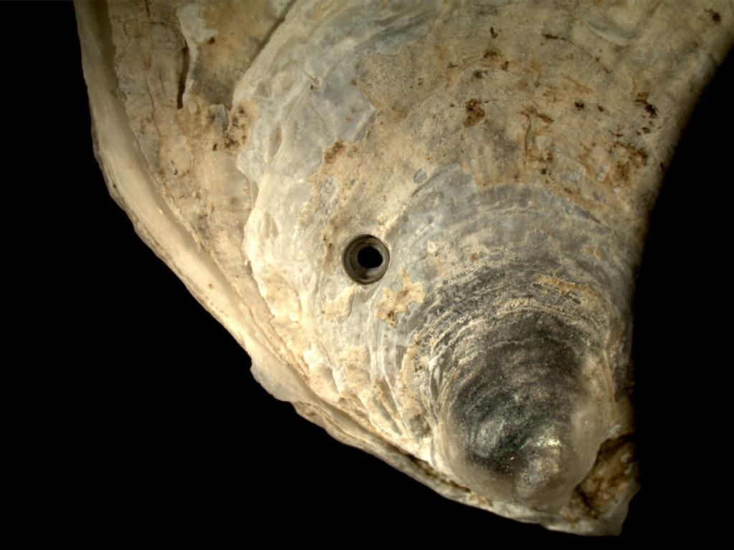
Notes:
The oyster drill is a species of predatory sea snail. The oyster drill secretes an enzyme to soften an oyster’s shell, then drill pin-sized holes through the shell to reach the oyster’s soft parts inside.
Photo courtesy of: http://www.davisenterprise.com/media-post/drilled-oyster-photos/attachment/oyster1w/

Slide 11
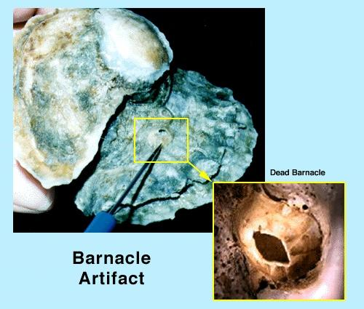
Notes:
Commensal symbiosis. You may find a live or dead barnacle attached to the oyster shell.

Slide 12
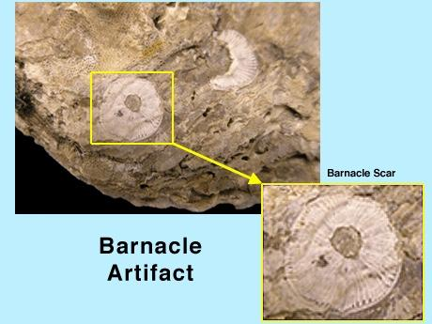
Notes:
Footprint scar of a barnacle on an oyster shell where a barnacle used to be attached. These scares are typically round and have striations radiating from the center.

Slide 13
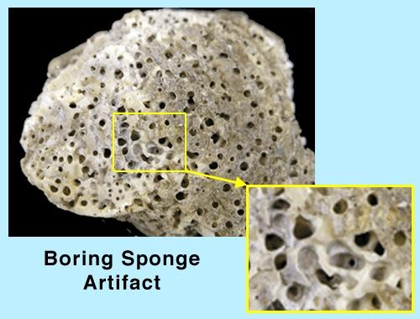
Notes:
Predatory. This picture shows the holes created by the boring sponge in the oyster shell.

Slide 14
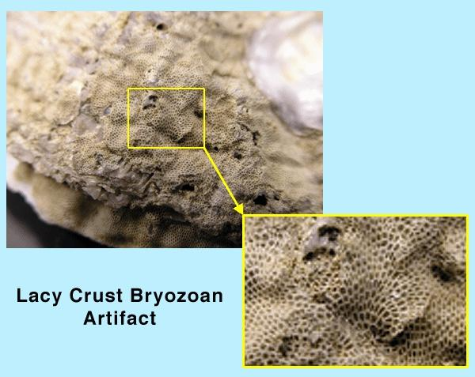
Notes:
Commensal symbiosis. This picture shows the encrusting structure created by the lacy crust bryozoan on an oyster. These colonies have a hony-comb appearance.

Slide 15
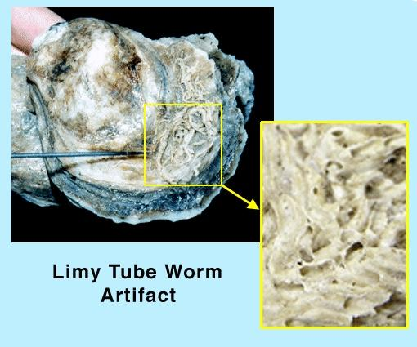
Notes:
Commensal symbiosis. This show the calcareous tube remains of a limey tube worm on an oyster.

Slide 16
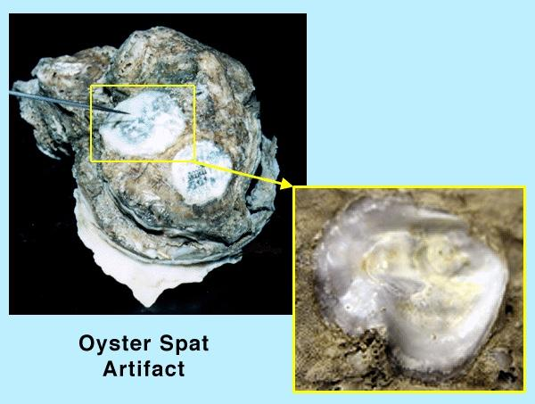
Notes:
Commensal symbiosis. Scar of where an oyster spat used to be. Oyster spat scars are smooth and often irregularly shaped.

Slide 17
Internal Anatomy

Slide 18
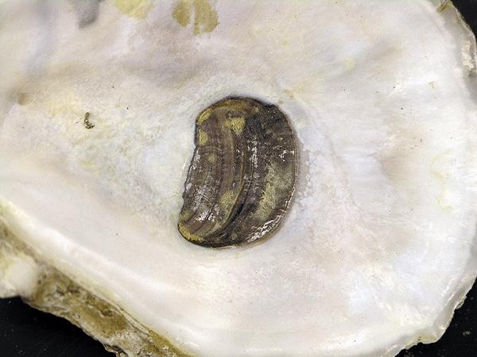
Notes:
This is the abductor muscle scar and shows where the abductor muscle was once attached to the shell.

Slide 19
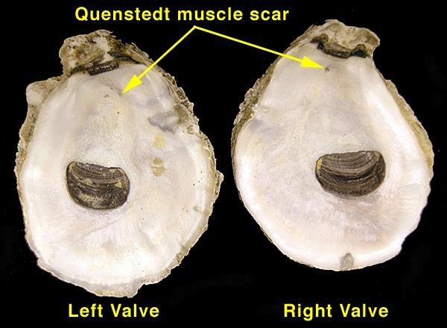

Slide 20
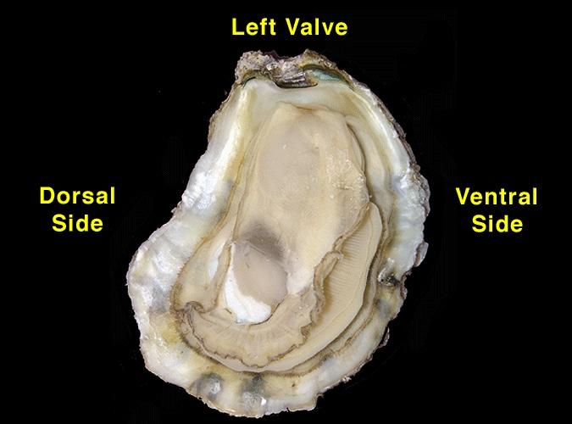

Slide 21
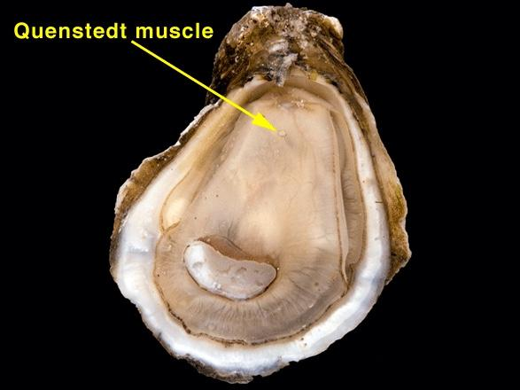
Notes:
Challege! Can you find the quenstedt muscle in your oyster? This muscle is most likely a foot (pedal) remnant from the larval stage of the oyster.

Slide 22
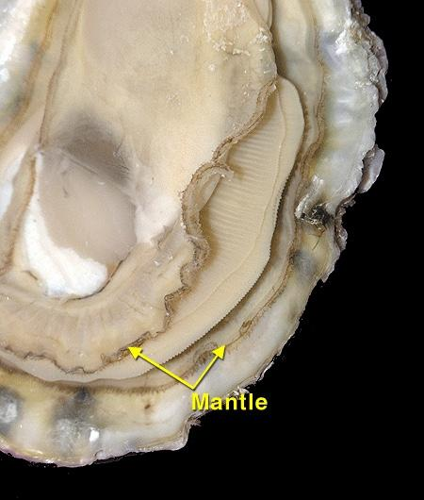
Notes:
The mantle is a thin layer of tissue that lines the inner part of each shell (valve) and covers the entire body of the oyster. It contains glands that extract elements from the water and convert them to compounds that make up each valve. Calcium carbonate makes up about 98 percent of each valve, this is the same material used to make chalk.

Slide 23
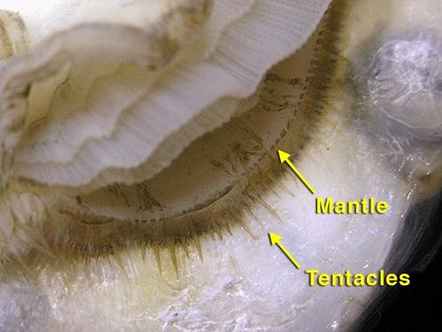
Notes:
The tentacles are small sensory organs attached to the edge of the mantle used for the detection of environmental stimuli. They can sense changes in light, chemicals in the water, sediments, and temperature. Oysters don’t have a brain, but they do have simple nervous systems containing nerves and organs called ganglia (which will NOT be visible in the dissection).

Slide 24
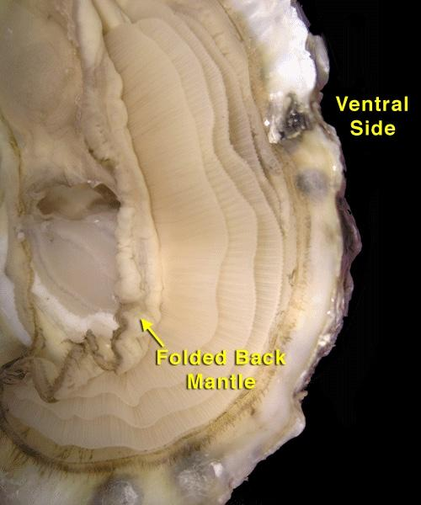

Slide 25
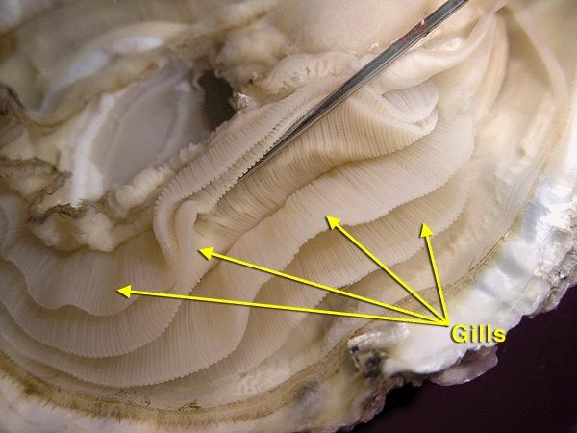
Notes:
The gills are the largest organ in the oyster. Each gill has two folds (or four layers) of tissue. The gills are covered by tiny hairs, known as cilia, which move water across the oyster’s body, moving food toward the oyster’s mouth and removing oxygen from the water.

Slide 26
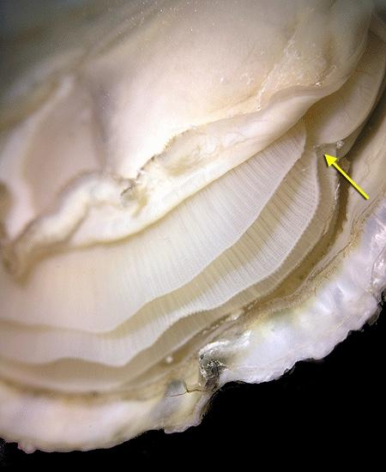
Notes:
Anterior point of gill attachment

Slide 27
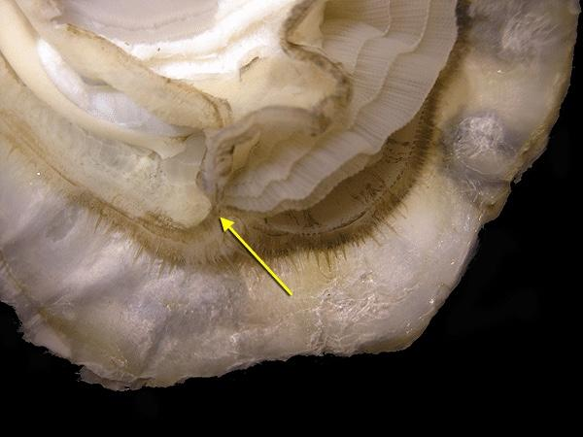
Notes:
Posterior point of gill attachment.

Slide 28
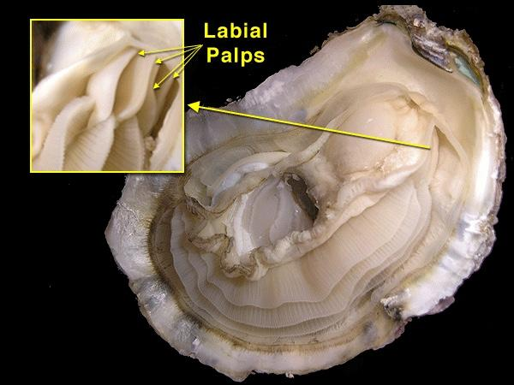
Notes:
Follow the gills up toward the umbo area. There will be a slit followed by two thicker layers of tissue. These are the palps and this is the area where the mouth can be found. Food enters the oyster through the mouth.

Slide 29
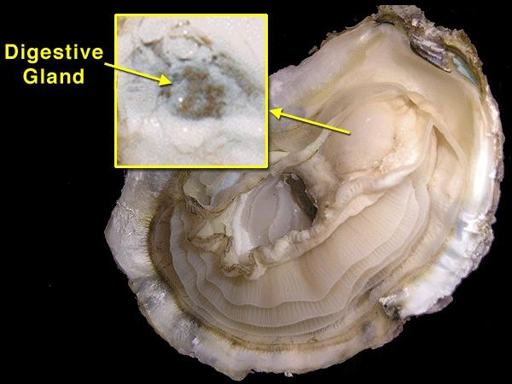
Notes:
Food is passed from the mouth through a short esophogus to the stomach. In connects to the intestines and is surrounded by the digestive glands. The stomach and digestive glands lie under the mantle layer and will often be dark brown. This is where food is broken down into nutrients.

Slide 30
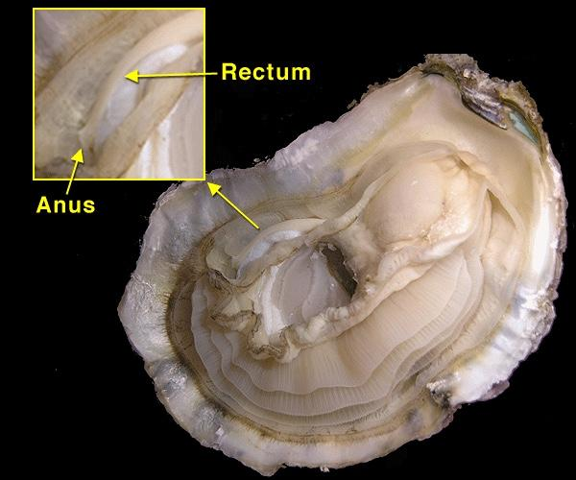
Notes:
From the stomach undigested and digested materials are passed to the intestines where absorption of nutrients and further processing of wastes occurs. Waste products are passed onto the rectum exiting out the anus.

Slide 31
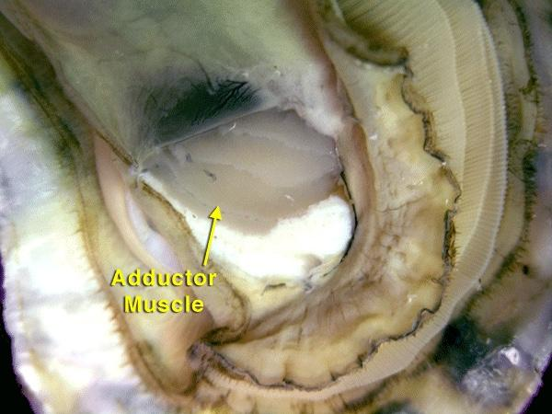
Notes:
The abductor muscle is what holds an oyster closed when it is alive. This muscle is very strong and make up about 20-40% of the soft tissue weight of the oyster. This is a notably different type of tissue, generally shaped like an oval.

Slide 32
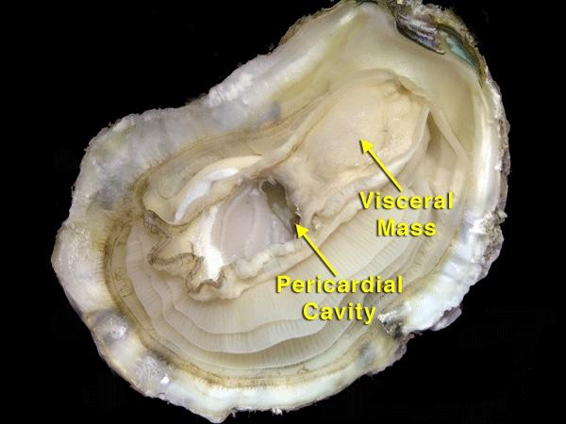
Notes:
Pericardial cavity holds the heart which lies just above the abductor muscle. The oyster’s heart has three chambers (whereas the human heart has four). Sometimes you can see it beating. It is located in a clear sac and looks like a tiny sponge connected to a tube. Oysters have blood, but it is not red like human blood. The heart pumps the blood through the oyster’s body. The oyster does not have defined veins. Instead blood drains through open sinuses within the body.

Slide 33
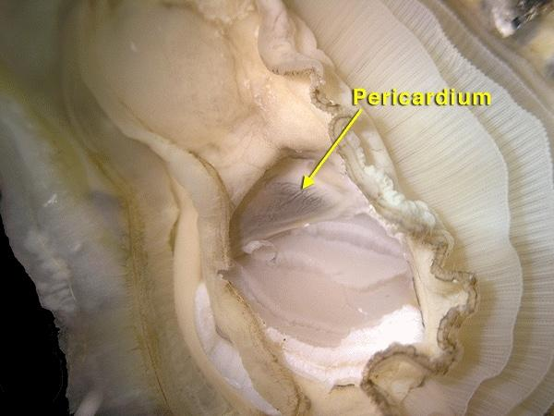

Slide 34
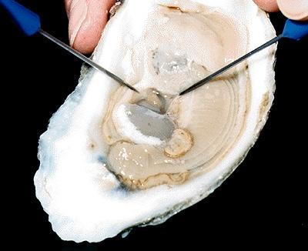

Slide 35
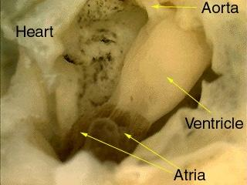

Slide 36
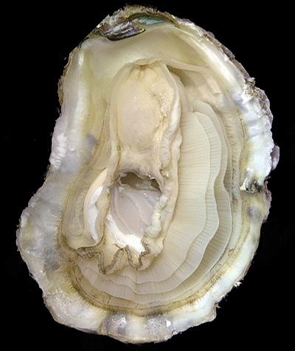
Notes:
Can you locate the following body parts?
Gills, labial palps, mouth, esophogus, stomach, digestive gland, intestine, rectum, anus

