Slide 1

New Members Orientation

Slide 2
Who we are?
C2PA Charter
Develop technical specifications that can establish content provenance and authenticity at scale to give publishers, creators, and consumers the ability to trace the origin of media.
Joint Development Foundation Project
https://www.jointdevelopment.org/
February 2021

Slide 3
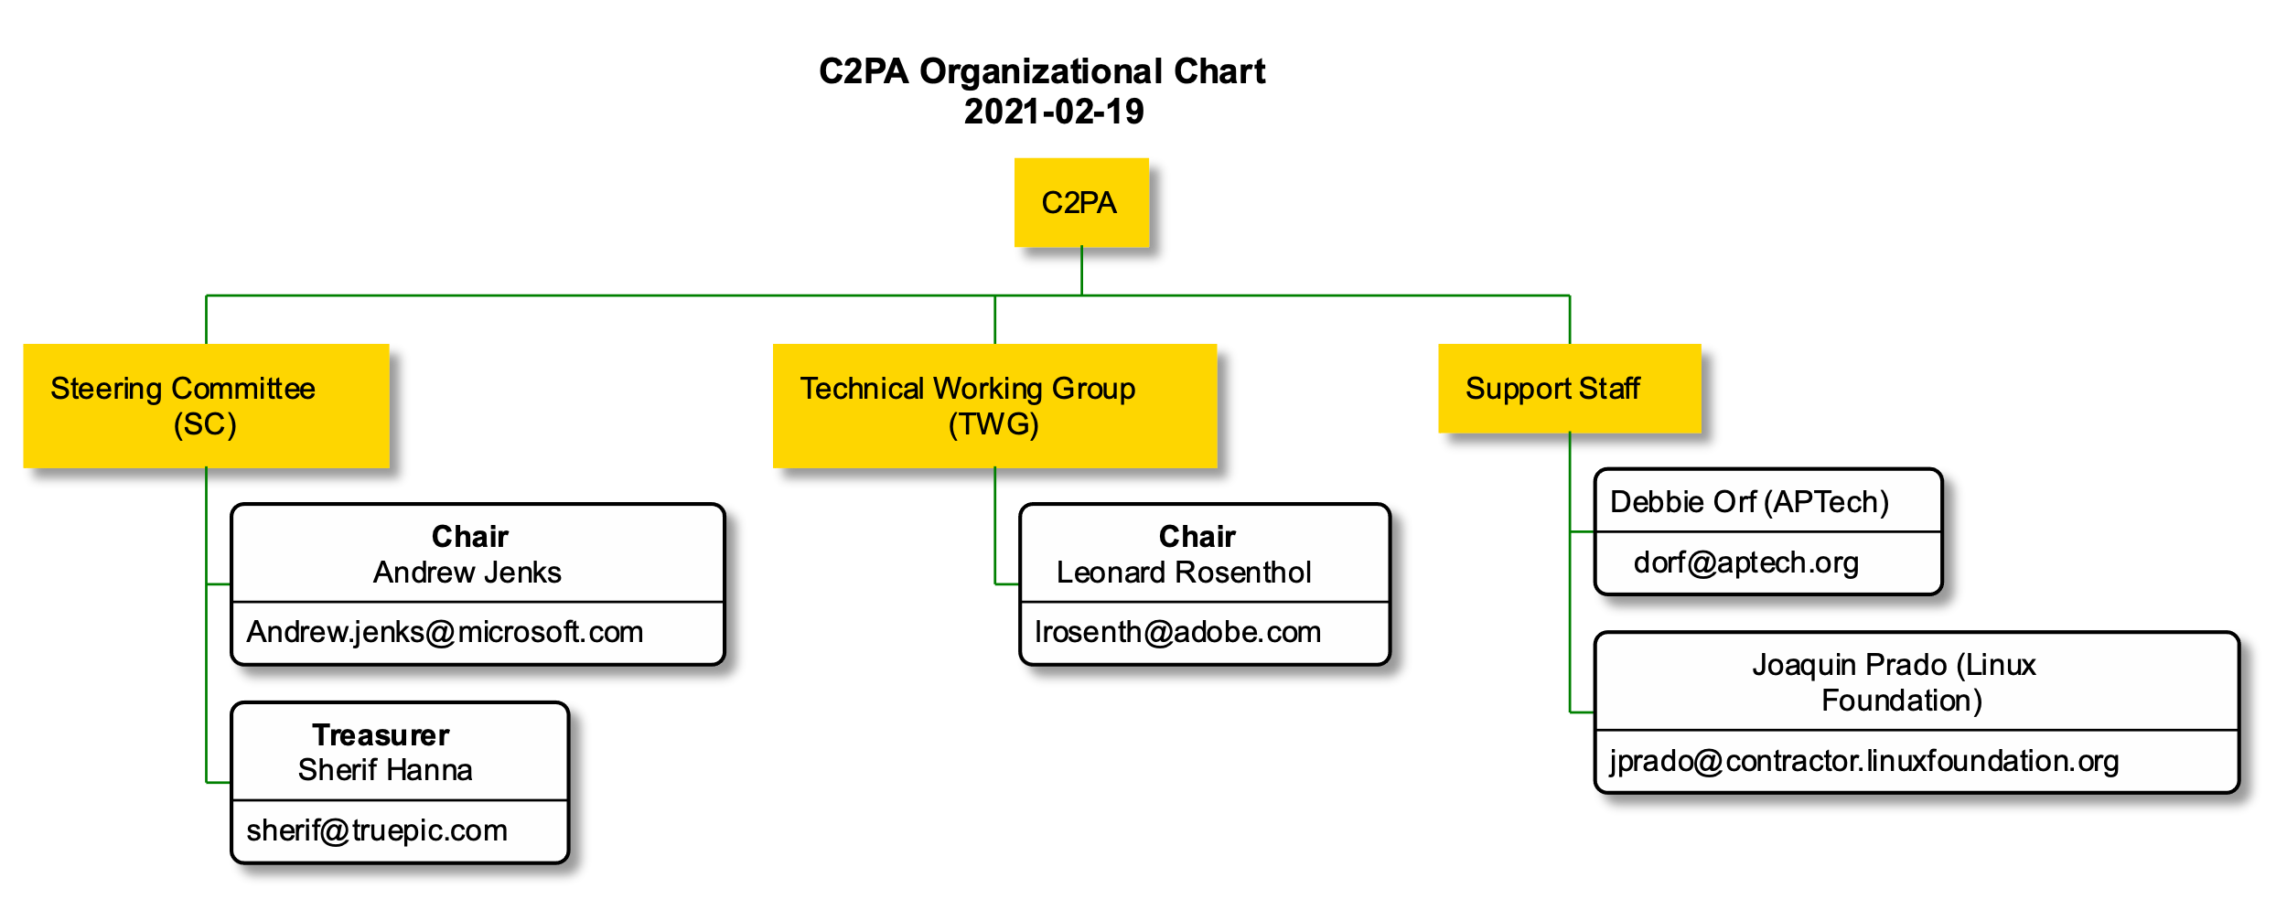
Organizational Structure

Slide 4
How we work
Tools
Groups.io
GitHub
Slack
Helpdesk
help@c2pa.org

Slide 5
Groups.io
Collaboration Platform
Online platform that provides document storage, mailing lists, calendar, membership management
Groups Available to Members
Main
By invitation only
Common area to all C2PA members
Steering Committee (SC)
By invitation only
Calendar
Files
Technical Working Group (TWG)
By invitation only
Calendar
Files

Slide 6
Group.io Invitation
1. Invitation sent by the Project Manager (PM)
2. You will receive the several emails:
Welcome to main@lists.c2pa.org
You have been added to the main@lists.c2pa.org
One email for each group to which you have been added, e.g. “Welcome to twg@lists.c2pa.org”
3. Click to create your account

Slide 7
Group.io – Email Invitation
Invitation email sent by PM
You will be invited by default to Main and TWG.
If you are members of the Steering Committee you will be also invited to that group.
Create your Groups.io Account

Slide 8
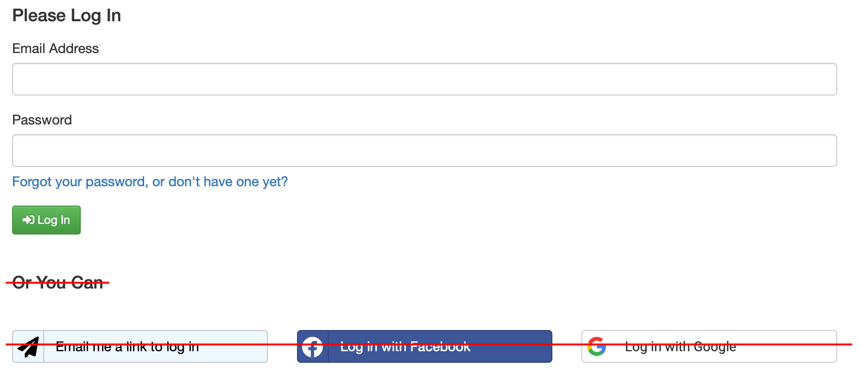
Create Your Groups.io Account
Add email company email address & Password
Click “Log In”
Note: Please don’t use “FaceBook” or “Google” to sign in
The system will send you an email to confirm your registration

Slide 9
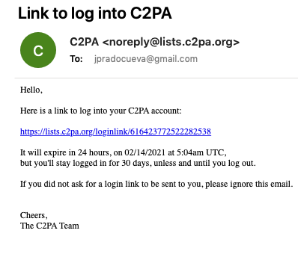
Confirm Registration Mail
Click the link to confirm your email

Slide 10
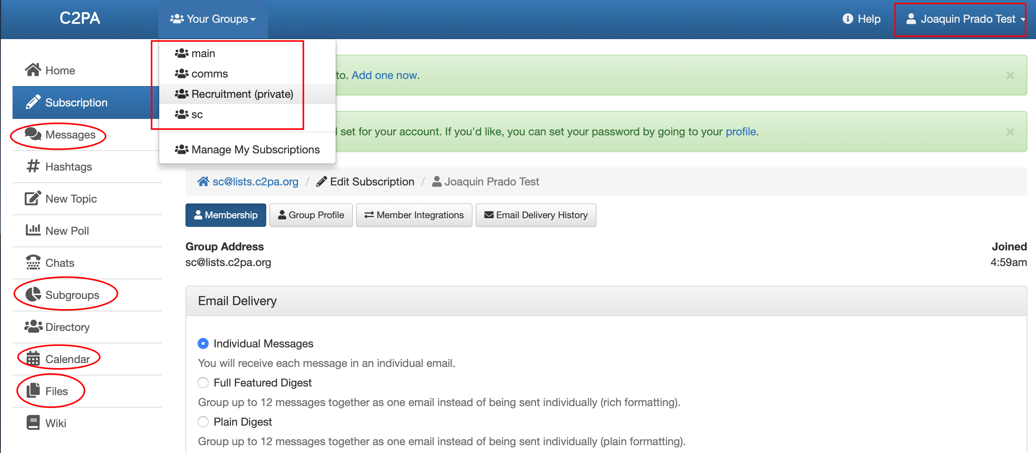
Groups.io functionality

Slide 11
List of Groups.io
Messages
mails sent to that distribution list. You can send emails from your Email Client, e.g. Outlook
Subgroups
list of groups that you have joined or are able to join
Calendar
each group has its own calendar, please download meetings to your calendar
Files
file storage
Account
manage your account

Slide 12
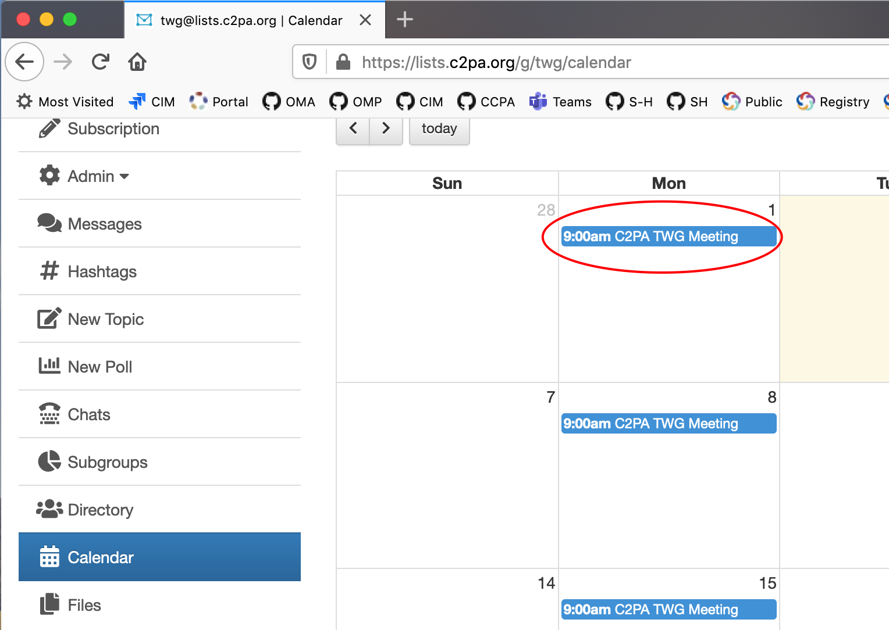
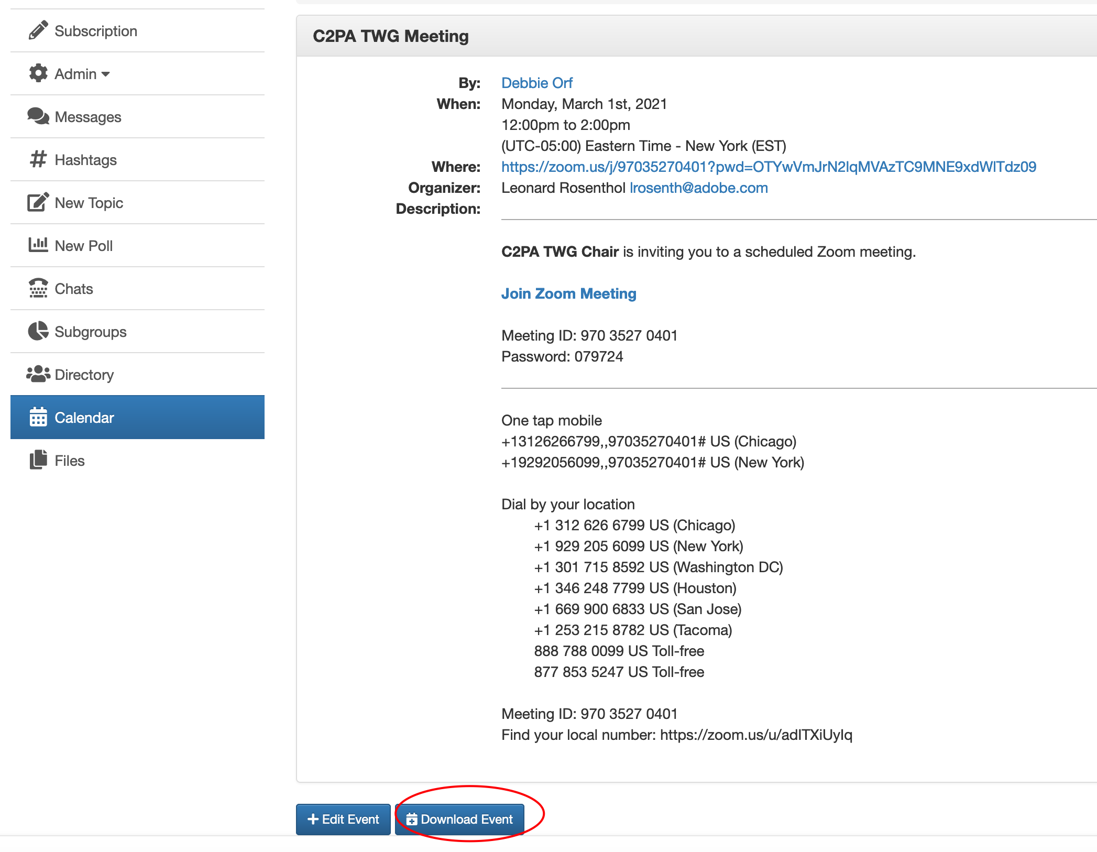
Calendar – Download Meeting

Slide 13
GitHub
Online platform for collaborative editing, review & commenting
Used for our Documentation and Specifications
Provides our Project Management
issue tracking
road map management

Slide 14
Familiarize yourself
If you are not already familiar with GitHub, we recommend you review the material at https://iherman.github.io/misc-notes/docs/BasicGitHubContributionIntro
There are also numerous tutorials and videos online

Slide 15
Working with GitHub
The C2PA has adopted the same model as the W3C for working with GitHub.
For more details, please consult our “Working Procedures” document.
In addition, each repository contains a CONTRIBUTING file that specifies how to work on a particular repository
Submitting Issues
Submitting Changes
Authoring Content

Slide 16
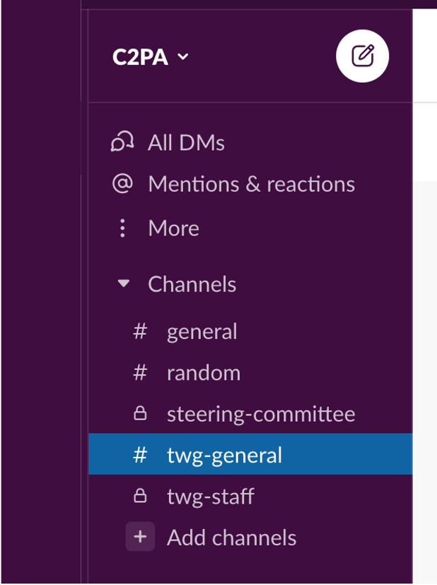
Slack
C2PA Slack Channels
general
twg-general
steering-committee (Steering Members only)
All what you need to know about Slack under 1 minute video …

Slide 17
Reference Documentation
Title | Description
C2PA Introduction Deck | What is to C2PA
Contributing | How to contribute to a repository in C2PA
GitHub C2PA | GitHub Organization Account
Glossary | Terminology
Guiding Principles | Intend to guide C2PA specifications and designs
New Members Orientation | Onboard new members
Release Planning | Roadmap, what features by when
Technical Requirements | List of requirements to be addressed by the Technical Specs

Slide 18
Questions?

