Slide 1
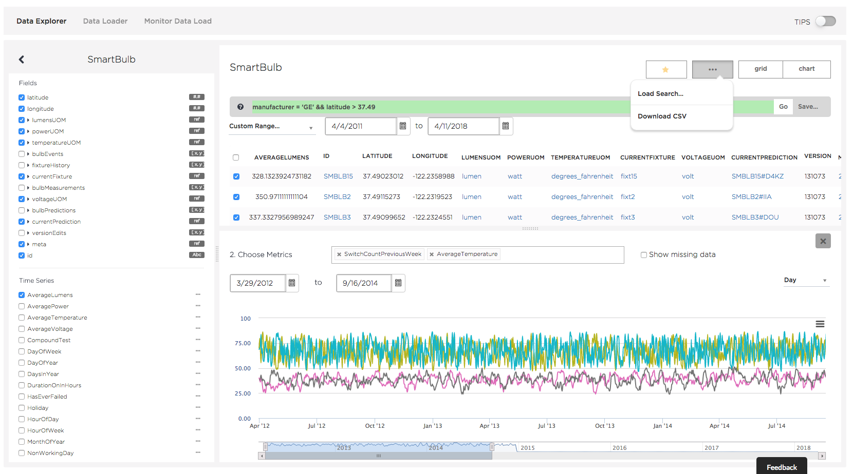
Selected Type
Search Bar
Dates for AverageLumens Time Series
Grid View or Chart View
Save Search Button
Fields to Display
Time Series Section
Data Grid
Data Aggregation for Chart
Time Series to Display
Metrics to Chart
Dates for Metrics Chart
Time Series Section
Time Series Options
SwitchCountPreviousWeek for SmartBulbs 15, 2, 3.
AverageTemperature for SmartBulbs 15, 2, 3.

Slide 2
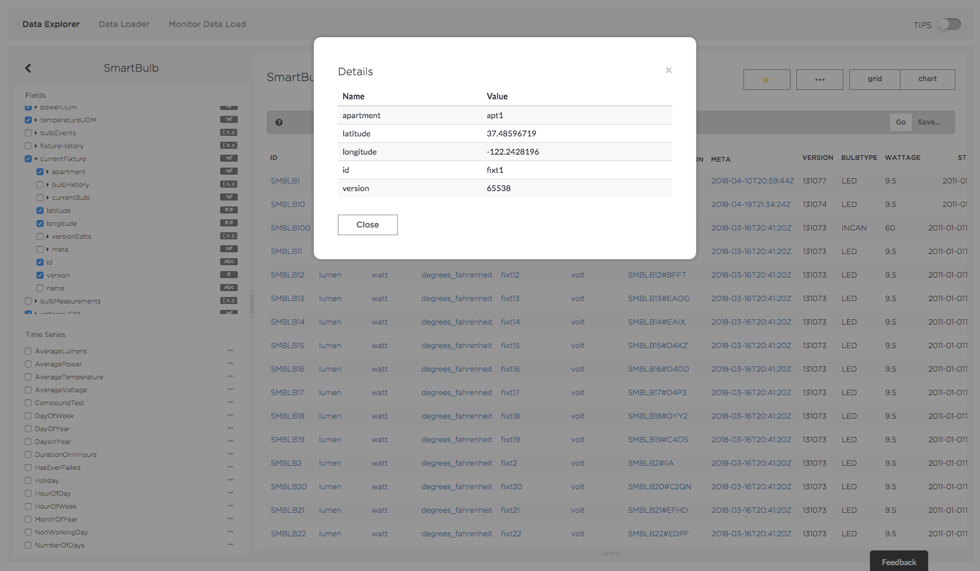
Modal Window for selected Reference Field obtained by clicking on fixt1 in the currentFixture column
Fields to Display in Grid
Fields of Reference field to Display in Modal
powerUOM column
temperatureUOM column
currentFixture column

Slide 3
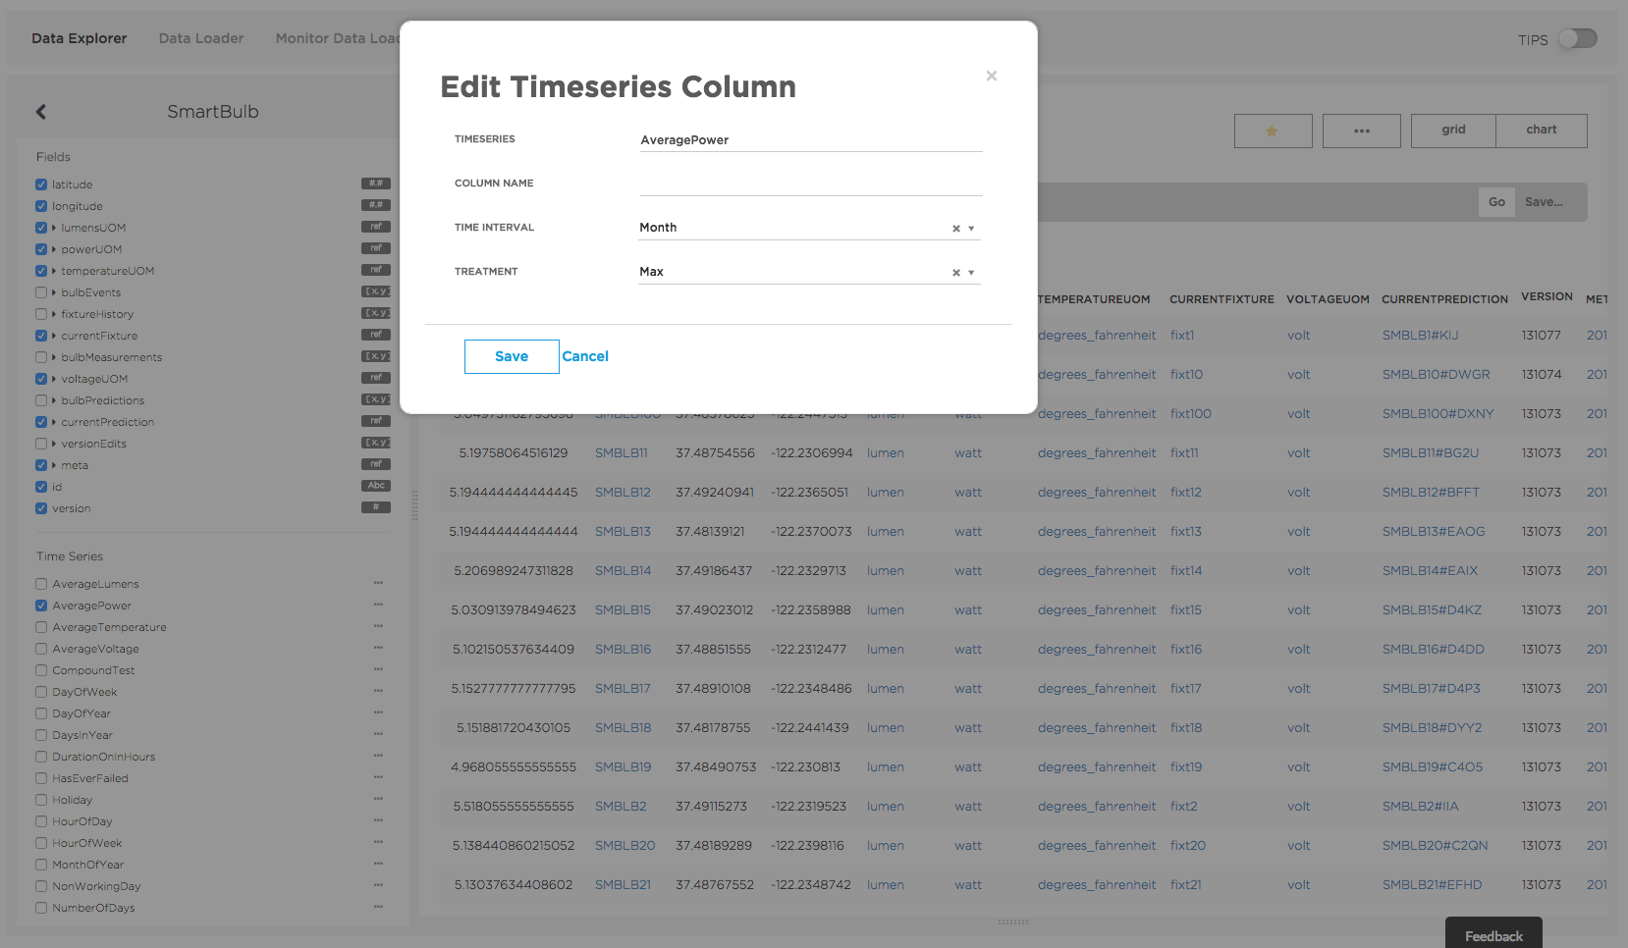
Modal Window opened by clicking ”…”
Selected Time Series
AveragePower Time Series Column

Slide 4
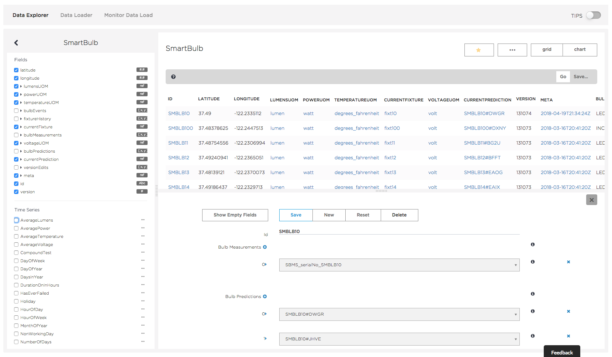
Selected SmartBulb ID
Buttons to save edits, create new data, reset edits, delete data
SmartBulb Fields
...

