Slide 1
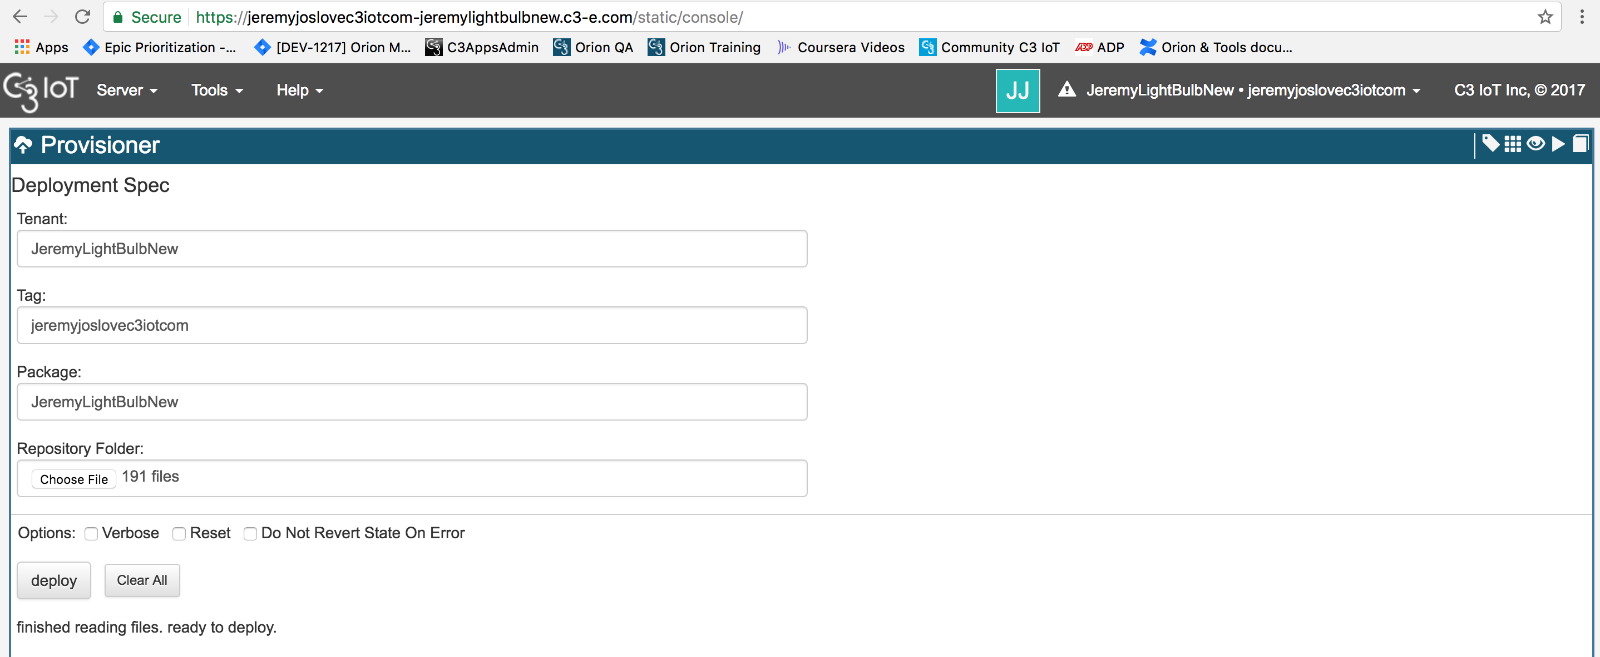
Your Tenant
Your Tag
The Package you want to provision
The local repository folder that contains the files to provision

