Slide 1
This experiment LabVIEW control is developed in 2018 by YE, Xin from Dajun Wang's Group @ CUHK based on an early version from JILA. If you have any question about the program, please contact yexinzju@gmail.com, not JILA The block diagram of this VI is organized in a 'state machine' fashion. The actions happen on the front panel control the flow between different states. In each state, different functions are organized in a parallel fashion as much as possible, typically one block, one function. This programming style allows you to easily add on new features. Feel free to modify it and make it a more powerful experimental control. And (hopefully) this programming style also make the maintaining and debugging easier.

Slide 2
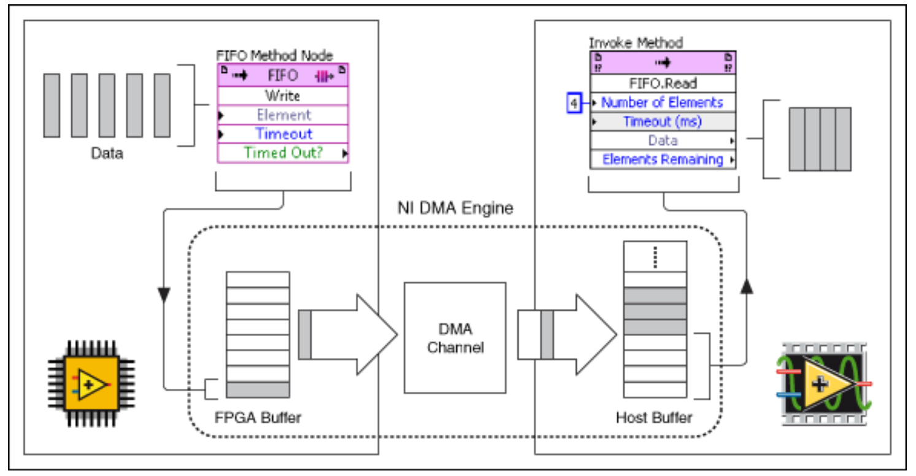
The overall architecture
3 Direct Memory Access (DMA) channels
Timings
Port A & B outputs
Port C & D outputs
Machine code via DMA
(U64)
DAC
manager.vi
host.vi
FPGA
state mechine.vi
(Digital outputs)
External clock (TTL pulses)
Machine code
(waveform)
Machine code
(Double)
Start trigger (TTL pulse)
AO*
Global
variables
AO

Slide 3
FPGA
state machine.vi
idle
run
reset
Fetch data from FIFO
Output data with 1-us time resolution (finest 25-ns resolution can be set)
Standby
Clear FIFO
Allow real-time monitoring

Slide 4
Open module
Read/write module sequence (module lists)
Host 1st.vi
state machine
Update module list / module timings
Read/write modules
… …
idle
Default outputs
Force outputs
Check timings
Programmable data acquisition
Single shot
load
… …
Programmed data acquisition

Slide 5
DAC manager.vi
state machine
force out
break
update
idle
loop

Slide 6
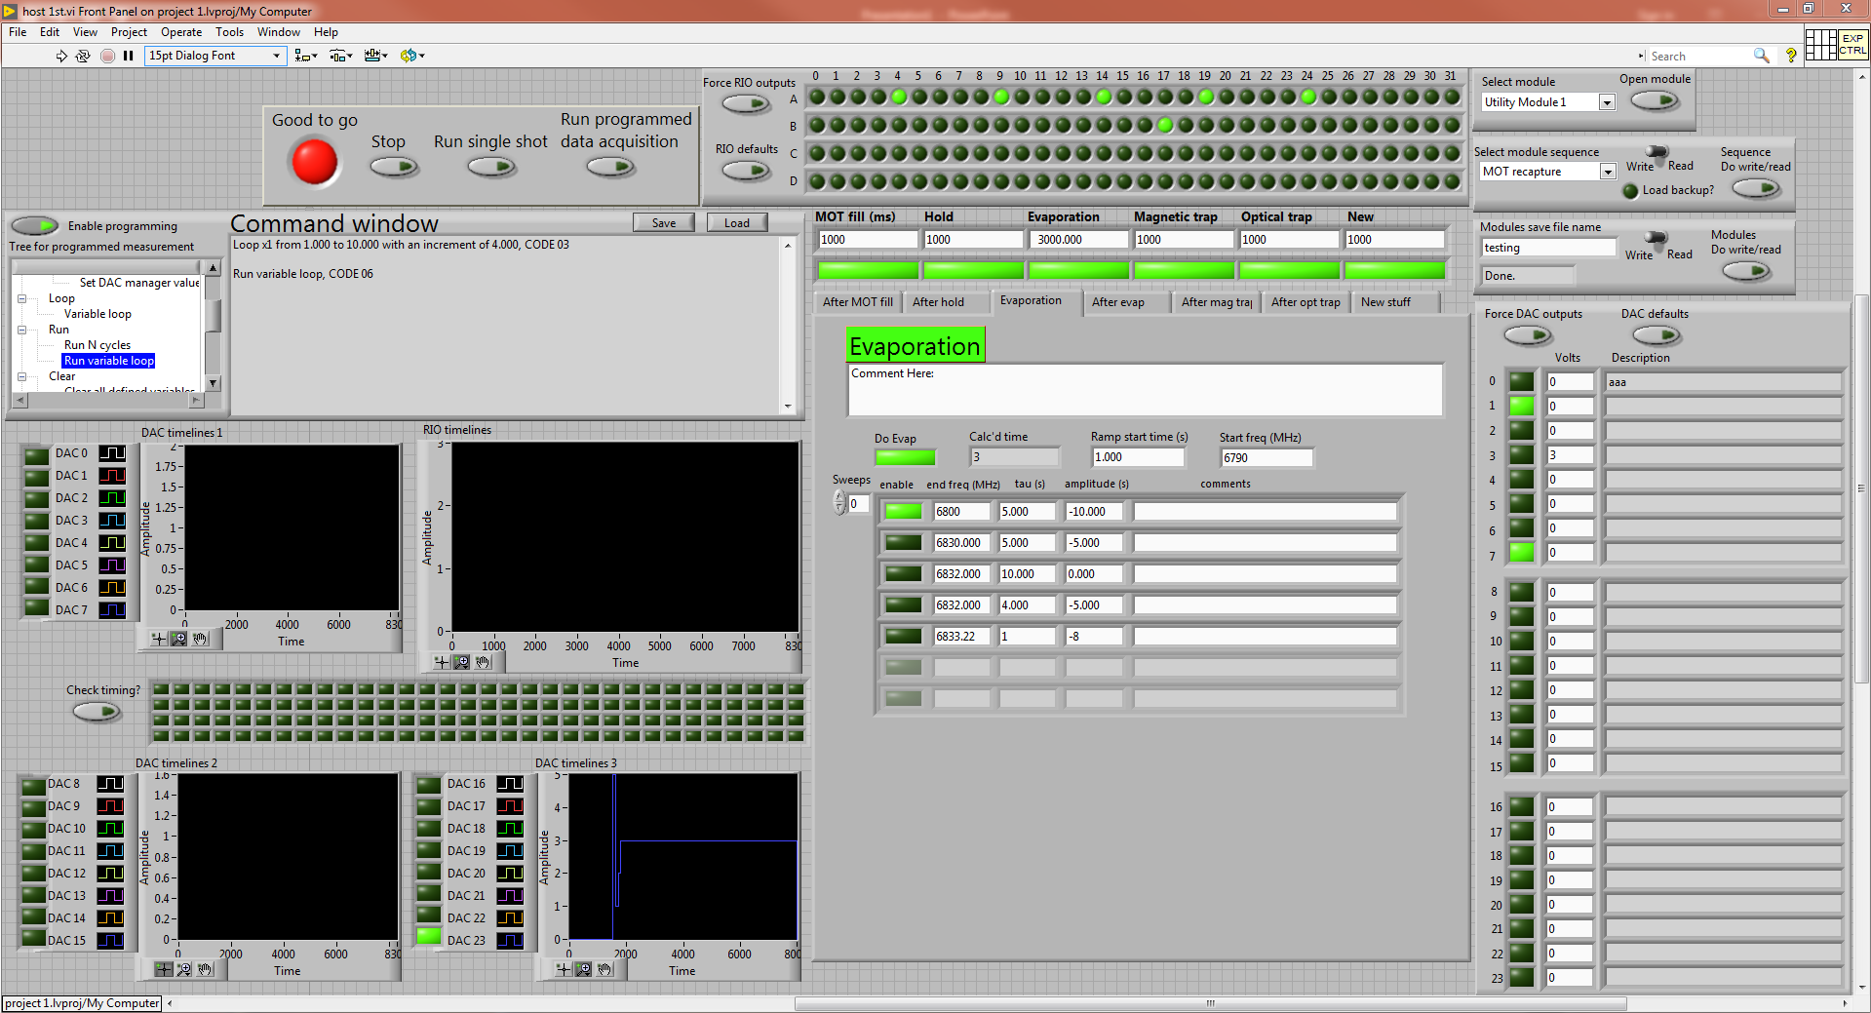
The front panel

Slide 7
The front panel
Run/Stop Zone
Digital output Zone
File I/O Zone
Programming Zone
Analog output Zone
Modules Zone
Check Timing Zone

Slide 8
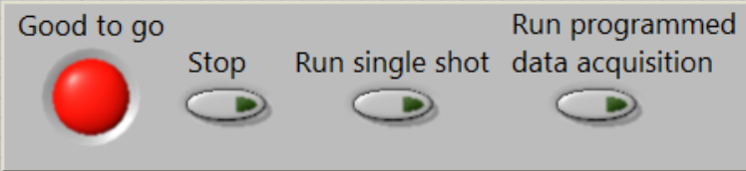
The front panel
Run/Stop Zone
An indicator showing whether experiment is running or not
Stop experiment, in the case when “Run variable loop” is running within a “repeat”, it takes one additional shot to stop. During this shot, self-defined variables are not activated.
Run a single shot, self-defined variables are not activated.
Run experiment according to the commands in the command window. Usually the experiment runs multiple times if you use this button

Slide 9
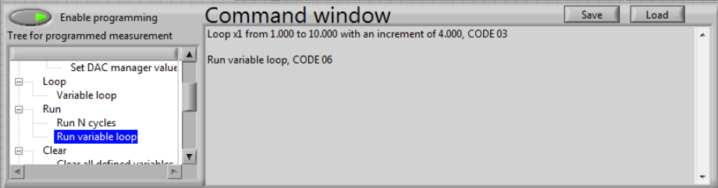
The front panel
Programming Zone
Writing a sophisticated sequence of commands takes O(n) time, but you can save it to a .txt file and load it next time with only O(1) time!
Button to activate/deactivate programmable data acquisition
When activated, all the other items in this zone will be enabled and the “Run programmed data acquisition” button will be enabled. Otherwise, these items are disabled and greyed out
The command tree offers legal commands to use and offers standard ways to editing the command window. Double click an item, a dialog will pop out. Follow the instructions in the dialog and enter parameter values and click “OK”, corresponding command or editing will show up in the command window. To use the “repeat” function, the “Repeat configuration” must appear first, then enclosed the commands you want to repeat with “repeat start” and “repeat end”
Commands been written will be shown here

Slide 10
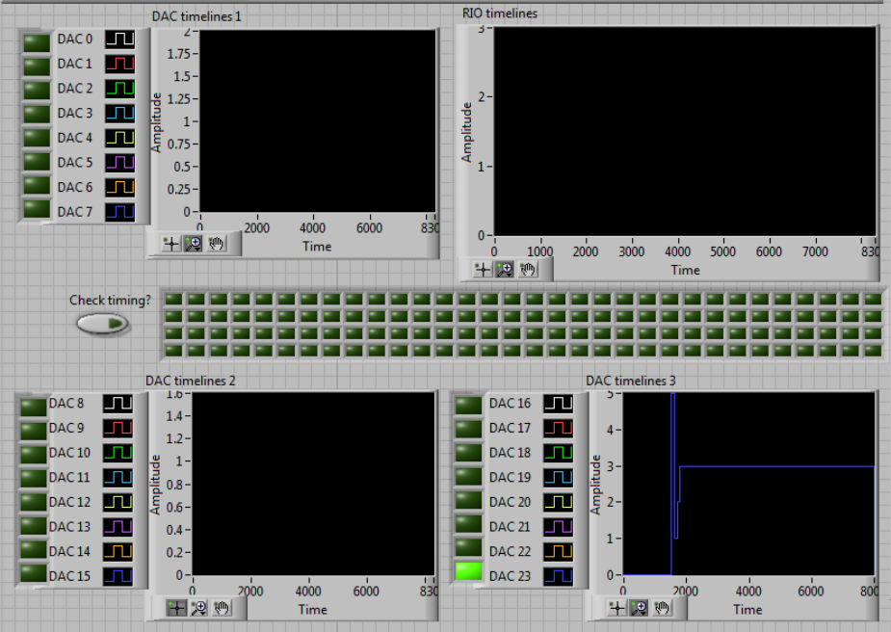
The front panel
Check Timing Zone
Graphs show digital outputs’ timings, horizontal axis is time in ms unit, vertical axis is not exactly the voltage (since only highs and lows are important here), when more than one channels are shown, channels are offset in y-direction.
Graphs show analog outputs’ timings, horizontal axis is time in ms unit, vertical axis is the voltage.
Click this button, timings will shown on the four graphs
Enable buttons to decide which digital output’s timing to be shown
Enable buttons to decide which analog output’s timing to be shown

Slide 11
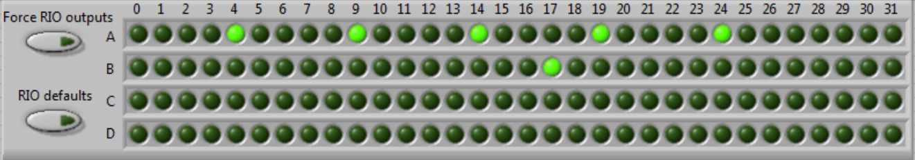
The front panel
Digital output Zone
Enables forced digital outputs according to the pattern of LEDs on the right hand side
Change the LEDs on the right hand side to default values
LEDs represent the values for digital outputs from port A to port D and line 0 to line 31 for each port

Slide 12
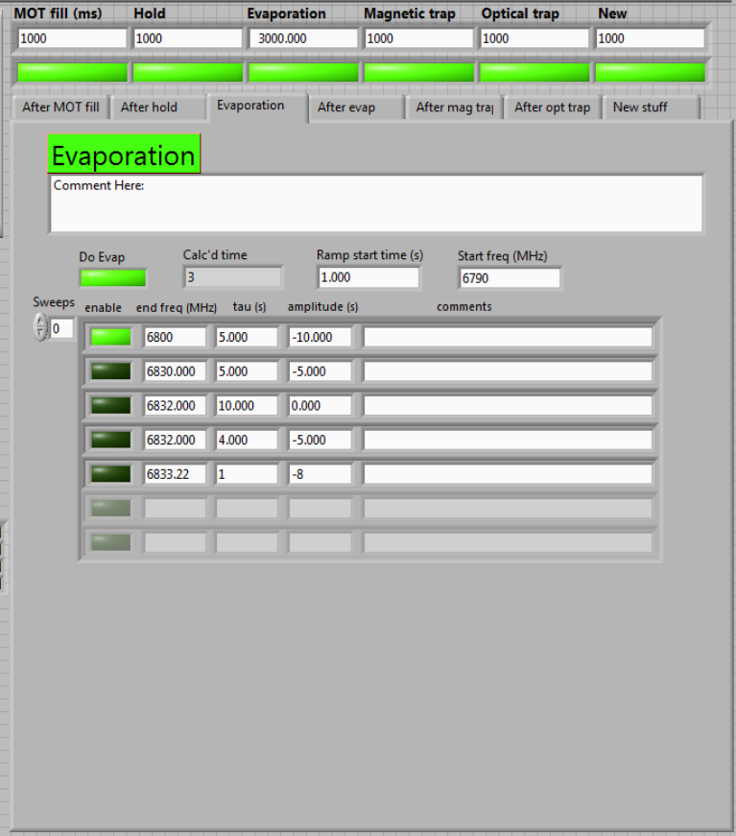
The front panel
Holding times, self-defined variables may be added besides
entry “Evaporation” whose time is automatically updated according to the evaporation cluster
Modules Zone
Module list enables
Module lists
Comments, you can leave some comment or description about the module list here in order to make it more readable
MW evaporation cluster
The frequency modulation goes in a linear way, with tau as the slope of the ascending.
Self-defined variables may be added in entries outside MW evaporation cluster:
“Ramp start time”,
“start freq”,
Or all entries inside MW evaporation cluster

Slide 13
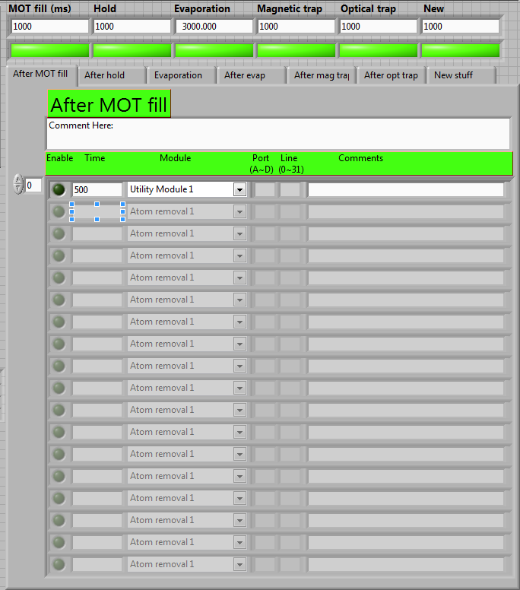
The front panel
The end time of “MOT fill” is the start time for module list “After MOT fill”
The end time of “Hold” is the start time for module list “After hold”
The end time of “Evaporation” is the start time for module list “After evap”
The end time of “Magnetic trap” is the start time for module list “After mag trap”
The end time of “Optical trap” is the start time for module list “After opt trap”
The end time of “New” is the start time for module list “New stuff”
Modules Zone
The module list enables activate/deactivate module lists “After MOT fill”, “After hold”, “After evap”, “After mag trap”, “After opt trap”, “New stuff” respectively
Modules, self-defined variables may be added in the “Time” entry of each picked module.

Slide 14
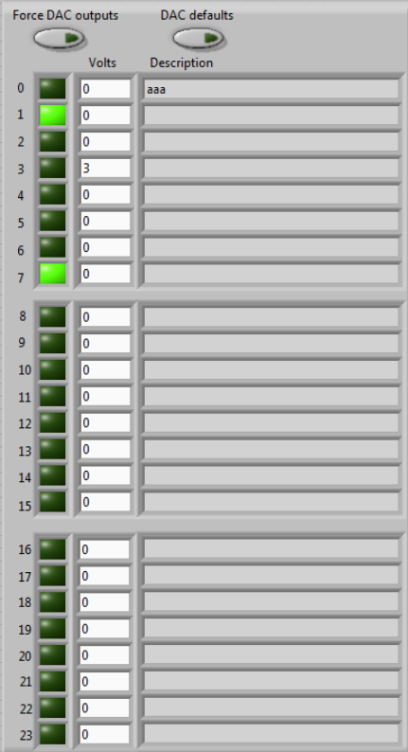
The front panel
Analog output Zone
Enables forced analog outputs
Change the LED values and numeric entry values below to default values
The LED enables/disables the channel,
The numeric entry gives the output voltage in Volt unit
If the channel is disabled, the output voltage is always 0

Slide 15
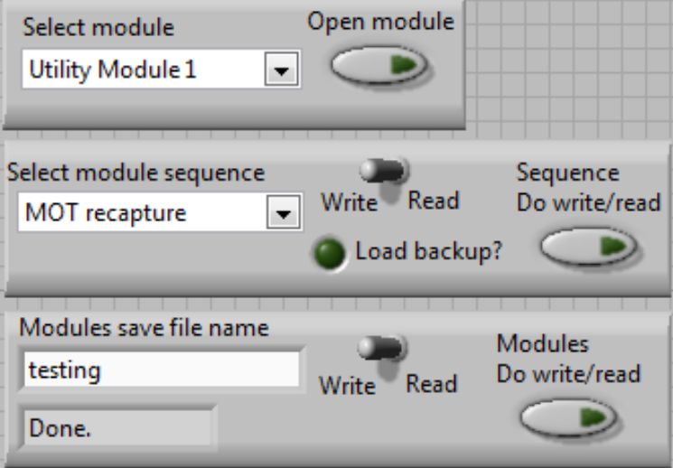
The front panel
Open Module subvi. When the experiment is not running, pick a module from the left list and click “Open module” allows you open the corresponding subvi. You can not with open subvi’s of “Defaults”, “TTL high”, “TTL low” and “GPIB” due to different terminal patterns. If you try to open those subvi’s, an error dialog will pop out, but doesn’t interrupt the main vi running. Just click “Continue” to close the error dialog
File I/O Zone
Save the current module lists settings or read from saved ones. Pick a module sequence name from the left list, with switch at the “Write” side, click “Sequence Do write/read”, the current module lists settings will be saved in ../Save/, also a backup will be saved in ../Save/backups/.
When “Read”, if you click on “Load backup?”, a file I/O dialog will pop out, and you need to choose a file in the ../Save/backups/
Save or load from saved ones the commands in each module subvi. It may take about 5 seconds to finish the task. The files are saved in ../, meanwhile backup files will be saved in ../Modules backups/

Slide 16
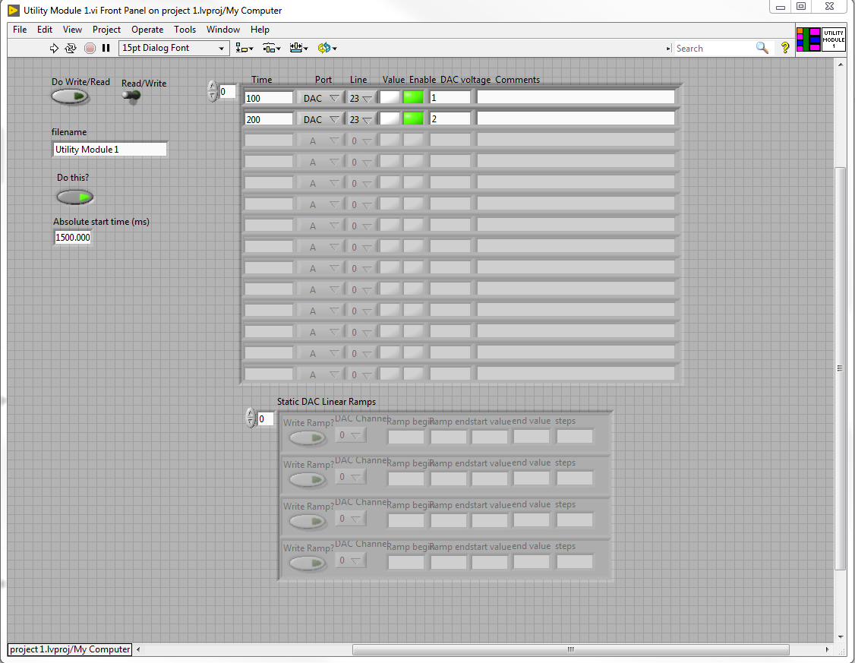
Module subvi
A single command for a digital output or an analog output or a GPIB channel.
Self-defined variables can be added in “Time” and “DAC voltage”
“Port” in includes “A”, “B”, “C”, “D”, “DAC”, “GPIB”.
“Line” in includes from “0” to “31”. Since there are only 24 analog channels, when port “DAC” and Line larger than “23” selected, the command takes no effect.
When port “GPIB” selected, “Line” means no thing. Enter the channel number of the GPIB in the “DAC voltage” entry
The “Value” LED works when you select a digital output, a lightened LED means a TTL high.
Static DAC Linear Ramps cluster
Self-defined variables can be added in all five entries. When enabled, the cluster generates a linear stepped ramp from time “Ramp begin” to “Ramp end” in “steps” with the initial voltage “start value” and the final voltage “end value” for the “DAC channel”
Do not change these values manually

Slide 17
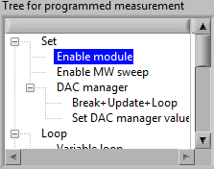
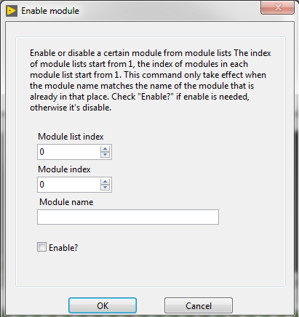
Programmable
data acquisition

Slide 18
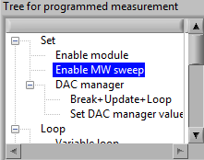
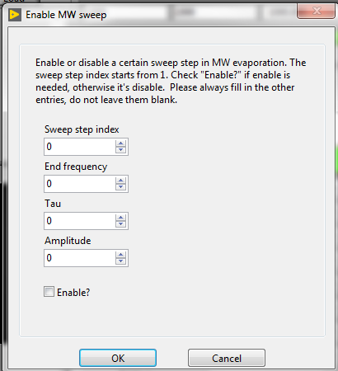
Programmable
data acquisition

Slide 19
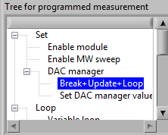
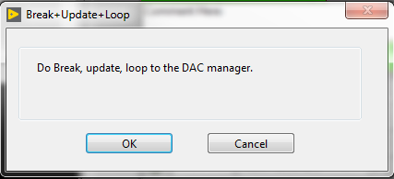
Programmable
data acquisition

Slide 20
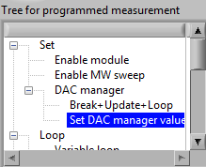
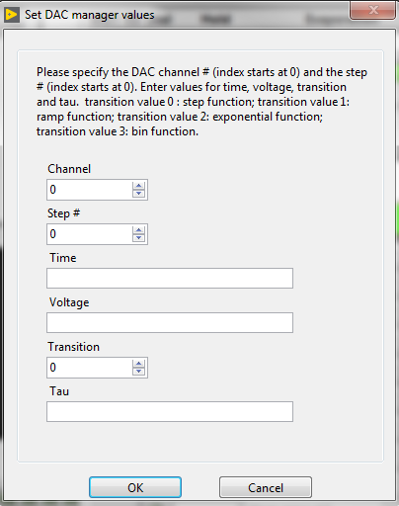
Programmable
data acquisition

Slide 21
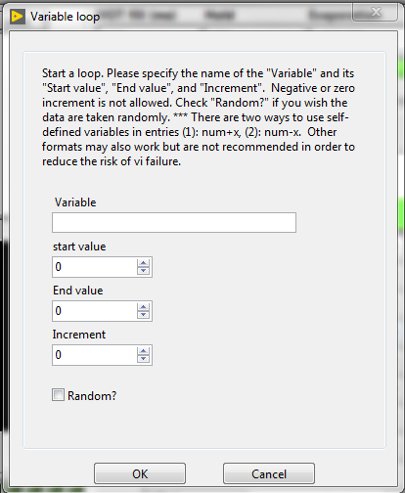
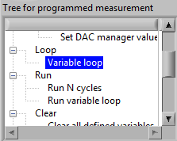
Programmable
data acquisition

Slide 22
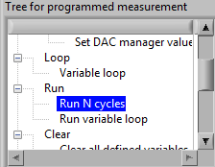
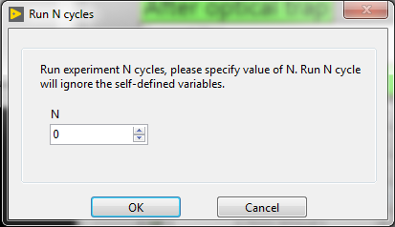
Programmable
data acquisition

Slide 23
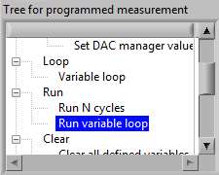
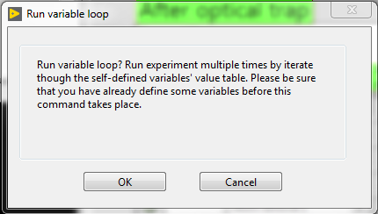
Programmable
data acquisition

Slide 24
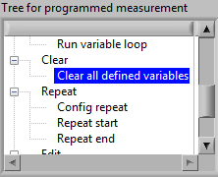
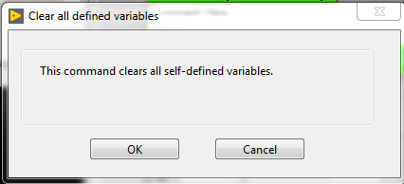
Programmable
data acquisition

Slide 25
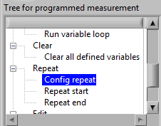
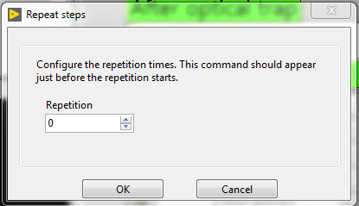
Programmable
data acquisition

Slide 26
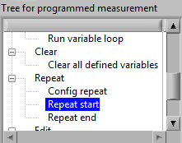
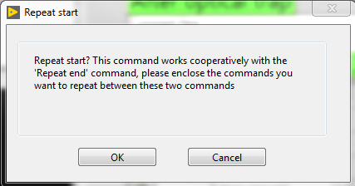
Programmable
data acquisition

Slide 27
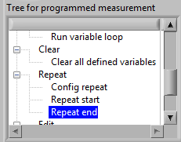
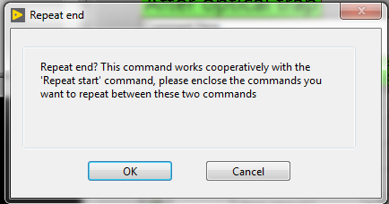
Programmable
data acquisition

Slide 28
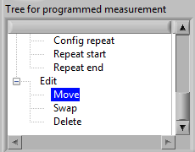
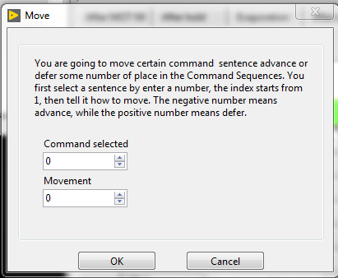
Programmable
data acquisition

Slide 29
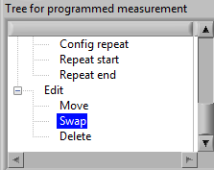
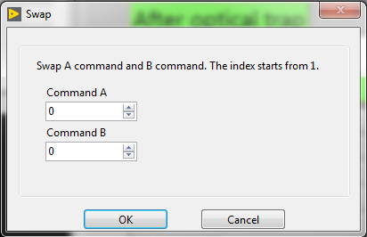
Programmable
data acquisition

Slide 30
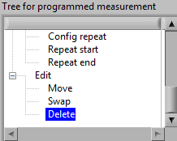
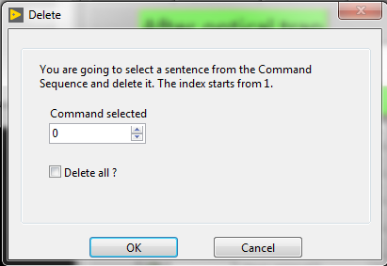
Programmable
data acquisition

Slide 31
For more information, please see the block diagrams.

