Slide 1

PonIO
BRECHT BONTE NIELS TIMMERMANS CEDRIC VAN BOCKHAVEN

Slide 2
Overview
What
Structure
Server
Agent
Demonstration
Reflection
Conclusion

Slide 3
What
Twiggy-TLS
Twitter bootstrap
stunnel
Twiggy
vash
Pocket.IO
Microsoft WebMatrix
Connect
Gepok
AnyEvent
Express
Windows Azure Cloud
Markdown
PSGI
Node.js
Server-agent
Jade
Plackup
Mojolicious
socket.io-client
Phonegap
iptables
Perl
DBI
App-TSLMe

Slide 4
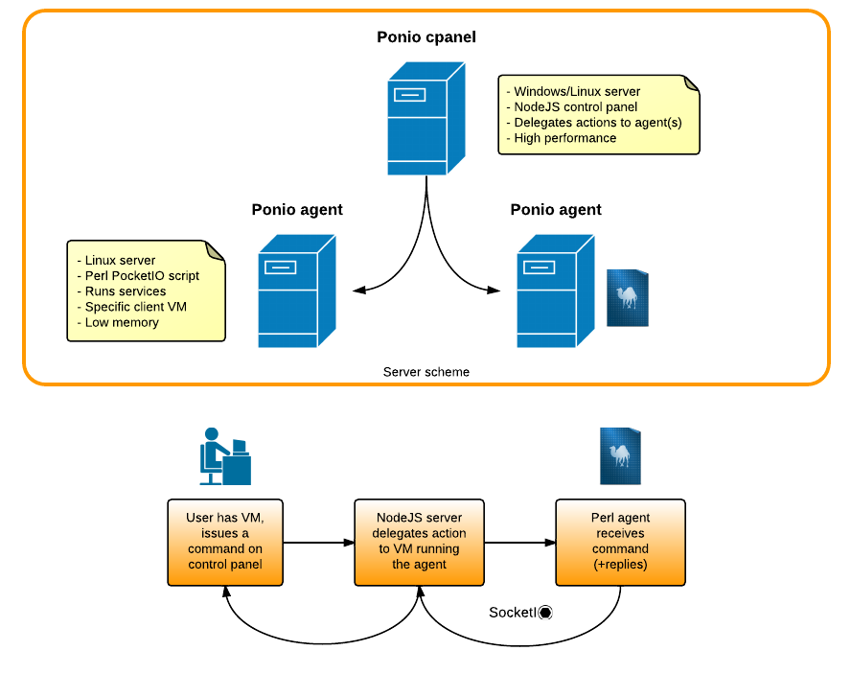
Structure

Slide 5
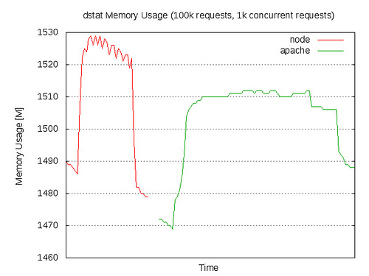


Server
Vs.
Faster
More memory
Javascript
Event- driven
Asynchronous I/O

Slide 6
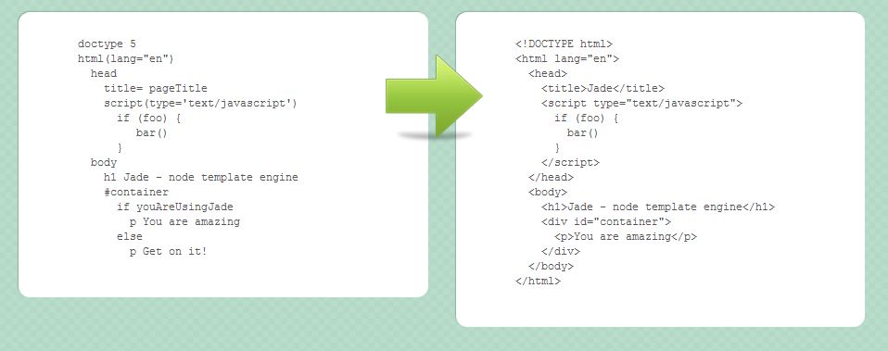
Jade

Slide 7
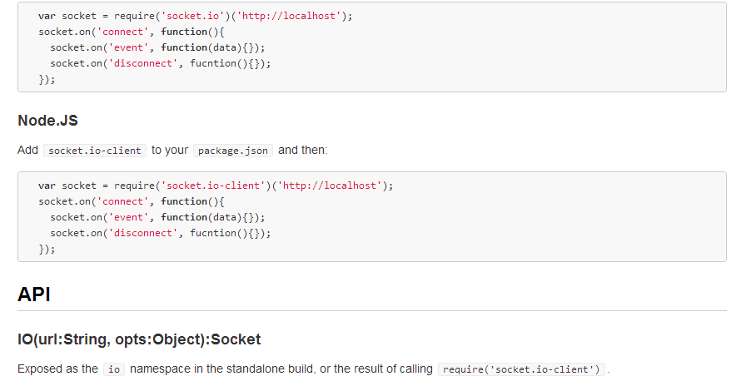
Socket.io-client

Slide 8
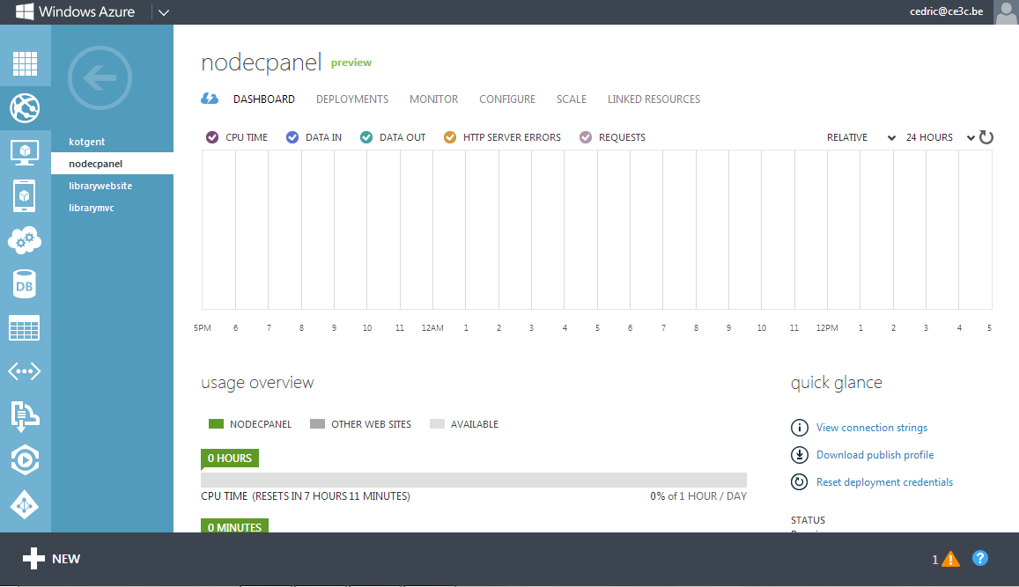
Windows Azure Cloud

Slide 9
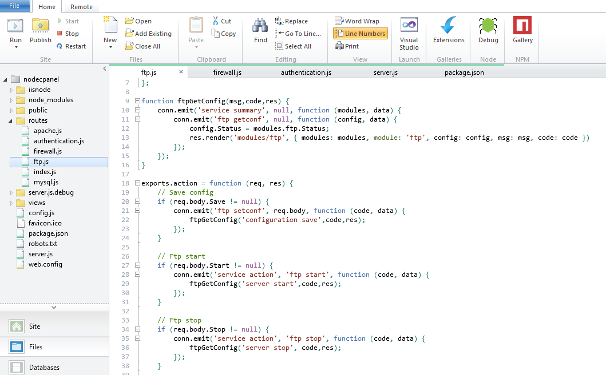
Microsoft WebMatrix

Slide 10
Agent
RPC-server (Remote Procedure Call)
Goal: speed, accessibility, low resources
Why Perl: small footprint, universal
Perl module system
PSGI-application
Socket.IO
Security

Slide 11
PSGI-application
Perl Web Server Gateway Interface
CGI-like
PSGI: interface between Perl scripts and web servers
Passes on environment variables (User-Agent, Host, …)
Twiggy: non-blocking, streaming server, 6MB

Slide 12
Socket.IO
Socket.IO via Pocket.IO
WebSockets: asynchronous, streaming, non-blocking
Accessible through WebSockets / JSONP / …

Slide 13
Security
Use of certificates
Modified Perl library: Twiggy-TLS
Authentication
IP block

Slide 14
Agent
Client
Twiggy
PSGI
Pocket.IO
Perl modules

Slide 15
Agent
Client
Server
Twiggy
Node.js
PSGI
Pocket.IO
Perl modules

Slide 16
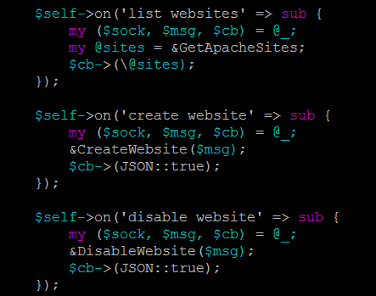
Agent
Client
Twiggy
PSGI
Pocket.IO
Perl modules

Slide 17

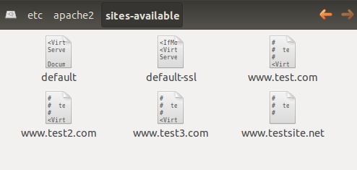
Agent
Client
Twiggy
PSGI
Pocket.IO
Perl modules

Slide 18

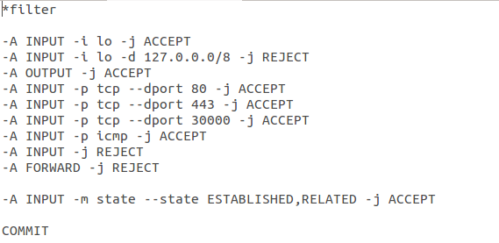
Agent
Client
Twiggy
PSGI
Pocket.IO
Perl modules

Slide 19

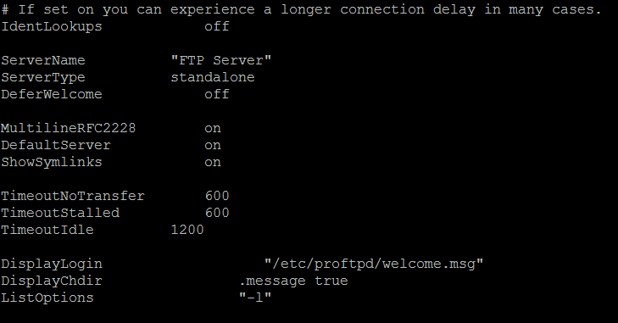
Agent
Client
Twiggy
PSGI
Pocket.IO
Perl modules

Slide 20

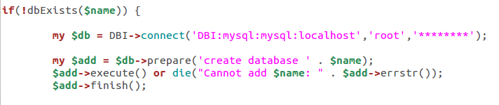
Agent
Client
Twiggy
PSGI
Pocket.IO
Perl modules

Slide 21
Agent
Client
Twiggy
PSGI
Pocket.IO
Perl modules

Slide 22
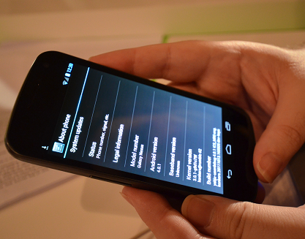
Demonstration

Slide 23
Reflection
Projected
Accomplished

Slide 24
Projected
Minimum
FTP module
MySQL module
Possible additions
Webserver module
Mail server module
Firewall module
Server & Agent: Node.js

Slide 25
Accomplished
Modules
FTP module
MySQL module
Apache module
Firewall module
Server: Node.js
Agent: Perl

Slide 26
Conclusion
Existing need
New approach
Main focus is speed
Portability, cross-platform

