Slide 1

Penta News
Game Show

Slide 2

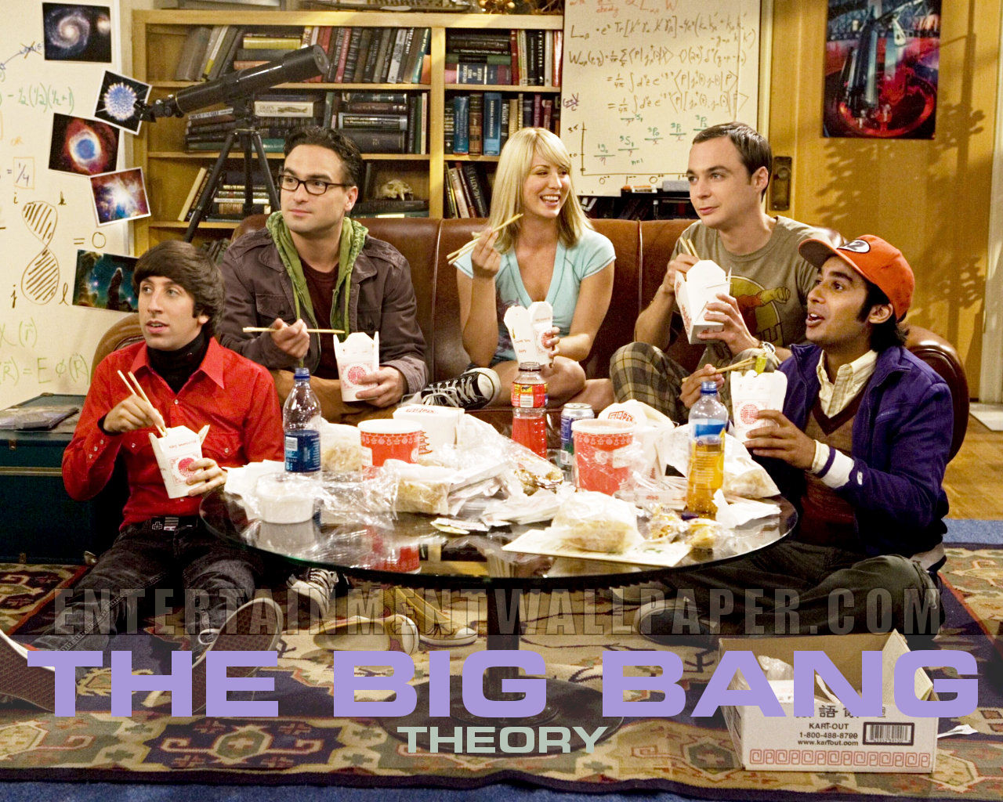
Prices

Slide 3


Sponsor

Slide 4
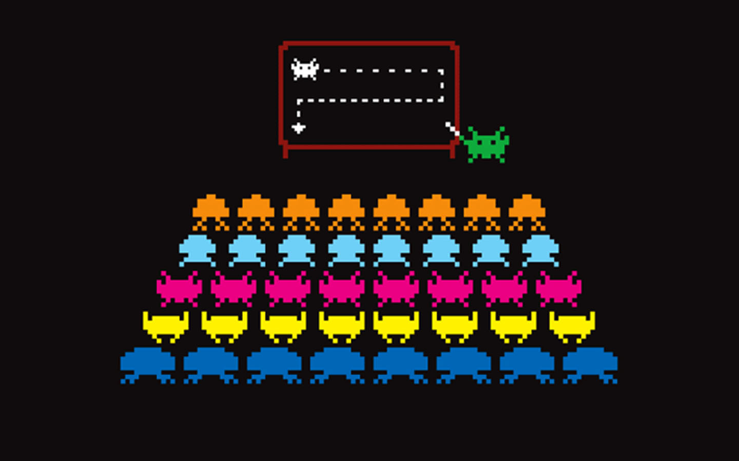
Rules

Slide 5
Rules
3 players,
1 question, and
4 answers
Timers
4 Jokers

Slide 6

Wikipedia
Joker

Slide 7

Nedap
Joker
http://poll.c3d2.de

Slide 8

IRC
Joker
irc.freenode.net #pentanews

Slide 9
ShiFT
Joker

