Slide 1
Esperanto WTF
This is the Esperanto Assembly (@c3esperanto).
ĤAOSO INTERNACIA!
Esperanto is a constructed language.
Constructed means, its phonology, grammar and vocabulary have been consciously devised for human communication, instead of having evolved naturally.
Most successful all-purpose conlang in history.
  Yes, we've heard of Klingon, Elvish and Dothraki. Esperanto still is more successful, and you'll soon learn, why. :-)

Slide 2
Esperanto Grammar:
Articles
There is no indefinite article
there is only a definite article la, alike for all genders, cases and numbers.
EXAMPLE
  libro = book, a book
  la libro = the book
Join our
Esperanto Workshop
here at 36c3 on day 2
2019/12/28 22:00 - 2019/12/28 23:59
CCL Seminar Room 14-15

Slide 3
Esperanto Facts:
Language Hacking in the 1800s
The first version of Esperanto was released in 1887.
In the late 19th century there was a thriving community of constructed language enthusiasts.
Esperanto became a huge success right from the start because of some of its special properties.
Join our
Esperanto Workshop
here at 36c3 on day 2
2019/12/28 22:00 - 2019/12/28 23:59
CCL Seminar Room 14-15

Slide 4
Esperanto Grammar:
Nouns
Nouns have the ending -o.
To form the plural, add the ending -j.
There are only two cases: nominative and accusative.
Accusative can be obtained from the nominative by adding the ending -n.
The other cases are expressed with the aid of prepositions.
EXAMPLE
  La hundo ĉasas katon tra la ĝardeno
  The dog chases a cat through the garden
Join our
Esperanto Workshop
here at 36c3 on day 2
2019/12/28 22:00 - 2019/12/28 23:59
CCL Seminar Room 14-15

Slide 5
Esperanto Facts:
Of Course it's Open Source!
At the time of Esperanto's release in 1887, many enthusiasts had been let down by the inventors of other conlangs who personally controlled them and wouldn't allow "their" copyrighted languages to evolve freely.
The inventor of Esperanto, Ludwig Zamenhof, firmly believed in constructed languages as a tool for overcoming language barriers and a basis for peace between formerly hostile ethnic groups.
Esperanto became a huge international success because it was released under the terms of what we today would call an open source license.

Slide 6
Esperanto Grammar:
Adjectives
Adjectives end in -a.
Cases and numbers are as for nouns.
The comparative is made with the word pli, the superlative with plej;
for the comparative the conjunction ol is used.
EXAMPLE
  Hodiaŭ, la vetero estas pli suna ol hieraŭ.
  Today, the weather is more sunny than yesterday.
Join our
Esperanto Workshop
here at 36c3 on day 2
2019/12/28 22:00 - 2019/12/28 23:59
CCL Seminar Room 14-15

Slide 7
Esperanto Facts:
Speakers Worldwide
Spoken by absolutely nobody, according to many estimates.
Spoken by about 10⁶ people worldwide, according to more educated estimates.
Native speakers? Sure, since the beginning of the 20th century.
  Ino Kolbe (1914-2010) even had her first name in Esperanto.
  George Soros comes from an Esperanto family, too.
Join our
Esperanto Workshop
here at 36c3 on day 2
2019/12/28 22:00 - 2019/12/28 23:59
CCL Seminar Room 14-15

Slide 8
Esperanto Grammar:
Numerals
The basic numerals are: unu, du, tri, kvar, kvin, ses, sep, ok, naŭ, dek, cent, mil.
Tens and hundreds are formed by simple juxtaposition of the numerals.
EXAMPLE
  Du mil du dek unu = Two thousand twenty one
  Du trionoj = Two thirds
Join our
Esperanto Workshop
here at 36c3 on day 2
2019/12/28 22:00 - 2019/12/28 23:59
CCL Seminar Room 14-15

Slide 9
Esperanto Facts:
Ease of Learning
Okay, we're trying to make this look more simple than it is.
Esperanto is designed to be easily learned, which means, it still does need to be learned.
The language is defined by only 16 rules. Some of them are fairly trivial, others imply a lot and must be read more carefully than an OpenBSD manpage or IPv6 RFC.
Nevertheless, after taking basic lessons for an hour or two, you'll be able to construct simple Esperanto phrases.
A degree of fluency is easily reachable within 6-12 months.

Slide 10
Esperanto Grammar:
Pronouns
Join our
Esperanto Workshop
here at 36c3 on day 2
2019/12/28 22:00 - 2019/12/28 23:59
CCL Seminar Room 14-15
Personal pronouns
  mi, vi, li/ŝi/ĝi (I, you, he/she/it)
    unofficial gender-independent pronoun: ŝli
  ni, vi, ili (we, you, they)
The possessive pronouns are formed by addition of the adjective ending.
Declension is as for nouns.
EXAMPLE
  Mi amas vin = I love you.
  Mia hundo amas vian katon = My dog loves your cat.

Slide 11
Esperanto Facts:
Dictators hate it!
Adolf Hitler notably mentioned Esperanto in "Mein Kampf" as the mandatory language to be spoken under his imagined "jewish world dominion".
Esperantists were subject to persecution between 1933 and 1945, still barely tolerated in a few authoritarian regimes today.
Esperanto had been a tremendous success at the time, but after Hitler and Stalin were done with it, most of the community was destroyed.
Huge recovery since the mid 1990s and the advent of the world wide web.

Slide 12
Esperanto Grammar:
Verbs
Join our
Esperanto Workshop
here at 36c3 on day 2
2019/12/28 22:00 - 2019/12/28 23:59
CCL Seminar Room 14-15
The infinitive always ends in -i
Present tense ends in -as
Past tense ends in -is
Future tense ends in -os
Participle, imperative and conditional are formed similarly.
EXAMPLE
  Mi legas = I am reading.
  Mi ŝatas danci = I like to dance.

Slide 13
Esperanto Facts:
1 Million Euro Trivia
Around 1960, the U.S. Army used Esperanto as a fictional "aggressor language" for training communication with foreign prisoners of war.
Before Star Trek, William Shatner starred in the 1966 movie "Incubus" which was entirely in Esperanto. Did we mention it's a horror movie?
"The Great Dictator" by Charlie Chaplin features Esperanto shop signs in his depiction of the jewish ghetto.
Join our
Esperanto Workshop
here at 36c3 on day 2
2019/12/28 22:00 - 2019/12/28 23:59
CCL Seminar Room 14-15

Slide 14
Esperanto Grammar:
Adverbs
Adverbs end in -e
EXAMPLE
  La kato kuris rapide = The cat ran fast.
  Mi dormis malkviete = I slept uneasily.
Join our
Esperanto Workshop
here at 36c3 on day 2
2019/12/28 22:00 - 2019/12/28 23:59
CCL Seminar Room 14-15

Slide 15
Esperanto Facts:
Esperanto in Your Computer
The Facebook website offers a fairly good and complete Esperanto translation.
Google can be switched to Esperanto, too.
Thanks to Linux, Gnome, Firefox and LibreOffice, you can use your computer entirely in Esperanto.
Minecraft still has a pretty well-maintained esperanto translation.
Join our
Esperanto Workshop
here at 36c3 on day 2
2019/12/28 22:00 - 2019/12/28 23:59
CCL Seminar Room 14-15

Slide 16
Esperanto Grammar:
Prepositions
Join our
Esperanto Workshop
here at 36c3 on day 2
2019/12/28 22:00 - 2019/12/28 23:59
CCL Seminar Room 14-15
Prepositions take the nominative:
EXAMPLE
  Ŝi kuras en la stadiono = She's running in the stadium.
  La libroj de la knabo = The books of the boy.
Prepositions take the accusative if they express motion:
EXAMPLE
  Ŝi kuras en la stadionon = She's running into the stadium.
  Li sidiĝas sur la benkon = He sits down onto the bench.

Slide 17
Esperanto Facts:
Origin of the Name
Esperanto was originally named "International Language" by its inventor, Ludwig Zamenhof.
The unua libro (the first book) was published in russian, polish, german and french, which were merely a few of the languages spoken fluently by Zamenhof.
Zamenhof published it under the pseudonym "Dr. Esperanto", which the community quickly adopted as the name of the language.
The unua libro contained a surprisingly wide spectrum of materials, translated verses from the bible, original and translated poetry as well as a 900 word dictionary.

Slide 18
Esperanto Grammar:
Pronunciation and Accent
Every word is pronounced as it is written.
  No exceptions.
The accent always falls on the second-to-last vowel.
  Bedaŭrinde
  Saluton
  Bonan tagon
  Nekredeble
Join our
Esperanto Workshop
here at 36c3 on day 2
2019/12/28 22:00 - 2019/12/28 23:59
CCL Seminar Room 14-15

Slide 19
Esperanto Facts: fork() || die();
In 1907, some members of the community started a fork of Esperanto named "ido", meaning "child" (of Esperanto), which never really caught on.
Among Esperanto historians, this incident is nevertheless known as
"the ido crisis".
Despite many other language forks, all with their own goals and agendas, Esperanto is still on the original development branch even after 132 years.
Join our
Esperanto Workshop
here at 36c3 on day 2
2019/12/28 22:00 - 2019/12/28 23:59
CCL Seminar Room 14-15

Slide 20
Esperanto Grammar:
Compound Words
Compound words are formed by simple juxtaposition of words.
The main word stands at the end.
The ending of the base word form and/or accusative may be inserted between the words for style, pronuncability or clarity. ^{Good luck.}
EXAMPLES
  ŝipo (ship) + veturi (travel) = ŝip(o)veturo (a journey by ship).
  ami (to love) + plena (full) = am(o)plena (full of love)
  pagi (to pay) + povi (to be able) = pag(i)pova (able to pay)
  nenio (nothing) + fari (to do) = neni(o[n])fara (doing nothing)

Slide 21
Esperanto Facts:
Congresses and Couch Surfing
The first World Esperanto Congress, aka Universala Kongreso, took place in 1905, with 688 attendees from 20 countries.
2019's Congress will be in Lahti (Finland).
In most countries, the local Esperanto associations host their own congresses and youth congresses, plus many other ones, including end-of-the year congressess happening right now.
The Esperanto community accidentally invented Couch Surfing around 1970 when an address book with Esperanto-speakers willing to host other Esperantists was published for the fist time.

Slide 22
Esperanto Grammar:
Wildcard Preposition
If it's unclear which preposition to use, the wildcard preposition je may be used. Instead of je, the accusative may be used without a preposition.
EXAMPLES
  Mi ĉeestos je la oka horo = I'll be there at eight o'clock.
  Mi finstudos la kvinan = I'll be done studying (on the) fifth.
  Mi kredas je dio = I believe in god.
Join our
Esperanto Workshop
here at 36c3 on day 2
2019/12/28 22:00 - 2019/12/28 23:59
CCL Seminar Room 14-15

Slide 23
Esperanto-Workshop
Join our
Esperanto Workshop
here at 36c3 on day 2
2019/12/28 22:00 - 2019/12/28 23:59
CCL Seminar Room 14-15

Slide 24
Esperanto-Workshop
Join our
Esperanto Workshop
here at 36c3 on day 2
2019/12/28 22:00 - 2019/12/28 23:59
CCL Seminar Room 14-15

Slide 25
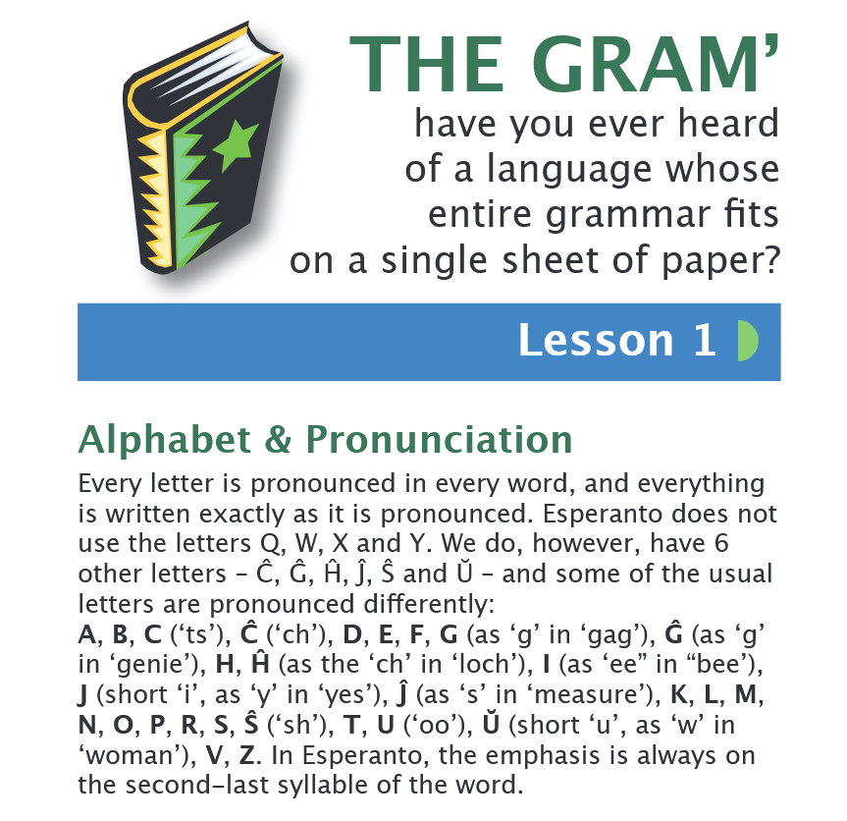

Booklet "Esperanto in your pocket"
https://c3eo.chaotik.de/dosieroj/pocket-guide.pdf

Slide 26
Booklet "Esperanto in your pocket"
https://c3eo.chaotik.de/dosieroj/pocket-guide.pdf

