Slide 1
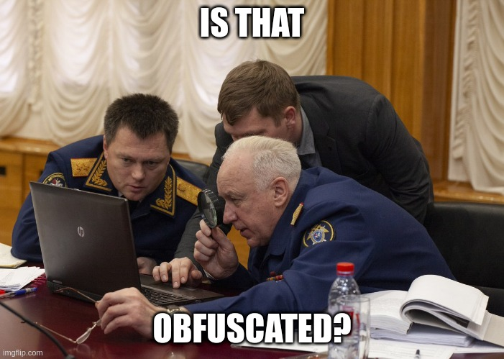
Malware Analysis
Deobfuscating Scripts
Notes:
Hey everybody it’s c3rb3ru5, and welcome to malware hell.
Today I’ll be teaching you about deobfuscating malicious scripts. More specifically, scripting languages common to the Windows operating system.

Slide 2

Prerequisites – Skills
Scripting
Coding
Programming
Notes:
In order to get started, you need some experience in scripting coding or programming. Without this knowledge some of the concepts might be difficult to follow. There are tons of great tutorials out there, once you have some scripting under your belt come back and continue this video!

Slide 3
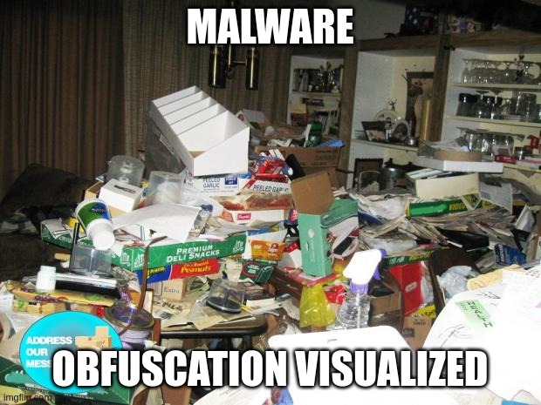
Prerequisites – Obfuscation Definition
Obfuscation - The action of making something obscure, unclear, or unintelligible.
Notes:
Obfuscation is defined as...
We will be doing the exact opposite, making the scripts intelligable.

Slide 4
Windows Script Host
Wscript
  Execute script without console window
  Wscript.Echo message box
Cscript
  Execute script with console window
  Wscript.Echo Writes to console

Slide 5
Component Object Model (COM)
COM is a platform-independent, distributed, object-oriented system for creating binary software components that can interact. COM is the foundation technology for Microsoft’s OLE (compound documents) and ActiveX (Internet-enabled components) technologies.
Demo: Accessing COM Objects and Methods
Notes:
COM can be described as...
Let’s now get to a demo on enumerating COM objects with PowerShell.

Slide 6
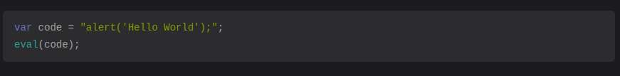
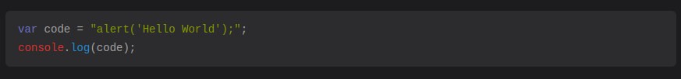
Common Techniques – Evaluation
Functions that can be called to directly evaluate code are an excellent tool for malware authors.
Notes:
Direct evaluation of code means we can execute code as a string by calling an evaluation function. This allows malware authors to store their code in all kinds of strange ways, which prevents analysts from easily understanding its functionality.

Slide 7
Common Techniques - Comments
To add variation and to slow malware analysts down, malware authors will sometimes insert comments all throughout their scripts. This can make the task of deobfuscation annoying if you do not remove the comments.
Varies by scripting language

Slide 8
Common Techniques – Garbage Code
When deobfuscating scripts, we will almost always do our best to ensure that the code that we are looking at is referenced or run at all. It is not uncommon for the code authors to create a large amount of useless code. Again, their job is too slow you down.

Slide 9
Common Techniques – Decoding/Decryption
To store obfuscated code, it is common for the authors to store code in an encrypted or encoded state. Executing the code to perform the decoding or decryption for us is usually the preferred method.
Should be able to visually recognize Base64, XOR and Hex.

Slide 10

Common Techniques – Concatenation
Another technique malware authors like to use is concatenation. This is usually applied to strings in order to make them difficult to read. An example can be seen below.

Slide 11
Common Techniques – Additional Stages
There are cases where the malware author will decide to split their obfuscated scripts into multiple stages. This usually includes downloading additional obfuscated scripts or payloads from the internet. These kinds of payloads have been observed being hosted on Discord, Google Drive, Pastebin, Dropbox, GitHub, GitLab and more. Anywhere that users can upload content under their control on the internet, this is possible.

Slide 12
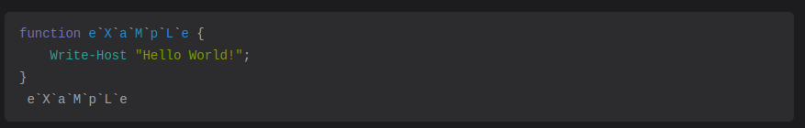
Common Techniques – Escape Characters
In PowerShell, methods or functions can be obfuscated with backticks.
Since they act as escape characters, it does not change the functionality at all.

Slide 13
Scripting Languages - JScript
One scripting language malware authors like to take advantage of is Microsoft’s JScript, not to be confused with JavaScript. JScript is Microsoft’s implementation of the JavaScript engine using the Windows programming interface. Typically, to interact with this programming interface, we use Window’s Component Object Model (COM)
Demo

Slide 14
Scripting Languages - VBScript
VBScript is an Active Scripting language developed by Microsoft that is modeled on Visual Basic. It allows Microsoft Windows system administrators to generate powerful tools for managing computers with error handling, subroutines, and other advanced programming constructs.
Demo

Slide 15
Scripting Languages - PowerShell
PowerShell is a task automation and configuration management program from Microsoft, consisting of a command-line shell and the associated scripting language.
It is still possible to access COM objects as discussed earlier in this guide. However, it is often not necessary with PowerShell due to the other built-in commands and access to the .NET interpreter.
Demo

Slide 16

Conclusion
Obfuscation can be a time-consuming task, for myself I think of it like a game of Sudoku. There is enjoyment in creating orderly code and uncovering secrets. When I need a break from reverse engineering, I’ll take a task to deobfuscate a script, it always rekindles my joy of the field.

