Slide 1



Collaborative (CPU + GPU) Algorithms for Triangle Counting and Truss Decomposition
Vikram S. Mailthody, Ketan Date, Zaid Qureshi, Carl Pearson, Rakesh Nagi, Jinjun Xiong, and Wen-mei Hwu

Slide 2
Objective:
To design algorithms for TC and TD for GPUs as well as collaborative CPU + GPU system such as the IBM “Newell” platform.
Notes:
Sequential Triangle Counting (Algorithm Forward):
TC for an edge = Total intersects in the adjacency lists of endpoints.
Triangle count = ($\sum{\text{Triangles} \text{in} \text{all} \text{edges}}$) / 3
Sequential Truss Decomposition Algorithm:
Start with $k=3$. Count triangles for each edge.
Loop over each edge. Delete if $TC<k−2$. Decrement triangle counts of each edge connected to the endpoints.
Continue until no edges can be deleted. Increment $k$ and repeat until graph is empty.

Slide 3
2018 Triangle Counting
Initialization
Algorithm Forward
0 1 2 3 4
0 0 1 1 0 0
1 0 0 1 1 1
2 0 0 0 1 1
3 0 0 0 0 1
4 0 0 0 0 0
1 0 1
2 0 1
0 1 1
2 1 1
…
Graph
Graph File(.tsv)
Adjacency matrix
Number of edges
Source edge array
Zs
0
0
1
1
1
2
2
3
COO for finding nodes neighboring an edge
Destn edge array
Zd
1
2
2
3
4
3
4
4
CSR for finding edges neighboring a node
Node Pointer array
P
0
2
5
7
8
8
Number of nodes + 1
Notes:
Input graph - integer triplets - tail id, head id, weight (ignored)
Adjacency list- 3 arrays:
Two separate 32 bit integer edge arrays (Zs and Zd) (size → number of edges)
Node pointer array P - P[u] points in the edge array Zd, the first edge connected to node u.
Use lexicographic ordering to read the file into CSR format to the memory.
Read only forward edges e = (u,v) with u<v for CSR construction.

Slide 4
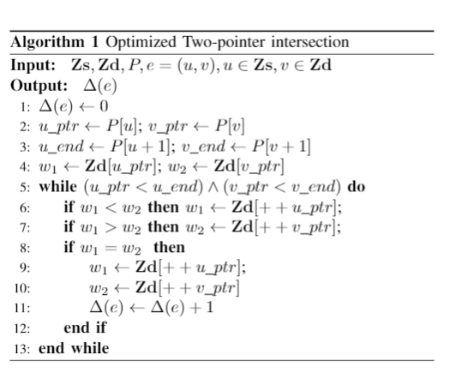
2018 Triangle Counting
Initialization
Algorithm Forward
Zs
0
0
1
1
1
2
2
3
0 1 2 3 4 5 6 7
Zd
1
2
2
3
4
3
4
4
P
0
2
5
7
8
8
0 1 2 3 4 5
Graph Based Algorithm

Slide 5
2018 Triangle Counting
Initialization
Algorithm Forward
thread
Zs
0
0
1
1
1
2
2
3
0 1 2 3 4 5 6 7
Zd
1
2
2
3
4
3
4
4
P
0
2
5
7
8
8
0 1 2 3 4 5

Slide 6
2018 Triangle Counting
Initialization
Algorithm Forward
Zs
0
0
1
1
1
2
2
3
0 1 2 3 4 5 6 7
Zd
1
2
2
3
4
3
4
4
P
0
2
5
7
8
8
0 1 2 3 4 5
thread2
1
2
Edge 1->2
u
v

Slide 7
2018 Triangle Counting
Initialization
Algorithm Forward
Zs
0
0
1
1
1
2
2
3
0 1 2 3 4 5 6 7
Zd
1
2
2
3
4
3
4
4
P
0
2
5
7
8
8
0 1 2 3 4 5
finding edges
neighboring a node
thread2
1
2
Edge 1->2
u
v

Slide 8
2018 Triangle Counting
Initialization
Algorithm Forward
Zs
0
0
1
1
1
2
2
3
0 1 2 3 4 5 6 7
finding nodes neighboring those edges
Zd
1
2
2
3
4
3
4
4
u_ptr
u_end
v_ptr
v_end
P
0
2
5
7
8
8
0 1 2 3 4 5
thread2
1
2
Edge 1->2
u
v

Slide 9
2018 Triangle Counting
Initialization
Algorithm Forward
Zs
0
0
1
1
1
2
2
3
0 1 2 3 4 5 6 7
Zd
1
2
2
3
4
3
4
4
u_ptr
u_end
v_ptr
v_end
P
0
2
5
7
8
8
0 1 2 3 4 5
thread2
1
2
Edge 1->2
u
v

Slide 10

2018 Triangle Counting
Initialization
Algorithm Forward
TC
=2
$$∩$$
Zd
2
3
4
4
1
2
2
3
4
3
4
4
3
4
u_ptr
u_end
v_ptr
v_end
P
0
2
5
7
8
8
0 1 2 3 4 5
thread2
1
2
Edge 1->2
u
v
Last step after all threads finished the work
Total TC = sum of TC in edges

Slide 11
2018 Triangle Counting
Initialization
Algorithm Forward
Removed preprocessing overhead
Multiple kernel launch and data copy
75% of total execution time
Removed redundant memory access
Happens when only one of the pointers is incremented
Minimized control/memory divergence
Removed redundant storage overhead
From storing forward and reverse edges

Slide 12
2018 Parallel Truss Decomposition Algorithm
K=3
Delete edges
with TC<K-2
This subgraph is 3 truss
K=4
Delete edges
with TC<K-2
K=4
Recount TC for
Affected edge
K=4
Delete Edges
With TC < K-2
Initial Graph
Calculate TC

Slide 13
2018 Parallel Truss Decomposition Algorithm
K=4
Delete Edges
With TC < K-2
This subgraph is 4 truss
K=5
Delete Edges
With TC < K-2
K=5
This subgraph is only 4 truss

Slide 14
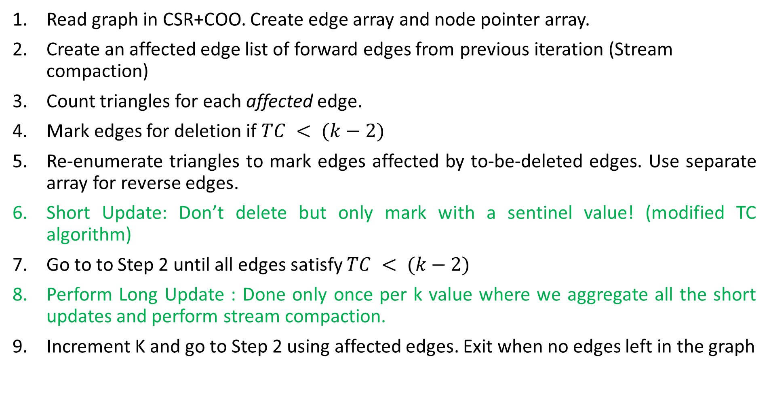
2018 Parallel Truss Decomposition Algorithm
Read graph in CSR+COO. Create edge array and node pointer array.
Create an affected edge list of forward edges from previous iteration (Stream compaction)
Count triangles for each affected edge.
Mark edges for deletion if $TC < (k−2)$
Re-enumerate triangles to mark edges affected by to-be-deleted edges. Use separate array for reverse edges.
Short Update: Don’t delete but only mark with a sentinel value! (modified TC algorithm)
Go to to Step 2 until all edges satisfy $TC < (k−2)$
Perform Long Update : Done only once per k value where we aggregate all the short updates and perform stream compaction.
Increment K and go to Step 2 using affected edges. Exit when no edges left in the graph

Slide 15
Results

Slide 16
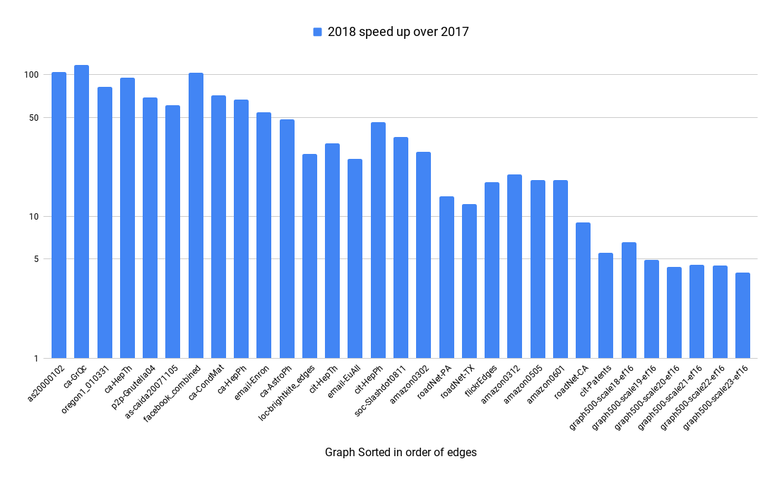
Triangle Counting Speed Up comparison 2017 submission
Data in GPU memory

Slide 17
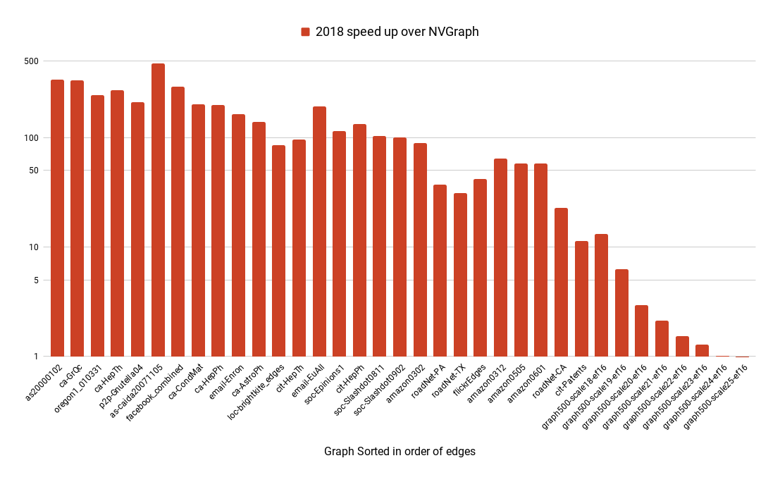
Triangle Counting Speed Up comparison with NVGraph
Data in GPU memory
Best case = 476 * NVGraph
Worst case = NVGraph

Slide 18
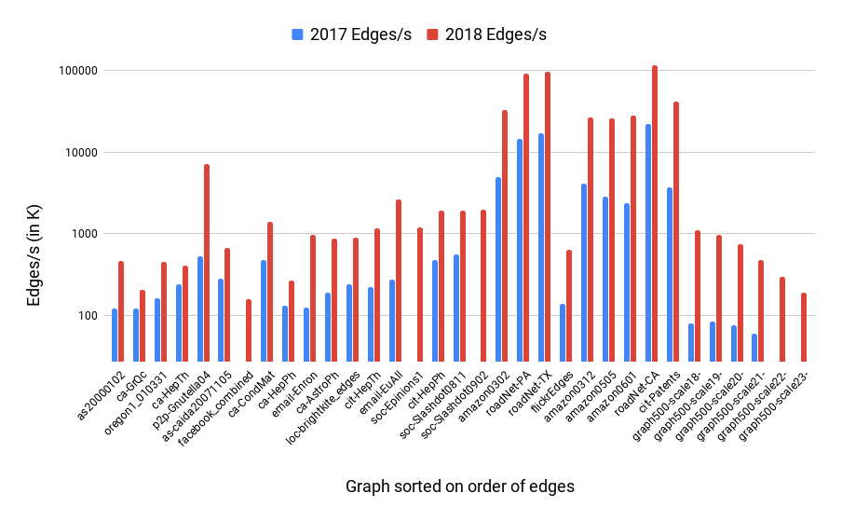
K-truss decomposition Speed Up comparison
Data in GPU memory

Slide 19
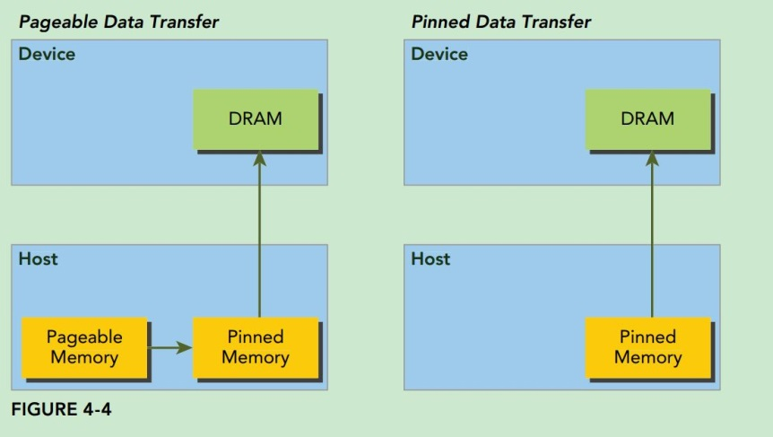
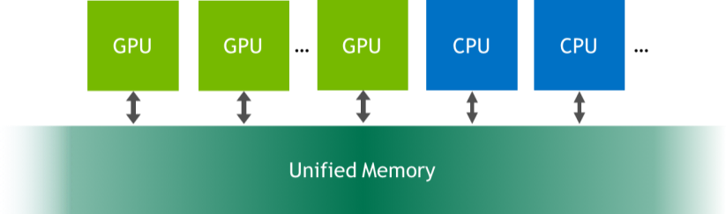
Newell Machine
Memory Management
2 IBM Power9 CPUs.
1 CPU: 10 cores, 80 threads @4.02GHz, 256GB RAM.
4 NVIDIA Volta V100 GPUs (16GB).
GPUs connected using NVLink Interconnect.
3 abstractions – Device, zero copy and unified memory
For Zero copy and Unified - Adjacency list centrally stored in Host Memory.
CPU and GPU threads seamlessly access the data without explicit memory transfer.
“Zero-copy” memory
Notes:
CPU and GPU

Slide 20
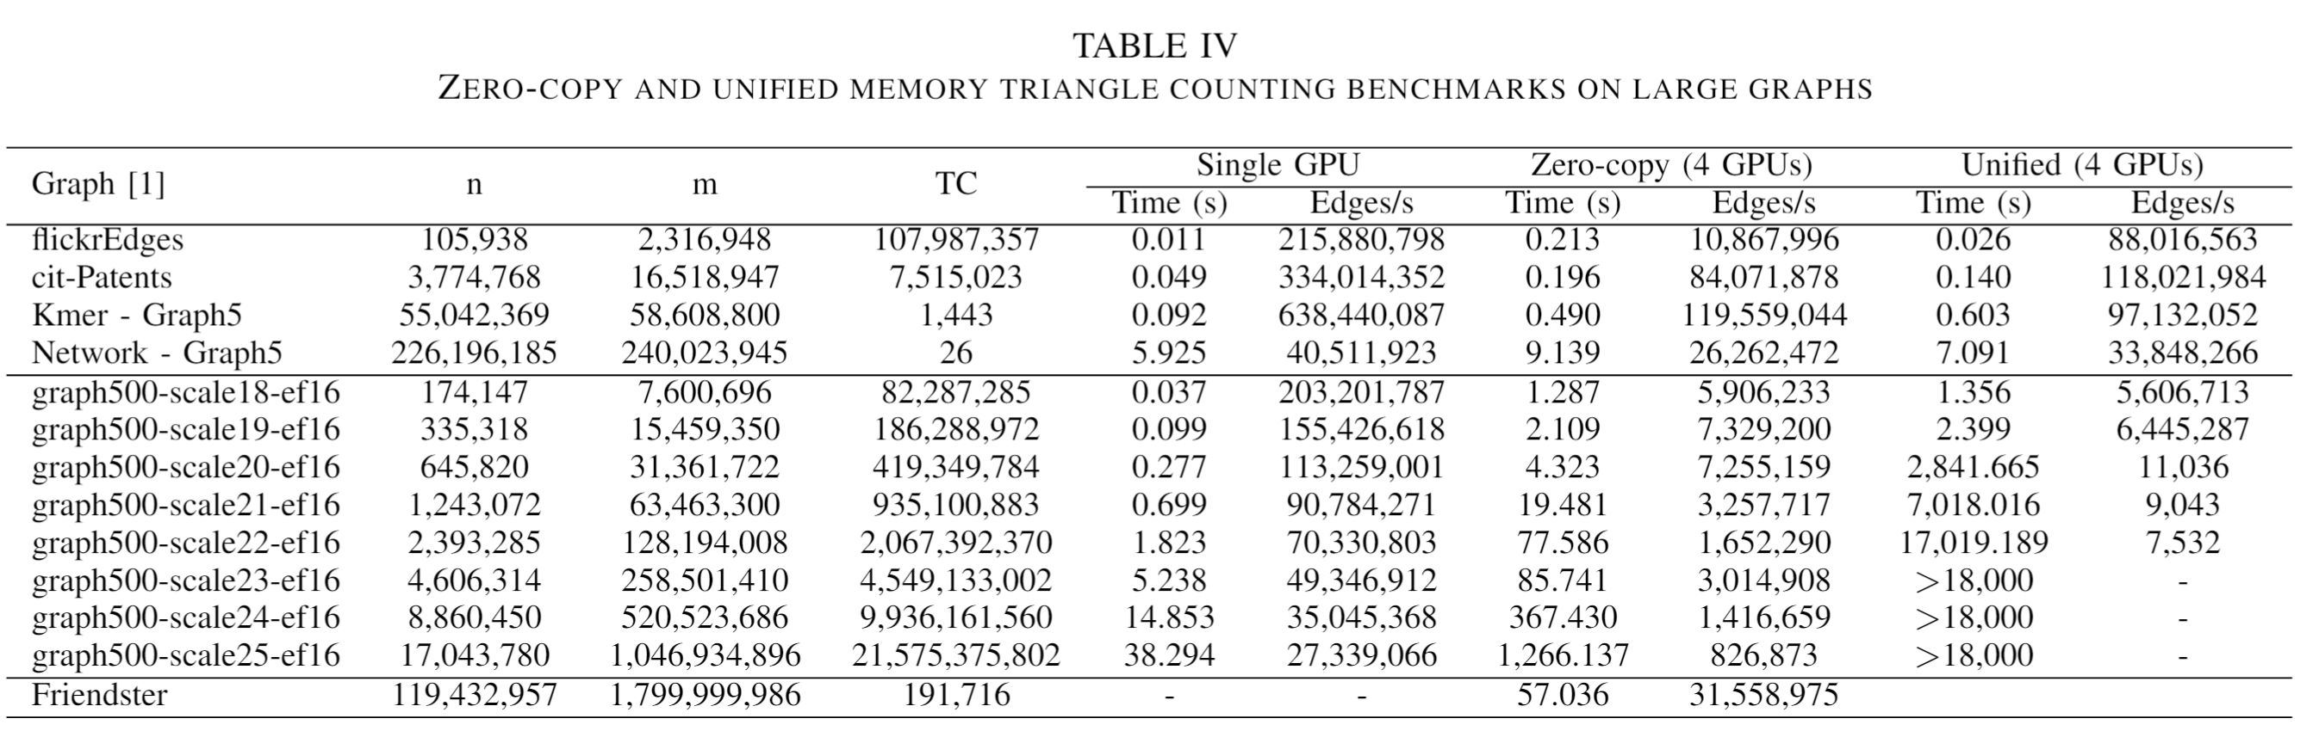
TC Collaborative Algorithm performance
GPU: 90% of the edges
CPU: 10% of the edges

Slide 21
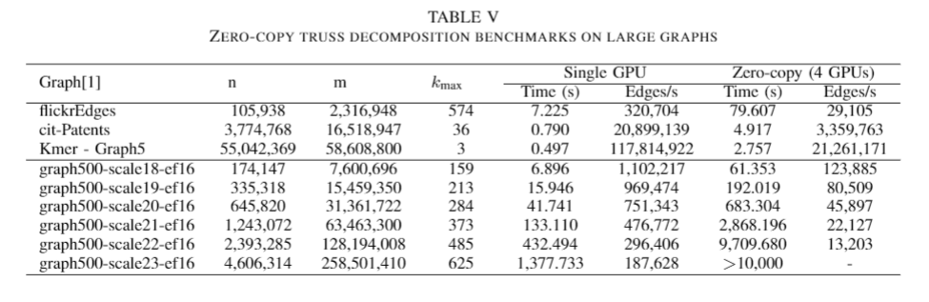
Next Steps:
Lots of room for improvement on algorithm side
We barely scratched the surface of the k-truss decomposition algorithmic optimization!
Balanced graph partitioning schemes for distributed algorithms

Slide 22
Summary
Collaborative algorithms utilize both CPU and GPU threads concurrently
If the graph fits in GPU memory, run the graph in GPU only mode.
If not, “Zero Copy” memory performs really well for large graphs
Friendster graph (1.8B edges) could finish triangle counting in 57s.
Watch out for performance bottlenecks in the algorithm:
Minimize number of kernel launches and data copy
Minimize redundant memory access
Minimize Stream compaction and binary search in GPU
Minimize preprocessing overhead
Future work: Balanced graph partitioning schemes for distributed algorithms

Slide 23
Thank you

Slide 24
2018 Triangle Counting
Initialization
Algorithm Forward
0 1 2 3 4
0 0 1 1 0 0
1 0 0 1 1 1
2 0 0 0 1 1
3 0 0 0 0 1
4 0 0 0 0 0
Number of edges
2 1 1
3 1 1
1 2 1
3 2 1
…
Zs
0
0
1
1
1
2
2
3
Zd
1
2
2
3
4
3
4
4
P
0
2
5
7
8
8
Graph
Graph File(.tsv)
Adjacency matrix
Input graph - integer triplets - tail id, head id, weight (ignored)
Adjacency list- 3 arrays:
Two separate 32 bit integer edge arrays (Zs and Zd) (size → number of edges)
Node pointer array P - P[u] points in the edge array Zd, the first edge connected to node u.
Use lexicographic ordering to read the file into CSR format to the memory.
Read only forward edges e = (u,v) with u<v for CSR construction.

Slide 25
2018 Triangle Counting
Initialization
Algorithm Forward
TC=2
2
3
4
$$∩$$
3
4
Zd
2
4
1
2
3
4
3
4
4
u_ptr
u_end
v_ptr
v_end
P
0
2
5
7
8
8
0 1 2 3 4 5
thread2
1
2
Edge 1->2
u
v
Last step after all threads finished the work
Total TC = sum of TC in edges

