Slide 1














TEAM 5
Public Transit vs. Weather Consumer Sentiment Analysis
18th April 2018
Team Members: Tyler Guo / Olivier Brouard / Charles Fortuno / Jason Dickey

Slide 2




INTRODUCTION
Current observations:
Most of us live in major cities in the world where the tertiary sector is located
Urban density has grown significantly over the last decade causing public transportation congestion due to mass volume often time disrupted with external factors such as the weather impacting people mood
Within the same time frame, social networks / online news publicly accessible and smart phone technology revolution has transformed the way people communicate and share their instantaneous opinion
The intent of the study is to figure if people sentiment over tweeter is correlated to the weather when using public transportation.
Access Twitter’s API to create a sentiment analysis for specific public transportation twitter accounts. Map sentiment based on time and weather variables at that current moment
The week from April 10th, 2017 through April 17th, 2017 will be used as the common denominator timeframe to correlate the tweets against the weather data

Slide 3

ANNUAL WEATHER DATA FOR VARIOUS US CITIES
The questions you and your group found interesting, and what motivated you to answer them:
How often does weather affect customer tweets about public transit?
How does overall sentiment differ across cities?
How is tweet volume impacted?

Slide 4



CHALLENGES, LIMITATION AND DATA BIAS
Limiting capabilities of the APIs
OpenWeatherMap API: (limited calls per minute, very costly to access historical weather data)
Twitter API: (limitation of 15 requests per 15 minutes, limitation of historical tweets count requests, cost)
Pivot the initial goal as we moved forward
Limited access of historical data for both APIs
Used WeatherUnderground webpage instead manually parsing the data over the last week
Assembled and cleaning manually the data into a csv file
Used the last week weather hourly time bins to match the tweet API calls up to 7 days back
Data Bias
Weather stations are often located at airports in large open sites where local climates variables may differ from city ones
Restricted timeframe taken is relatively short (less volume of tweets and various climates diversity events)
Volume of tweets varies greatly from one public transportation service to another
Users sentiment analysis isn’t only linked to climate variables (rain, sun, wind, snow etc)
Transportation machinery malfunction or maintenance can lead to negative sentiment tweets
Tweets are not necessarily linked to transportation usage
Tweets sentiment polarity can be greatly affected by external variables (games, politics, news, personal life)

Slide 5

DATA MINING AND RETRIEVAL PROCESS ROAD MAP
Where and how you found the data you used to answer these questions
Retrieve Weather Underground historical data for 6 major cities:
San Francisco
Las Vegas
Atlanta
Chicago
Washington DC
New York
Leverage Twitter API to gather tweet
Data on various mass transits:
@SFBART (San Francisco)
@RTCSNV (Las Vegas)
@MARTASERVICE (Atlanta)
@CTA (Chicago)
@WMATA (Washington DC)
@NYCTSUBWAY (New York)
Annual Monthly
Weekly
Hourly
Aggregated Dataframe
CSV file
Excel
Time Zone match
Merge on time bins
Final Dataframe
Visuals
API “statuses” tweets
Weekly
Hourly
Aggregated Dataframe
Jupyter Notebook
Matplotlib

Slide 6
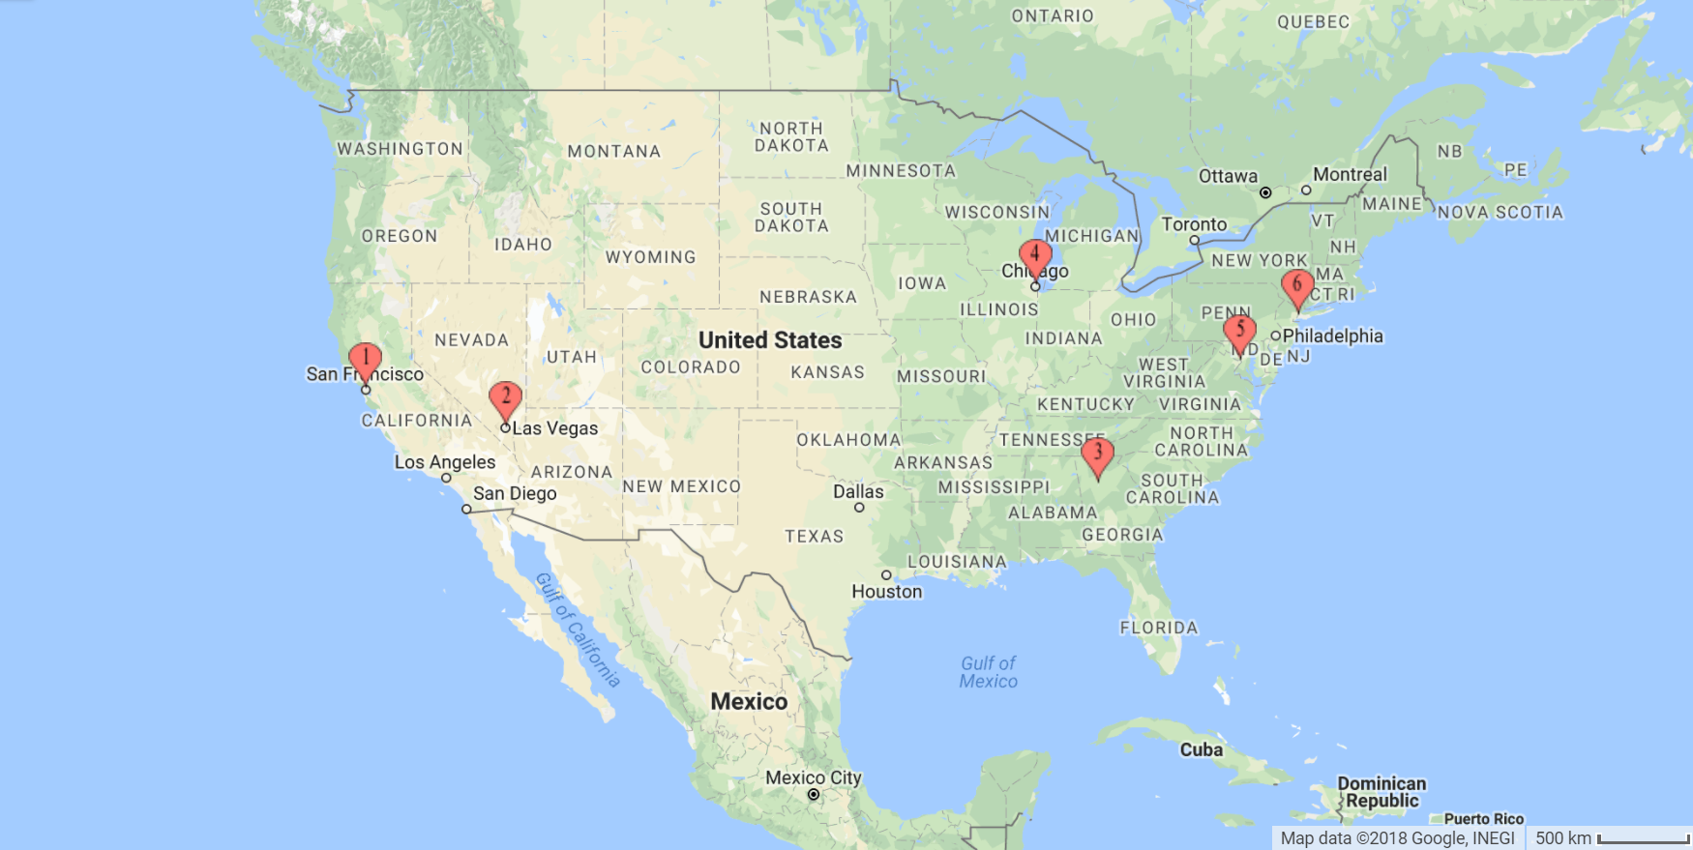
ANNUAL WEATHER DATA FOR 6 URBAN US CITIES
New York
Washington DC
Atlanta
Source: https://www.mapcustomizer.com/

Slide 7
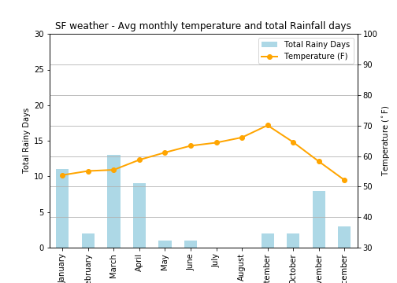
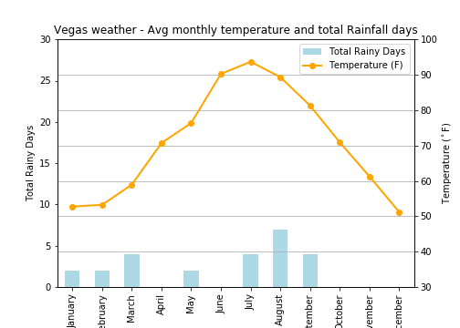
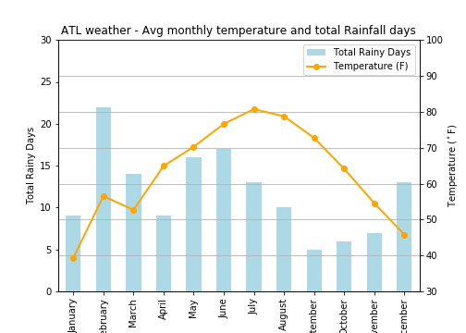
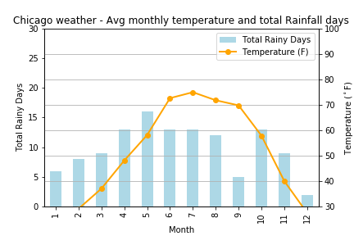
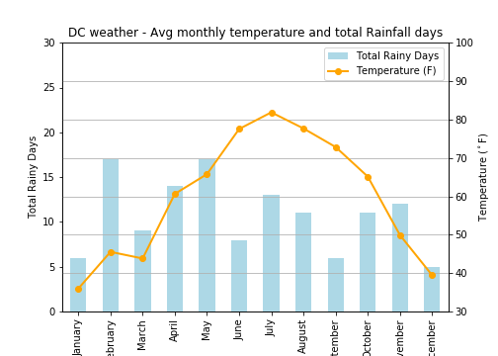
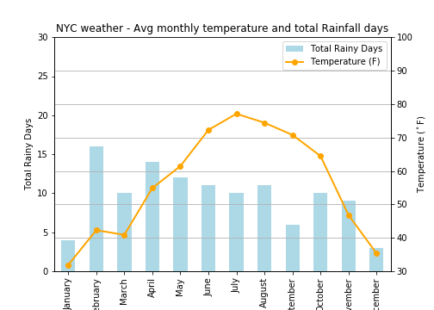
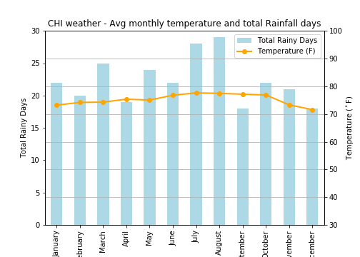
ANNUAL 2017 WEATHER DATA FOR 6 URBAN US CITIES
San Francisco
Las Vegas
Atlanta
Chicago
Washington DC
New York

Slide 8
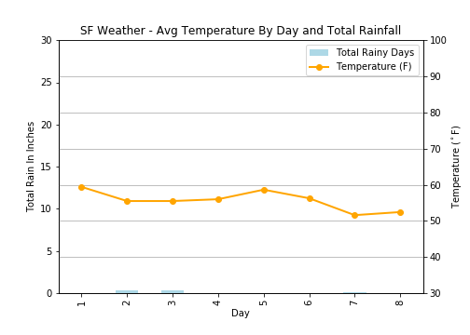
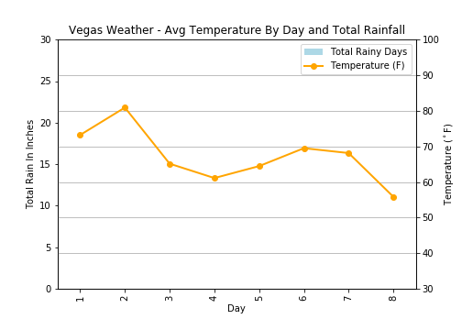
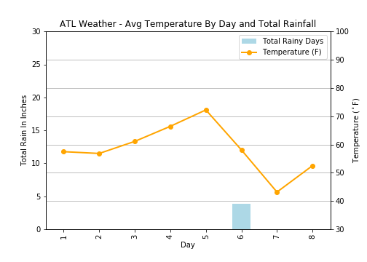
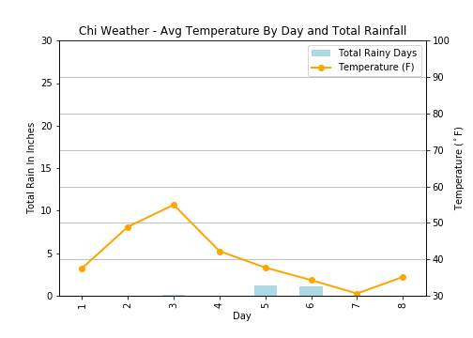
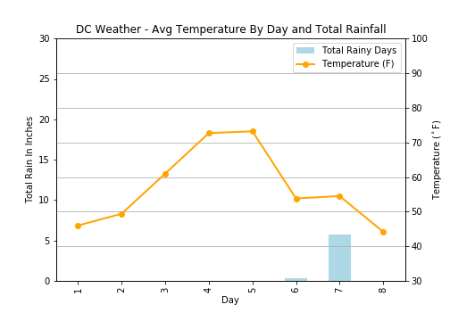
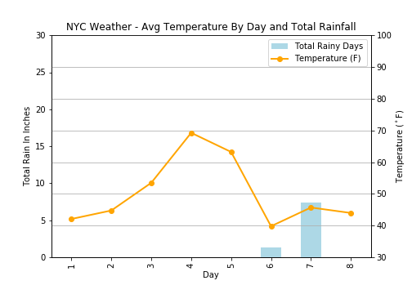
WEEKLY DAILY WEATHER DATA FOR 6 URBAN US CITIES
San Francisco
Las Vegas
Atlanta
Chicago
Washington DC
New York

Slide 9
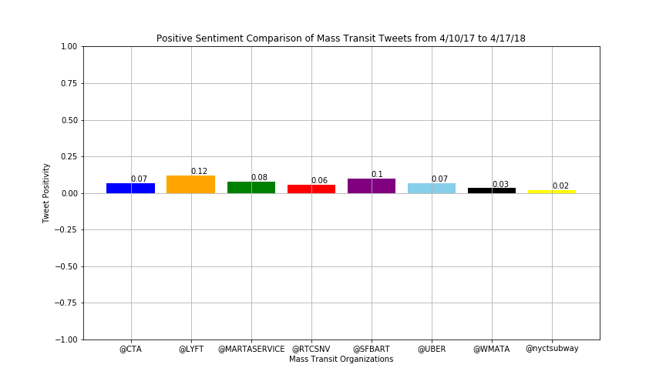
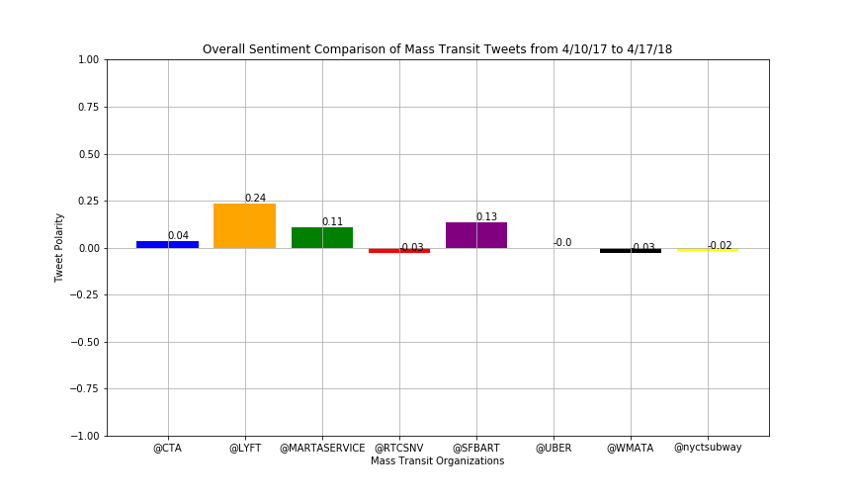
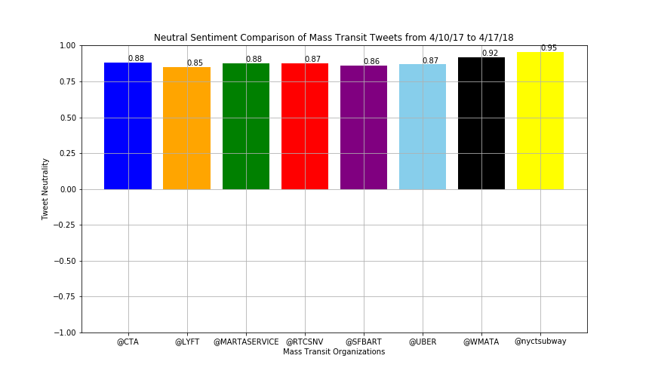
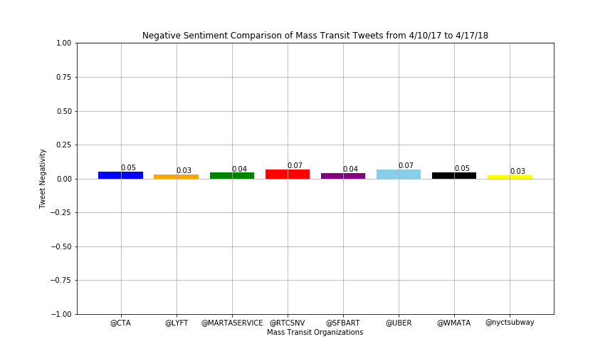
OVERALL SENTIMENT POLARITY FROM TWEETER ACROSS ALL CITIES (WEEK BASED)
Across the last week the Bart (SF) showed the highest result, but overall the highest satisfaction was still noticed with the ride sharing service.
San
Francisco
Chicago
Atlanta
Las Vegas
Washington DC
New York
Positive sentiment
Neutral sentiment
Negative sentiment

Slide 10

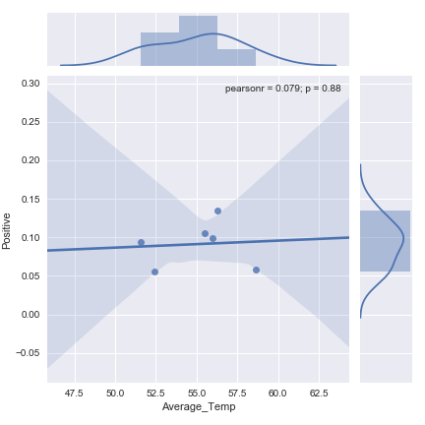
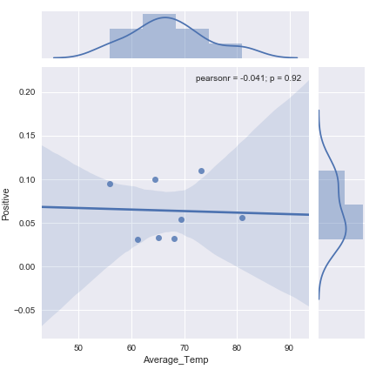
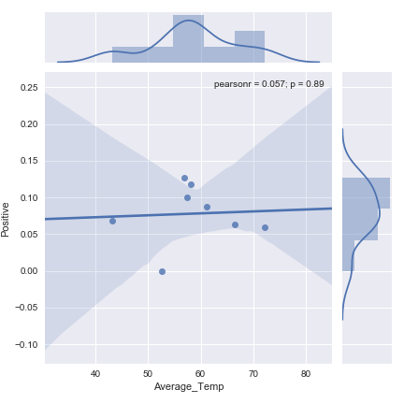
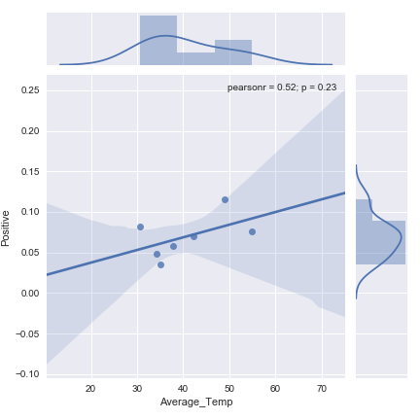
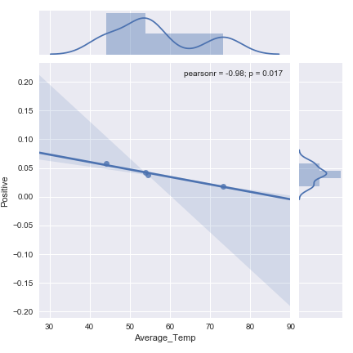
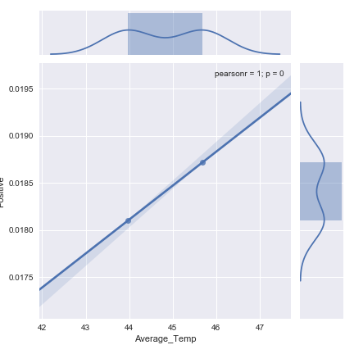
SENTIMENT (NEUTRAL, POSITIVE, NEGATIVE) FROM TWEETER
Temperature vs Positive sentiment shows a wide range of disparity for each cities, from low to very high
San Francisco
Las Vegas
Atlanta
R2 = 0.079
R2 = 0.041
R2 = 0.057
Chicago
Washington DC
New York
R2 = 0.52
R2 = 0.98
R2 = 1

Slide 11

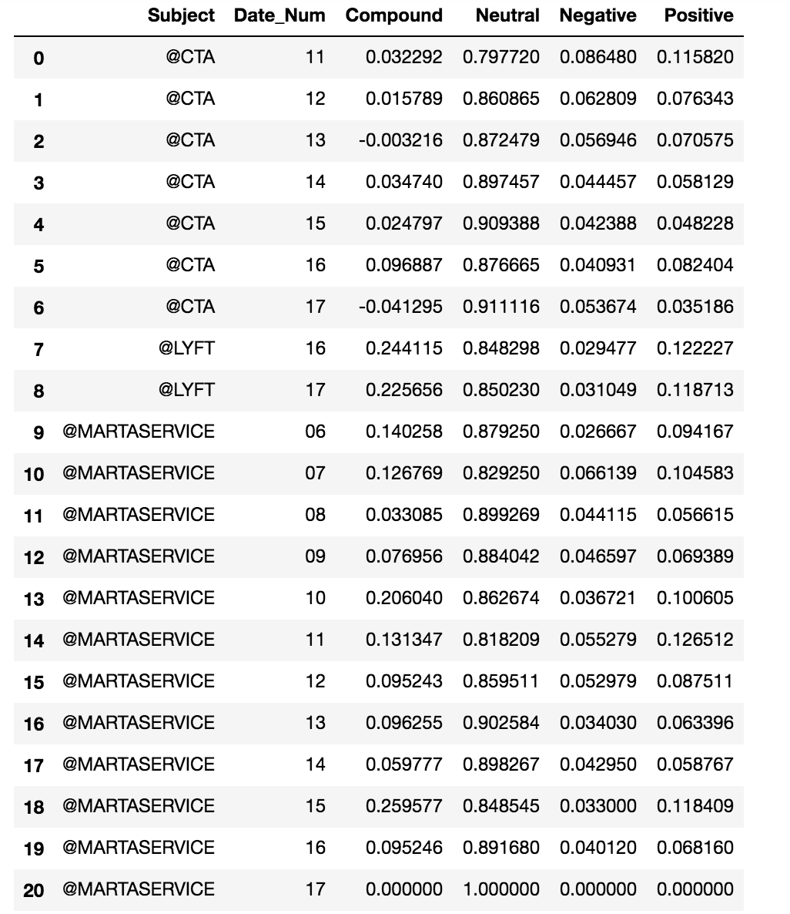
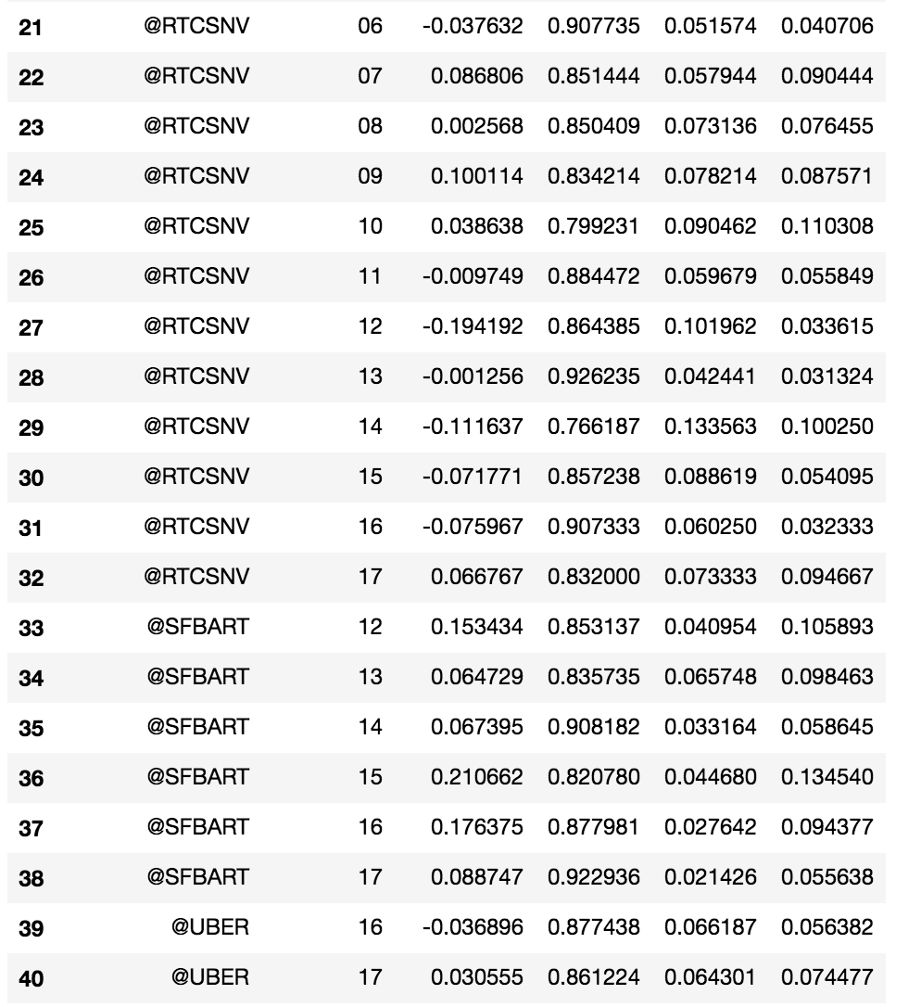
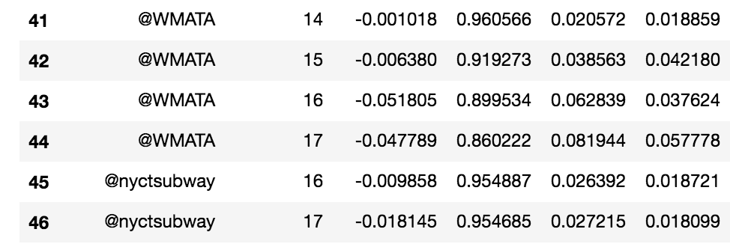
NUMERICAL SUMMARY OF SENTIMENTS TWEETS (DATAFRAMES)
Dataframes

Slide 12
SUMMARY OF MAJOR FINDINGS
How often does weather affect customer tweets about public transit?
All things being relative to the variables analyzed, overall it was noticed that San Francisco mild climate could have a positive impact on tweet sentiments
How does overall sentiment differ across cities?
Across all cities, there wasn’t much difference in the average compound sentiment results.
How is tweet volume impacted?
Tweet volume is impacted by weather. The two hottest cities, Atlanta and Vegas didn’t tweet as much as all the other cities
CONCLUSION AND OPEN DISCUSSION
Additional time needed to identify true correlation between mass transit and weather data.
It would be worth considering adding more publicly free accessible data source to retrieve more granularity
Adding more adding data sources (ie: Instagram, Facebook,

