Slide 1
Cell Phone Mart
GROUP 1 - Wednesday
Adarsh Rajanikanth,
Malatesha Somasundar Anantha, Neelima Vangipuram, Sahil Wadhwa
1/23

Slide 2

Introduction
Motivation
Approach
Data Acquisition
Data modeling & Linking
Ontology Relationships, RDF
SPARQL queries
Challenges
Project Demo
Future Scope
2/23

Slide 3
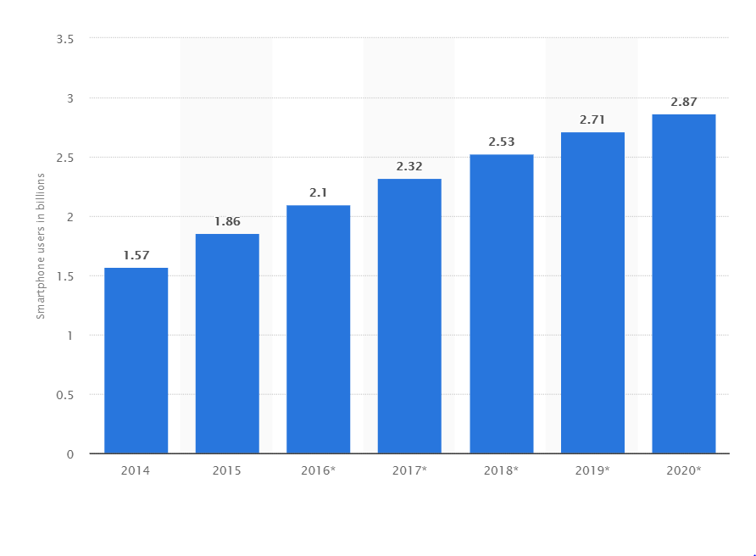
Introduction
Mobile phones – A perfect way to stay connected with others.
An industry touching all corners of the globe.
Smartphone shipments worldwide are projected to add up to 2.87 billion in 2020.
By 2018, over a third of the world’s population is projected to own a smartphone, an estimated total of almost 2.53 billion smartphone users in the world.
3/23

Slide 4
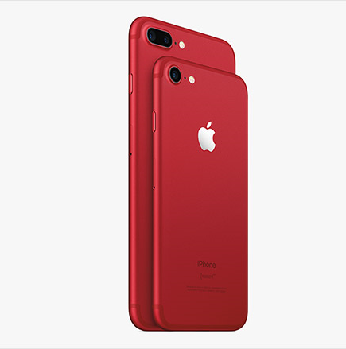
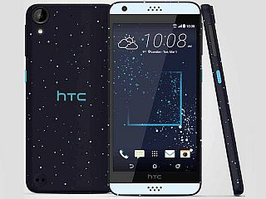

Motivation
Often a user while upgrading their Smartphone, looks out for other smartphone specifications
Inherent need for consolidated information about different brands and their models from several sources, not just one.
Analytics from collected information, to assist with decision-making.
4/23
Notes:
Link 1: https://epjdatascience.springeropen.com/articles/10.1140/epjds/s13688-015-0046-0

Slide 5

5/23

Slide 6





Data Acquisition
Additional Specs
Comments
Specifications
Company Details
6/23

Slide 7
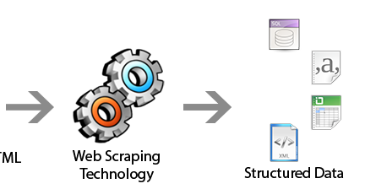

Web Crawling & its Challenges
Web Pages with HTML content
7/23

Slide 8
Web Crawling & its Challenges
Collecting and maintaining a huge data set ~ 320,000 records
Non-uniform data structure makes it difficult to map and aggregate.
Parsing different XML documents is cumbersome and time consuming.
8/23

Slide 9
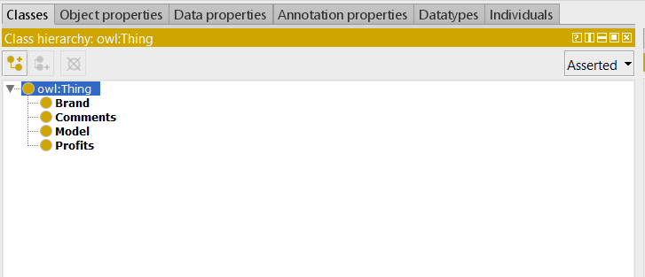
Ontology
Classes
Fig: Protégé Screenshot
9/23

Slide 10
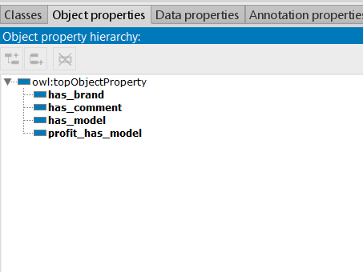
Ontology
Object Properties
10/23

Slide 11
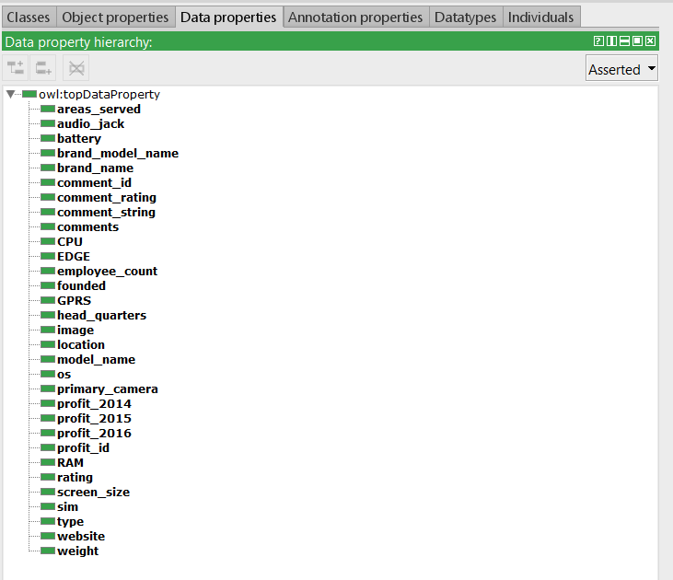
Ontology
Data Properties
11/23

Slide 12
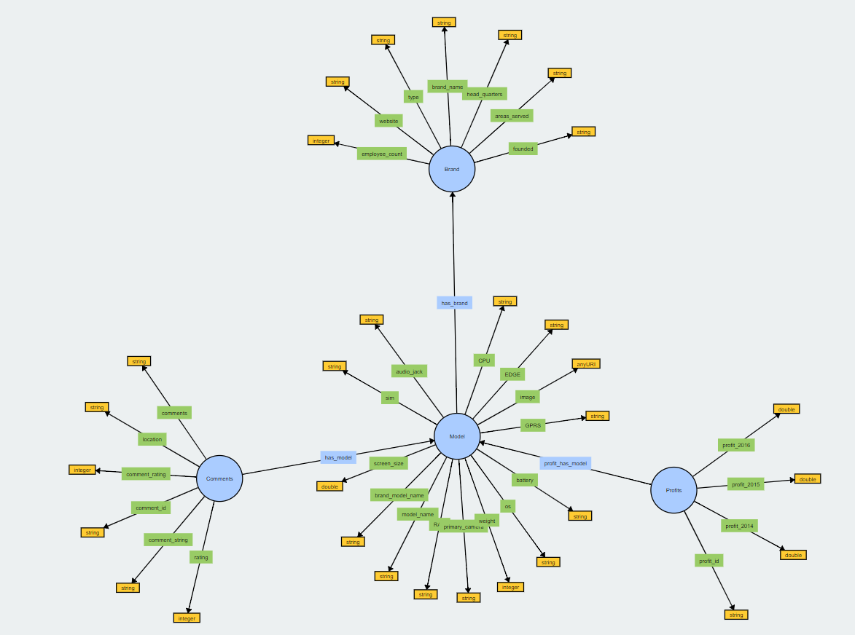
Ontology Graph
Ontology Graph
12/23
Notes:
http://visualdataweb.de/webvowl/#opts=[sidebar=0;cd=100;dd=130;mode_compact=true;]#file=owlFile.owl

Slide 13
Data Modelling and Linking Summary
8632 different Models belonging to various brands.
108 different brands around the world.
413000 consolidated comments for the available models.
25896 year wise revenue for all models for years 2014 to 2016.
13/23

Slide 14

Data Cleaning
Enforcing UTF-Encoding.
Organizing scrapped data.
Handling empty and null values.
Special character support (`, ^, /).
Handling website links/image URLs.
14/23

Slide 15
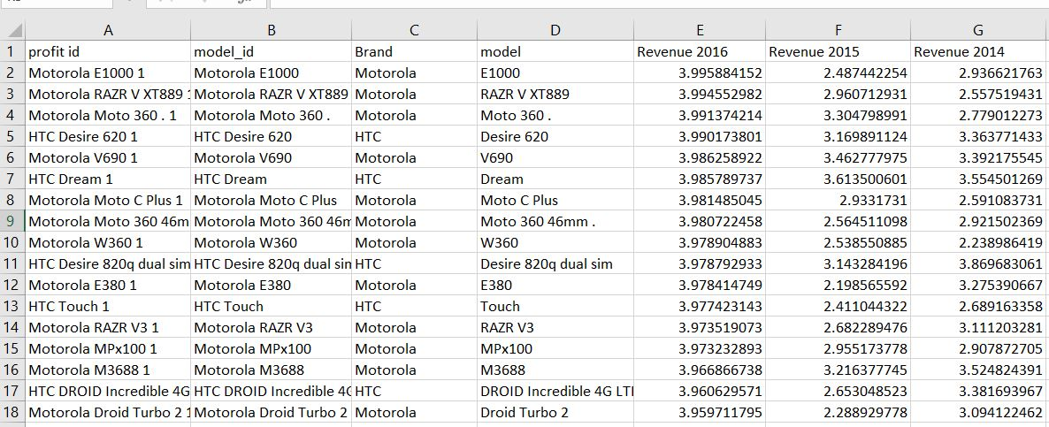
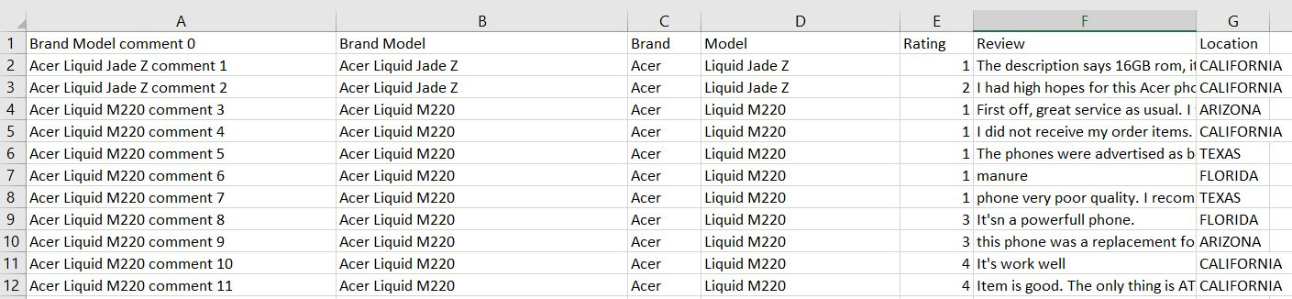
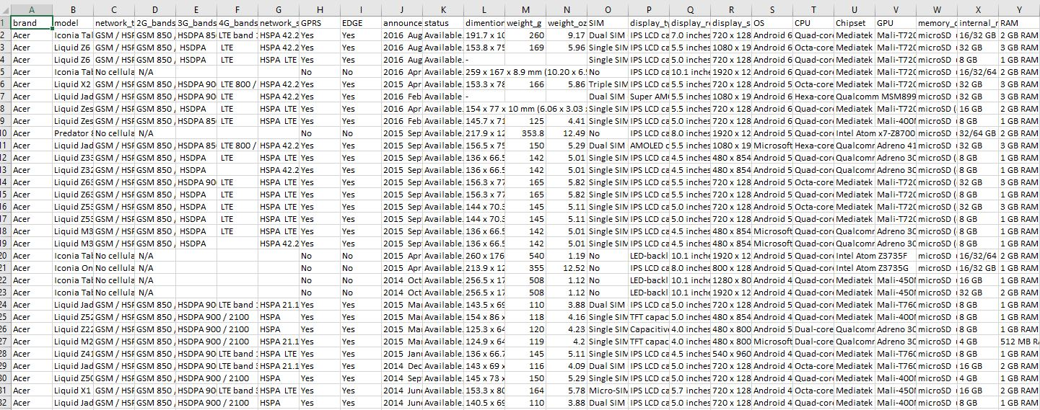
Data Linking
Comments
Revenue
+
+
=
Consolidated
Data Set
Features
15/23

Slide 16
Challenges
Handled redundant comments – Added Comment_ID as primary key.
N:1 relationship between models and brand – applied transformation rules.
Manual scrapping to simulate data for revenue from various brand websites.
Linked multiple CSV outputs to create composite primary keys
16/23

Slide 17




Ontology specific Transformation
Applied rules
Import Excel
data
Unstructured data
Uses
Cellfie Plugin
OWL file
Added data
To Ontology
Created Ontology
17/23

Slide 18
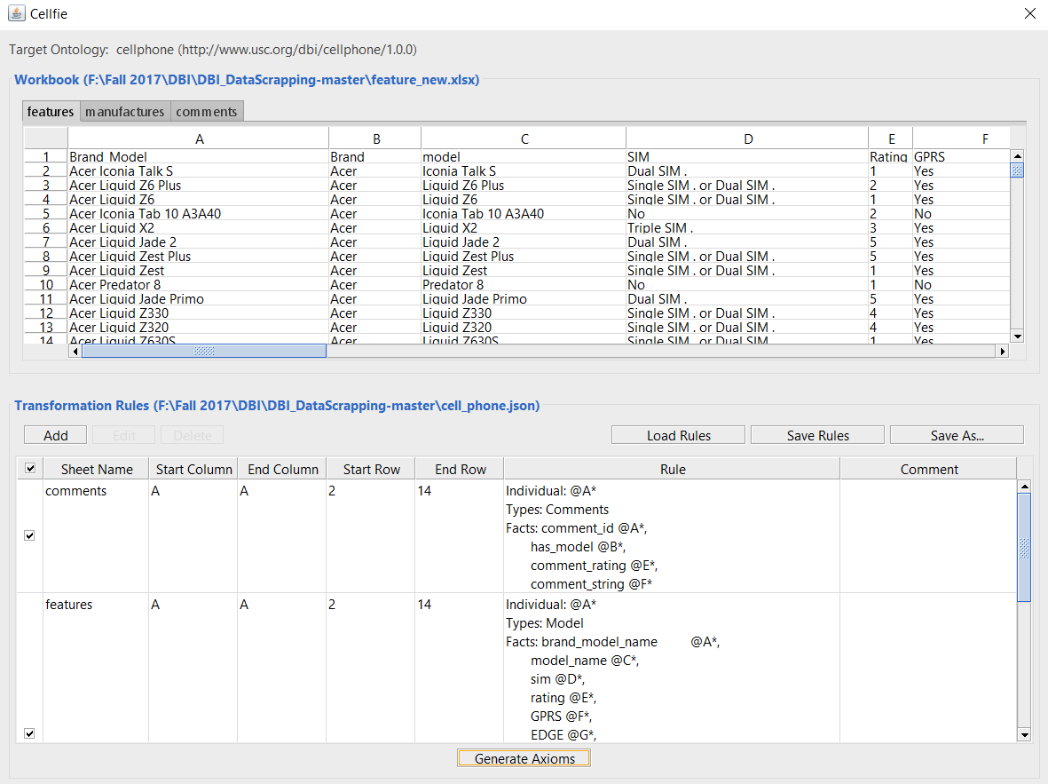
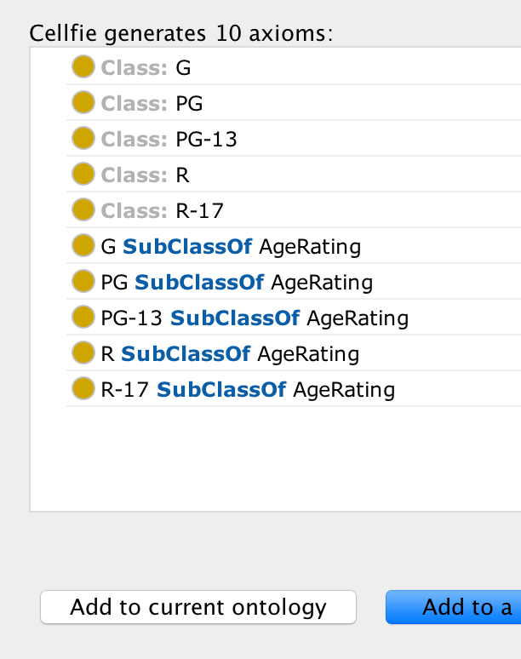
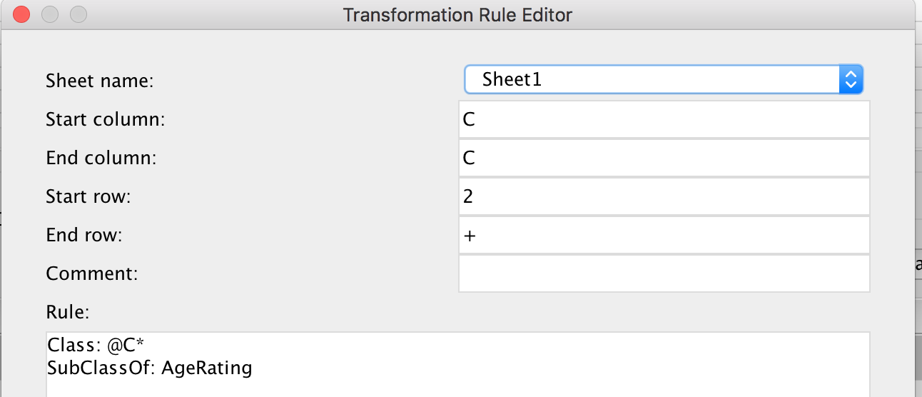
Creating OWL file using Cellfie plugin
Fig: Transformation Rule
18/23

Slide 19
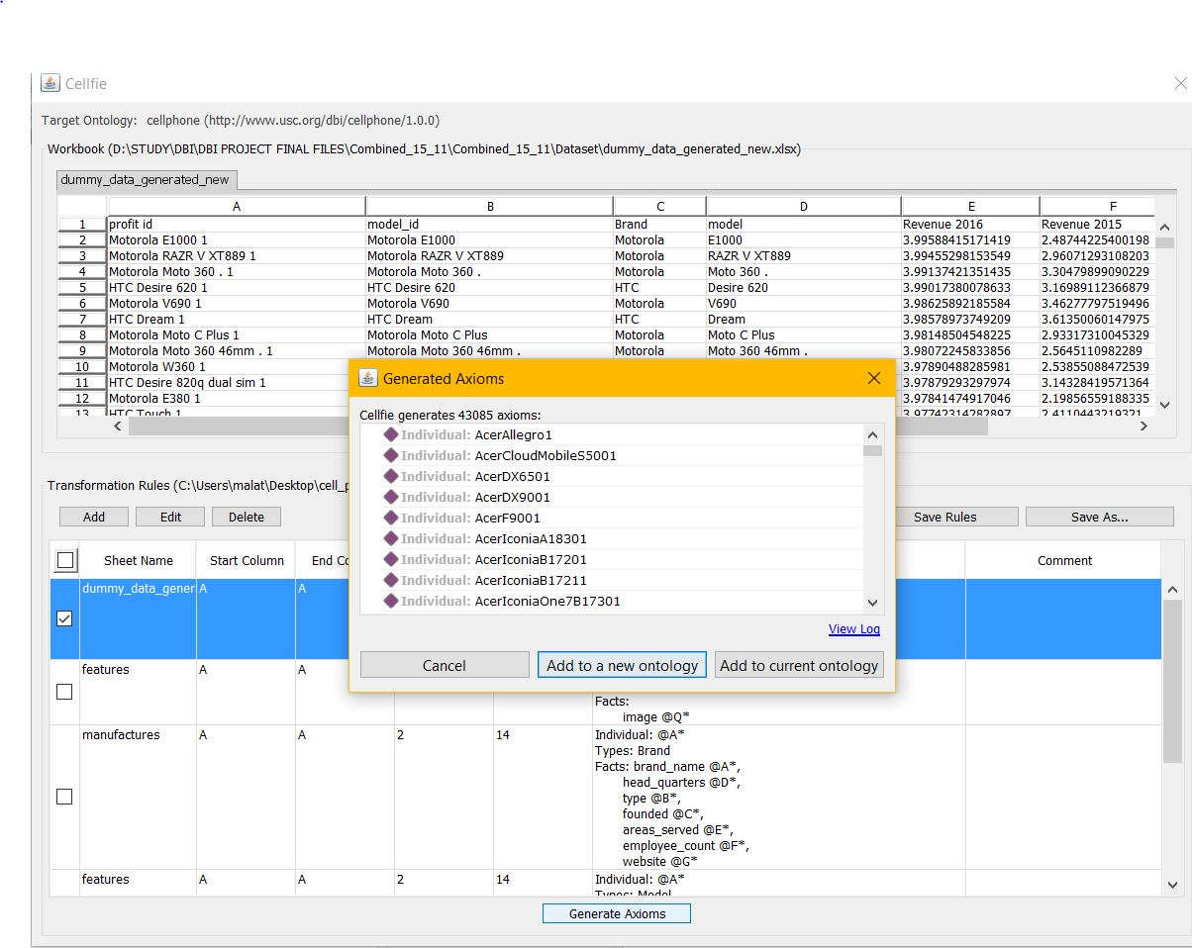
Generated Axioms in Protege
Total 390 Rules
19/23

Slide 20
Apache Jena Fuseki as SPARQL endpoint
Result Data in JSON format
OWL file
SPARQL Query Result
Input
Apache Jena
20/23

Slide 21

Project Demo
21/23

Slide 22

Generalized queries
Extension of Schema
Include more key performance indices and extend scope of analytics
Include different types of charts for better visualization
Integrating different ontologies to existing Ontology, eg, Stock Info.
22/23

Slide 23


23/23

