Slide 1
The Joy of Reproducibility
Three techniques for robustness and repeatability
Paul Walmsley
Senior Principal Engineer
Avid/Sibelius
June 2012

Slide 2

About me
PhD in Bayesian Modelling of Musical Signals
University of Cambridge Engineering Department, 2000
Professional Software Developer since 2000
Sibelius 2.0 to 7.0

Slide 3

Importance of Reproducibility
Basic tenet of scientific research
Collaboration
Publication
Commercialisation

Slide 4
Overview
Experimental Design
Version Control
Unit Testing

Slide 5
Case Study: Journal Paper
6 months of research
Submit journal paper
Continue with research [6 months…]
Reviewer’s response:
“Please provide more data points for the analysis in the 100-150Hz region and I would like to see how the algorithm performs with ‘How Much Is That Doggy In The Window’ ”
How can you reproduce your earlier results?

Slide 6

What Is An Experiment?
Experiment:
A well-defined activity intended to
generate a reproducible result

Slide 7
Research
A natural progression of experiments, both to develop ideas and to publish those results for a wider audience.
Experiment 1
Experiment 2
Experiment 3
Seminar
(Exp. 4)
Experiment 5
Journal Article
(Exp. 6)
1. Investigate Smurf’s classic widget estimation algorithm: evaluate SNR performance
2. Evaluate Bayesian detection of widgets in noise for high SNR case
3. Compare noise performance of refined Bayesian algorithm with Smurf’s method
4. Produce graphs of detection probability against SNR for seminar slides
Notes:
Evaluate other techniques in the literature
Proof of concept for a new method
Development and refinement of new method
The preparation of data for publication is itself considered an experiment.
Enumeration is important

Slide 8
Experimental Objectives
Establish a hypothesis
Classic Scientific Method
eg. Determine whether a uniform or Gaussian prior produces optimal frequency estimates when SNR is low
Produce a specific set of results for publication
Graphs
Audio outputs

Slide 9
What Are the Constituents of an Experiment?
Algorithm
Presentation of results
Source data
Define data sets and generators
The implementation at a particular point in time
Graphs, tables, audio output
Notes:
A generator is a function that generates synthetic data with particular characteristics, eg mixture of harmonically-related sinusoids in Gaussian noise

Slide 10
Coding the Experiment
One experiment = One application/script
experiment12.exe
Core
Library
Exp. 1
Exp. 2
Exp. 3
Notes:
This makes it much easier to separate each experiment and compare results or to revisit later on. Each application/script just calls into the core library where the algorithms are implemented

Slide 11
What The Experiment Script Does
Sets up the environment
Prepares source data
Runs algorithm
Present results
Automation is key!

Slide 12
Experimental Write-Up
The experiment has done most of the work
Where:
Logbook
Wiki
iPython Notebook
Evernote
Back up:
Source
Results
Scripts/applications

Slide 13
Version Control
At it’s simplest a time-ordered incremental backup system
Roll back to any point in time
Easy to find regression bugs
Checkpointing
Save a new version when milestones are reached or bugs fixed
Fits with experimental time-line
Collaboration
Ease of sharing source with others
Pick one:
Subversion, Git, Mercurial, …

Slide 14
Branching and Tagging
Exp6_branch
Exp1
…
Exp6_ Journal1
Exp7
Exp6b
Merge
Notes:
In journal review, reviewer finds an error so you need to fix and re-run experiment 6. You then want to apply the fix to your current code

Slide 15
Unit Testing
Spend your time doing research, not debugging

Slide 16

Cost of Fixing Low-Level Bugs
Debugging is expensive
System
F0 estimator
Convolution
Posterior calculation
Gaussian PDF
LPF
FIR
FFT
Bugs propagate upwards
Cost of debugging

Slide 17
WHY To Unit Test
Automated, reproducible testing
Detect regressions instantly
Test boundary conditions
Be confident of your algorithm implementations
Easier to change platforms, tools or libraries
Eg evaluate alternative FFT library

Slide 18
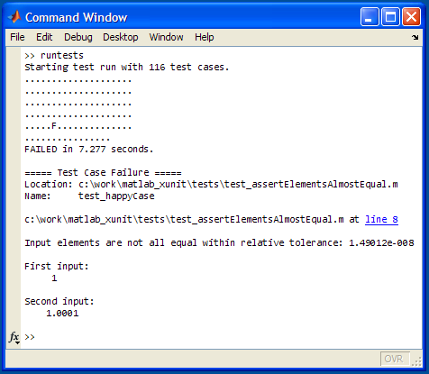
HOW To Unit Test
Pick a Unit Test Framework
xUnit (Matlab), CppUnit (C++), PyUnit,…
Break system into smaller components
Test low-level components first
[for extra credit] Set up build server to run tests daily

Slide 19
FFT test suite
testFFT() {
x=GenerateSine(Fs/Nfft)
X=FFT(x)
assertEqual(Nfft, length(X))
assertAlmostEqual(0, X[0]) // no DC
…
d=GenerateDC(Nfft)
D=FFT(x)
assertEqual(normalisingFactor, D[0])
…
// test complex/imag packing
// check zero-padding
// check Fs/2 behaviour
Generate test data
Call function
Check results

Slide 20
Conclusion
3 steps towards reproducibility:
Design and enumerate your experiments
Get your code into Version Control, commit early and often
Introduce Unit Testing to your codebase

