Slide 1
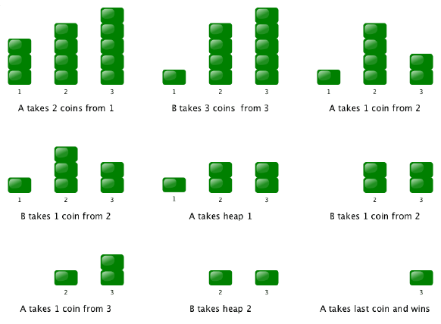
ARTIFICIAL INTELLIGENCE
MINI PROJECT
GAME OF NIM
VASVI GUPTA
111803128

Slide 2
nim game
NIM-SUM
Given a number of piles in which each pile contains some number of objects. In each turn, a player can choose only one pile and remove any number of objects (atleast one) from that pile. The player who takes the last stone is the winner.
The cumulative XOR value of the number of objects in each pile at any point of the game is called Nim-Sum at that point. The optimal strategy for each player is to make the Nim-Sum zero for his opponent in each of their turn.

Slide 3
ALGORITHM
      else
        for row in rows
          remove objects one by one from that row
          if board is balanced, change board balanced to True and break
          if row becomes 0, recopy the original board
      print move
c. if winner declared, end game
d. else change player and continue
5. For player vs player mode
while winner not declared
a. if current player is player 1
      remove valid amount of an object from a valid row
      print move
b. else
      remove valid amount of an object from a valid row
      print move
c. if winner declared, end game
d. else change player and continue
1. Initialise the game with default:
mode = player vs player
player 1 = 1, player 2 = 2
winner = none
GUI for the game
2. Load menu for selecting mode
3. Select mode to load another menu accordingly
4. For player vs AI mode
while winner not declared
a. if current player is player 1
      remove valid amount of an object from a valid row
      print move
  b. else
      initialize board balanced to False
      copy game board
      check if the copied game board is balanced
      if already balanced, remove 1 object from the first non-empty pile

Slide 4
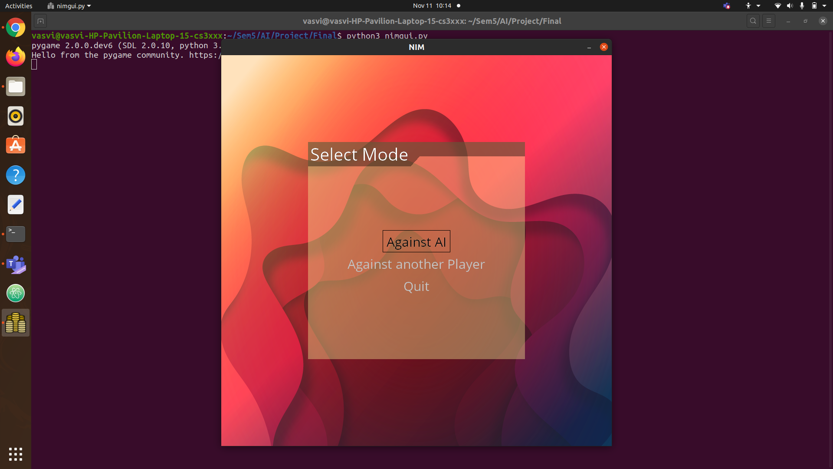
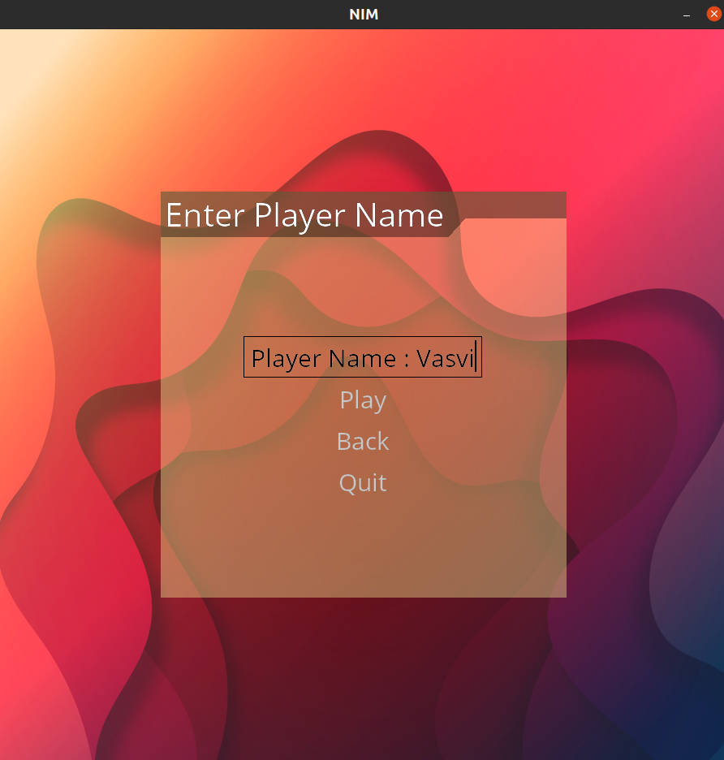

Player vs AI mode menu
Player vs Player menu
Mode selection menu
A still from the game I have made

Slide 5
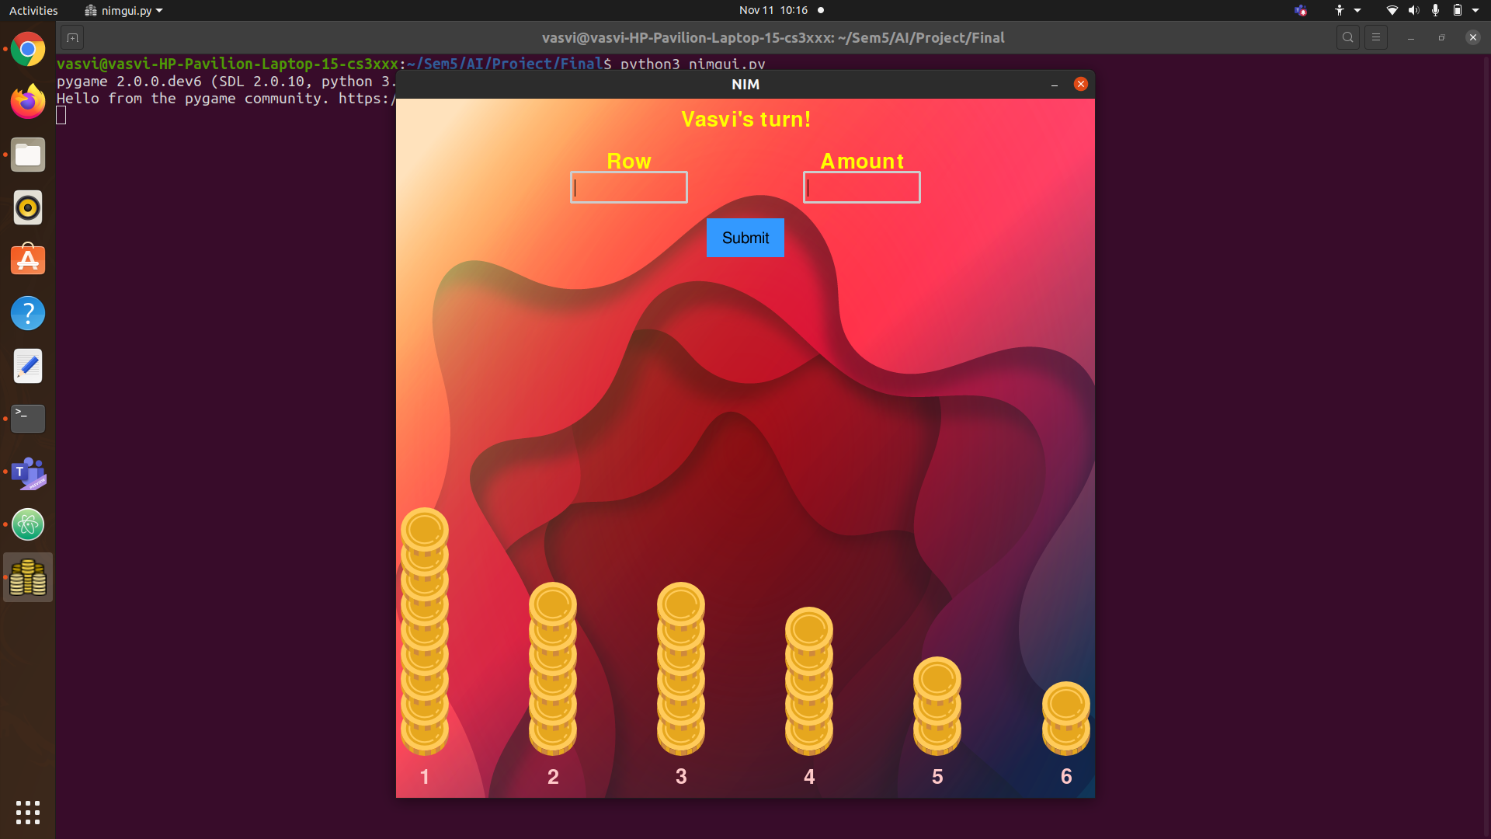
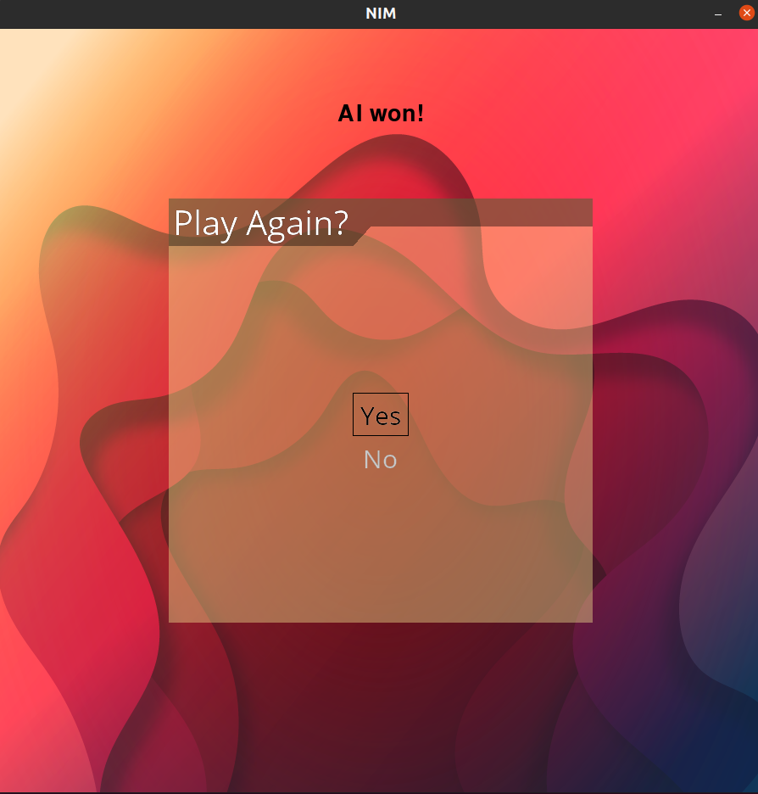
Main game screen
Winner screen/Play again menu

Slide 6
CONCLUSION
I learnt about Combinatorial Game Theory and how to implement Nim Game in which both the players try to make the Nim-Sum zero in order to win the game.
I also learnt a lot about the pygame library, which I have used to make the GUI of the game.
THANK YOU !

