Slide 1





1st openBIM Hackathon, Porto 2026
Sponsored by:
Organised by:

Slide 2

Federated Framework for Extended Engineering Linked Lifecycle Assets Architecture
FELA
Sponsored by:
Organised by:

Slide 3
Using InfoBIM open source project to check IFC models against engineering standards, by structuring domain knowledge so AI behaves deterministically.
Sponsored by:
Organised by:

Slide 4
IDS workflow
Sponsored by:
Organised by:

Slide 5
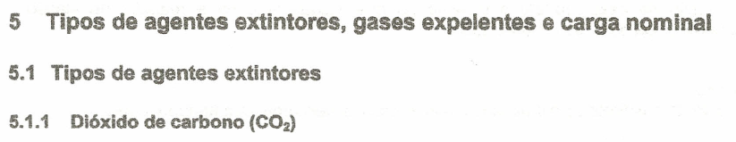
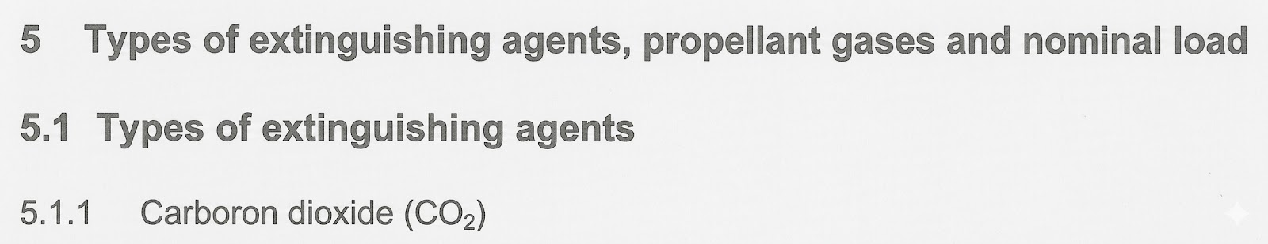
Brazilian NBR 15808 - Portable Fire Extinguishers
Sponsored by:
Organised by:

Slide 6
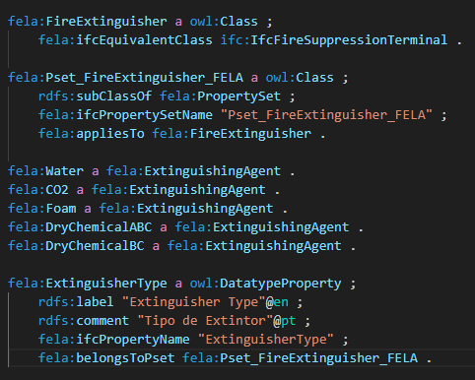
Portable Fire Extinguishers demo ontology
Sponsored by:
Organised by:

Slide 7
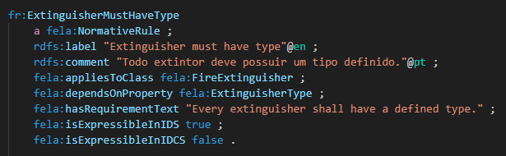
Portable Fire Extinguishers RULES demo ontology
Sponsored by:
Organised by:

Slide 8
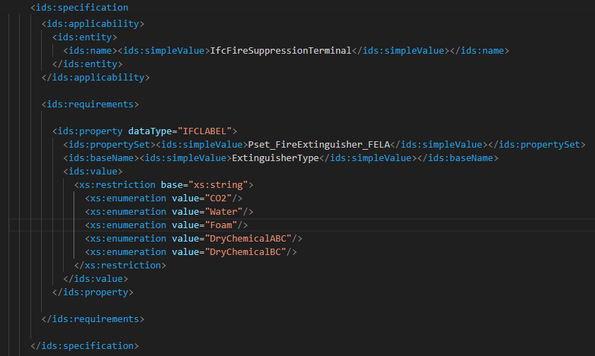
Portable Fire Extinguishers demo IDS file
Sponsored by:
Organised by:

Slide 9
IDCS workflow
Sponsored by:
Organised by:

Slide 10
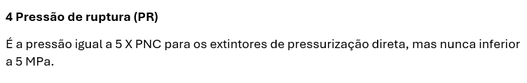
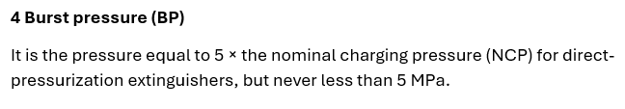
Brazilian NBR 15808 - Portable Fire Extinguishers
Sponsored by:
Organised by:

Slide 11
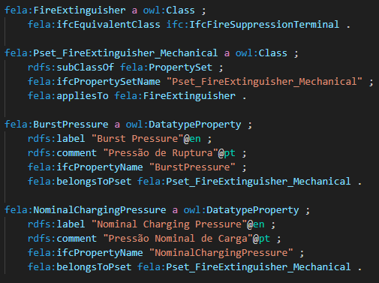
Portable Fire Extinguishers demo ontology
Sponsored by:
Organised by:

Slide 12
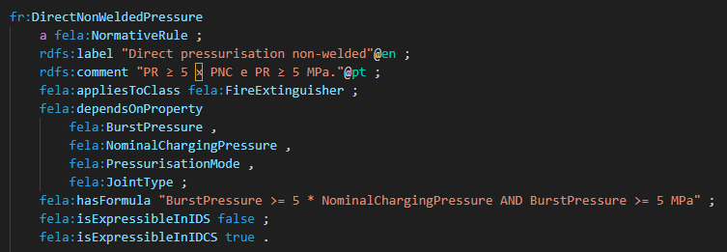
Portable Fire Extinguishers RULES demo ontology
Sponsored by:
Organised by:

Slide 13
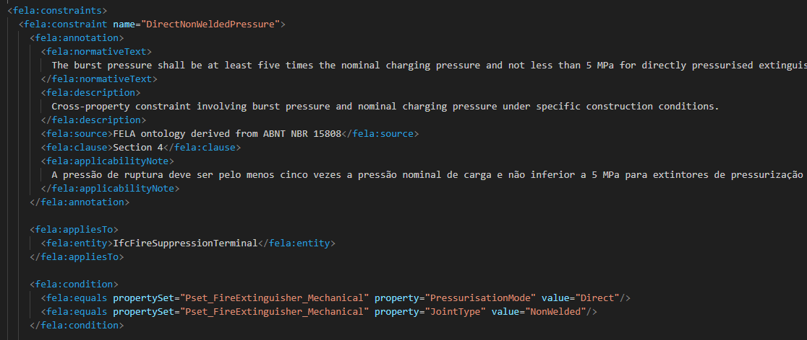
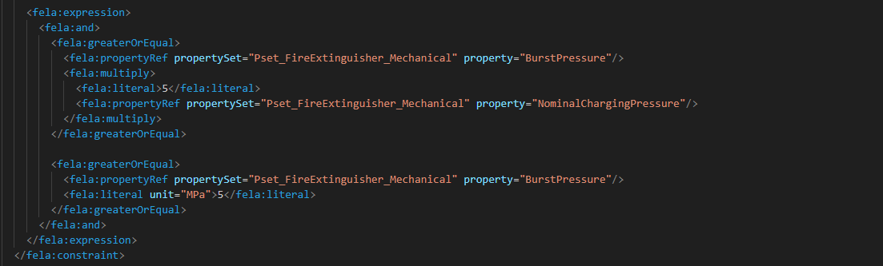
Portable Fire Extinguishers demo IDCS file
Sponsored by:
Organised by:

Slide 14
Sponsored by:
Organised by:

