Slide 1





1st openBIM Hackathon, Porto 2026
Sponsored by:
Organised by:

Slide 2

Federated Framework for Extended Engineering Linked Lifecycle Assets Architecture
FELA
Sponsored by:
Organised by:

Slide 3
Using InfoBIM open source project to check IFC models against engineering standards, by structuring domain knowledge so AI behaves deterministically.
Sponsored by:
Organised by:

Slide 4
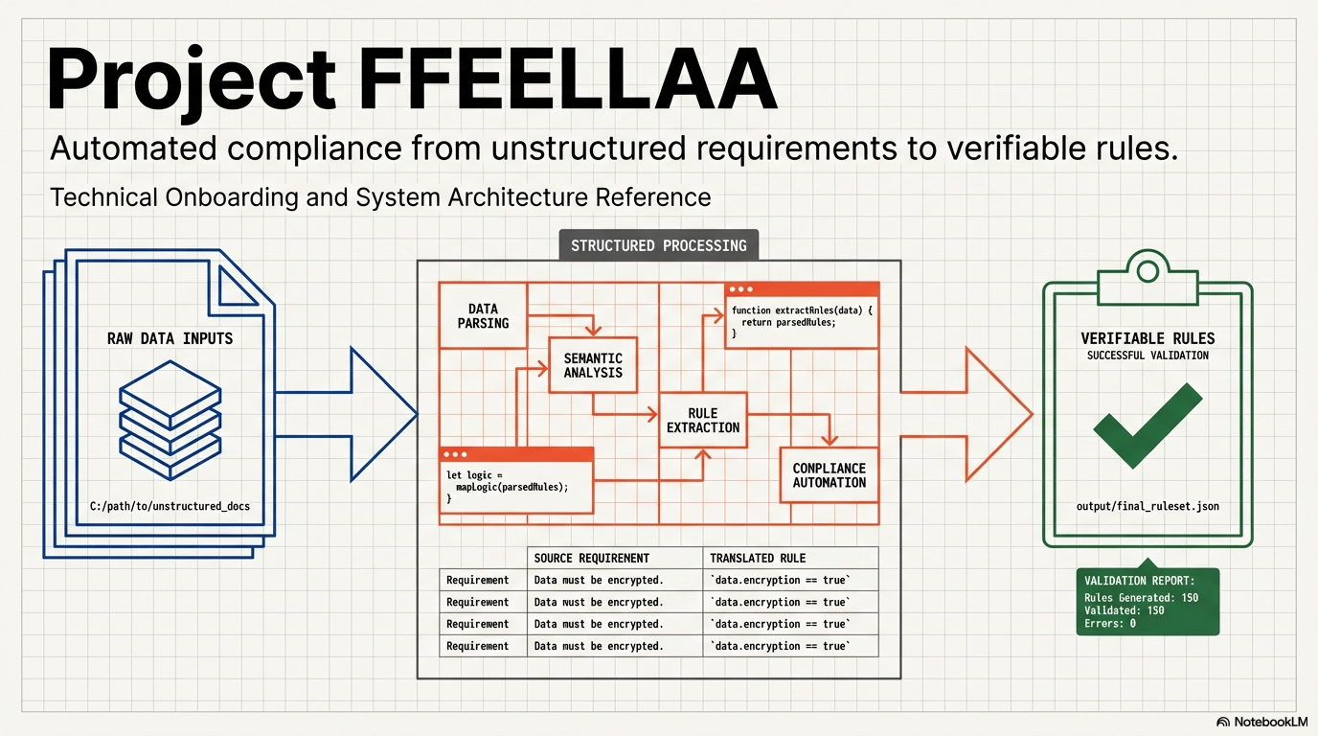

Slide 5
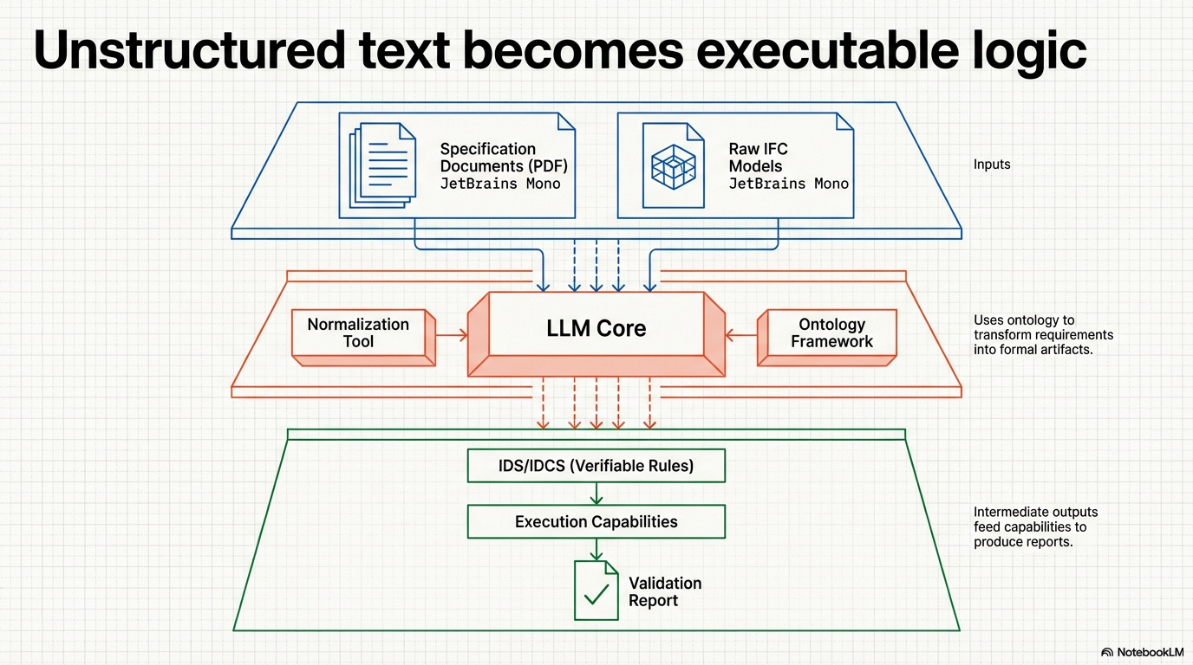

Slide 6
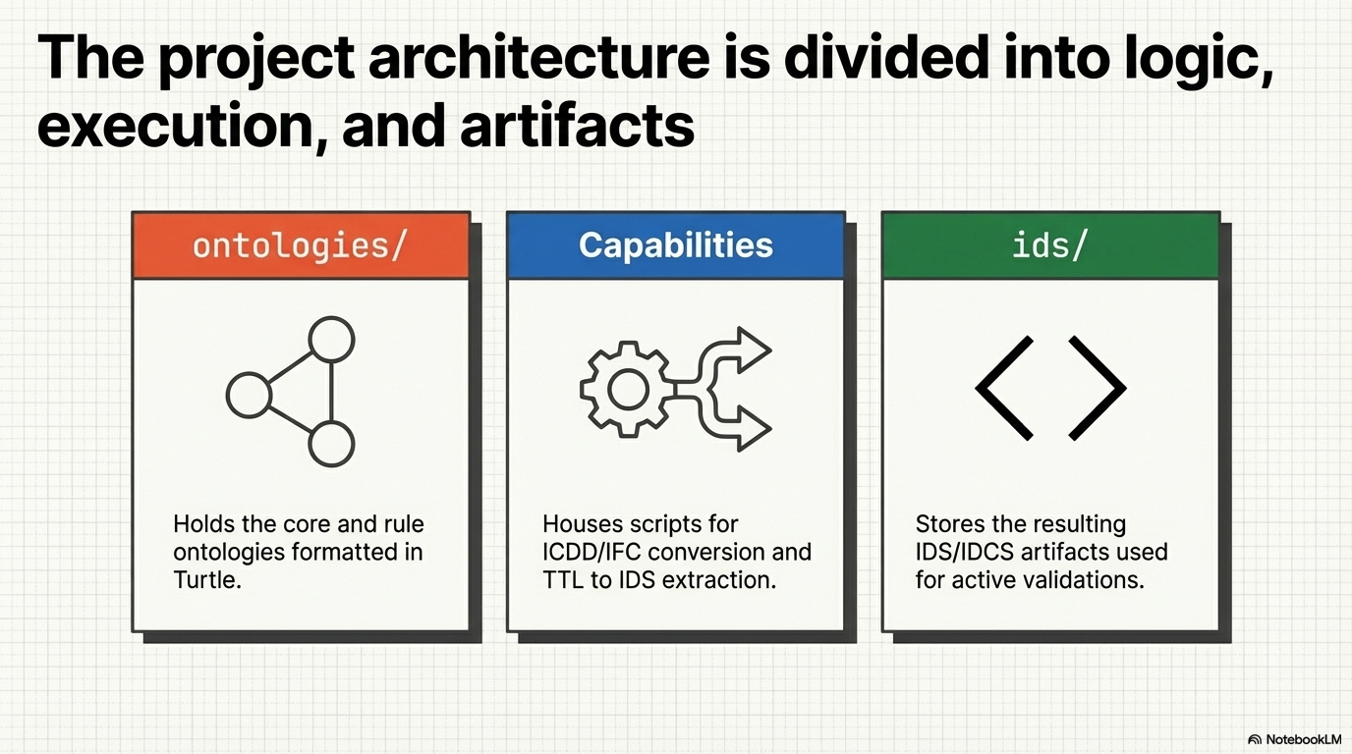

Slide 7
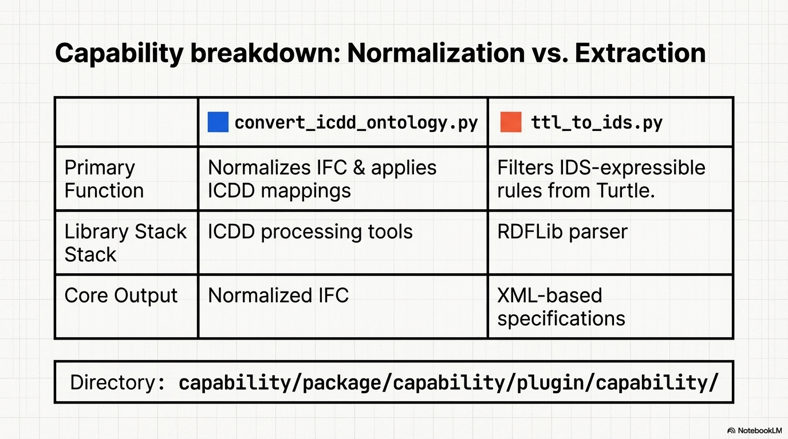

Slide 8
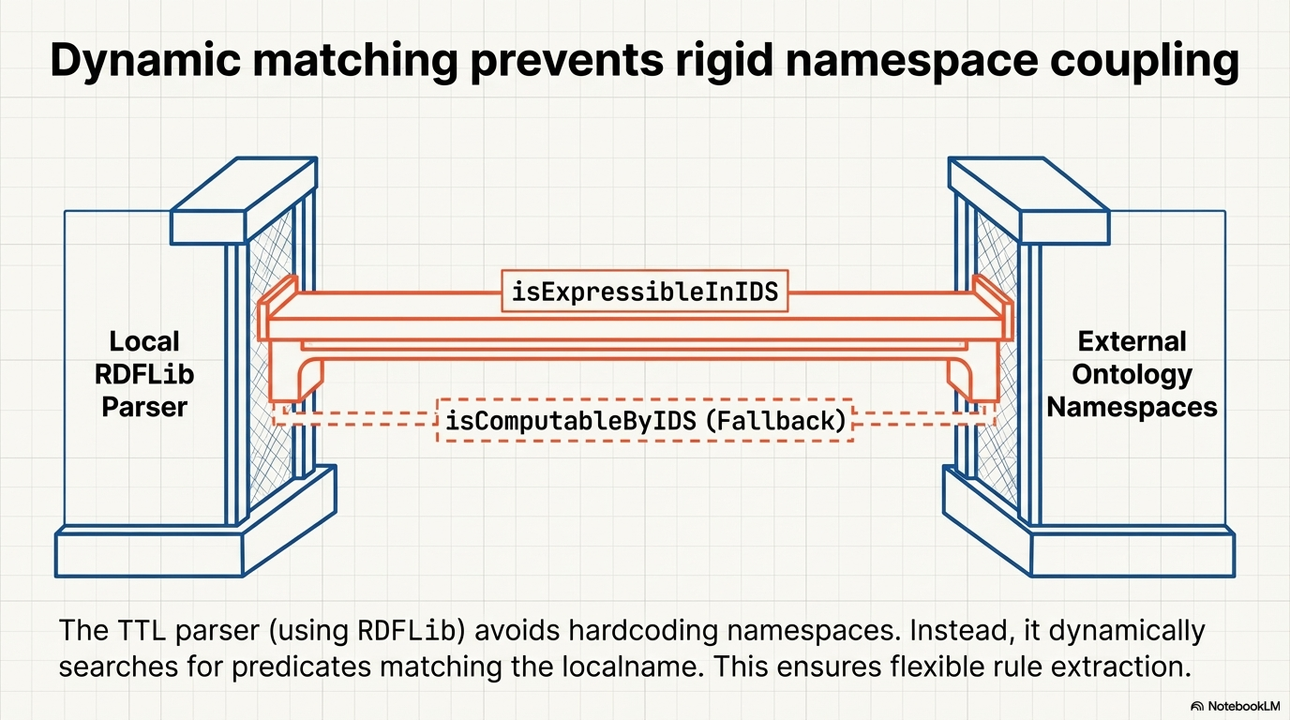

Slide 9
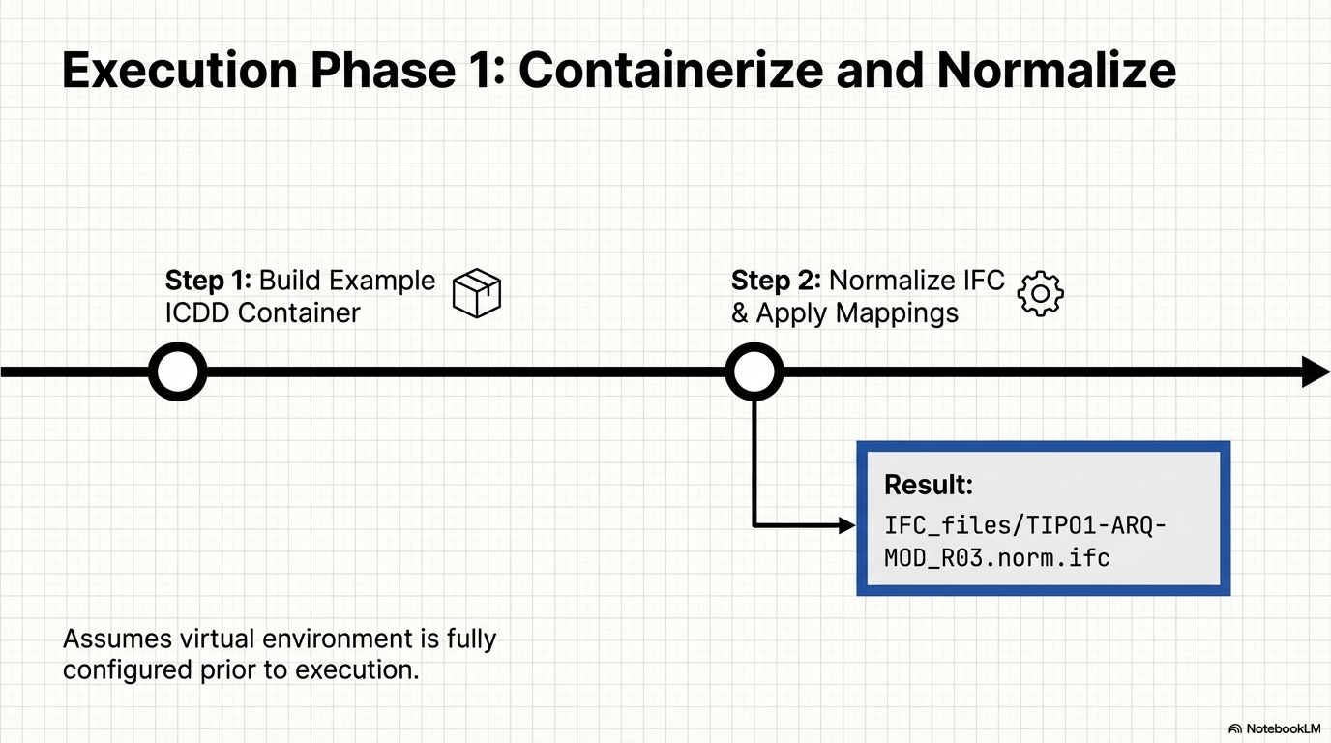

Slide 10
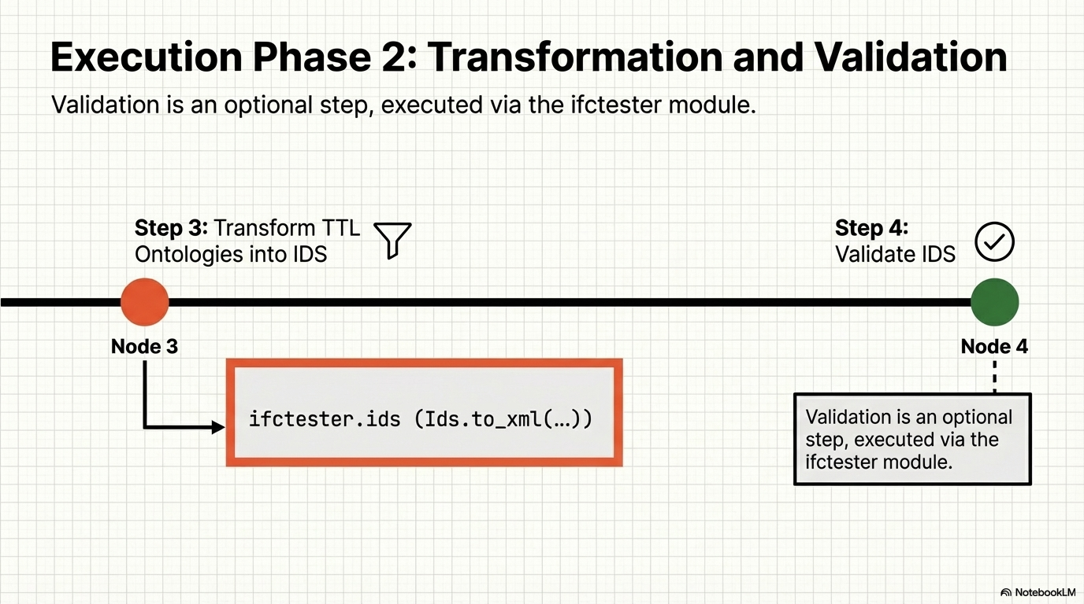

Slide 11
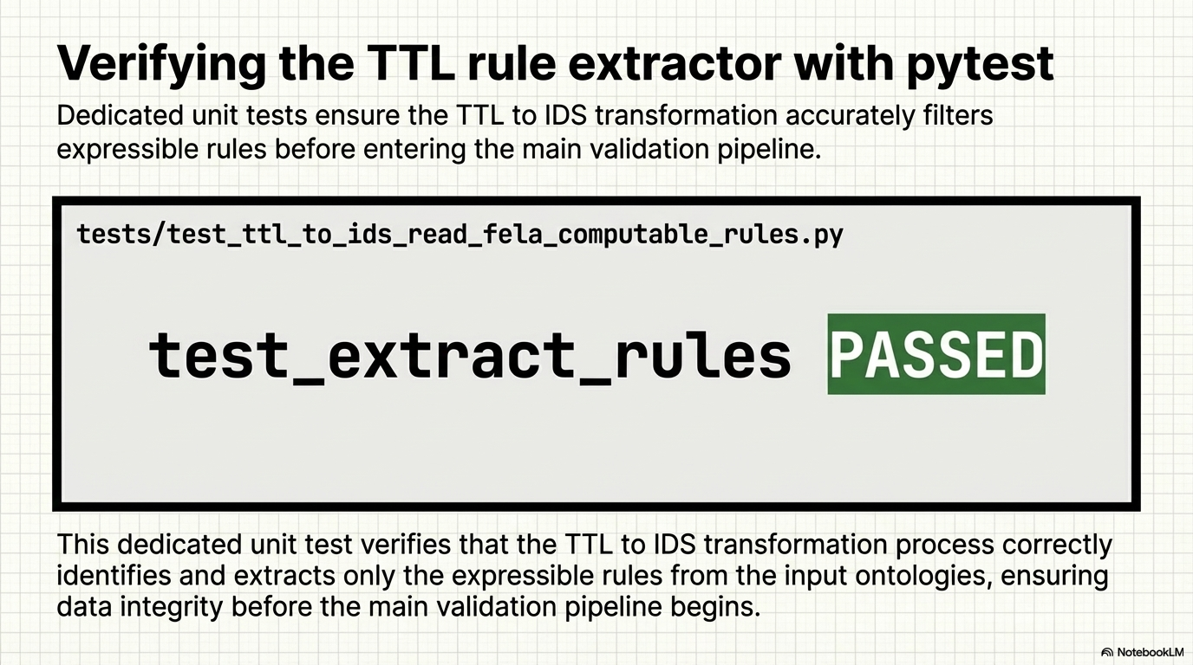

Slide 12
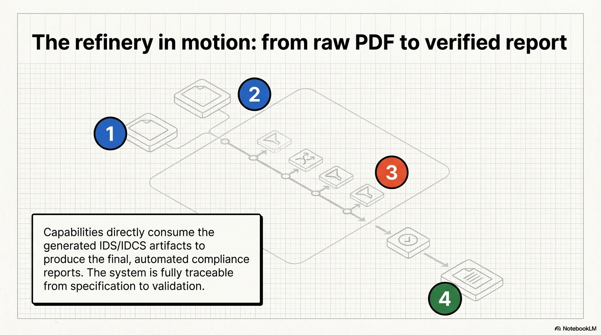

Slide 13
Sponsored by:
Organised by:

