Slide 1
ADVANCED ARTIFICIAL INTELLIGENCE PROJECTS IN DATA SCIENCE • 55-710603
AT A GLANCE
NoteRecall
CORPUS
33 markdown notes, 98 / 65 / 33 chunks
GOLD SET
Semantic Search over Personal Notes using Pinecone ANN Retrieval
30 hand-judged queries, note-level relevance
COMPARED AGAINST
BM25 over exactly the same chunks
Group presentation and live demonstration
Retrieval only. No language model. Every result is a verbatim quote.
HEADLINE
Aggregate is a tie. The split by question type is not.
GROUP MEMBERS
Venkat Vivek Gopisetty C5066016
Mounika Maddula C5061339
RUNS
Nithinreddy Duggireddy C5066028
Vinay Krishna Kommalapati C5064808
Offline, no API key, no language model
Venugopal Raja C5058976
Venkat Vivek Gopisetty • Nithinreddy Duggireddy • Venugopal Raja • Mounika Maddula • Vinay Krishna Kommalapati
Notes:
Open by naming the one design decision that shapes everything: there is no language model in this project. Nothing is generated, so nothing can be invented. Say we will show where semantic search wins, where it loses, and that the honest headline is that it is a tie until you split by question type.

Slide 2
PROBLEM
Venkat Vivek Gopisetty
Why this project exists
You remember the idea, not the words
Every note application searches the characters you typed. Six months later that is exactly the thing you have forgotten.
Several thousand markdown files between the five of us: lecture notes, solved errors, half-finished supervision thoughts
THE QUERY THAT MOTIVATED IT
“cutting a long document into pieces before indexing it”
Keyword search only finds a note if you reproduce its vocabulary from memory
Two notes can describe the same idea and share almost no words
The note that answers this is chunking-strategies.md. It contains none of the words cutting, pieces or long document. Keyword search cannot reach it. That single query is the project in miniature.
A generative assistant would answer, but you could not check what it based the answer on
Venkat Vivek Gopisetty • 0:00–1:30
Problem
System
Method
Results
Limits
Demo
Notes:
Set the problem as a retrieval problem, not a chatbot problem. The right test of a notes search tool is whether it finds the note you were thinking of when you cannot remember how you phrased it. Read the quoted query aloud and say the target note contains none of those words.

Slide 3
SOLUTION
Venkat Vivek Gopisetty
What the system is
Search by meaning, answer only by quoting
Chunks are embedded once, the query is embedded the same way, and the nearest chunks are printed verbatim with the note they came from.
33
384-d
0
3.0 ms
notes indexed
vector per chunk
words generated
median query latency
THE CLAIM WE CAN ACTUALLY DEFEND
A tool that only ever quotes cannot fabricate. There is no faithfulness problem to evaluate and no way for it to state something you never wrote, so the whole measurement budget goes into retrieval quality instead of being split with a grader.
The same chunks feed a BM25 keyword baseline, so the two arms of the comparison differ in exactly one respect: how a match is scored. That is what makes the result in the next three slides worth anything.
Venkat Vivek Gopisetty • 1:30–2:30
Problem
System
Method
Results
Limits
Demo
Notes:
Two things to land here. First, no generation means no hallucination, by construction rather than by evaluation. Second, the baseline runs over identical chunks, so any difference we report is attributable to scoring and nothing else.

Slide 4
SYSTEM
Nithinreddy Duggireddy
Architecture
Two paths, one index
The indexing path runs once per corpus and writes to the index. The query path runs per search and reads from it.
INDEXING PATH · ONCE PER CORPUS
01
02
03
04
Load
Chunk
Embed
Upsert
strip front matter title from first H1
128 / 256 / 512 tokens with overlap
MiniLM-L6-v2 L2 normalised
batches of 100 namespace per size
Vector index
one protocol, two backends
Pinecone serverless
Local numpy store
384-d, cosine, one namespace per chunk size
QUERY PATH · ONCE PER SEARCH
01
02
03
04
Embed query
Search
Dedupe
Show
same encoder
cosine top k or BM25 over the same chunks
collapse to distinct notes
verbatim snippet + note and score
Both retrieval modes consume the identical chunk set, so the comparison in this deck differs in scoring alone. Swapping Pinecone for the local store is a configuration change, not a code change.
Nithinreddy Duggireddy • 2:30–3:30
Problem
System
Method
Results
Limits
Demo
Notes:
Walk the write path along the top, then the read path along the bottom, and point out that both meet at the index in the middle. Stress that the index sits behind one protocol with two backends, so nothing above it knows or cares which is running.

Slide 5
COMPONENT 1
Venkat Vivek Gopisetty
Corpus ingestion and chunking
Real notes are not uniform
The loader has to cope with front matter, inconsistent headings and unfinished notes, because that is what a genuine vault looks like.
YAML front matter stripped, tags kept, first H1 becomes the note title
WHY THE TITLE IS PREPENDED
Most notes name their subject only in the heading. Without the title, the second and third chunk of a note carry no signal about which document they belong to.
Windows of N whitespace tokens with overlap carried forward, so a sentence on a boundary still appears whole somewhere
The note title is prepended to every chunk before embedding
CHUNK SIZE
CHUNKS
INDEX
A trailing window under 24 tokens is dropped rather than indexed alone
128 tokens
98
0.22 MB
256 tokens
65
0.17 MB
512 tokens
33
0.10 MB
Whitespace tokenisation only approximates the model tokeniser. It is a known source of imprecision and it is stated in the report rather than hidden.
Venkat Vivek Gopisetty • 3:30–4:20
Problem
System
Method
Results
Limits
Demo
Notes:
The title-prepending decision is worth dwelling on because it is measurable and non-obvious. Also flag the 512 row: 33 chunks from 33 notes means every note is one chunk, which matters when we read the results.

Slide 6
COMPONENT 2
Nithinreddy Duggireddy
Embeddings and the vector index
One protocol, two backends
Vectors are unit length so a dot product is the cosine, and the chunk-size experiment is carried by the namespace rather than by separate indexes.
MiniLM-L6-v2
384
cosine
1500
sentence-transformer
dimensions per vector
similarity metric
char metadata cap
PINECONE
LOCAL BACKEND
Serverless index created on demand with the cosine metric, upserted in batches of 100, queried with metadata included. Namespaces chunk128 / chunk256 / chunk512 keep the three arms of the experiment apart inside one index.
A numpy matrix and a JSON sidecar on disk. Exact cosine through a single matmul, which makes it a correctness reference rather than a speed comparison. It is also why the whole project runs with no API key and nothing leaving the machine.
Nithinreddy Duggireddy • 4:20–5:10
Problem
System
Method
Results
Limits
Demo
Notes:
Make the point that the protocol is what allowed the retrieval code to be written and tested before anyone had a Pinecone account. Be explicit that the local backend is exact search, so its latency is not comparable with a hosted approximate service over a network.

Slide 7
COMPONENT 3
Venugopal Raja
Retrieval and the BM25 baseline
Making the comparison fair
Both arms return the same result type over the same chunks, so nothing downstream branches on which method produced a hit.
SEMANTIC
BM25 KEYWORD
The query is embedded with the same model and the index returns the nearest chunks by cosine. It never came back empty-handed on this gold set, because every chunk has some similarity to every query.
Term frequency weighted by inverse document frequency. That IDF term is precisely why it wins on rare literal strings, and why it returns nothing at all when the note shares no vocabulary with the query.
Reciprocal rank fusion combines the two rankings without tuning a weight. It is kept deliberately secondary: it exists to show the two signals are complementary, not to claim a third headline result.
Venugopal Raja • 5:10–6:00
Problem
System
Method
Results
Limits
Demo
Notes:
The fairness argument is the point of this slide. Same chunks, same return type, one difference. Mention that BM25 sometimes returns nothing while semantic never does, because that is the difference a user actually feels.

Slide 8
COMPONENT 4
Mounika Maddula
Command line and web interface
Two front ends, one search path
Everything a user touches goes through the same functions the evaluation harness calls, so the demo and the numbers cannot drift apart.
COMMAND
WHAT IT DOES
ERROR HANDLING
index
chunk, embed and upsert
A missing index exits non-zero with one line naming the fix, not a traceback. The things a user can actually correct get a message; everything else is allowed to raise normally.
search
query in three modes
stats
namespaces and index size
STREAMLIT PAGE
Mode radio for semantic, keyword and hybrid; a top-k slider; a chunk-size selector; results as expandable blocks with title, note id, score and a snippet centred on the query term.
This component has no metrics of its own, and the report says so. Its contribution is that switching mode in the sidebar is what makes the comparison visible to somebody who has not read the tables.
Mounika Maddula • 6:00–6:40
Problem
System
Method
Results
Limits
Demo
Notes:
Be straight that this component is judged differently because it produces no numbers. Its value is that the mode switch turns an abstract comparison into something an audience can see in one click, which is exactly what we will use in the demo.

Slide 9
COMPONENT 5
Vinay Krishna Kommalapati
Evaluation methodology
Thirty queries, judged at note level
Relevance is binary and judged per note, the ranking is deduplicated to distinct notes before scoring, and the whole sweep reruns in about ten seconds.
30
10 / 8 / 12
4
3
gold queries
paraphrase / exact / lookup
metrics at k = 5
chunk sizes swept
Precision@5, Recall@5, MRR and nDCG@5, with recall as the primary metric
THREAT TO VALIDITY
We wrote the corpus and we judged the gold set, one person per judgement. Thirty queries is a small sample and a couple of large per-query margins can carry an average on their own, which is why we report win counts alongside the means.
The harness fetches 4k chunks and keeps the first k distinct notes, so precision is not depressed by several chunks of one note
Latency is the fastest of three timed runs after warm-up
Vinay Krishna Kommalapati • 6:40–7:40
Problem
System
Method
Results
Limits
Demo
Notes:
Explain why P@5 looks low: most queries have one or two relevant notes, so a query with one right answer can never score above 0.2. Only the comparison between rows means anything. Then own the threat to validity before anyone raises it.

Slide 10
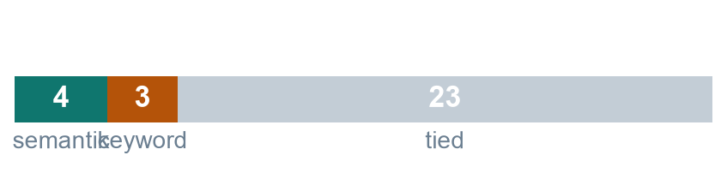
RESULTS
Vinay Krishna Kommalapati
Aggregate comparison
On the aggregate, it is a tie
Across 30 queries at chunk size 512, semantic wins 4, keyword wins 3, and 23 are ties. Neither method leads consistently on the means.
CHUNK
METHOD
P@5
R@5
MRR
NDCG@5
PER-QUERY OUTCOME AT 512
128
Semantic
0.253
0.906
0.867
0.843
128
Keyword
0.233
0.856
0.868
0.828
256
Semantic
0.247
0.894
0.889
0.856
256
Keyword
0.267
0.933
0.882
0.866
512
Semantic
0.253
0.911
0.942
0.893
512
Keyword
0.247
0.872
0.883
0.856
READ THIS HONESTLY
Precision@5 is capped by design: most queries have one or two relevant notes, so only the comparison between rows carries meaning.
Three chunk sizes, three different verdicts. That is what a difference smaller than the noise looks like when you plot it.
Vinay Krishna Kommalapati • 7:40–8:30
Problem
System
Method
Results
Limits
Demo
Notes:
Do not rush past this slide to get to the good one. The aggregate genuinely does not settle anything, and saying so first is what makes the next slide credible. Point at the three chunk sizes giving three different winners.

Slide 11
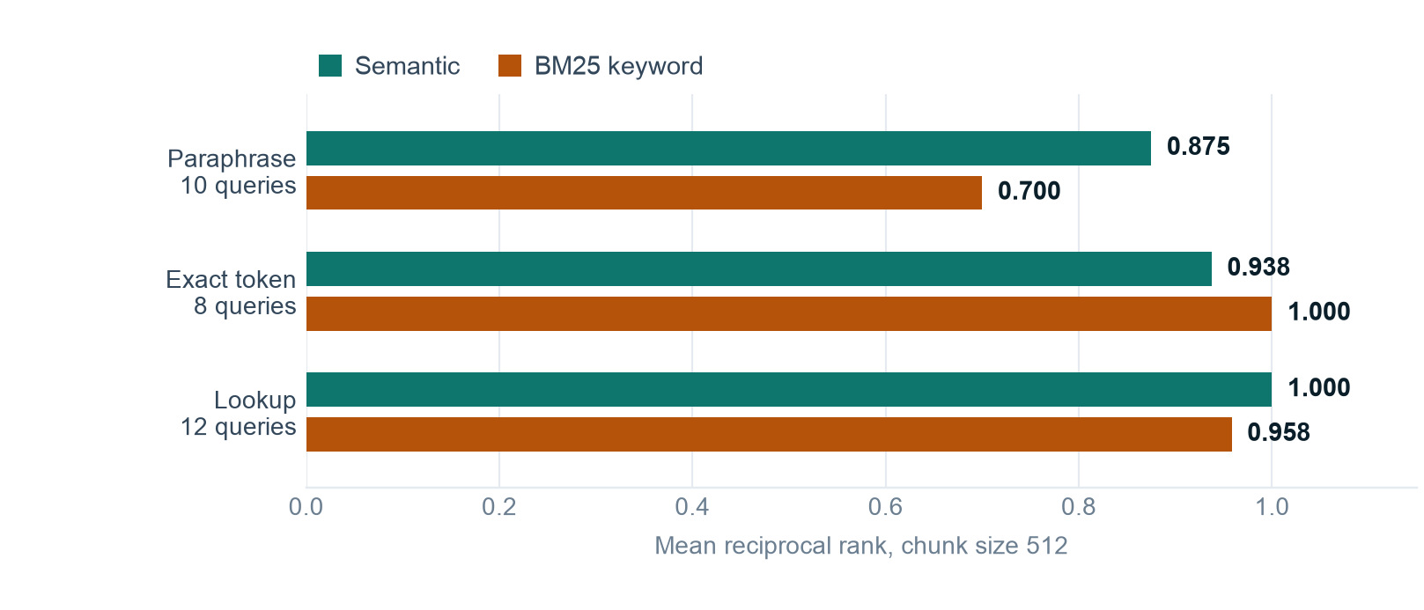
RESULTS
Vinay Krishna Kommalapati
Split by question type
The aggregate hides the whole story
Once the same 30 queries are split by what kind of question they are, the two methods separate cleanly and in opposite directions.
SEMANTIC WINS
+0.175 MRR on paraphrases, where the note shares no vocabulary with the query.
KEYWORD WINS
A perfect 1.000 on rare literal tokens, at every chunk size, and roughly sixty times faster.
Higher is better. Every query is scored by both methods over the identical chunk set.
This is the trade the proposal predicted before we measured it: embeddings reach meaning, BM25 owns exact strings, and on ordinary lookups it barely matters. The two effects very nearly cancel, which is exactly why the aggregate looked like nothing.
Vinay Krishna Kommalapati • 8:30–9:30
Problem
System
Method
Results
Limits
Demo
Notes:
This is the slide the presentation exists for. Say the aggregate was a wash because the two effects cancel: semantic gains on paraphrases are almost exactly offset by keyword gains on exact tokens. Averaging them was the wrong thing to look at.

Slide 12
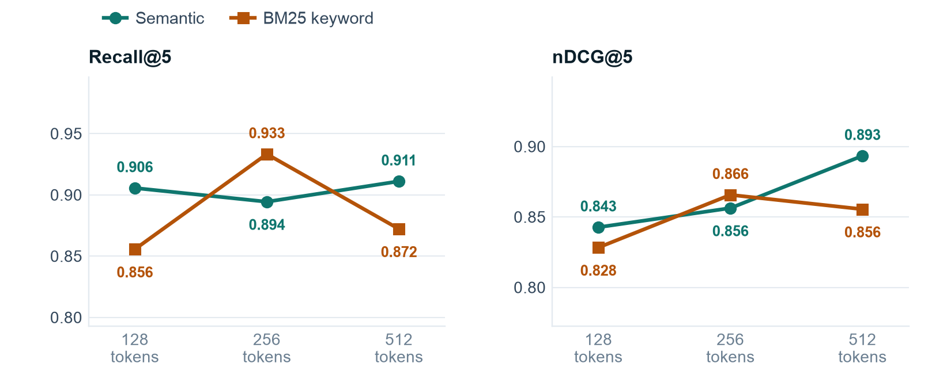
RESULTS
Nithinreddy Duggireddy
Chunk size
512 wins, and the reason undercuts the result
Recall and nDCG both cross twice across the sweep. Whichever method leads depends entirely on the chunk size, which is itself a null result.
THE CAVEAT THAT MATTERS
Our notes are 250 to 350 words each, so at 512 tokens every note becomes exactly one chunk. 33 notes, 33 chunks. That row is really measuring whole-note indexing, not a chunk size. On a corpus of longer documents it would not hold, and we say so rather than claiming 512 as a recommendation.
Note the truncated vertical axes: the whole spread is under 0.08 on both metrics.
Overlap scales with the window, so chunk size stays the only variable across the sweep.
Nithinreddy Duggireddy • 9:30–10:10
Problem
System
Method
Results
Limits
Demo
Notes:
Resist the temptation to present 512 as the answer. Explain that at 512 the chunker is not really chunking on this corpus, which makes that row the least trustworthy number in the table even though it is the largest.

Slide 13
DISCUSSION
Venugopal Raja
What surprised us
Three things we did not expect
None of these were in the proposal. Two of them changed how we report the results.
01
02
03
The aggregate was a tie
512 stopped being chunking
BM25 sometimes returns nothing
We expected dense retrieval to win outright. 23 of 30 queries were ties. The finding only exists because we split by question type afterwards.
At the largest setting every note collapsed to a single chunk, so the best-scoring row in our table is measuring something other than what the column header says.
On paraphrase queries it scored zero relevant notes several times. Semantic search never did. That asymmetry is invisible in a mean and obvious to a user.
Venugopal Raja • 10:10–10:50
Problem
System
Method
Results
Limits
Demo
Notes:
Frame all three as things that made the report more honest rather than less impressive. The third one is the most practically useful: a method that is sometimes empty feels much worse to use than a method that is sometimes second-best.

Slide 14
LIMITS
Mounika Maddula
Limitations
What we did not do, and why
These are deliberate boundaries and known weaknesses, not oversights discovered afterwards.
The corpus and the gold set were both written by us, after reading the same material
DELIBERATELY OUT OF SCOPE
No language model, so no summarisation and no generated answers. No inferential statistics: with thirty queries a significance test would be theatre rather than evidence. No learned reranker, no fine-tuning, no query expansion. Each would have added a variable we could not have measured cleanly at this sample size.
Thirty queries is well under the fifty a test collection would normally use
Whitespace tokenisation only approximates the model tokeniser
The local backend is exact search, so its latency is not comparable with hosted ANN
Pointing NOTES_DIR at a real vault and rewriting the gold set is the single change that would improve every number here.
Mounika Maddula • 10:50–11:20
Problem
System
Method
Results
Limits
Demo
Notes:
Say the sample size limit plainly and early, because a marker will otherwise ask. The point about significance testing being theatre at n=30 shows we thought about it rather than forgot it.

Slide 15
DEMO
Venugopal Raja
Live demonstration
The same query, both modes
Everything runs locally on this laptop. No API key, no network, one cached model.
QUERY ONE
“cutting a long document into pieces before indexing it”
Semantic returns chunking-strategies.md first. Switch the mode to Keyword and rerun: it disappears.
QUERY TWO
karpukhin2020dpr
Keyword finds it instantly, semantic ranks it second, hybrid recovers it at rank one.
Fallback if the model cache is unavailable: EMBEDDING_BACKEND=hashing runs the whole pipeline with no download. Results are visibly worse and we will say so rather than pretend otherwise.
Venugopal Raja • 11:20–13:30
Problem
System
Method
Results
Limits
Demo
Notes:
Run query one in semantic, then flip the mode radio and run it again. Let the audience see the note vanish. Then query two in keyword to show the honest reverse. Close with hybrid on query two if there is time.

Slide 16
CONCLUSION
Venkat Vivek Gopisetty
What we found
Neither method wins. That is the result.
The useful question was never which retriever is better, but which one is better for which kind of question.
23 / 30
+0.175
1.000
queries tied
semantic MRR on paraphrases
keyword MRR on exact tokens
WHERE WE WOULD TAKE IT NEXT
Run it against a real vault rather than a corpus we wrote, and have somebody outside the group write the queries. Both would make every number here more trustworthy, and neither is hard.
Route the query by type instead of choosing a method: a rare-token query goes to BM25, everything else to the encoder. Our own results say that would beat either arm alone.
Venkat Vivek Gopisetty • 13:30–14:20
Problem
System
Method
Results
Limits
Demo
Notes:
End on the routing idea, because it follows directly from our own evidence rather than from a wish list. Then hand over to questions.

Slide 17
THANK YOU
RUN IT YOURSELF
Questions
pip install -r requirements.txt
python -m noterecall index
python -m noterecall search "..."
Semantic Search over Personal Notes using Pinecone ANN Retrieval
python -m evaluation.run_eval
No API key at any point. The last command regenerates every number on these slides in about ten seconds, so anything here can be checked rather than taken on trust.
noterecall/
the pipeline
evaluation/
the harness
results/
the numbers
data/notes/
the corpus
Venkat Vivek Gopisetty • Nithinreddy Duggireddy • Venugopal Raja • Mounika Maddula • Vinay Krishna Kommalapati
Notes:
Leave this up during questions. If asked which method to use in production, the answer is route by query type. If asked about the corpus, concede immediately that we wrote it and that a real vault is the obvious next step.

