Slide 1

Exploratory Data Analysis
G2M Case Study Virtual Internship
05/08/2021

Slide 2

Agenda
Executive Summary
Problem Statement
Approach
Hypothesis
EDA
EDA Summary
Recommendations

Slide 3
Executive Summary
Background : XYZ is a private firm in US. Due to remarkable growth in the Cab Industry in last few years and multiple key players in the market, it is planning for an investment in Cab industry and as per their Go-to-Market(G2M) strategy they want to understand the market before taking final decision.

Slide 4
Problem statement and approach
Problem statement: XYZ firm wants to invest in either Yellow cab or Pink cab but need more insights into both Yellow cab and Pink cab to establish which company will be more profitable to invest in.
Objective : Provide actionable insights to help XYZ firm in identifying if Yellow cab or Pink cab is the right company for XYZ firm in making investment
The analysis has been divided into 3 parts
Data understanding and visualisation
Identifying the most profitable cab company
Recommendations for investment

Slide 5
Hypothesis
Males bring in less profits than female for Yellow Cab
Males bring in less profits than female for Pink Cab.
No significant difference between distance travelled by men and distance travelled by women for Yellow cab
No significant difference between distance travelled by men and distance travelled by women for Pink cab
There is no difference in Profits for Card and Cash Payers for Yellow Cab
There is no difference in Profits for Card and Cash Payers for Pink Cab
There is no difference in Profits for customers over age 35 or under 35 for Yellow Cab
There is no difference in Profits for customers over age 35 or under 35 for Pink Cab

Slide 6
EDA
There were four datasets : Cab_Data, City, Customer_ID and Tranasction ID
Timeframe of the data was from 2016-01-31 to 2018-12-31
Total data points: 355,032
No null values were found in the data
The four datasets were combined to create master_data

Slide 7
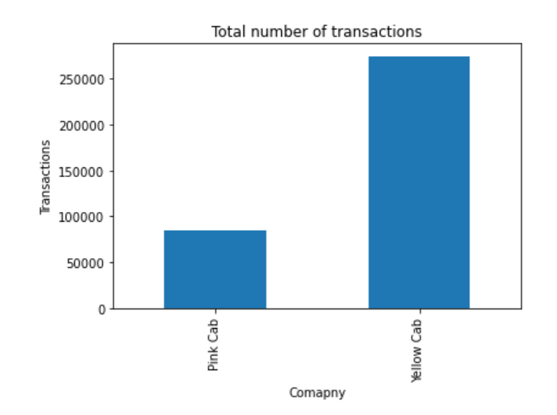
From 2016-01-31 to 2018-12-31 Yellow cab had more transactions compared to Pink cab

Slide 8
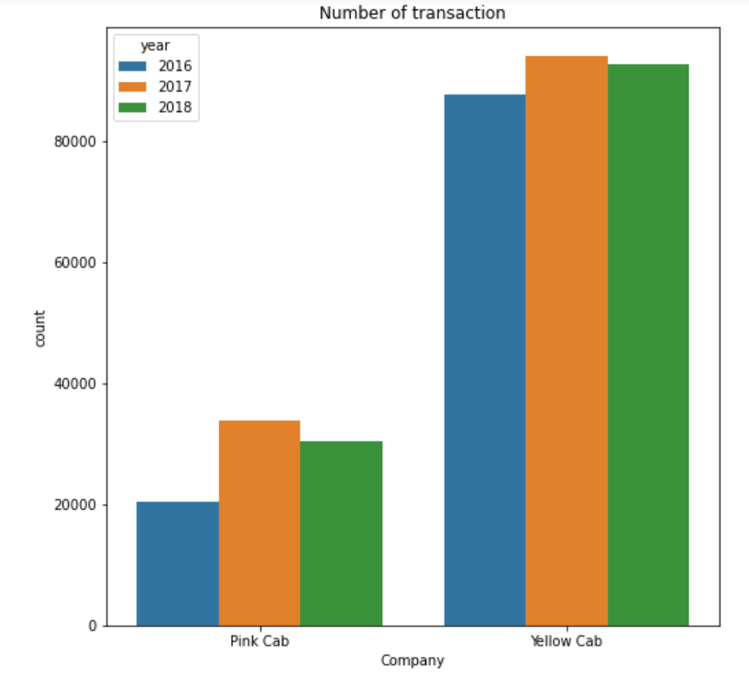
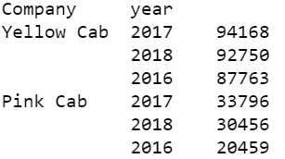
Looking at the transactions figures for both company on yearly bases, Yellow cab has had more customers using their cab service compared to pink cab in 2016,2017 and 2108.
In 2018 Yellow cab had 92750 transaction, Pink cab had a total of 30456 transaction in 2018.

Slide 9
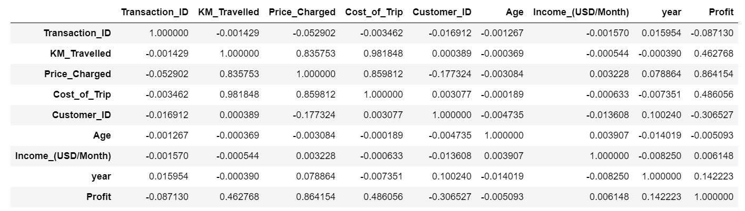
There was a positive correlation between profit and KM travelled
There was also a positive correlation between profit and price charged

Slide 10
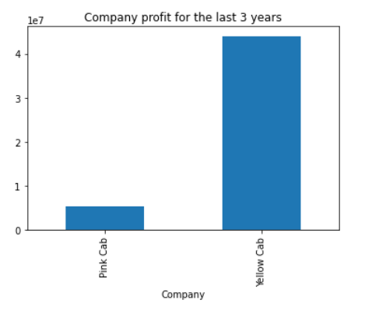
Company | Profit
Yellow Cab | 44,020,373
Pink Cab | 5,307,328
Combining the profit made in the 3 years, Yellow cab made more profit than Pink cab.
Yellow cab more than double the profit Pink cab did in total.

Slide 11
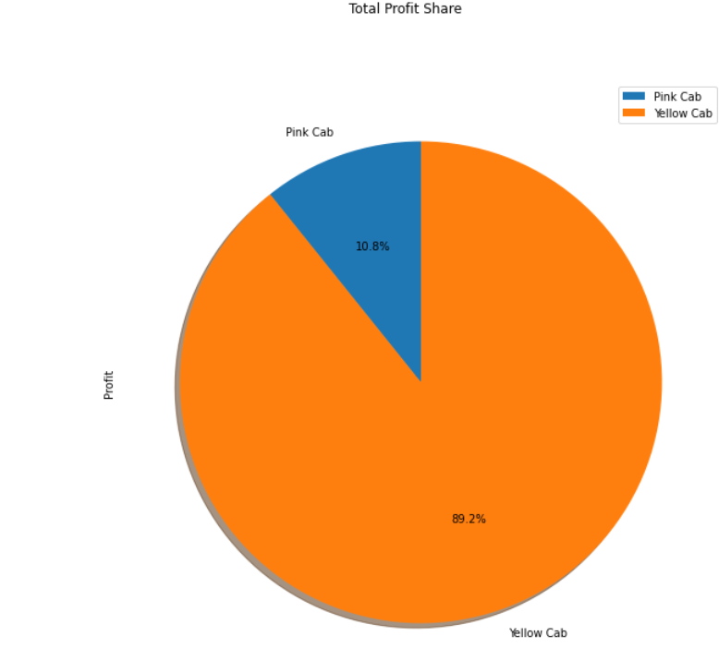
Looking at the market share Yellow cab has 89.2%

Slide 12
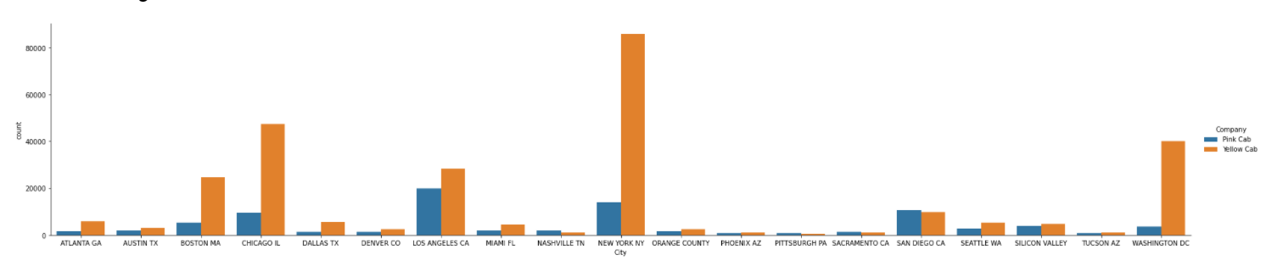
Yellow cab has a higher customer reach compared to Yellow cab.
Out of the 19 cities Pink cab have only a greater customer reach in the following 4 cities – San Diego, Nashville, Sacramento and Pittsburgh.
Yellow cabs top city reach is New York City.
Pink cab has a greater number of customers in Los Angeles compared to the other cities they operate in however Yellow cabs have more customers in Los Angles compared to Pink Cab.

Slide 13
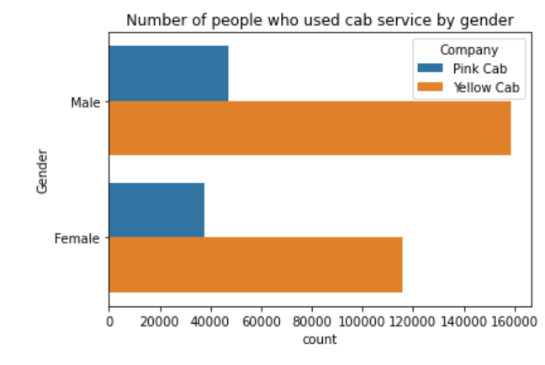
There is a not a significant difference between the number of males and females using cab services for Pink cab

Slide 14
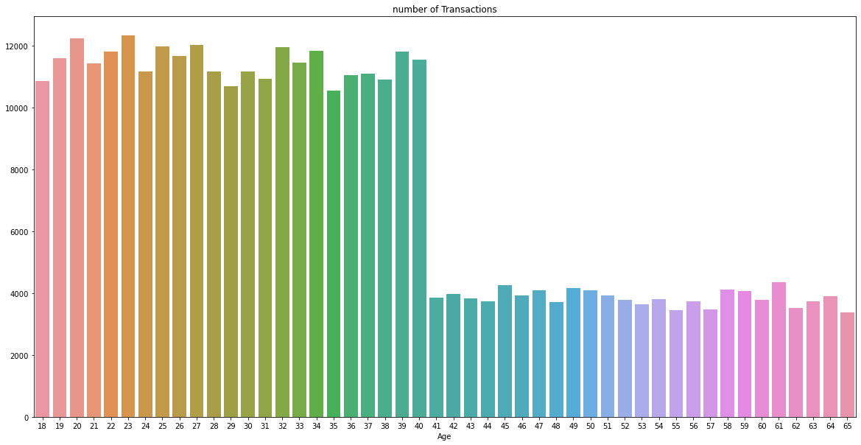
Under 40s use the cab services more compared to Over 40s

Slide 15
EDA summary and recommendation
Looking at 2018 transactions for both Yellow and Pink cab number of transaction has increased from 2016
Both Yellow and Pink cab showed has more transactions in 2017 compared to 2016 and 2018
Cities with the greatest number of transactions are New York, Chicago, Los Angles, Washington DC, and Boston
Under 40s use the cab services more compared to Over 40s
The more KM travelled by customer the greater the profit for cab service
In terms of gender there is not a significant difference between number of males and females using cab service for Pink cab.
Yellow cab has made more profit than Pink cab looking at the market share Yellow cab has 89.2% share
Out of the 19 cities Yellow cab have a greater customer reach in 15 cities

Slide 16
Hypothesis
Males bring in less profits than female for Yellow Cab – We reject the hypothesis; males bring is more profit than female for Yellow Cab
Males bring in less profits than female for Pink Cab – There is not enough evidence to reject the hypothesis that males bring is more profit than female for Pink Cab
No significant difference between distance travelled by men and distance travelled by women for Yellow cab – There is not enough evidence to reject the hypothesis that there is no significant difference between distance travelled by men and distance travelled by women for Yellow cab
No significant difference between distance travelled by men and distance travelled by women for Pink cab – There is not enough evidence to reject the hypothesis that there is no significant difference between distance travelled by men and distance travelled by women for Pink cab
There is no difference in Profits for Card and Cash Payers for Yellow Cab – There is not enough evidence to reject the hypothesis that there is no difference in Profits for Card and Cash Payers for Yellow Cab
There is no difference in Profits for Card and Cash Payers for Pink Cab – There is not enough evidence to reject the hypothesis that there is no difference in Profits for Card and Cash Payers for Pink Cab
There is no difference in Profits for customers over age 35 or under 35 for Yellow Cab – There is not enough evidence to reject the hypothesis that there is no difference in Profits for customers over age 35 or under 35 for Yellow Cab
There is no difference in Profits for customers over age 35 or under 35 for Pink Cab – There is not enough evidence to reject the hypothesis that there is no difference in Profits for customers over age 35 or under 35 for Pink Cab
It is recommend to invest in Yellow cab because they make more profit compared to Pink cab they have a greater market share as well as greater reach of customers (out of 19 cities Yellow cab have a greater customer reach in 15 cities)

Slide 17
Thank You

