Slide 1

Final report + presentation
Healthcare project
October 2021

Slide 2

Agenda
Business Problem
Week 8 - 9
Week 10 -11
Week 12 - 13

Slide 3
Team member's details:
Group Name - Chandni
Name – Chandni
Email – cpatel521351@hotmail.com
Country – England
College/Company – NA
Specialization - Data Science
Github - https://github.com/c5678/healthcare/tree/main/7

Slide 4
Problem statement and approach
ABC is a pharma company who wants to understand the persistency of drug as per the physician prescription for the patient. To solve this problem ABC pharma company approached us to automate the process of identification for the drug by building a classification machine learning model.
Using a classification machine learning model, we were able to classify the dataset and find the variables that affect the target variables "Persistency Flag".
ABC pharma company has provided us with a dataset in xlsx format which had to be cleaned so that the machine learning model is accurate and therefore can be used to gain actionable insight.

Slide 5
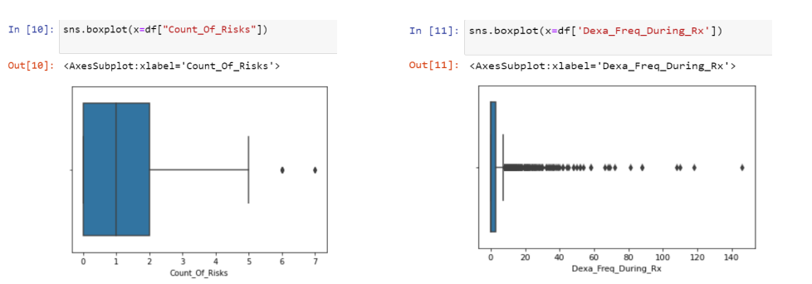
Week 8 -9
There was one data dataset with 63 columns
Total data points: 3424
No null values were found in the data
No duplicated values were found in the data
We used box plots to identify outliers – graph can be seen below dots highlights outliers

Slide 6
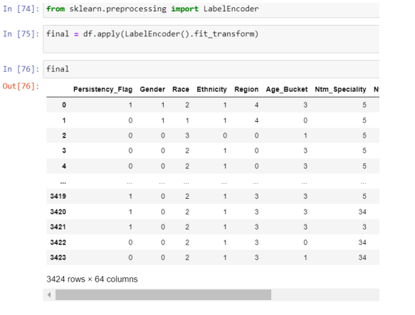
Data was transformed using label encoding. We used label encoding because the dataset contained categorical data which had to be converted to numerical data for the machine learning models.

Slide 7
Week 10 - 11
During week 10-11 data was analyse to establish any relationship/ patterns between data features and persistency flag
One issue we found whilst analysing the data was imbalance data

Slide 8
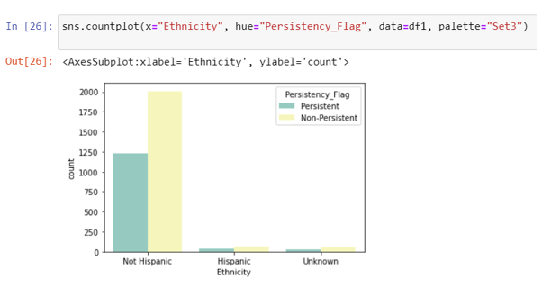
People with Hispanic ethnicity was less persistent to the drug compared to not Hispanic ethnicity.
However we can also see from the plot where is a imbalance between Hispanic ethnicity and no Hispanic Ethnicity. There are greater number of patients who are not Hispanic.
For more accurate analysis the sample same size Non Hispanic vs Hispanic should have been roughly the same.

Slide 9
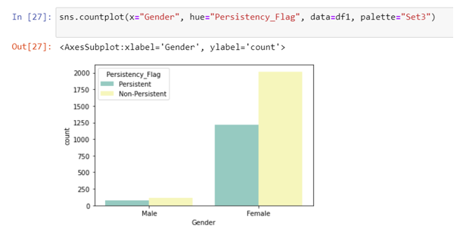
We can also see from the plot where is a imbalance between Gender male and female. There are greater number of female patients compared to female patients.

Slide 10
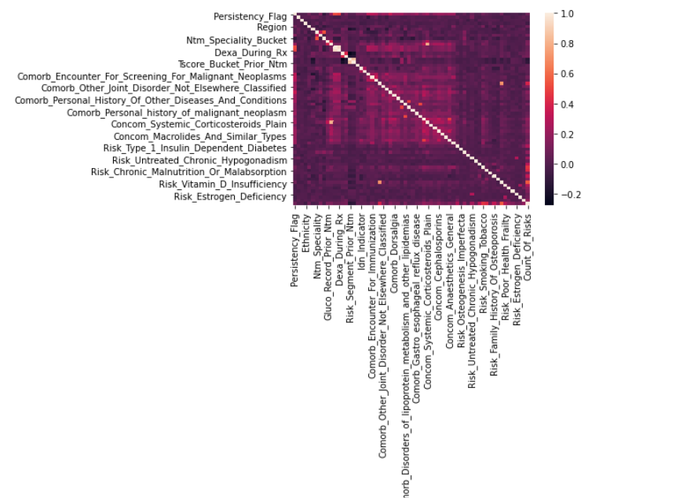
To find the best features for persistency flag we conducted correlation analysis
Initial correlation analysis suggesed features for importance to Persistency_Flag are – Dexa_During_RX and Dexa_Freq_During_FX

Slide 11
Week 12 - 13
During week 12-13 dataset was split into train and test and the train dataset was used to create a machine learning model and test data was used for validation – predicating accuracy of model.
In total 7 models were applied which will be Gradient Boosting, Random Forest, KBB, Gaussian NB, Multinomial NB, Logistic Regression, Linear SVM and Non-Linerar SVM
Wrapper method will be used to find the best features to use for the models
The models were be compared by accuracy, precision, recall and ROC-AUC score , to find the best model
Finally the best model was deployed.

Slide 12
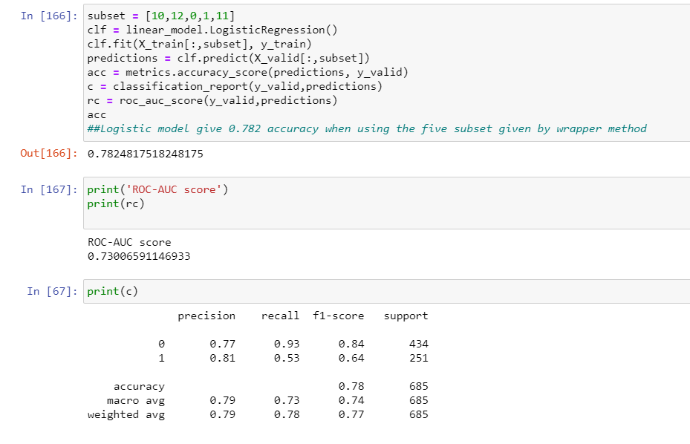
After comparing different models found that the best model was a logistic regression model.

Slide 13
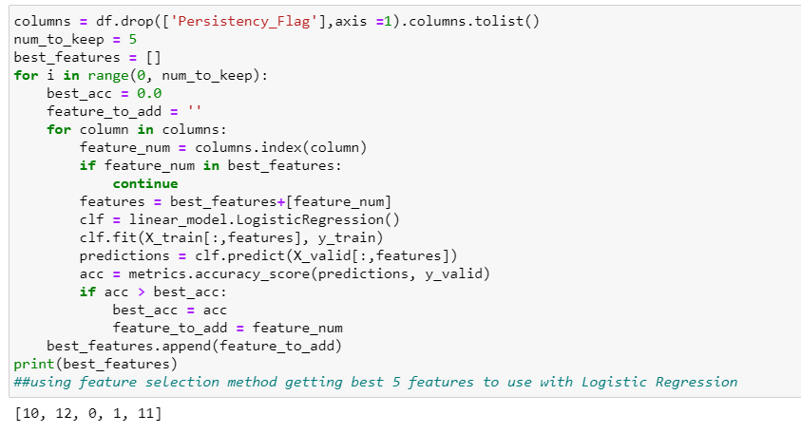
Using the warpper method the best 5 features for the logistic regression model was
Gender¶
Race
Dexa_Freq_During_Rx
Dexa_During_Rx
Frag_Frac_Prior_Ntm

Slide 14
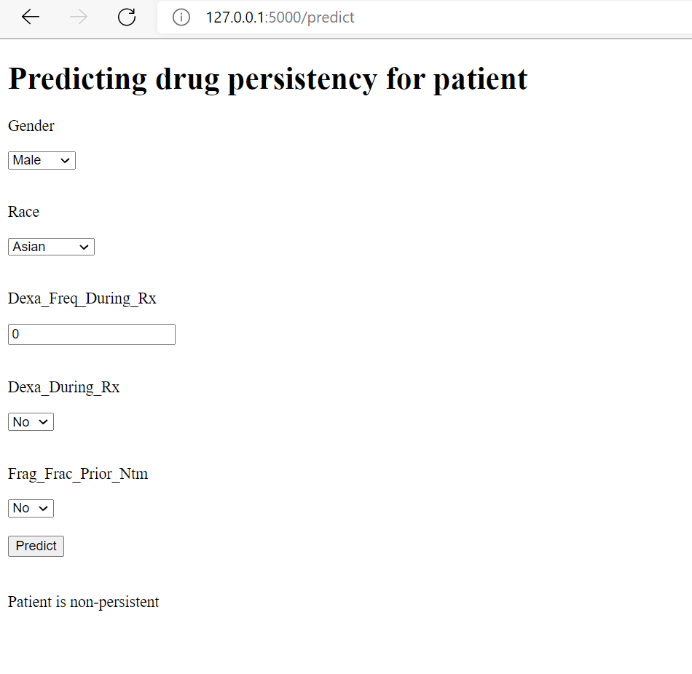
logistic regression model using 5 best features establish by wrapper method was deployed

Slide 15
Thank You

