Slide 1

Exploratory Data Analysis
G2M Case Study Virtual Internship
September 2021

Slide 2

Agenda
Problem Statement
Approach
EDA
Recommendations

Slide 3
Team member's details:
Group Name - Chandni
Name – Chandni
Email – cpatel521351@hotmail.com
Country – England
College/Company – NA
Specialization - Data Science
Github - https://github.com/c5678/healthcare/tree/main/5

Slide 4
Problem statement and approach
ABC is a pharma company who wants to understand the persistency of drug as per the physician prescription for the patient. To solve this problem ABC pharma company approached us to automate the process of identification for the drug by building a classification machine learning model. Using a classification machine learning model, we will be able to classify the dataset and find the variables that affect the target variables "Persistency Flag". ABC pharma company has provided us with a dataset in xlsx format which needs to be cleaned so that the machine learning model is accurate and therefore can be used to gain actionable insight.
Objective : Provide actionable insights to help ABC pharma company in persistency of drug
The analysis has been divided into 2 parts
Data understanding and visualisation
Recommendations for machine learning model

Slide 5
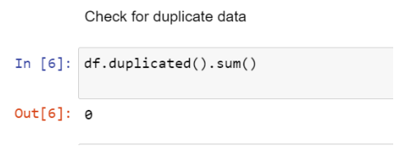
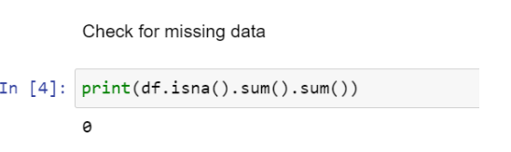
EDA
There was one data dataset with 63 columns
Total data points: 3424
No null values were found in the data
No duplicated values were found in the data
The dataset was cleaned for analysis

Slide 6
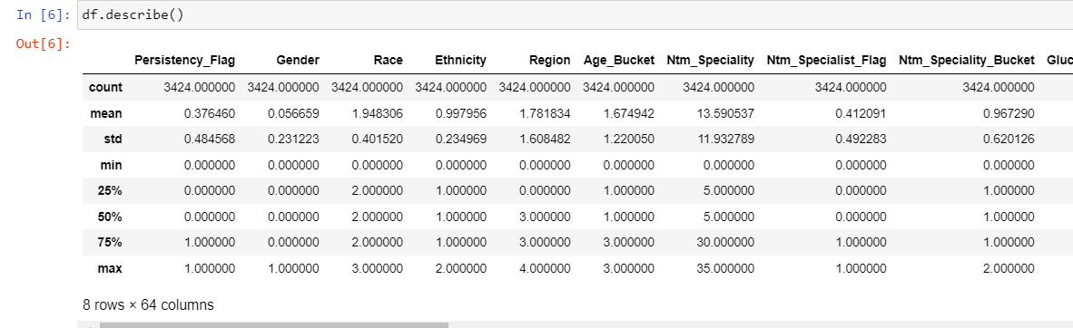
Statistical analysis

Slide 7
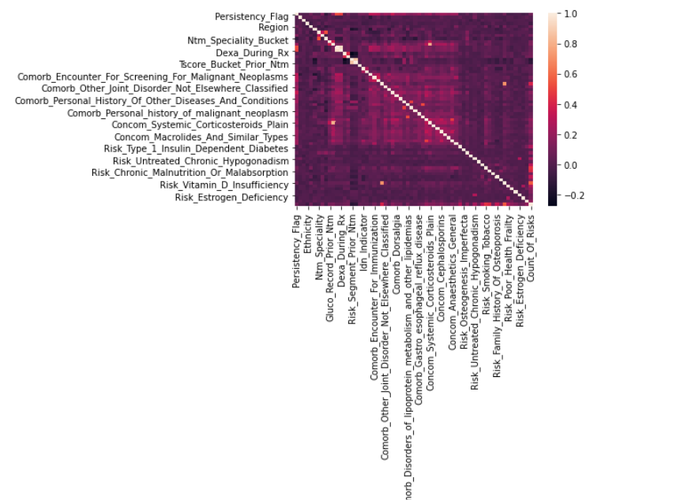
Correlatonal analysis
Initial correlation analysis suggest features for importance to Persistency_Flag are – Dexa_During_RX and Dexa_Freq_During_FX

Slide 8
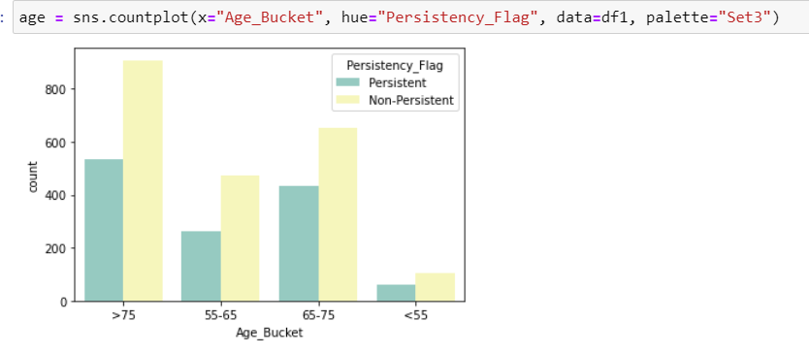
More patient age >75 were persistent to drug compared to patient age <55.

Slide 9
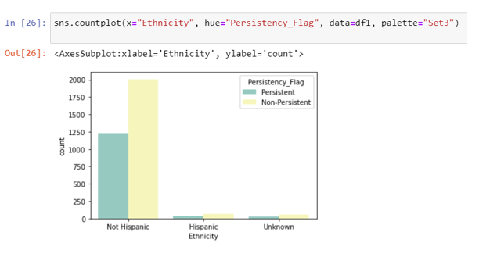
People with Hispanic ethnicity was less persistent to the drug compared to not Hispanic ethnicity.
However we can also see from the plot where is a imbalance between Hispanic ethnicity and no Hispanic Ethnicity. There are greater number of patients who are not Hispanic.
For more accurate analysis the sample same size Non Hispanic vs Hispanic should have been roughly the same.

Slide 10
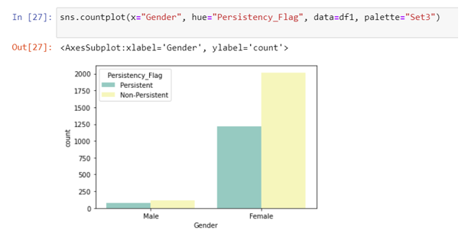
Female patients was more persistent to the drug compared to male patients.
However we can also see from the plot where is a imbalance between Gender male and female. There are greater number of female patients compared to female patients.
For more accurate analysis the sample size male vs female should have been roughly the same.

Slide 11
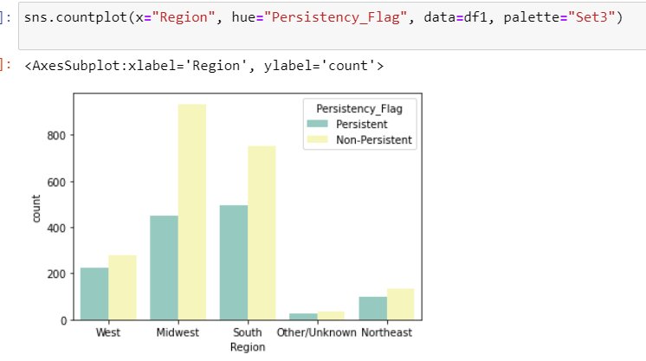
Patients living in South Region were more persistent to drug compared to patients living in other regions. North East had the least amount of patients who were persistent to drug .

Slide 12
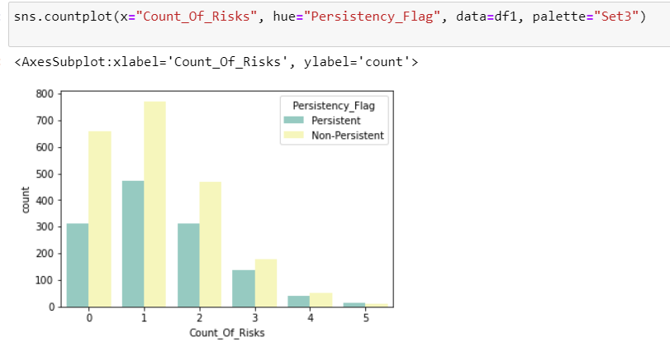
As the number of Risks there is an increase in number of patients testing persistent to the drug compared not non-persistent in same risk group.

Slide 13
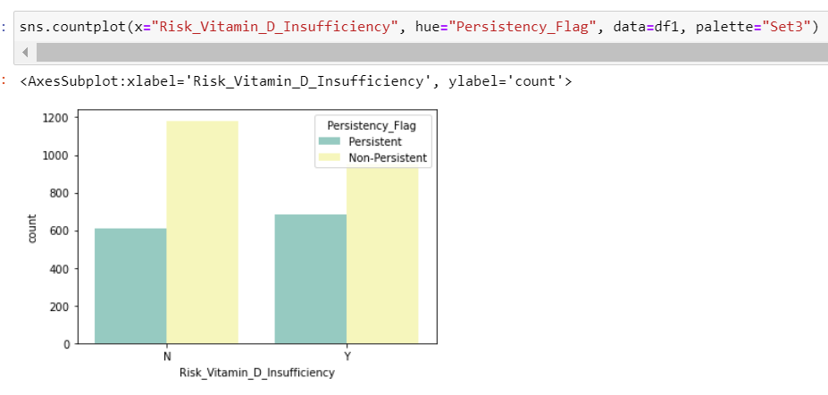
There is a slight increase in persistency for drug if a patient has Vitamin D insufficiency compared to Persistency for drug if a patient does not have Vitamin D insufficiency.

Slide 14
Recommendation
In total 7 models will be applied which will be Gradient Boosting, Random Forest, KBB, Gaussian NB, Multinomial NB, Logistic Regression, Linear SVM and Non-Linerar SVM
Wrapper method will be used to find the best features to use for the model
The models will be compared by accuracy to find the best model

Slide 15
Thank You

