Slide 1
PGE GIS CC&B Gap information updates to GIS
05/13/2013

Slide 2
Tools
Current Conversion Process
Conversion Example
Option Example

Slide 3
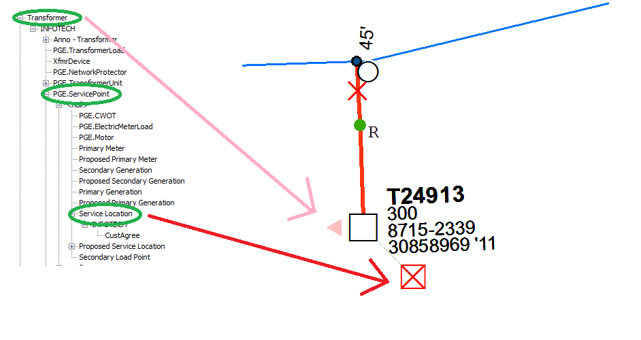
Data Model for GIS , eg. Pad Mounted XFMR

Slide 4
Current Conversion Process
CEDSA data table “Meters” is exported
Database view converts the fields to GIS table ServicePoint compatible values.
Service Point table is truncated and reloaded with new values
Service Location (~500 month) are manually added and related for all new Service Points.
Note: In EDGIS a Service Point is only a Table. The Service Location is the point feature class.

Slide 5
Current Conversion Process
Meters Table Converted Attributes:
Local_Office Table Converted Attributes:
METER_ID | ESSENTIAL
SERVICE_POINT_ID | SERVICE_AGREEMENT_ID
UNQSPID | SVC_DATE
ACCT_ID | CUST_TYP
TRF_ID | NAICS
LOCAL_OFFICE | BILLING_CYCLE
SVC_ST_# | ROUTE
SVC_ST_NAME | REV_ACCT_CD
SVC_ST_NAME2 | RATE_SCHED
SVC_CITY | PREMISE_TYPE
SVC_STATE | TOWNSHIP_TERRITORY_CD
SVC_ZIP | NEM
OFFICE_NAME | DISTRICT

Slide 6
High Level Logic of New Automated Process

Slide 7
Interface Logic
User Scenario CASE |  | Data before interface run. |  |  |  |  |  | Data Outcome After interface run.
Action In System | What Changed | CEDSA Service Point | CEDSA Rel | CEDSA xfmr | GIS Service Point | GIS Rel | GIS xfmr | CEDSA Service Point | CEDSA Rel | CEDSA xfmr | GIS Service Point | GIS Rel | GIS xfmr
Equal Data | Nothing | 1 | 1-A | A | 1 | 1-A | A | 1 | 1-A | A | 1 | 1-A | A
CEDSA Deletes Service Point | 1 changed to Null | null | null | A | 1 | 1-A | A | null | null | A | null | null³ | A
CEDSA Changes Relationship | 1-A Change 1-B | 1 | 1-B | B | 1 | 1-A | A | 1 | 1-B | B | 1 | 1-B | B
CEDSA fixes CWOT | null rel to 1-A | 1 | 1-A | A | 1² | null | A | 1 | 1-A | A | 1 | 1-A | A
GIS fixed a CWOT | null rel to 1-A | 1 | null | A | 1 | 1-A | A | 1 | null | A | 1² | null | A
GIS Changes Relationship | 1-A change 1-B | 1 | 1-A | A | 1 | 1-B | B | 1 | 1-A | A | 1 | 1-A | A
GIS Deletes Transformer¹ | A xfmr deleted | 1 | 1-A | A | 1² | null | null | 1 | 1-A | A | 1² | null | null
¹ This case should never occur because it is accounted for in the GIS QA requirements. However for the interest of completeness of logic, this is in the workflow.
² This is in the CWOT Table as Service Points without Transformers will only exist in the CWOT table for GIS.
³ Will cause a delete for the relationship from Service Point to Service Location.

Slide 8
Batch Logic to support Process

Slide 9
Dependencies for Business
Business Workflows:
Customer without a Transformer Report
Service Location without a Customer Report
Customers without Service Location Report
Street Light /Equipment Transformer with Customer Report
Deleting a Transformer with Customer results in a QA rule violation.
Mappers manually creating Service Locations for new Service Points.

Slide 10
Review: Extend Conversion Process till Dec.
What would this look like?
Export/Import Data in batch
Run SQL in batch
Submit version with changes to GDBM in batch.
Business User will be supplied the steps in ArcMAP to help them find and build the missing Service Locations.
Benefits:
Development quick turn around.
Issues
Dependent on CEDSA export process.
CWOTs are not being converted today, so new logic to implement CWOTs has to be developed.

Slide 11
Business Workflow:Decisions
Frequency:
CC&B is monthly to CEDSA today.
Assumed no more frequent than every two weeks. -- Add this to UC4 for bi-monthly runs.
Reports:
Is a Service Location without Service Point Report needed? -Yes
Is a Service Point without Service Location needed? - Yes

Slide 12
Question and Answers

