Slide 1
ED 46 KT
Phil Penn & Don Peaslee

Slide 2
ED46 Overview
Architecture
FME Desktop
FME Server
WEBR (DWG Export)
Performance Testing
GIS-CAD Symbology Mapping Document
AutoCAD: Symbology

Slide 3
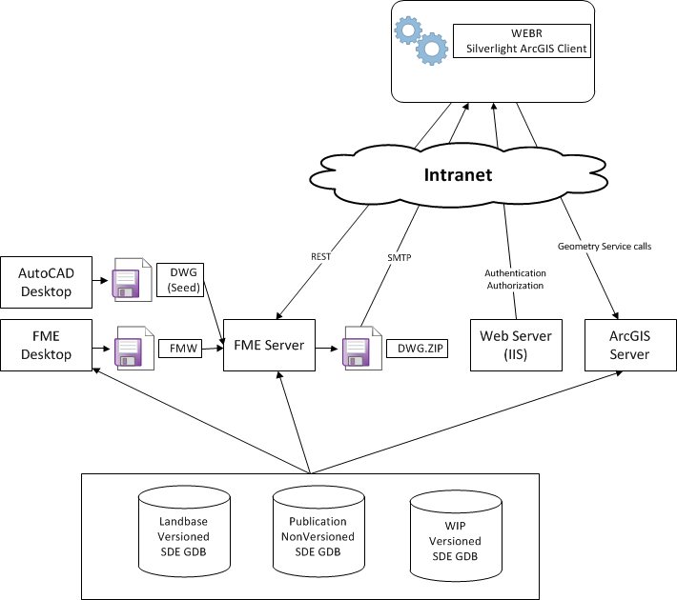

Slide 4
FME Desktop
No FME Desktop in Production
Beta 2014 b14212
Licenses still TBD
Single Workspace in TFS at $/EDAMGIS/Source_Development/EDER/EDGIS Interfaces/ED0046/FME/edgis_to_cad.fmw

Slide 5
FME Server
Beta 2014 b14212
Licenses still TBD
FME Cloud Architecture chosen (Leg approach)
Install & Configuration Instructions and resources at \\sfetgis-nas01\sfgispoc_data\ApplicationDevelopment\IBM_Delivery\Releases\ED46\FME Server

Slide 6
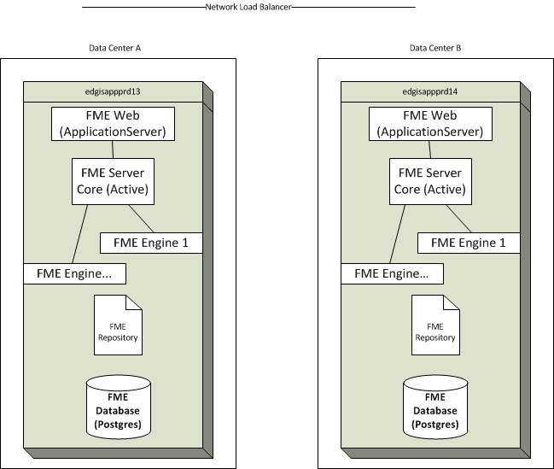
FME Server Architecture (Prod)
Notes:
Repos have to be manually sync’d

Slide 7
WEBR (DWG Export)
WIP toolbar users can see DWG Export
Page.config new section, <CADExport>
Key Setting is <ExportRESTService URL="http://wsgo496902:8080/fmedatadownload/EDGIS/edgis_to_cad.fmw" />
Code is in TFS at $/EDAMGIS/Source_Development/WEBR/Miner.Server.Silverlight/ArcFMSilverlight

Slide 8
AutoCAD 2012 (MET)
Used to author Seed/Template file
Used to verify DWG output
Used to run MET (account required)
Alternatively run DWGTrueView 2014 at \\sfetgis-nas01\sfgispoc_data\ApplicationDevelopment\Software\Autodesk
Blocks are in TFS at $/EDAMGIS/Source_Development/EDER/EDGIS Interfaces/ED0046/FME

Slide 9
Performance Testing
Visual Studio Project used to fire jobs (extents) synchronously/asynchronously at FME Server
Used to calculate # of Cores/Licenses required for Production based on NFR of 496 jobs/hour
Run in Dev, will be run in Production
Database Speed is the biggest bottleneck
Code & Results in TFS at $/EDAMGIS/Source_Development/EDER/EDGIS Interfaces/ED0046/Tests/TestFMEServer

