Slide 1
Basil Al-labadi
“I have not failed. I’ve just found 10,000 ways that won’t work”

Slide 2

Basil “ Funny and Serious”
Software Engineer
.. In love with math
.. Easy is boring

Slide 3
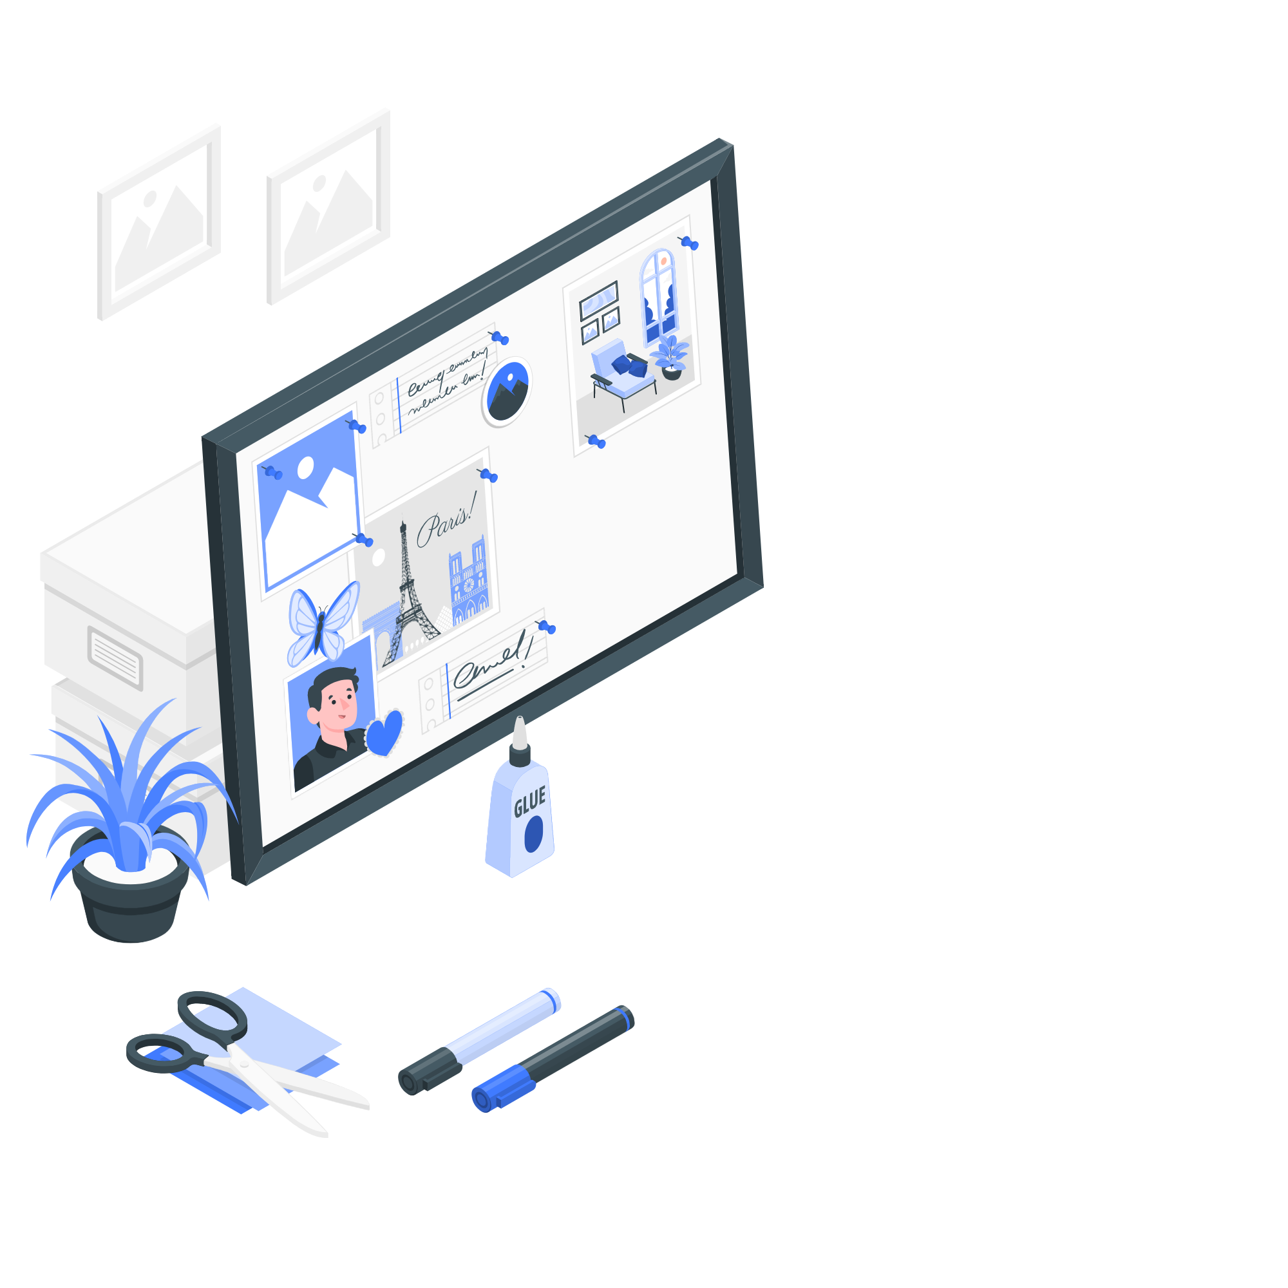
Garage Sooq Website
An interactive website for displaying vehicles Advertisement, selling them by their owners, displaying their information, pictures and information of their owners

Slide 4
Garage Sooq Website Demo

Slide 5
How did I do it??
Stage 1 :
1- Create the Diagram for the database schemas
2- Planning and creating tickets using Trello for (Backend,Frontend)
3- Create an initial design for Frontend using wireframe

Slide 6
How did I do it??
Stage 2 :
1- Building the database using MongoDB & Mongoose
2- Building the Backend code using ExpressJs
3- Testing the Backend API’s using Postman

Slide 7
How did I do it??
Stage 3 :
1- Building the Frontend code using ReactJS
2- Connecting the Frontend with the Backend API’s
3- Testing the Frontend using Google Chrome

Slide 8
What went Well??
Its my first experience to build a full-stack website (Backend-Frontend) with a responsive design ( for laptops, tablets , mobiles )

Slide 9
Where I strugggeled??
In login via Google, dealing with the information that Google sent was a little tricky because its format differs from the information format built in my project

Slide 10
What my stretch goals??
In the near future, I will add the chat and messaging feature between the users of the website

Slide 11
THANK YOU

